Slide 1
Parch and Posey: the deepdive
Exploratory Analysis Report

Slide 2

Contributors
Jerry Ogbuani
Chikodi Obu

Slide 3
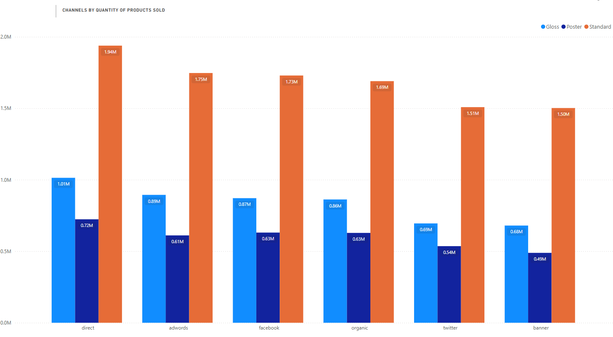
Channel Performance
Standard products are the dominant revenue driver, consistently leading across all channels, with Direct sales exceeding 1.9M units sold. Facebook and AdWords each also perform strongly at around 1.7M units.
Direct sales further stand out for Gloss products, delivering over 1M units sold, the top channel for that product line.
Poster products lag significantly, averaging below 0.7M units per channel, signaling low demand.
Recommendation: Strengthen investments in Direct sales and AdWords, as they are the biggest contributors to Standard product success. At the same time, maintain Direct sales strategies for Gloss, while exploring repositioning or promotional campaigns for Poster products.

Slide 4


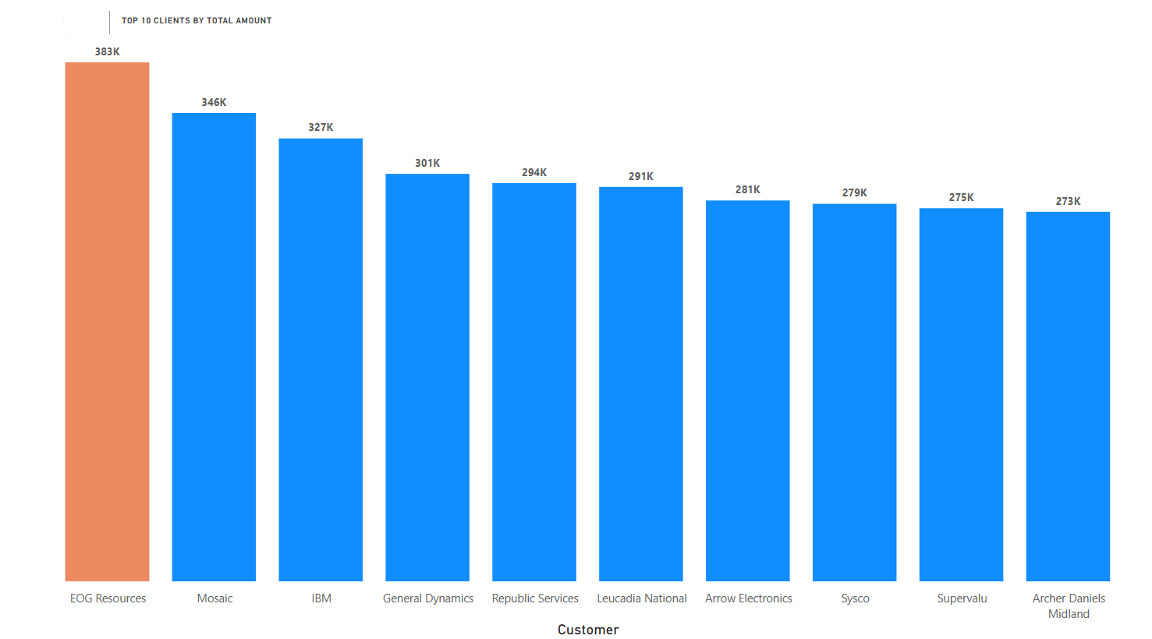
Impact of Top 10 Clients on Total Amount
Percentages
Top 10 contribution: 3.05M ÷ 23.14M ≈ 13.18%
Remaining 341 contribution: ≈ 86.82%
Insights
Revenue is widely
distributed — the top 10 customers account for only ~13% of total amount, so the business is not highly dependent on a very small number of accounts.
This is the opposite of a
high-concentration risk scenario; instead you have a broad base of contributing customers.

Slide 5
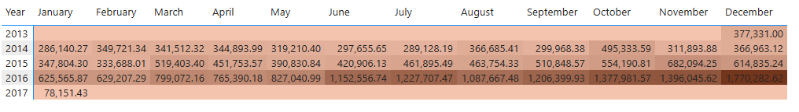
Sales peaked in 2016 among the years 2013–2017, with December showing the highest monthly sales, indicating strong seasonal trends at year-end.
Sales Trends by Year and Month
Key Observations:
Peak Year: 2016 shows the highest total sales across all years, with sales exceeding 1.7 million in December 2016.
Peak Month: December consistently has the highest sales each year, highlighting strong seasonal/holiday demand.
Insight for Management:
Focus marketing and inventory strategies around December and other 4th quarter months, especially leveraging peak performance observed in 2016.

Slide 6
Thank You
the-olympics

