Slide 1
Multiplexing and Demultiplexing in Transport Layer
Simulation using Python
Presented by : Y. Jyothika
Ch. Anjali Devi
D. Ramalakshmi
A. Bhargavi Priya

Slide 2
Table of Contents
Introduction to Transport Layer
What is Multiplexing
What is Demultiplexing
Need for Multiplexing
Need for Demultiplexing
Difference Between Multiplexing and Demultiplexing
Python Program
Output Explanation
conclusion

Slide 3
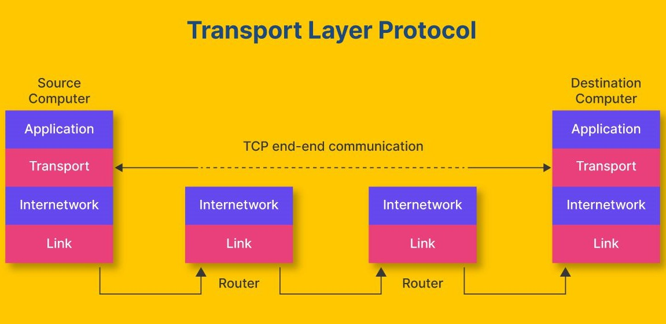
Introduction to Transport Layer
Responsible for end-to-end communication
Provides process-to-process delivery
Uses port numbers to identify processes
Protocols: TCP and UDP

Slide 4
What is Multiplexing ?
Combining data from multiple processes
Sent through a single communication channel
Adds headers with port numbers*
Done at the sender side

Slide 5
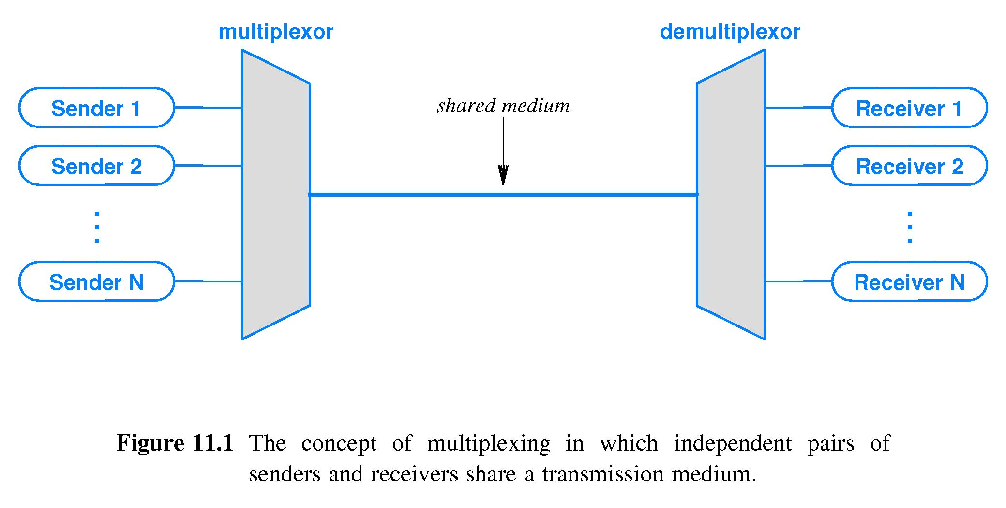
What is Demultiplexing ?
Separating received data to correct processes.
Uses port numbers to identify destination.
Done at the receiver side.

Slide 6
Need for Multiplexing:
Efficient use of network resources
Allows multiple applications to share network
Reduces communication cost

Slide 7
Need for Demultiplexing:
Ensures correct delivery to applications
Avoids data confusion between processes
Maintains communication accuracy

Slide 8
Difference Between Multiplexing and Demultiplexing
Multiplexing | Demultiplexing
Combines multiple signals/data into one channel | Splits one channel into multiple signals/data
Done at the sender side | Done at the receiver side
Many → One | One → Many
Example: Sending data from many processes together | Example: Receiving and separating data to correct processes
Realworld example: Many people make calls at the same time.All calls are combined and sent through a single communication system | Realworld example: Cable brings all channels together.TV lets you select one channel

Slide 9
Algorithm : Multiplexing and Demultiplexing
Step 1: Start
Step 2: Take data from different processes
Example: Process1 → Data1
Process2 → Data2
Step 3: Multiplexing
Combine all data into one channel
Send data one by one
Step 4: Demultiplexing
Receive the combined data
Separate data back to correct processes
Step 5: Display the received data
Step 6: Stop

Slide 10
PROGRAM:
# Multiplexing: sending data from multiple processes through a single channel
# Demultiplexing: receiving data and delivering it to the correct process based on port
# List of data streams: each item has (process name, data)
data_stream = [
("Process1", "Data1"),
("Process2", "Data2")
]
# Multiplexing part
print("Multiplexing:")

Slide 11
# Loop through each process and its data
for process, data in data_stream:
# Simulate sending data from each process into one shared channel
print("Sending:", data, "from", process)
# Demultiplexing part
print("\nDemultiplexing:")
# Loop through each process and its data again
for process, data in data_stream:
# Simulate receiving data and sending it to the correct process
print("Received:", data, "to", process)

Slide 12
OUTPUT :
Multiplexing:
Sending: Data1 from Process1
Sending: Data2 from Process2
Demultiplexing:
Received: Data1 to Process1
Received: Data2 to Process2

Slide 13
Conclusion :
Multiplexing combines multiple data streams
Demultiplexing separates them correctly
Both are essential in transport layer
Python program clearly demonstrates the concept.

Slide 14
Thank you

