Slide 1
Who is who?
Prototype design insights

Slide 2
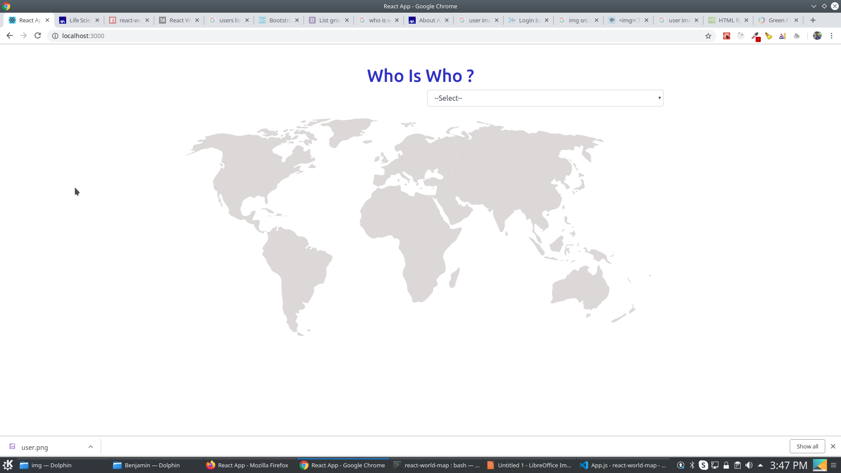
A world map added to our viewport

Slide 3
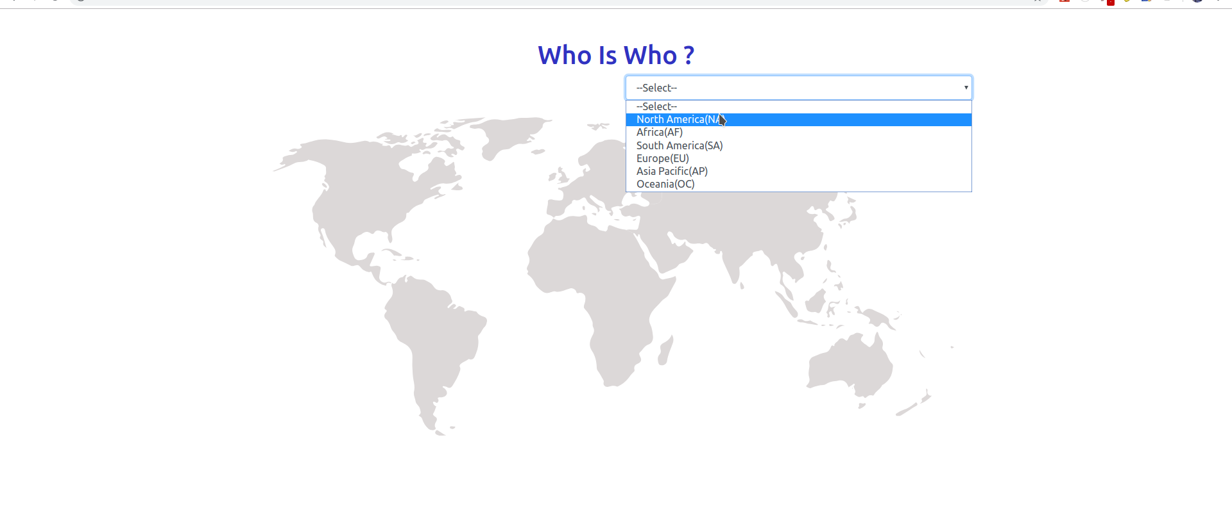
The intended user is able to select a region from the list of suggestions

Slide 4
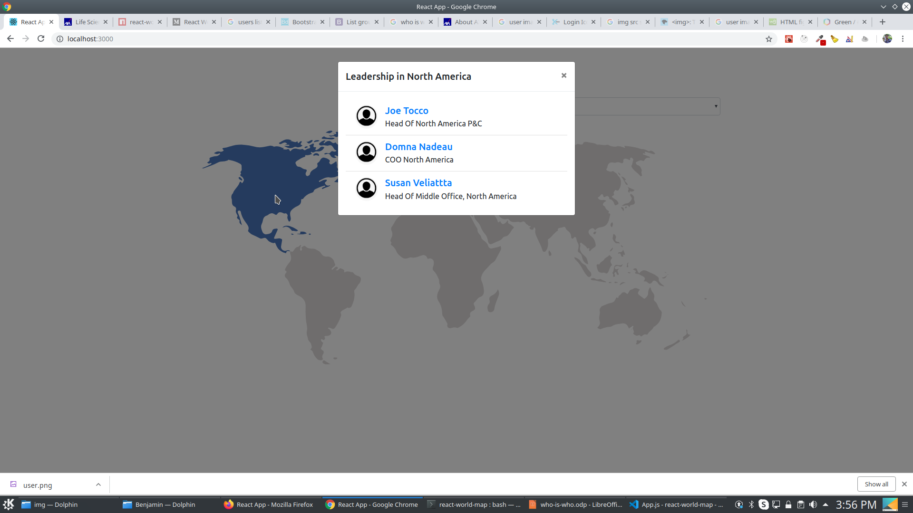
After he/she selects the option, the corresponding area will be highlighted and a pop up window appears

Slide 5
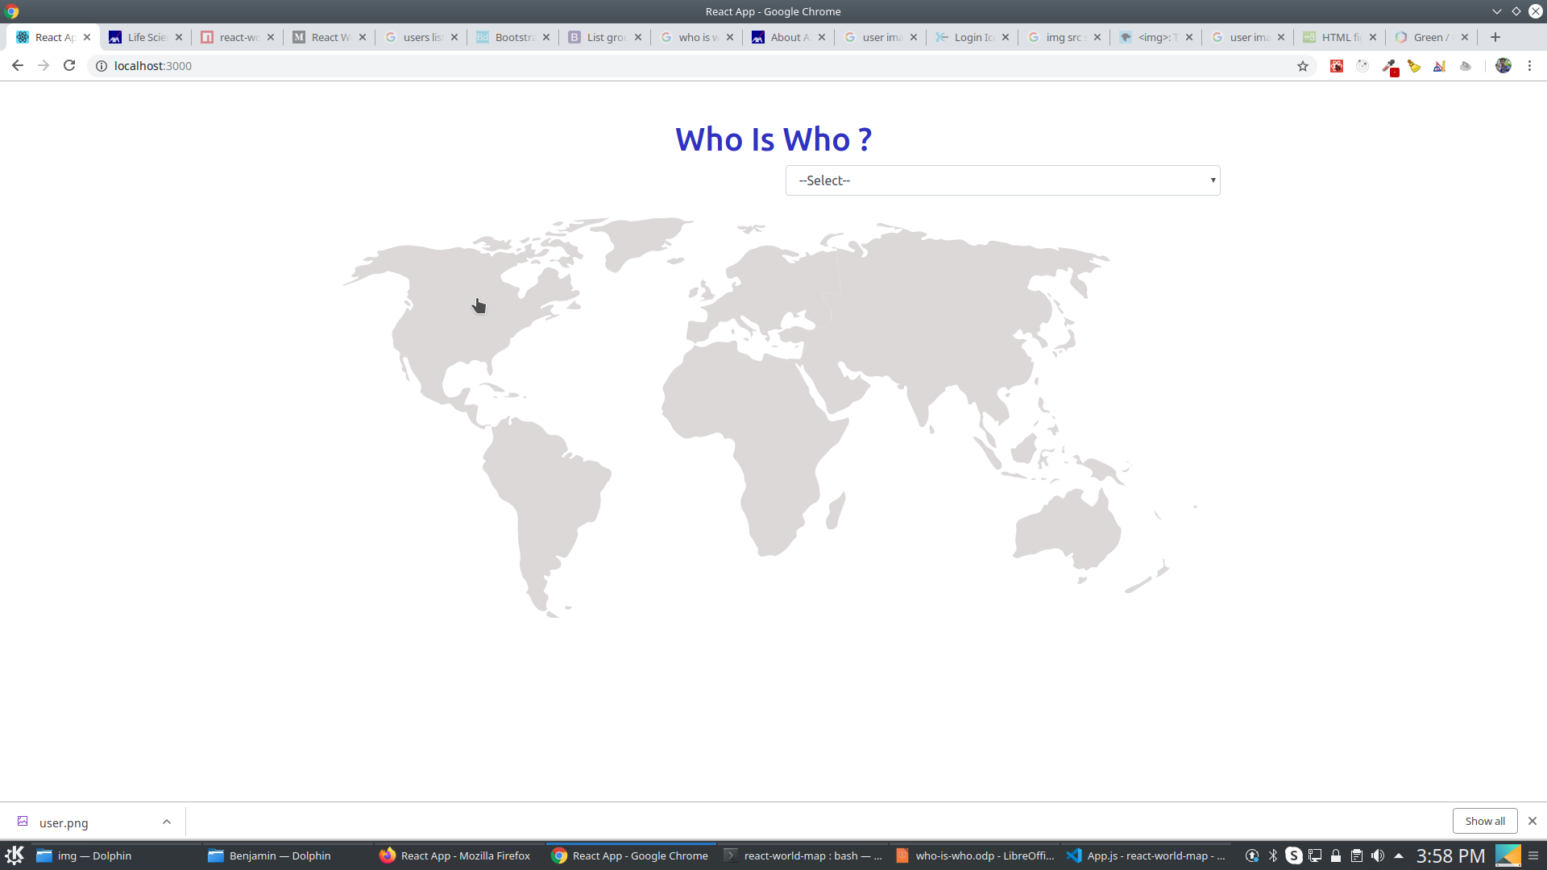
The same action will be implemented while the user clicks on a particular region

Slide 6

The modal contains the Leadership about the corresponding region

Slide 7
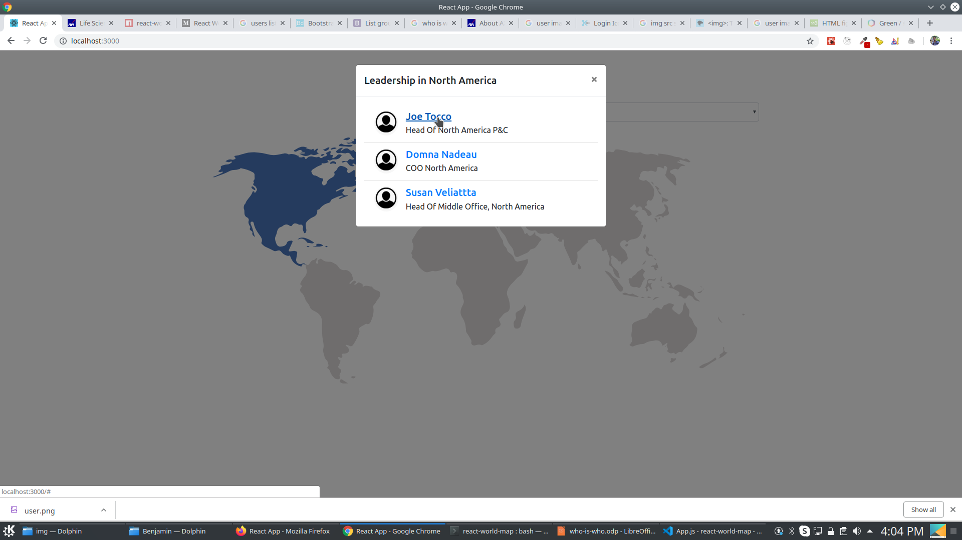
Each list item contains info about the name, display pic, designation of the leader.The name is a hyperlink to the corresponding profile page

