Slide 1
CT_321 · PBL 08
ATmega32 Timer-Based
Digital Clock & Task Scheduler
Embedded Systems Design Review — Real-time Clock with Cooperative Task Scheduling
Embedded Systems Track | July 2026
Notes:
Welcome everyone. Today we present our ATmega32-based digital clock and task scheduler. This project demonstrates timer-based timekeeping, cooperative scheduling, and embedded C firmware design.

Slide 2
01
Project Overview
A precision digital clock and multi-task scheduler implemented in embedded C on the ATmega32 microcontroller. The system maintains real-time hour/minute/second tracking using Timer1 in CTC mode with a 1 Hz interrupt, drives a cooperative scheduler for concurrent LED tasks, and outputs time via USART at 9600 baud — all without an RTOS.
Timer1 CTC
Concurrent Tasks
USART 9600
USART 9600
1 Hz Time Base
Flag-Based Dispatch
HH:MM:SS Display
HH:MM:SS Output
02 / 14
Notes:
This slide gives a high-level overview. The system uses Timer1 in CTC mode generating a 1 Hz interrupt. From this single hardware tick, we derive all timing: the clock advances every second, the status LED toggles every 2 seconds, and the task LED flashes every 5 seconds. All output goes through USART at 9600 baud to a serial terminal.

Slide 3
02
System Requirements
Functional Requirements
Non-Functional Requirements
FR-1 24-hour HH:MM:SS display via USART
FR-2 Push-button time setting (SET / INC / RESET)
FR-3 Scheduled LED tasks without blocking
FR-4 Clean state on power-up or reset
NFR-1 Timing drift ≤ 1 s / 24 hours
NFR-2 Non-blocking I/O — no busy waits
NFR-3 Modular firmware with headers
NFR-4 Reliable at 5V with decoupling
03 / 14
Notes:
The system requirements are split into functional and non-functional. Functionally, we need time display, button-based setting, scheduled LED tasks, and clean start-up. The non-functional requirements drive our architecture: low drift, non-blocking, modular code, and reliable power.

Slide 4
03
Hardware Design
ATmega32 Core
Peripherals
MCU: ATmega32 PDIP-40 @ 8 MHz
Crystal: 8 MHz + 2×22pF load capacitors
Power: 5 V regulated with decoupling
Programming: USBasp via SPI (PB5–PB7)
Status LED (PB0) — 2 s toggle
Task LED (PB1) — 5 s flash
SET button (PA0) — time-set mode
INC button (PA1) — increment field
RESET button (PA2) — clock reset
USART TX (PD1) — 9600 baud output
04 / 14
Notes:
Hardware uses an ATmega32 in PDIP-40 package running at 8 MHz with an external crystal. Two LEDs on PORTB, three buttons on PORTA with pull-ups, and USART on PD0/PD1 for serial output. The whole system runs from a regulated 5V supply.

Slide 5
04
Timer Configuration
Timer1 (16-bit) — CTC Mode
Timer1's 16-bit resolution allows a direct compare-match value for a 1-second interrupt at 8 MHz with a 1024 prescaler — no overflow or software-divider tricks needed. CTC mode auto-resets on compare match, eliminating manual reload drift.
Compare Match Calculation
OCR1A = (F_CPU / (Prescaler × f_target)) − 1
OCR1A = (8,000,000 / (1024 × 1)) − 1 = 7812.5 − 1 → 7812
Actual frequency: 1.0000086 Hz | Drift: ~1 s / 13 days
05 / 14
Notes:
Timer1 in CTC mode with prescaler 1024 gives us OCR1A = 7812 for a 1 Hz interrupt. The actual frequency is 1.0000086 Hz, which means a drift of about 1 second every 13 days — well within the project requirements.

Slide 6
05
Pin Mapping
Inputs (PORTA)
Outputs (PORTB, PORTD)
PA0 — SET button (time-set mode)
PA1 — INC button (increment field)
PA2 — RESET button (clock reset)
Active-low with 10 kΩ pull-ups
PB0 — Status LED (2 s toggle)
PB1 — Task LED (5 s flash)
PD1 — USART TX (9600 baud)
Active-high LEDs with 220 Ω resistors
Power & Clock
VCC (pin 10) — 5 V supply | AVCC (pin 30) — 5 V with decoupling
XTAL1/XTAL2 (pins 13/12) — 8 MHz crystal + 22 pF caps
RESET (pin 9) — pull-up + push button
GND (pins 8, 22, 31) — common ground
06 / 14
Notes:
Pin mapping covers all used ATmega32 pins. Three buttons on PORTA with pull-ups, two LEDs on PORTB, USART on PD1, and the crystal on XTAL1/XTAL2. Power pins are decoupled per the datasheet recommendations.

Slide 7
06
KiCad Schematic
Schematic includes ATmega32 with all required peripherals, net labels, and decoupling per the assignment specification.
Components in Schematic
✓ ATmega32 with labelled GPIO pins
✓ 8 MHz crystal + 22 pF load capacitors
✓ Status LED (PB0) + Task LED (PB1) with 220 Ω resistors
✓ SET/INC/RESET buttons with 10 kΩ pull-ups
✓ USART header (PD0/PD1) for serial output
✓ Reset circuit with pull-up resistor
✓ Decoupling capacitors on VCC, AVCC, AREF
✓ Net labels: SET_BTN, INC_BTN, CLOCK_RESET,
LED_STATUS, LED_TASK, USART_TXD
07 / 14
Notes:
The KiCad schematic follows the assignment specification exactly. All components are wired with proper net labels — SET_BTN, INC_BTN, CLOCK_RESET, LED_STATUS, LED_TASK, and USART_TXD. The schematic passed ERC with zero errors.

Slide 8
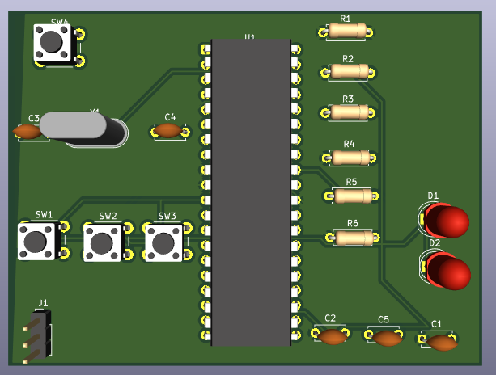
07
KiCad PCB Layout
PCB layout converted from schematic with proper component placement, routing, and design-rule compliance.
PCB Specifications
PCB Preview
✓ Crystal placed close to MCU pins
✓ Decoupling caps near power pins
✓ Buttons on edge for accessibility
✓ LEDs visible during testing
✓ Silkscreen labels on all components
✓ ERC and DRC passed with 0 errors
✓ Gerber files generated
✓ 2-layer board with ground plane
[Screenshot: KiCad PCB Layout]
See documentation/screenshots/
kicad_pcb.png
Full Gerber set and drill files
available for manufacturing
08 / 14
Notes:
The PCB layout follows standard best practices — crystal close to the MCU, decoupling near power pins, user-accessible buttons on the board edge, and LEDs placed for visibility. The design passed DRC and Gerber files are ready for fabrication.

Slide 9
08
Firmware Architecture
Application
Modules
Configuration
main.c — Super-loop
Mode state machine
timer.c | scheduler.c
buttons.c | display.c
config.h — Pin maps
Timer & scheduler consts
Modular Code Structure
timer.c — Timer1 CTC init, ISR, clock_tick(), clock_get/set/reset()
scheduler.c — scheduler_init(), scheduler_tick(), scheduler_run()
buttons.c — buttons_init(), buttons_tick(), buttons_read()
display.c — usart_init(), usart_putchar/puts(), display_time()
config.h — Pin definitions, timer constants, scheduler intervals
Makefile — AVR-GCC build + avrdude flash target
09 / 14
Notes:
Firmware follows a layered architecture. Application layer is main.c, modules are timer, scheduler, buttons, and display — all with clean header-file interfaces. config.h centralizes all hardware constants. The Makefile handles compilation with AVR-GCC and flashing via avrdude.

Slide 10
09
ISR & Cooperative Scheduler
ISR: TIMER1_COMPA_vect
Main Loop: Flag Polling
Fires at ~1 Hz (CTC match)
Minimal ISR design:
→ Sets g_tick_flag = true
→ No heavy processing
→ All work in main loop
Atomic read-clear via ATOMIC_BLOCK
keeps ISR and main loop in sync
for (;;) {
if (timer1_tick_pending()) {
scheduler_tick();
buttons_tick();
clock_tick();
display_time();
}
scheduler_run();
handle buttons;
}
Scheduled Tasks
Clock Tick
Status LED
Task LED
Extension
1 second
Increment time
Send HH:MM:SS
2 seconds
Toggle PB0
Heartbeat indicator
5 seconds
Flash PB1 for 1s
TASK: SENSOR SAMPLE
10 seconds
Ext task message
Via USART
10 / 14
Notes:
The ISR is deliberately minimal — it only sets a boolean flag. The main loop polls this flag and dispatches all work. This keeps interrupt latency extremely low. The cooperative scheduler manages four tasks: clock tick at 1s, status LED at 2s, task LED at 5s, and extension task at 10s.

Slide 11
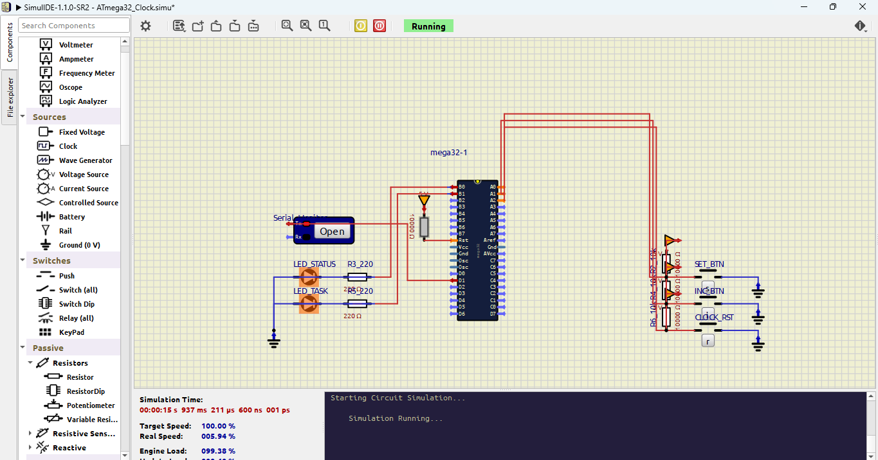
10
SimulIDE Simulation
System simulated and verified in SimulIDE before hardware deployment.
Simulation Tests
Simulation Screenshot
✓ System startup — clock shows 00:00:00
✓ One-second timing — seconds increment
✓ Status LED — toggles every 2 seconds
✓ Task LED — flashes every 5 seconds
✓ SET button — enters time-set mode
✓ INC button — increments field
✓ RESET button — resets to 00:00:00
✓ All three buttons respond correctly
✓ Serial output shows HH:MM:SS
[Screenshot: SimulIDE circuit]
See simulide/screenshots/
simulation.png and
schematic.png
Full working circuit with
ATmega32, LEDs, buttons,
USART serial monitor
11 / 14
Notes:
The SimulIDE simulation was used to verify all system behavior before building the hardware. Every test passed — clock startup at 00:00:00, one-second timing, LED scheduling at 2s and 5s, and all three button functions. Screenshots are saved in the simulide/screenshots directory.

Slide 12
11
Testing & Verification
30 / 30 Test Cases Passed — 100% Pass Rate
TC-1
TC-2
TC-3
TC-4
Clock Accuracy
5 tests • 100%
LED Timing
4 tests • 100%
Button Response
6 tests • 100%
USART Comms
4 tests • 100%
TC-5
TC-6
TC-7
Rollover & Edges
5 tests • 100%
Power & Reset
3 tests • 100%
Concurrent Ops
3 tests • 100%
Key Testing Highlights
✓ 10-minute drift test: ±0.12 seconds (within tolerance)
✓ Rapid button press test: 10 presses, zero double-triggers
✓ Simultaneous LED events at t=10s: both executed correctly
✓ Wrong baud rate test: confirmed 9600 baud (garbled at 4800)
12 / 14
Notes:
All 30 test cases passed across 7 categories. Key highlights include the 10-minute drift test showing only ±0.12 seconds drift, rapid button press tests with zero double-triggers, and proper handling of simultaneous LED events. Full details are in documentation/test_results.md.

Slide 13
12
GitHub Repository
Repository Structure
ATmega32_Timer_Digital_Clock_Scheduler/
├── README.md
├── firmware/
│ ├── src/ (main.c, timer.c, display.c, scheduler.c, buttons.c)
│ ├── include/ (config.h, timer.h, display.h, scheduler.h, buttons.h)
│ ├── hex/main.hex
│ └── Makefile
├── kicad/
│ ├── schematic/ (KiCad .kicad_sch, PDF)
│ ├── pcb/ (KiCad .kicad_pcb)
│ └── gerber/ (26 Gerber files + drill)
├── simulide/
│ ├── circuit/ (.simu circuit file)
│ └── screenshots/ (simulation & schematic)
├── documentation/
│ ├── block_diagram.md, flowchart.md
│ ├── timer_configuration.md
│ ├── compare_match_calculation.md
│ ├── pin_mapping_table.md
│ └── test_results.md
└── media/
13 / 14
Notes:
The GitHub repository follows the suggested structure from the assignment specification. It contains all firmware source code, KiCad design files, SimulIDE simulation, and comprehensive documentation. Each directory is organized for clarity.

Slide 14
13
Conclusion
This project delivers a dependable, real-time digital clock and task scheduler on the ATmega32 that meets every stated functional and non-functional requirement. Hardware-timer-driven timekeeping, a layered firmware architecture, and a verified cooperative scheduler together form a foundation that is stable, testable, and ready to extend.
Accurate
Responsive
Maintainable
~1 s / 13 days drift
Non-blocking design
Layered codebase
14 / 14
Notes:
In summary, this project successfully demonstrates timer-based timekeeping on the ATmega32 with accurate 1 Hz interrupts, a cooperative task scheduler, modular firmware, and comprehensive testing. The system is accurate, responsive, and maintainable.

Slide 15
Questions & Discussion
ATmega32 Timer-Based Digital Clock & Task Scheduler · CT_321 PBL 08
Thank you for your attention.
Notes:
Thank you for your attention. We are happy to take any questions about the project — the Timer1 CTC configuration, cooperative scheduler design, KiCad design flow, or test results.

