Slide 1


Diabetes Prediction
Harsh Kumar Sulya

Slide 2

PROBLEM STATEMENT
The project's problem statement revolves around the urgent need to develop a robust and accurate machine-learning model for the classification of patients based on their risk of developing diabetes. Diabetes, a chronic health condition, is on the rise globally, and early detection and intervention are paramount for effective management and prevention of complications.
The goal is to classify patients into two groups: those at elevated risk of developing diabetes and those not at risk, thereby assisting healthcare professionals in targeted intervention strategies, and preventive measures, and ultimately improving patient outcomes in the realm of diabetes management.

Slide 3
Project Description The Diabetes Prediction Project aims to create a robust predictive model for identifying individuals at risk of developing diabetes. By leveraging machine learning algorithms and analyzing relevant health parameters such as blood glucose levels, body mass index (BMI), age, and family history, the project seeks to establish an accurate and efficient system. The ultimate goal is to enable early detection of diabetes, facilitating timely intervention and personalized healthcare strategies.

Slide 4

WHO ARE THE END USERS?
Healthcare professionals, clinicians, and individuals seeking personalized health insights will benefit from the Diabetes Prediction Project. The predictive model serves as a valuable tool for early identification of diabetes risk, empowering healthcare providers to offer timely interventions and enabling individuals to proactively manage

Slide 5

Technology Used
Programming Language: Python
Data Analysis and Manipulation: Pandas
Data Visualization: Matplotlib and Seaborn
Machine Learning Libraries: Scikit-learn
Data Preprocessing: Scikit-learn (StandardScaler,SimpleImputer)
Model Training and Evaluation: Random Forest Classifier
Integrated Development Environment (IDE): Jupyter Notebook or Anaconda
Version Control: Git
Documentation: Markdown

Slide 6
MODELLING -
In the Diabetes Prediction project, Random Forest Classifier is used as the machine learning model.
A Random Forest Classifier for modeling offers several advantages. By leveraging ensemble learning, the Random Forest can effectively analyze diverse features like blood glucose levels, BMI, age, and family history. Its ability to handle complex relationships in the data, reduce overfitting, and provide robust predictions makes it a valuable tool. This classifier enhances the accuracy of diabetes risk prediction, enabling your project to deliver more reliable and actionable insights for early intervention and personalized healthcare.

Slide 7
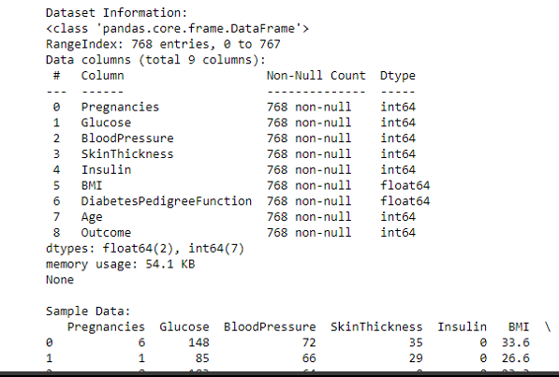
RESULTS
[Screenshots]

Slide 8
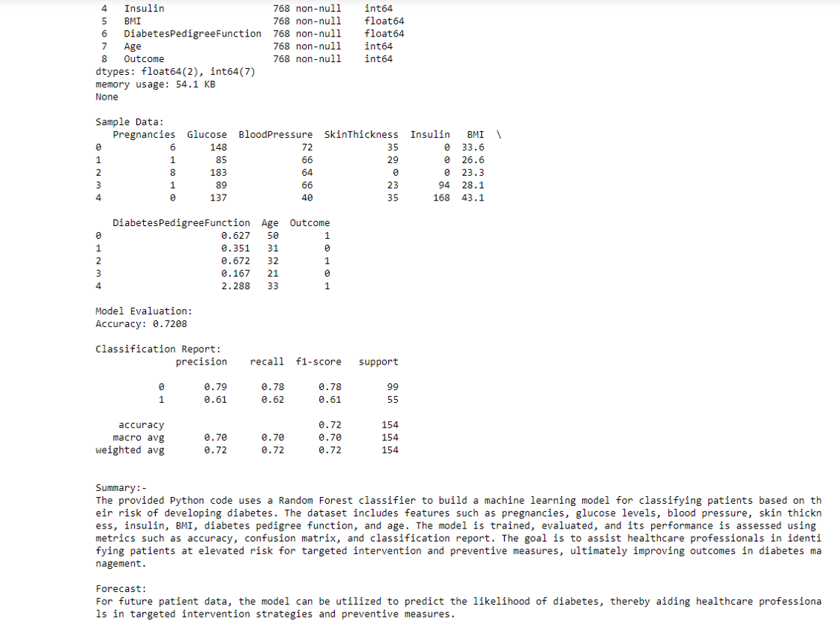
Results

Slide 9
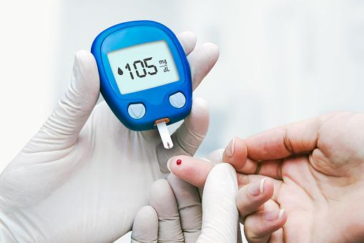
Google Drive link
Code Files
Code screenshots
Output screenshots
https://drive.google.com/drive/folders/1E2HmTnSMB-X21RY1VX5WSBsIhk3BrVd?usp=drive_link

Slide 10
Thank you
.
.

