Slide 1

A Proposal to Establish a Connecting Link Between Classroom and Real World.
Presented By MUTANTS:
Swati Kumari
Rajeshwari Das
Sonalika Nayak
Madhusmita Behera

Slide 2
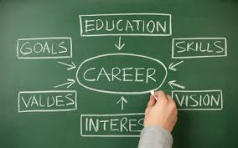
INTRODUCTION
The 21st century world needs people not just with knowledge but with prior expertise and application oriented skillset.
So, it is very important to preach those attributes in college level ultimately filling up the huge gap between college and real world circumstances.

Slide 3

PROBLEMS FACED BY STUDENTS IN REAL WORLD
NO REAL WORLD EXPERIENCE:
Recruiters prefer candidates with slight experience over the inexperienced ones for their firms. Having a degree doesn’t make one more marketable.
POOR INTERVIEW SKILLS:
Interview skills include the way in which one can present themselves infront of others and the communication skills. From the time you walk into the room until you leave, you are being judged.

Slide 4

PROBLEMS FACED BY STUDENTS IN REAL WORLD (contd.)
POOR EXPRESSING SKILLS:
After having lots of stuffs people fail to express itself in front of others . This is due to lack of confidence in himself.
UNREALISTIC EXPECTATIONS:
Having a degree doesn’t make you any different from others competing for a same profile in a firm. To expect more, one has to have that X- factor which makes you superior.

Slide 5
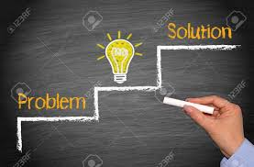
SOLUTIONS
MAKING OUR STUDY MORE PRACTICAL:
Our curriculum should include experiments which are more industry oriented. The concept of entrepreneurship should be well preached.
REAL WORLD EXPOSURE:
The curriculum should include internships as a mandatory part of the programme. This should be monitored by the college fraternities.

Slide 6

SOLUTIONS (contd.)
INTERACTION WITH EXPERTS AND EXPERIENCED PROFESSORS:
Our professors should have expertise in industry based practical knowledge.
There should be introduction of industry coordinated academics.
There should be frequent colloquiums organised in college and universities for a healthy interaction with successful personalities.
ASSIGNMENTS LOOK MORE REAL WORLD:
Introduction of high order thinking skill based assignments which would enhance a student’s dexterity. For ex- a want ad, a business letter, a memo, app development etc.

Slide 7

CONCLUSION
These new changes in the curriculum will bring a sporting enthusiasm in the student community.
These ideas are challenging and difficult to follow, yet can bring a humongous change in upcoming future.
The faster we implement these ideas, the more students benefit from it. A small effort now can lead us into a bright future.

Slide 8


