Slide 1
D. simulator
Isaac Yang, Yuxiang Lin

Slide 2
Outline
Application Introduction
Database Schema
Queries Worth Noting
Demo
Comparison with Existing Application
Notes:
Application Introduction 2
Database Schema 3
Queries Worth Noting 4
Demo 4
Comparison with Existing Application 1
Conclusion 1

Slide 3

Application Introduction
A detective simulator
Set in a town (1000 inhabitants)
User plays the role of a detective to capture the culprit of a series of murders
Motivation of the Concept
Scarcity of murder cases for detective work training
Provides a training ground for aspiring detectives
Simulation overview:
Killer selected
Kills every turn
Simulation ends when murderer is accused or when time limit has been reached

Slide 4
Database schema

Slide 5
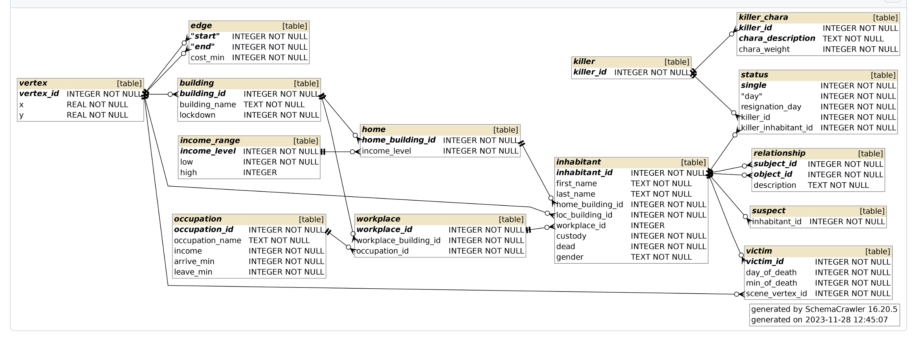
Database Schema Overview

Slide 6
Queries Worth Noting

Slide 7
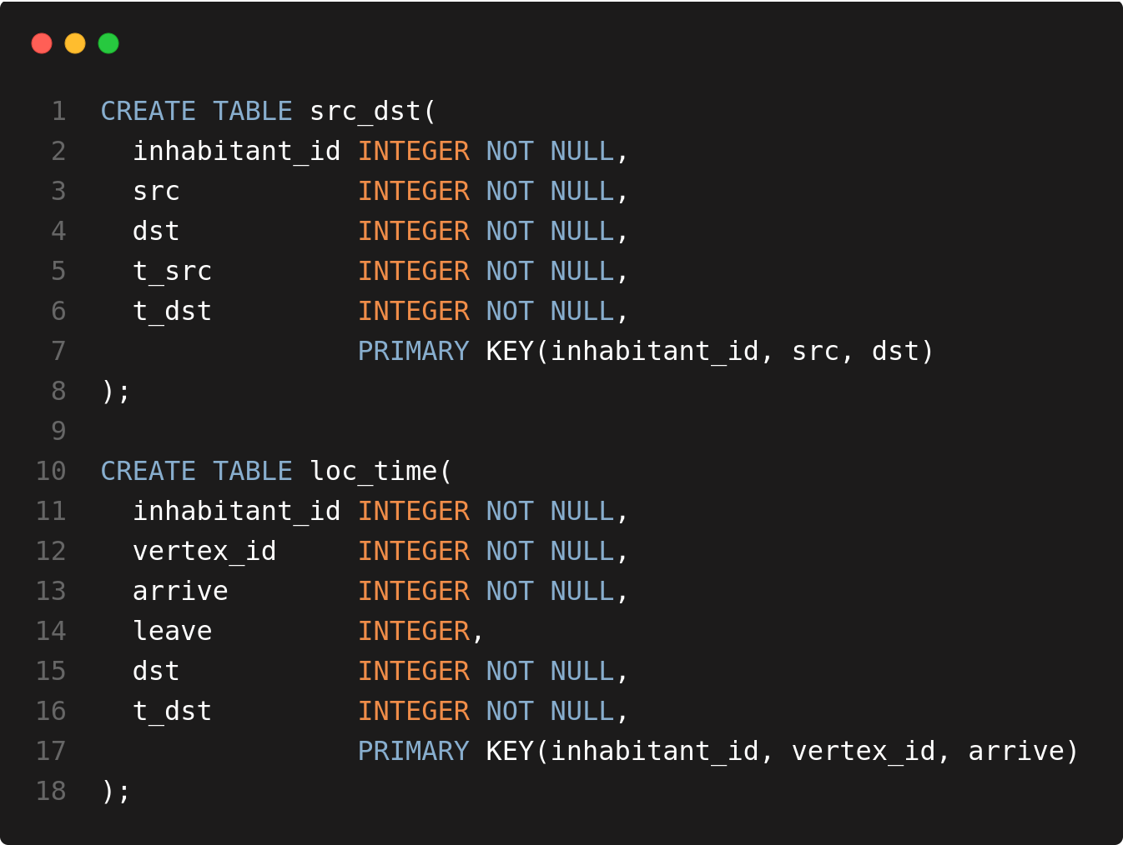
Random Generation of Loc-Time Pairs
Notes:
I use this for code image generation: https://10015.io/tools/code-to-image-converter

Slide 8
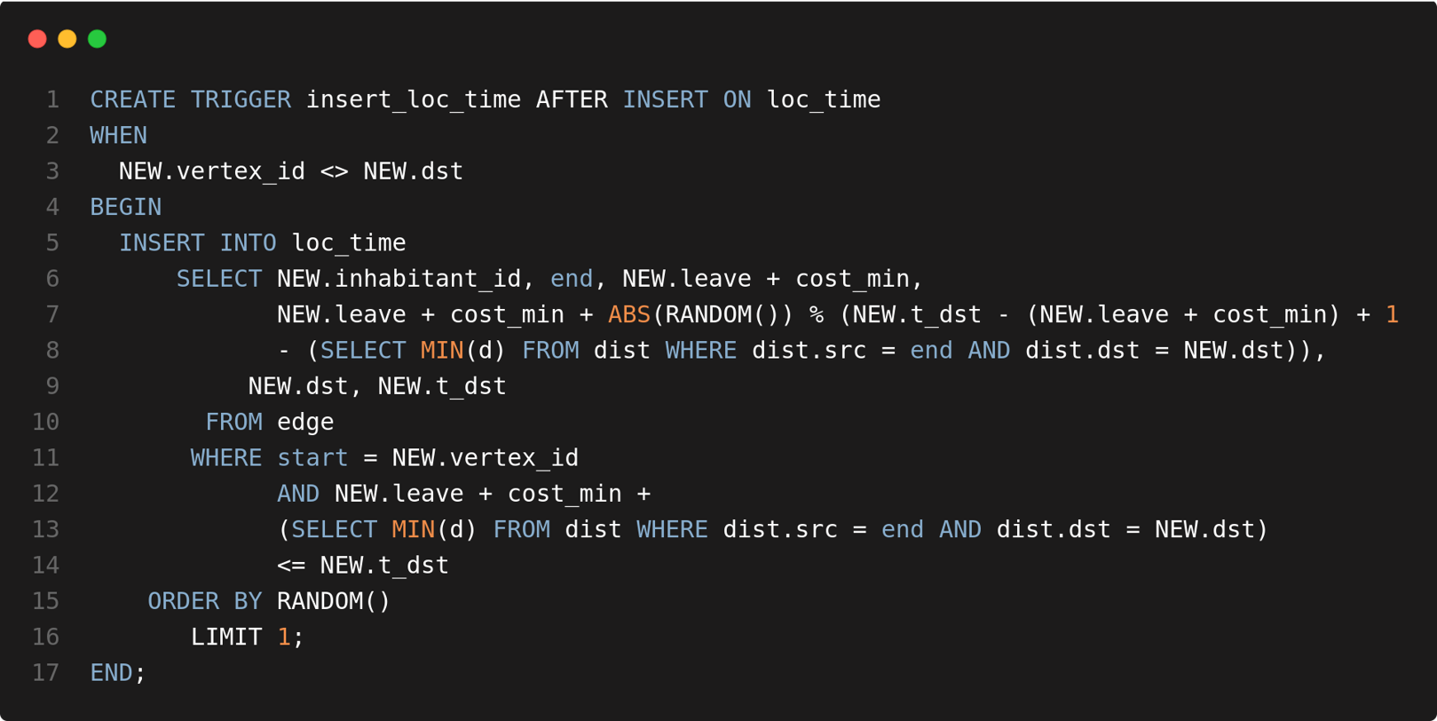
Random Generation of Loc-Time Pairs Cont'd
Notes:
I use this for code image generation: https://10015.io/tools/code-to-image-converter

Slide 9
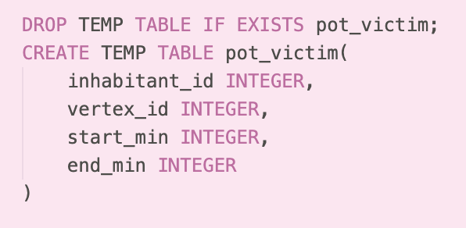
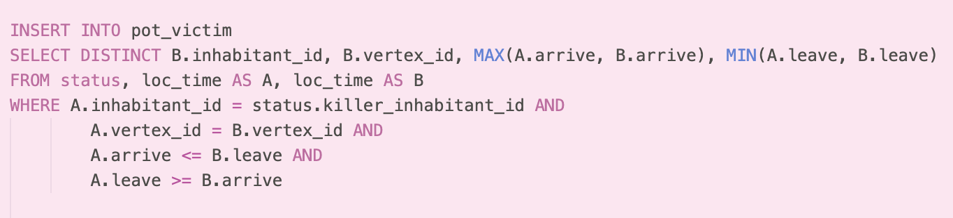
Kill Sequence
Marking of potential victim
Intersection of time and space
MAX and Min for noting intersecting interval

Slide 10
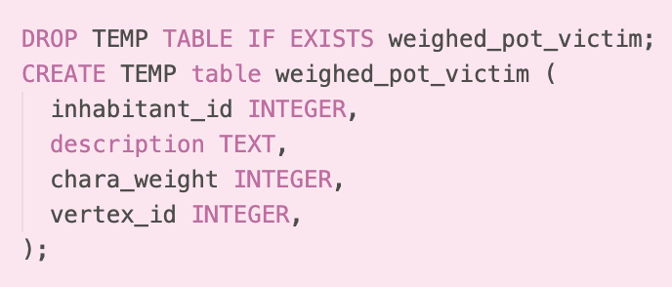
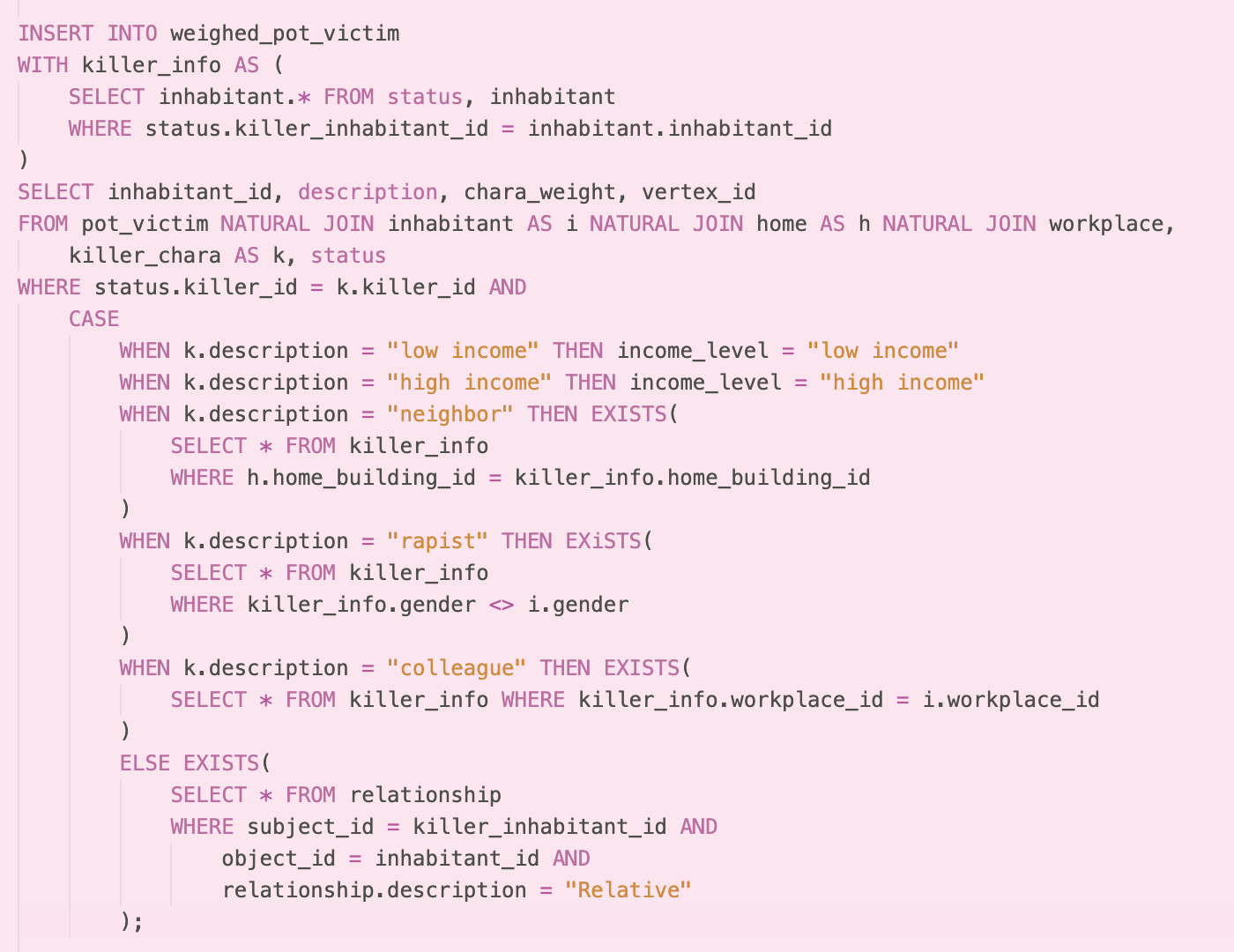
Kill Sequence Cont'd
Weighing potential victims based on Killer_chara
Cartesian product on killer_chara
Matching inhabitants with characteristic by case

Slide 11
DemO

Slide 12
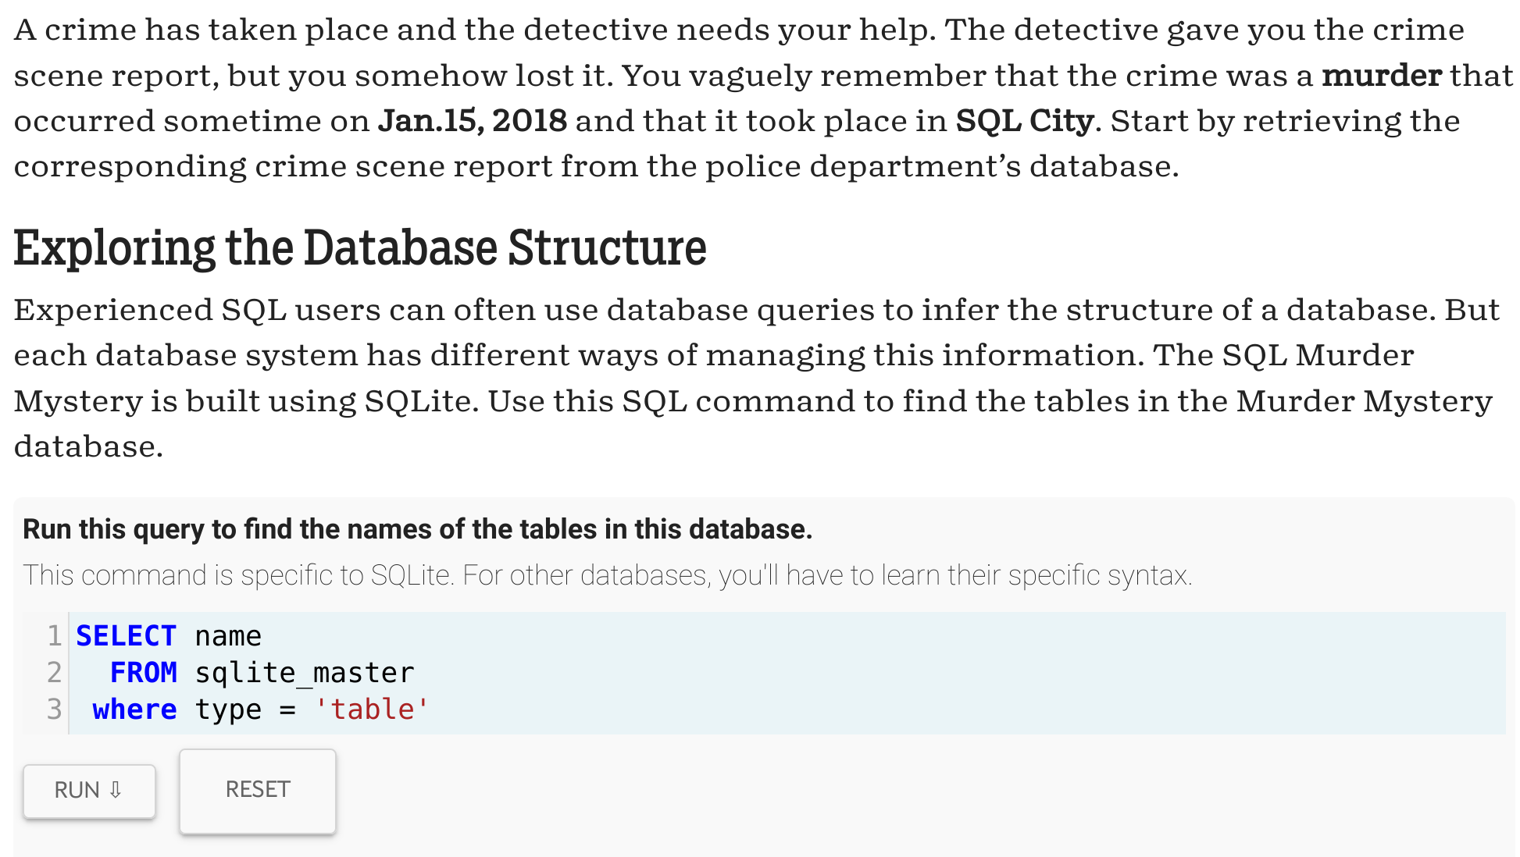
Comparison with Existing Application: SQL Murder Mystery
https://github.com/NUKnightLab/sql-mysteries

Slide 13
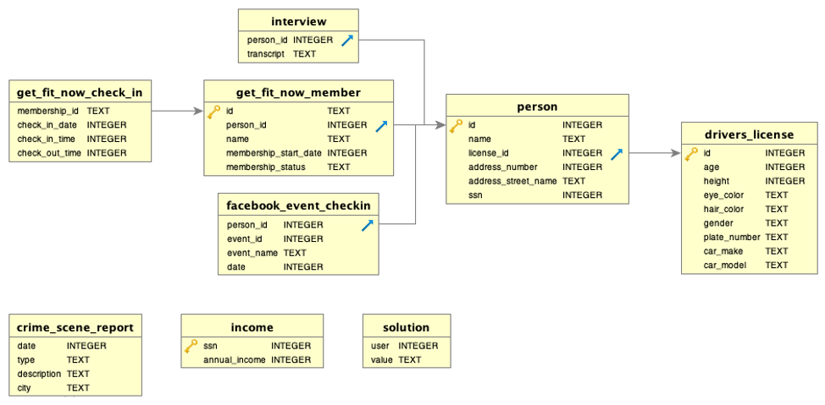
Comparison with Existing Application: SQL Murder Mystery

Slide 14
Q&A

Slide 15
Contributions
Project link: https://github.com/chikubidestroyer/D.-Simulator
Database schema version 1: – Collective effort amongst Isaac, Yuxiang, and Shanruo – Annotations written by Shanruo
Database schema version 2:
ER modeling designed by Isaac
Changes to final database schema reflected by Yuxiang
Database data generator:
building, income range, home, occupation and workplace written by Yuxiang
vertex, edge, inhabitant, killer, killer chara, status, relationship, victim written by Isaac

Slide 16
Contributions Cont'd
Query implementation:
Shortest path, inhabitant location-time pair generation, witness count, and plausible via point implemented by Yuxiang
Victim selection, victim commonality, inhabitant query implemented by Isaac
Isaac also experimented with implementing the inhabitant location-time pair generation in procedures, which is not used in the final game
Gameplay implementation:
Simple queries that provide basic information to the users are implemented by both Yuxiang and Isaac
Load-save functionality is written by Yuxiang
Checking the end-game condition and a view for edges that are not blocked is written by Isaac
Front-End UI:
Individual effort by Yuxiang

