Slide 1
Introduction to Fractals
Pablo’s

Slide 2
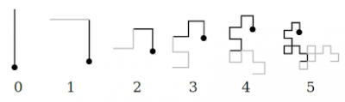
Folding a Paper
Notes:
* Audience tries to predict some first iterations.

Slide 3
Folding a Paper
[DEMO]
Notes:
* Known as Dragon Curve or Jurassic Park Dragon.
* Never intersects itself.

Slide 4
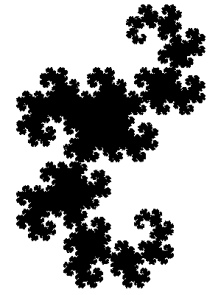
Folding a Paper

Slide 5

Jurassic Park
Notes:
* How I got into fractals.
* Chapter images (iterations).
* Quick overview (biology, computer science, math).

Slide 6
Dropping the Dice
1
2
S
1
2
3
Notes:
* Rules overview.

Slide 7
Dropping the Dice
[DEMO]
Notes:
* Chaotic attractors.
* Iterated Function Systems.

Slide 8
Chaos Game
Chaotic attractors.
Iterated Function Systems.
Shapes and coefficients.
Restricted IFS’.

Slide 9
Chaos Game
[DEMO]
Notes:
Other chaos games.
Restricted IFS.

Slide 10
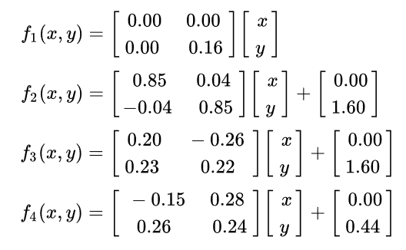
Advanced Chaos Game
1%
85%
7%
7%
Notes:
Fern

Slide 11
Advanced Chaos Game
[DEMO]

Slide 12
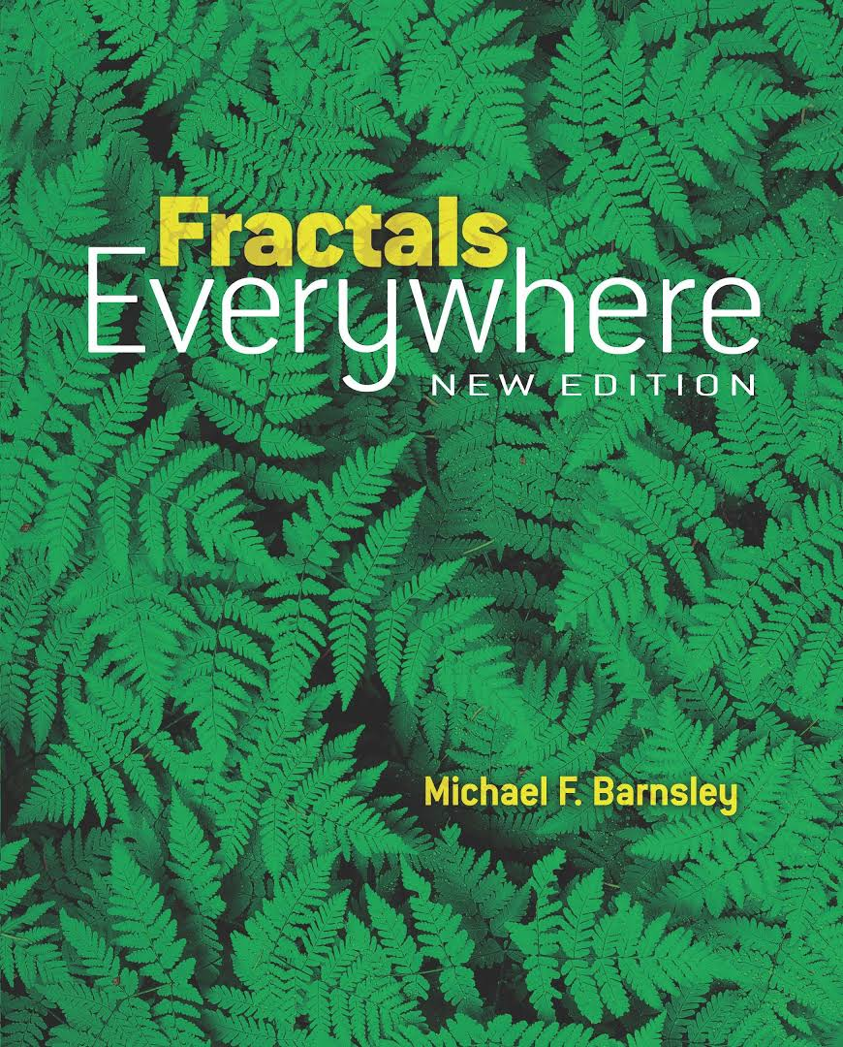
Fractals Everywhere

Slide 13
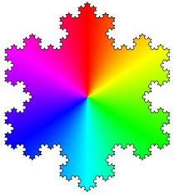
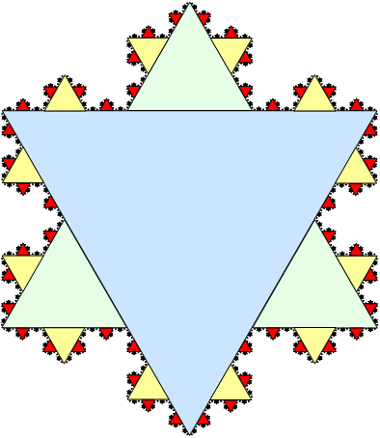
Other Popular Fractals

Slide 14
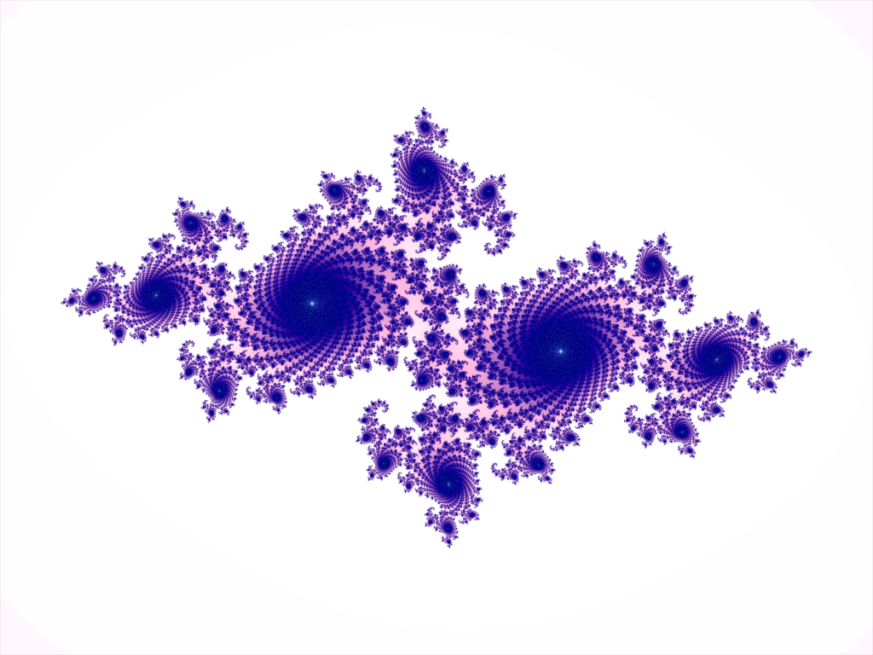
Other Popular Fractals

Slide 15
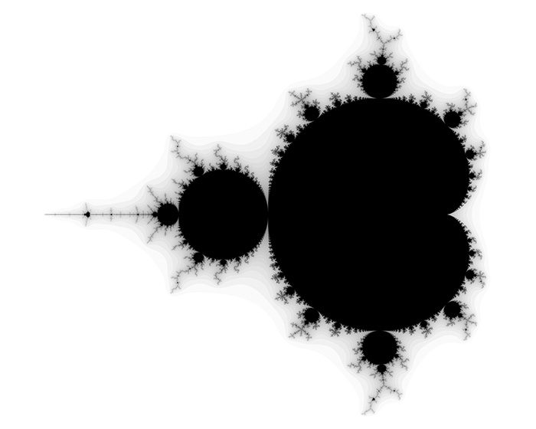
Other Popular Fractals

Slide 16
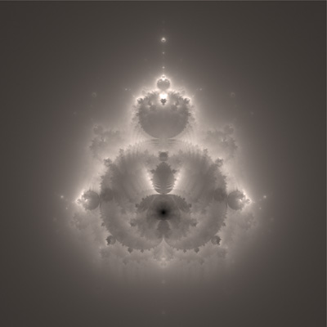
Other Popular Fractals

Slide 17
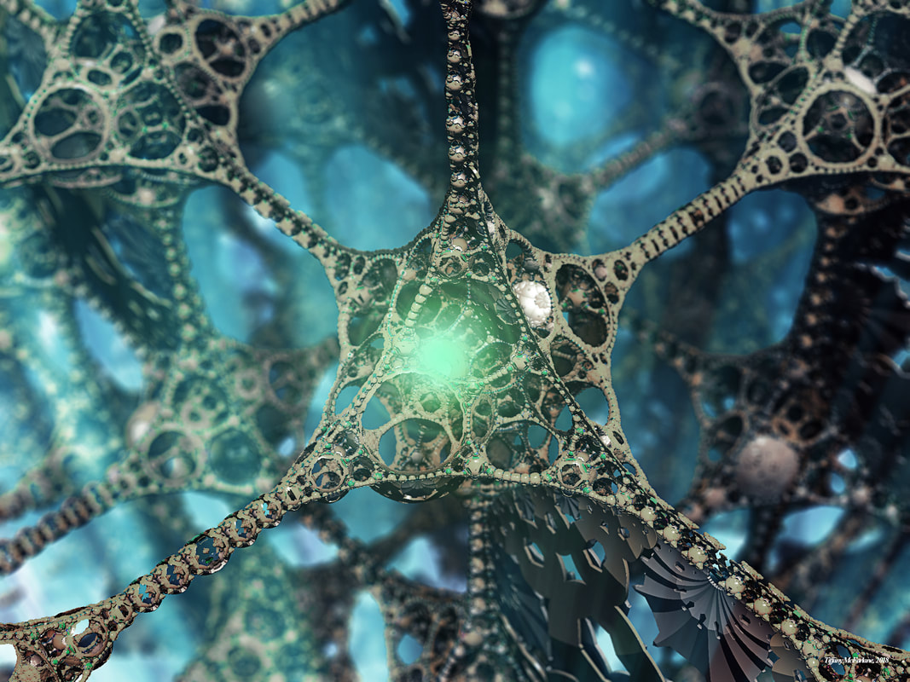
3D Fractals

Slide 18
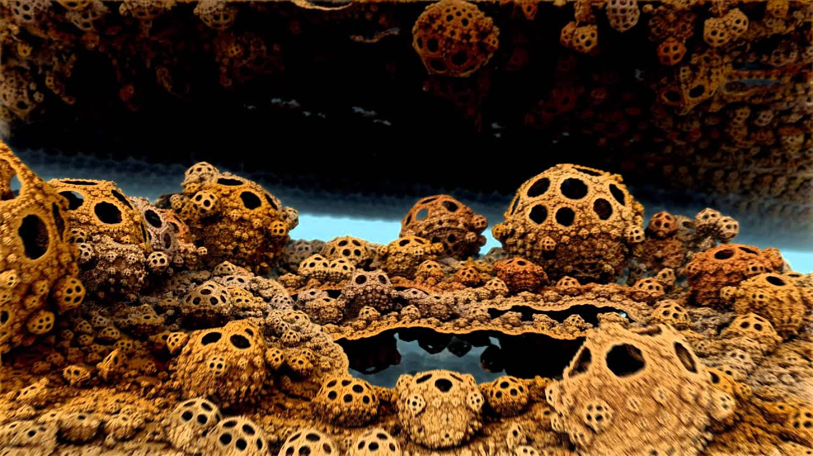
3D Fractals

Slide 19
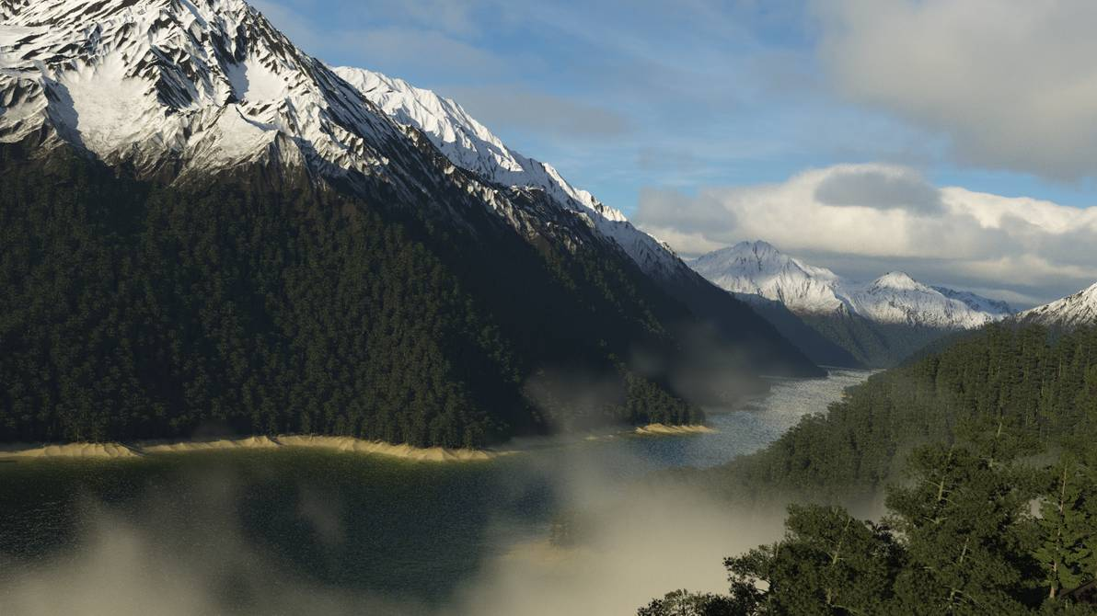
Fractal Lanscapes

Slide 20
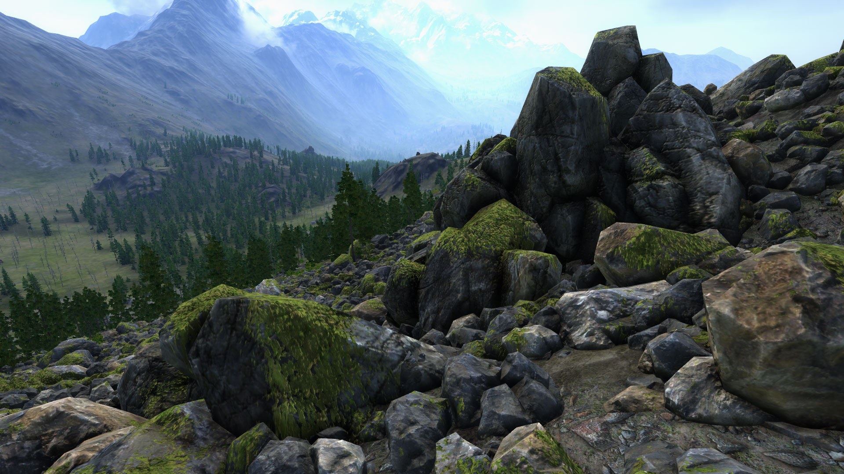
Fractal Landscapes

Slide 21
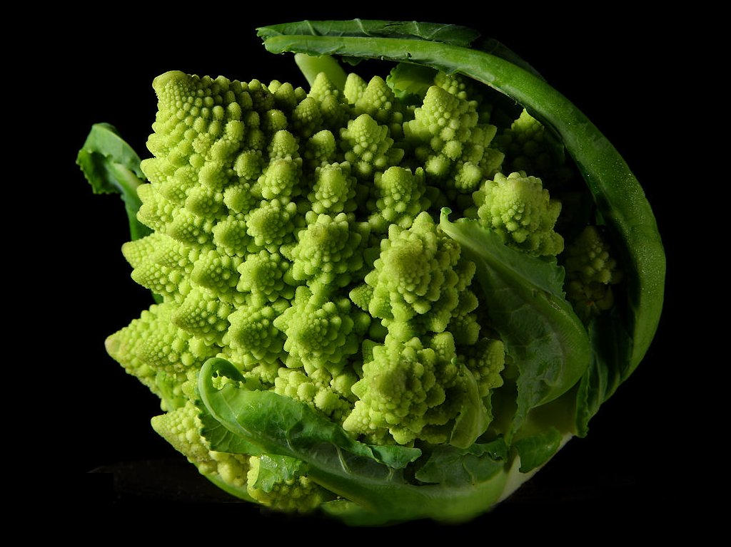
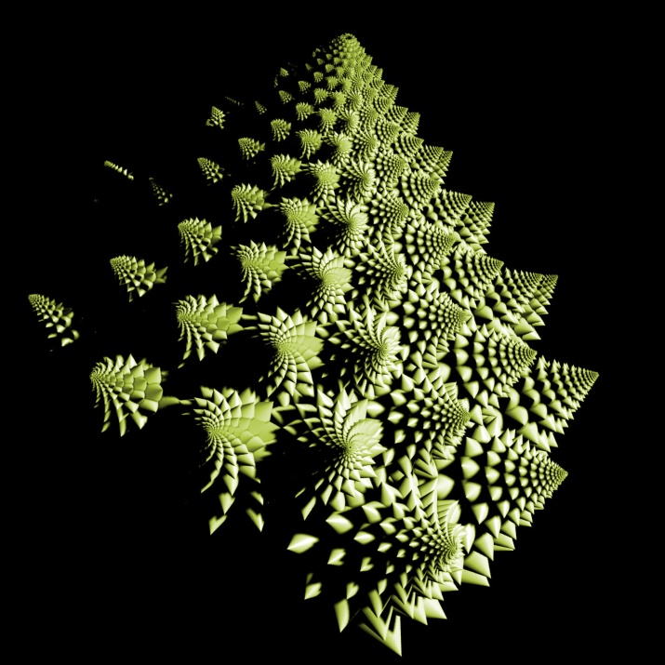
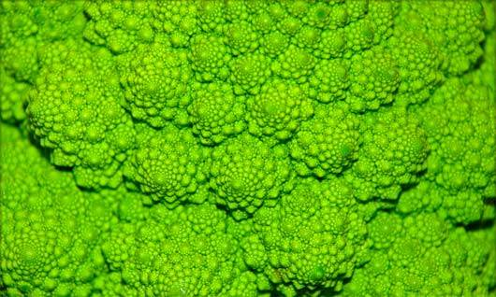
Fractals in Nature

Slide 22
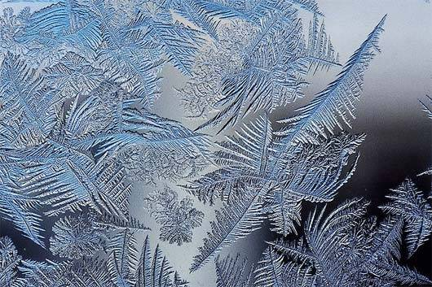
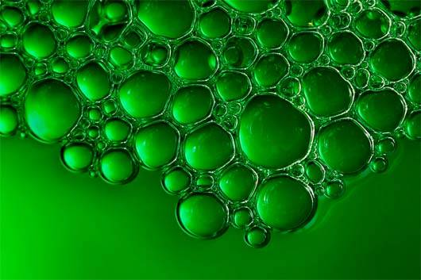
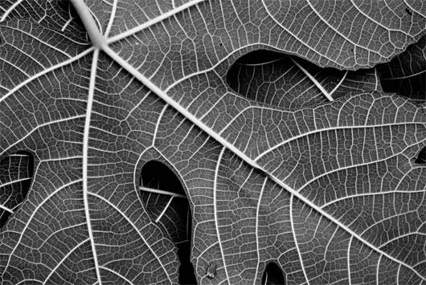
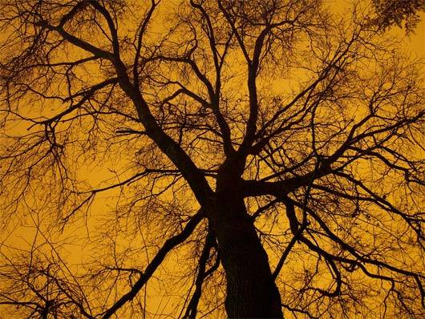
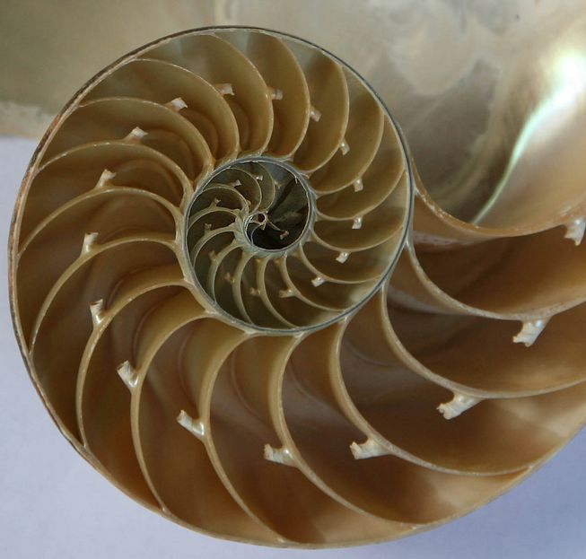
Fractals in Nature

Slide 23
Fun Facts
Usually not self-similar.
Fractional dimension.

Slide 24
Essential Literature
Michael F. Barnsley - Fractals Everywhere
Donald E. Knuth - Selected Papers on Fun and Games
Manfred Schroeder - Fractals, Chaos, Power Laws: Minutes from an Infinite Paradise

Slide 25
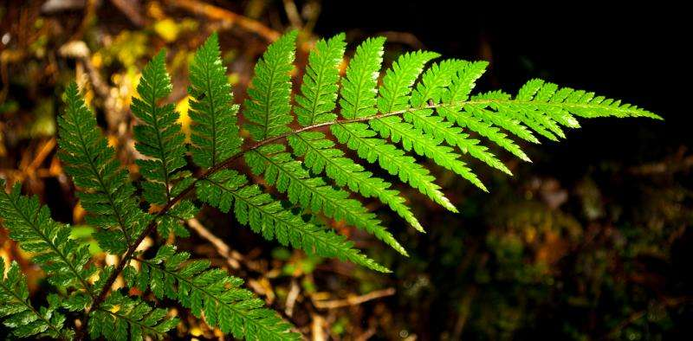
Thank you!

