Slide 1


Presentation
Here is my Python project
file handling, done by Pritha Roy.
✥

Slide 2

Project Title Smart File Organizer Using Python

Slide 3

Table of contents:
01
02
03
04
Introduction and Purpose.
File Type Mapping (file_types Dictionary).
organize_files( ) - Organizes files into folders.
create_custom_folder() - Create a new folder.
05
Delete_folder() - Deletes a specified folder.
06
Menu() - Main user interface for file operations.

Slide 4

Purpose of the Problem Statement
Clarity: Helps the user or collaborators understand the "why“behind the script. Focus: Sets clear objectives for what the script is solving. Guidance: Assists in further development or enhancements of the code.

Slide 5
Purpose of the Proposed Solution:
File Organization: - Automatically categorizes and moves files into predefined folders based on their extensions. Categories include - (a) Images, (b) Documents, (c)Videos , (d)Audio,(e) Spreadsheets ,(f) Presentations .
Custom Folder Management . Enables users to create custom folders within a directory # to support additional organizational needs.
3. Folder Deletion - Allows users to delete specific folders with confirmation, ensuring
no accidental deletions.
User-Friendly Interface - A menu-driven system guides users through various operations like organizing files, creating/deleting folders, and changing directories.
This solution is designed to simplify file organization, improve productivity, and save time for users who deal with large numbers of files on a regular basis.

Slide 6
To represent the Solution Design for your script, a UML (Unified Modeling Language) diagram can be helpful. Since your script revolves around organizing files, creating folders, and managing directories, the design can be broken down into Classes (or modules) and their relationships.
Solution Design - UML
+-------------------+
| FileOrganizer |
+-------------------+
| - file_types: dict|
|-------------------|
| + organize_files()|
+-------------------+
+-------------------+
| FolderManager |
+-------------------+
|-------------------|
| + create_folder() |
| + delete_folder() |
+-------------------+
+-------------------+
| UserInterface |
+-------------------+
|-------------------|
| + display_menu() |
| + handle_choice() |
+-------------------+
Key Components:
Classes/Modules:
FileOrganizer: Handles file categorization and movement.
FolderManager: Manages creation and deletion of folders.
UserInterface: Provides the menu-driven interaction.
Relationships:
UserInterface interacts with FileOrganizer and FolderManager.
FileOrganizer and FolderManager operate independently but serve the same purpose

Slide 7

Technology Stack and Requirements:
Concept 2
Concept 1
1. Hardware:
Processor: Any modern processor capable of running Python.
Memory: Minimal memory requirements since the script processes files locally without high memory usage.
Storage: Sufficient space for organizing files and creating new folders.
2. Software:
Operating System: Compatible with any OS that supports Python (e.g., Windows, macOS, Linux).
Python Interpreter: Python 3.7 or later installed on the system.
3. Environment Setup:
Install Python:
Download and install Python from python.org.
1. Programming Language: python
Python 3.x: The script uses Python for file and folder management, chosen for its simplicity and wide support for file handling.
2. Libraries/Modules:
os: Provides methods for interacting with the operating system, such as file and directory operations.
shutil: Offers high-level file operations like moving and deleting files and folders.
Built-in Input/Output: Used for menu-driven user interaction.

Slide 8
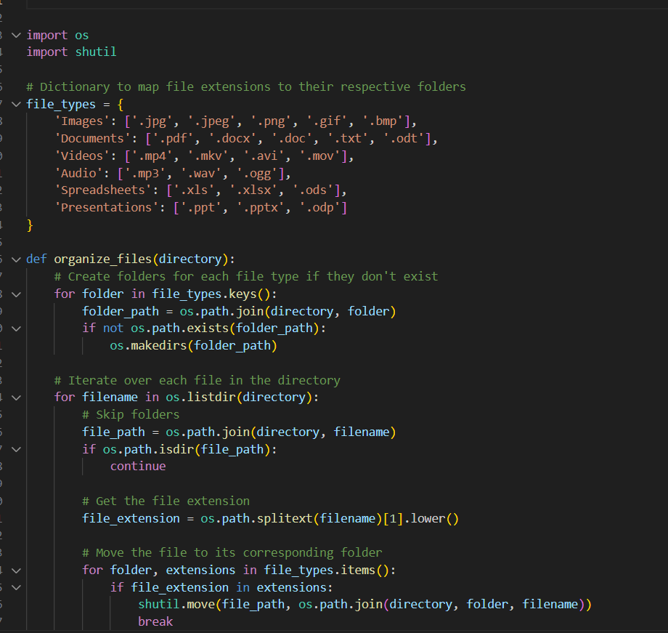
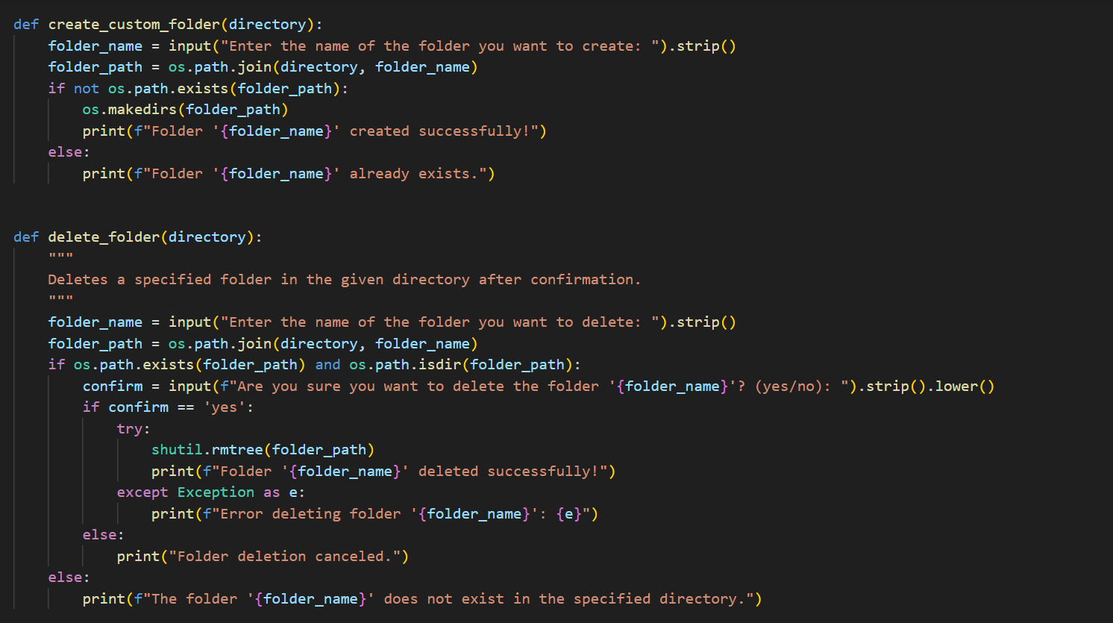
Python coding Example:

Slide 9
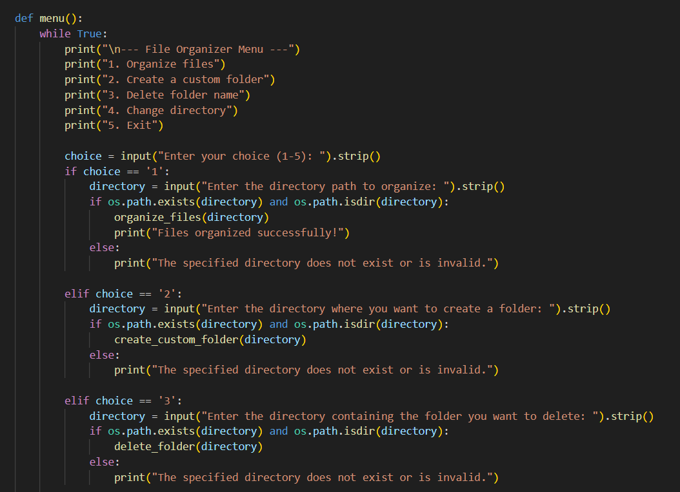
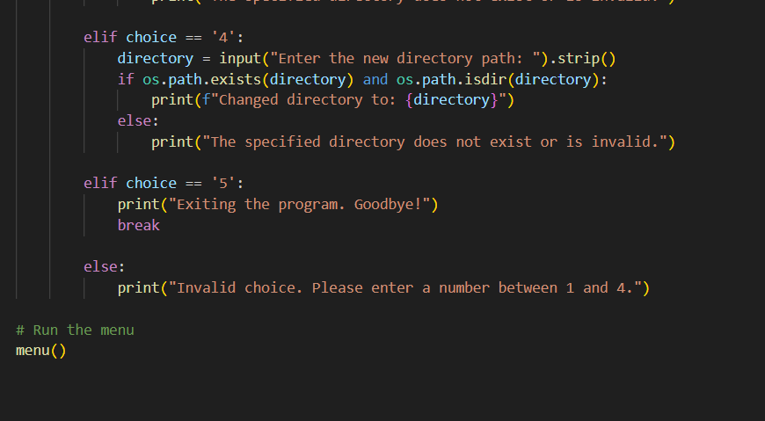
Python coding Example:

Slide 10
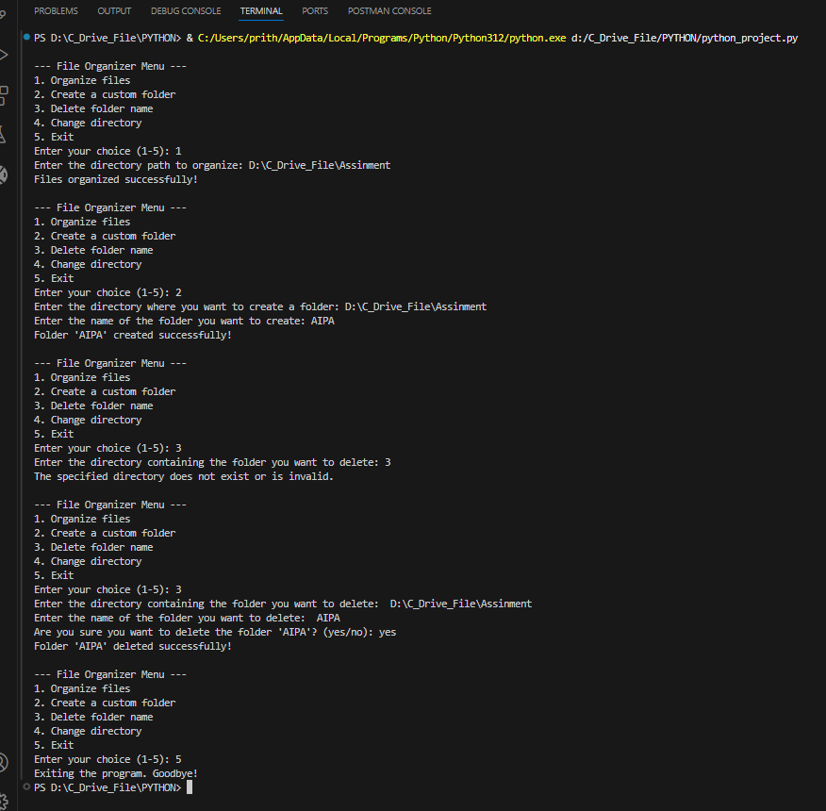
project Output
❅

Slide 11
Demo
Steps to Test the Script
Set Up the Test Environment:
Create a directory with a mix of files (e.g., images, documents, videos, etc.).
Ensure the directory includes at least one file for each type in the file_types dictionary in the script.
Example file structure:
Test_directory-
├── Images/
│ └── image1.jpg
├── Documents/
│ ├── document1.pdf
│ └── random.txt
├── Videos/
│ └── video1.mp4
├── Audio/
│ └── audio1.mp3
├── Spreadsheets/
│ └── spreadsheet1.xlsx
└── Presentations/
└── presentation1.pptx
Test directory-
├── image1.jpg
├── document1.pdf
├── video1.mp4
├── audio1.mp3
├── spreadsheet1.xlsx
├── presentation1.pptx
└── random.txt

Slide 12

THANK YOU
Do you have any questions?
Ask me any thinging.
✆
✈
✉

