Slide 1
Day 1: Switch-board your own cognitive application
Chik Wai Khong
iFin Technology Pte Ltd

Slide 2


Use Case
Service Provider has a SLA to respond to various incident severity levels.
Problem: Customers often classified incidents as urgent.

Slide 3

Objective
Use sentiment analysis to classify the severity level
SMS to relevant response team.

Slide 4

Components
Data source – URL
Cognitive component – Sentiment Analysis
Output-Twilio
Storage – Cloudant

Slide 5
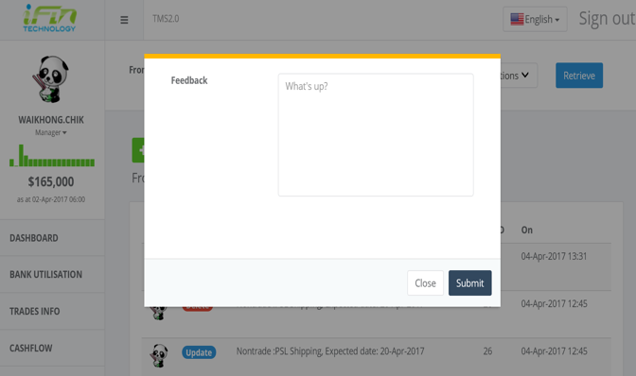
How?
Provided text only description box.
Post to the bluemix http endpoint upon submission.
Use sentiment analysis.

Slide 6
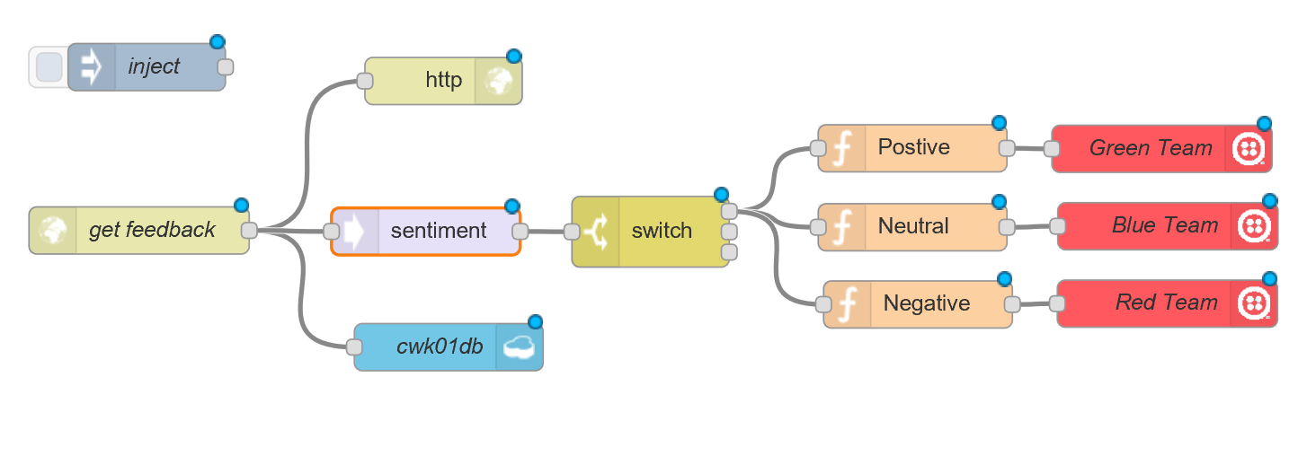
Node RED

Slide 7
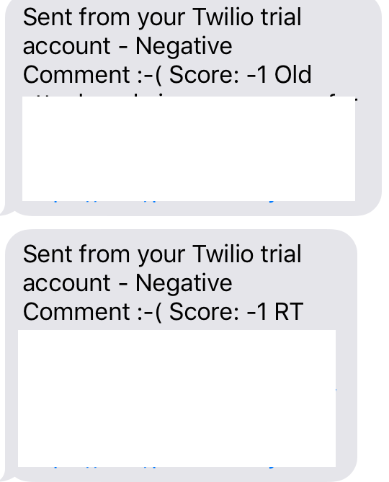
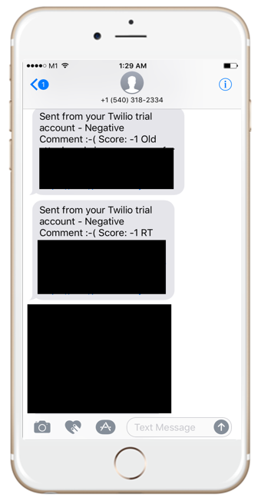
SMS received

Slide 8
Thank you!

