Slide 1

Project Title – Seasonal Agriculture Performance Analysis
[Student Name : CHILAKA SUPRIYA
College Name- MALLA REDDY COLLEGE OF ENGINEERING FOR WOMEN ]
AICTE STU ID : STU6a50ff438a13b1783693123

Slide 2

PROBLEM STATEMENT
Agricultural activities are influenced by seasonal variations in environmental conditions, farming practices, resource availability and market conditions. As a result, agricultural performance may differ from one season to another.
However, raw agricultural data does not clearly explain how agricultural performance changes across seasons or what patterns can be observed in different seasonal conditions.
The problem is to analyze the given agricultural dataset and investigate seasonal differences in agricultural performance by identifying meaningful patterns, trends, relationships and variations within the available data.
Project objective :
Analyze the agricultural dataset to identify meaningful seasonal patterns , trends, relationships and variations in agricultural performance.

Slide 3
PROJECT DESCRIPTION
Analyzed farm-level agricultural records
Studied different seasons
Examined environmental conditions
Analyzed farming resource usage
Compared crop yield and production
Studied revenue , cost and profit
Compared crop and irrigation performance
Performed statistical analysis
Studied relationships between variables
Investigated potential outliers
Generated evidence-based insights and recommendations

Slide 4

WHO ARE THE END USERS?
Farmers
For understanding seasonal agricultural performance.
Agricultural Departments
For seasonal planning and resource analysis.
Agricultural Analysts
For studying agricultural patterns.
Researchers
For further agricultural research.
Students
For learning and applying data analytics to agricultural data.

Slide 5

TECHNOLOGY USED
Programming Language
Python
Data Analysis
Pandas
Numpy
Visualization
Matplotlib
Seaborn
Statistical Analysis
SciPy
Platform
Google Colab
Techniques
Data Cleaning
EDA
Univariate Analysis
Bivariate Analysis
Multivariate Analysis
Correlation Analysis
Statistical Analysis
Outlier Analysis

Slide 6
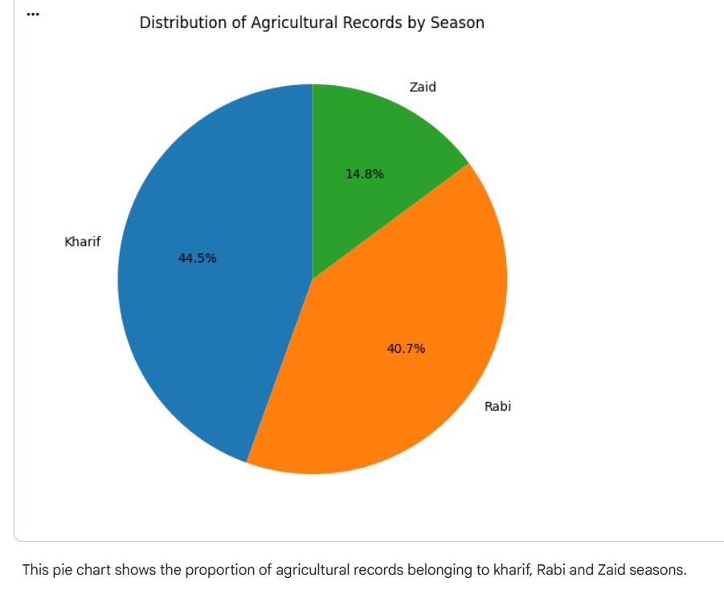
RESULTS
Seasonal Distribution
Key Findings
Dataset contains agricultural records from different seasons.
Kharif , Rabi and Zaid are compared.
The distribution of records varies between seasons.

Slide 7
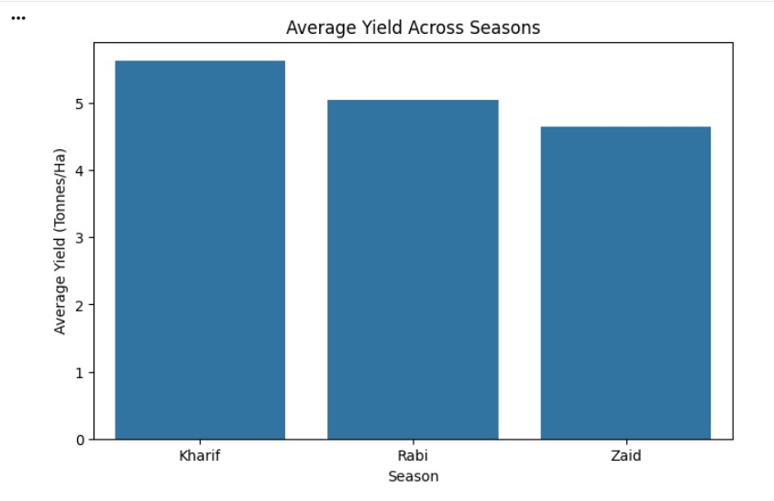
RESULTS
Seasonal Agricultural Performance
Season | Average Yield | Average Profit
Kharif | 5.64 | 178914.65
Rabi | 5.08 | 87689.47
Zaid | 4.67 | -24804.82
Key Finding
Agricultural performance differs across seasons.

Slide 8
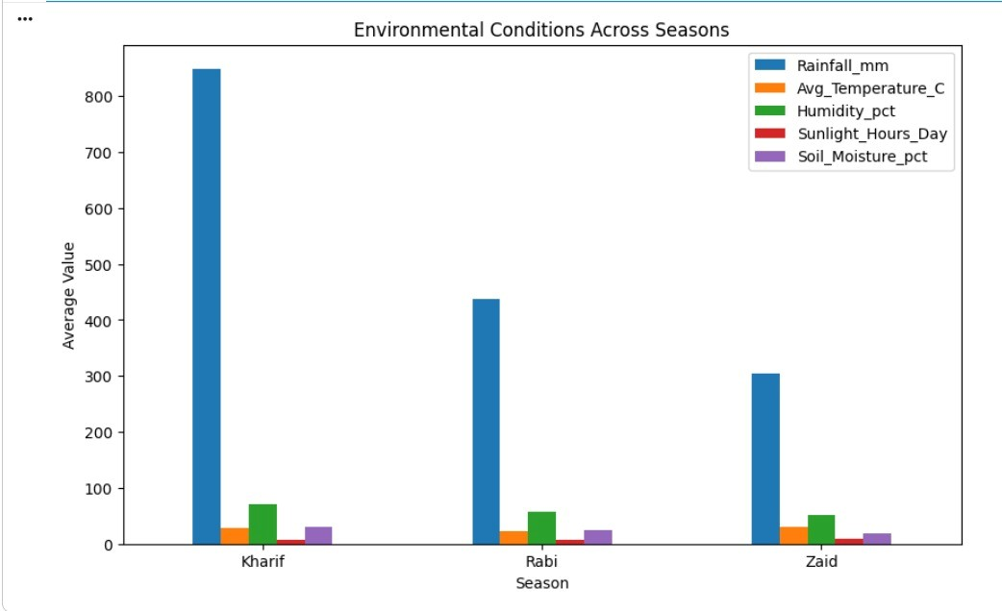
RESULTS
Key Finding
Environmental conditions and resource usage show seasonal variation.

Slide 9
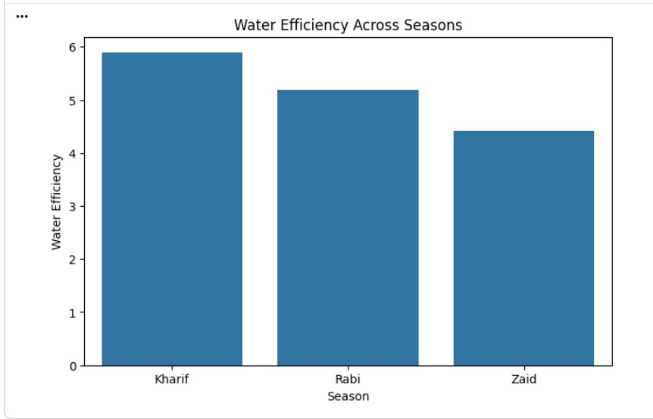
RESULTS
Key Finding
The analysis identifies differences in water usage and water-use efficiency between seasons.

Slide 10
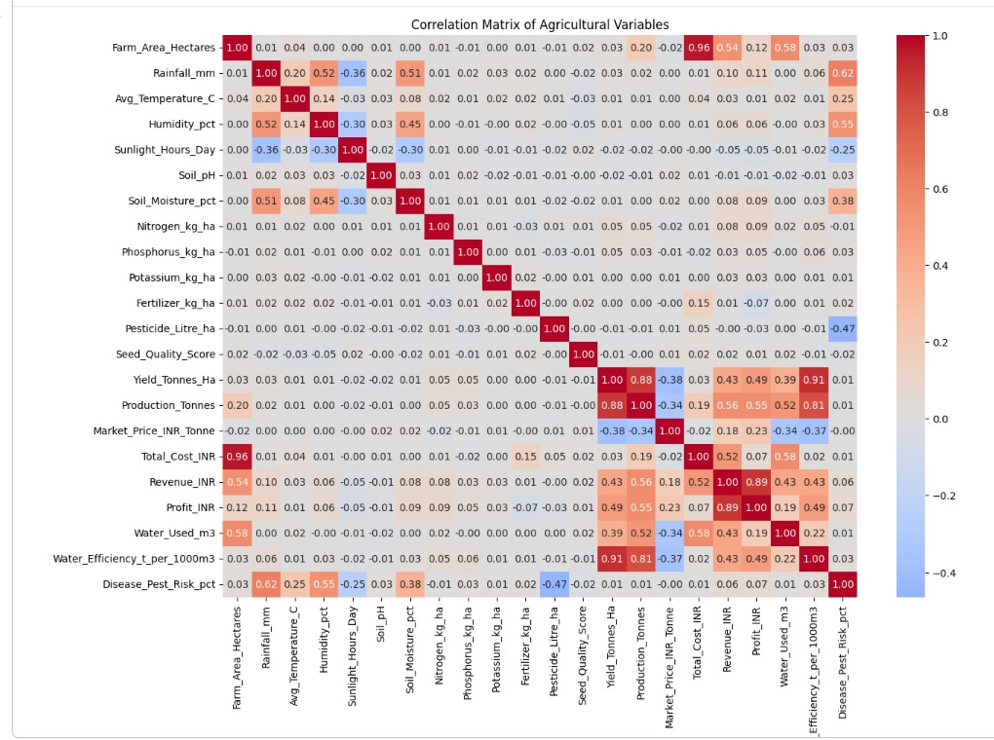
RESULTS
Correlational Analysis

Slide 11
FUTURE SCOPE
Analyze agricultural data from additional years.
Include more geographical regions.
Study additional environmental variables.
Perform deeper crop-level analysis.
Investigate unusual observations in greater detail.
Compare seasonal patterns over longer periods.
Include additional economic and resource variables.

Slide 12
GitHub Link
https://github.com/chilakasupriya-157006/VOIS_Major_Project-Seasonal-Agriculture-Performance-Analysis.git

Slide 13
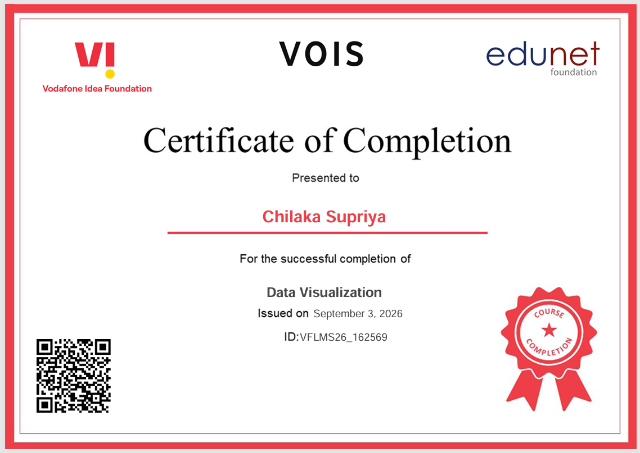
VOIS Course completion certificate - Course name- Data Visualization

Slide 14
Thank you
THANK YOU
Seasonal Agricultural Performance Analysis
Presented by: CHILAKA SUPRIYA
VOIS Major Project
.
.

