Slide 1

Case Study 4: Healthcare Electrification in Uganda
Abubakar Chilala
November 2026
Notes:
Uganda's Ministry of Health has one million dollars to bring power to health centres. We used Energy Access Explorer to decide where it should go.

Slide 2
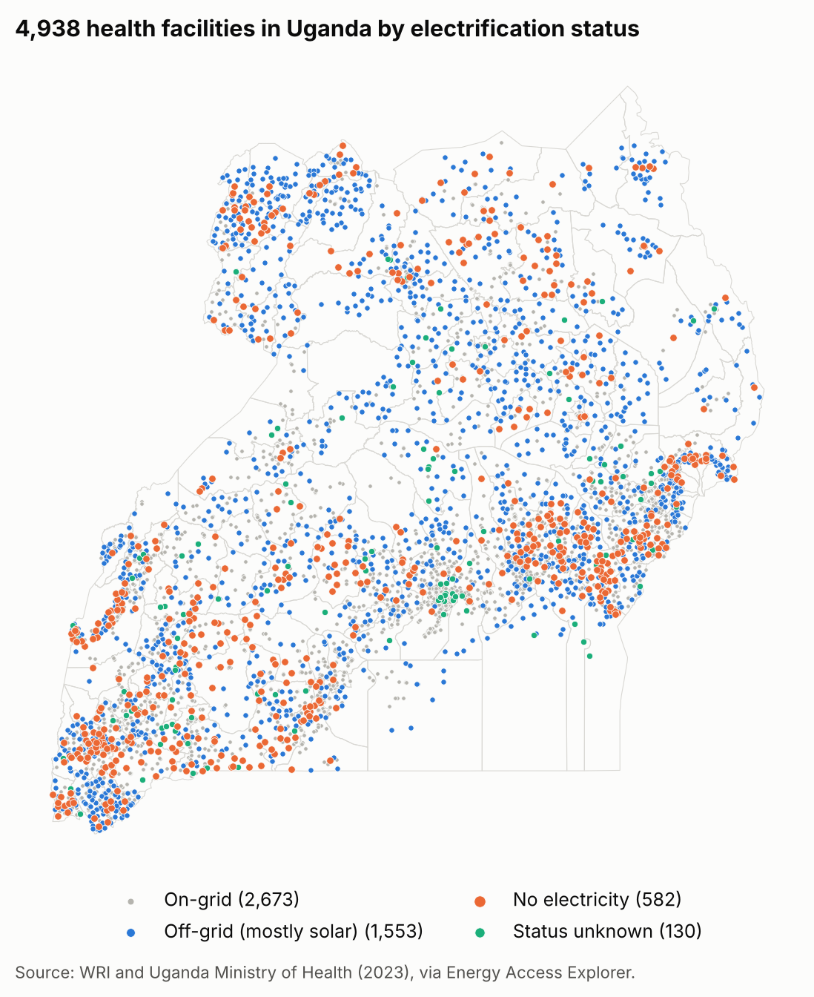
Why power at health centres matters
The Ministry of Health has $1,000,000. Where should it spend it?
Why it matters
Health centres need power for night births, baby warmers, vaccine fridges, lab tests and clean water.
Mothers and babies are at risk. In Uganda 189 mothers die for every 100,000 births, and 22 of every 1,000 babies die in their first month (UDHS 2022).
Without power, a health centre cannot do this safely at night.
582
2.5 M
1,553
68%
health centres with no power
people live near them
use small off-grid systems
of the 582 are close to a power line
The decision: which areas, and which health centres, should get power first.
Sources: Ministry of Health and WRI facility data (2023), via Energy Access Explorer; UBOS, Uganda Demographic and Health Survey 2022; WHO et al., Energizing Health (2023).
Notes:
Health centres need power to deliver babies at night, keep newborns warm and keep vaccines cold. 582 have no power at all, and most of them are close to a power line.

Slide 3
How we used Energy Access Explorer
Index: Assistance Need Index. It favours places with high need, poor people and no grid nearby.
EAE layer | Setting (filter) | Weight (1-5) | Why
Health facilities | within 5 km | 5 | The programme is about health centres, so this matters most.
Population | rural areas only (up to 1,500 people per km²) | 4 | More people helped. Towns already have power.
Wealth (Relative Wealth Index) | all areas | 4 | Poor areas cannot pay for power themselves.
Power lines | all areas | 3 | Places far from lines get the grid last.
What we left out
Sunshine: strong everywhere in Uganda. Adding it does not change the top 10.
The ">2 km from lines" filter: it would drop most health centres with no power.
Schools, mini-grids, night lights: not about health.
Why this index: this is public money, so it should go where the market will not reach.
Layers: Ministry of Health and WRI, WorldPop, Meta, Energy Sector GIS Working Group (2024), all via Energy Access Explorer.
Notes:
We used four EAE layers and the Assistance Need Index. It points to places with high need, poor people and no grid nearby, which is where public money should go.

Slide 4
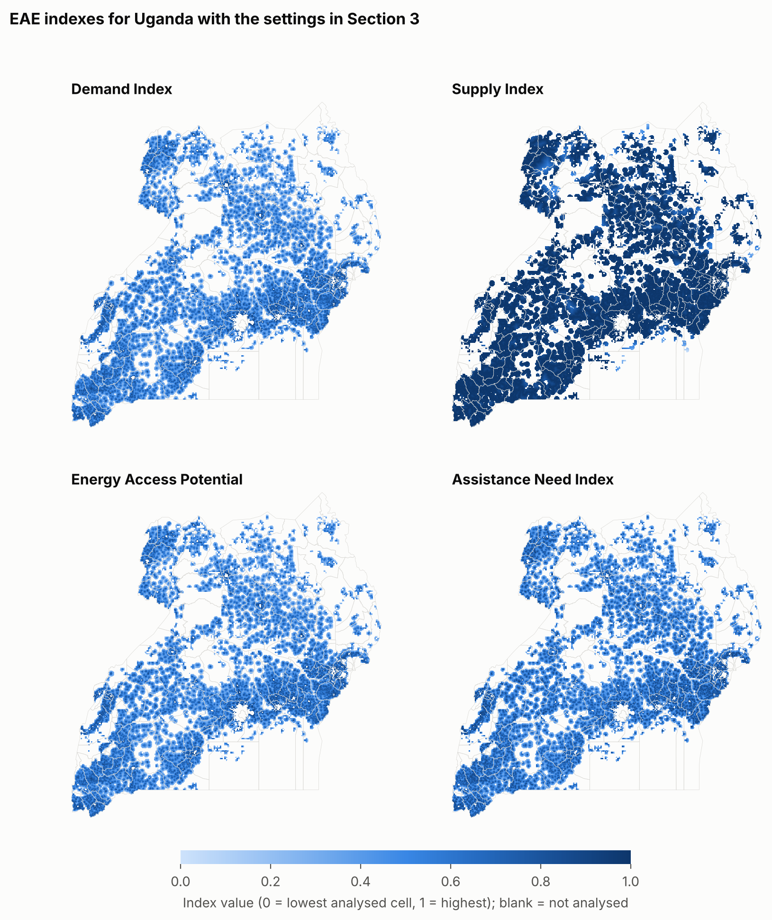
Different goals point to different districts
Rank | Demand | Supply | Energy Access Potential | Assistance Need (ours)
1 | Amudat | Tororo | Tororo | Kasese
2 | Buvuma | Kasese | Kasese | Isingiro
3 | Obongi | Rukungiri | Rukungiri | Tororo
4 | Kasese | Kamuli | Kamuli | Rukungiri
5 | Kalangala | Isingiro | Isingiro | Kamuli
Demand alone picks remote districts with few people (Amudat, Buvuma, Obongi).
Supply and Potential pick districts near the grid. They share 8 of our top 10.
Assistance Need looks for high need, poor people and no grid nearby.
Over 90%
Same top 5
4 of top 5
of 500 random weight choices keep Kasese, Isingiro and Tororo in the top 10
when all weights are equal
stay when we count only centres with no power
The goal matters more than the weights: with towns left in, Kampala would even rank 2nd though all its health centres have power.
Notes:
EAE has four ways to rank places. Each one answers a different question, so each picks different districts. We use Assistance Need because this is public money. The top districts hardly move when we change the weights.

Slide 5
The top five districts
Rank | District | Score | Centres with no power
1 | Kasese | 100% | 29
2 | Isingiro | 93% | 17
3 | Tororo | 91% | 22
4 | Rukungiri | 84% | 26
5 | Kamuli | 82% | 7
Why they rank high: they have the most health centres and people.
Real need: Kasese, Rukungiri and Tororo also have the most centres with no power.
Kamuli is weaker: only 7 centres have no power.
Big districts with many health centres come first. Poverty and distance from lines are similar across most rural districts.
Notes:
The top five are Kasese, Isingiro, Tororo, Rukungiri and Kamuli. They are big districts with many health centres and people. Three of them also have the most health centres with no power.

Slide 6
Cost of solar for one health centre
Solar panels and batteries, sized to the power each health centre needs
$3,609 per kW
Health centre | Power per day | Total cost | People nearby | Cost per person
Small (HC II, 2 beds) | 8 kWh | $14,824 | 2,229 | $6.65
Small (HC II, 3 beds) | 12 kWh | $21,755 | 7,718 | $2.82
With maternity ward (HC III) | 27 kWh | $47,519 | 2,727 | $17.43
Large (HC III, 14 beds) | 162 kWh | $288,464 | 9,152 | $31.52
of solar, batteries included (Uganda, 2022)
+20%
for design, transport and set-up
+17%
Check: this matches real Ugandan systems. Prices in Burkina Faso are 35% lower, so our cost is on the safe side.
kept aside for 5 years of maintenance
One large health centre costs as much as 13 to 19 small ones.
Sources: Green Empowerment et al. (2023), Uganda; IRENA and SELCO in WHO et al., Energizing Health (2023), Box 4.1.
Notes:
We sized a solar system with batteries for each health centre. The price comes from three real systems built in Uganda in 2022. We add 20% for set-up and keep 17% for five years of maintenance.

Slide 7
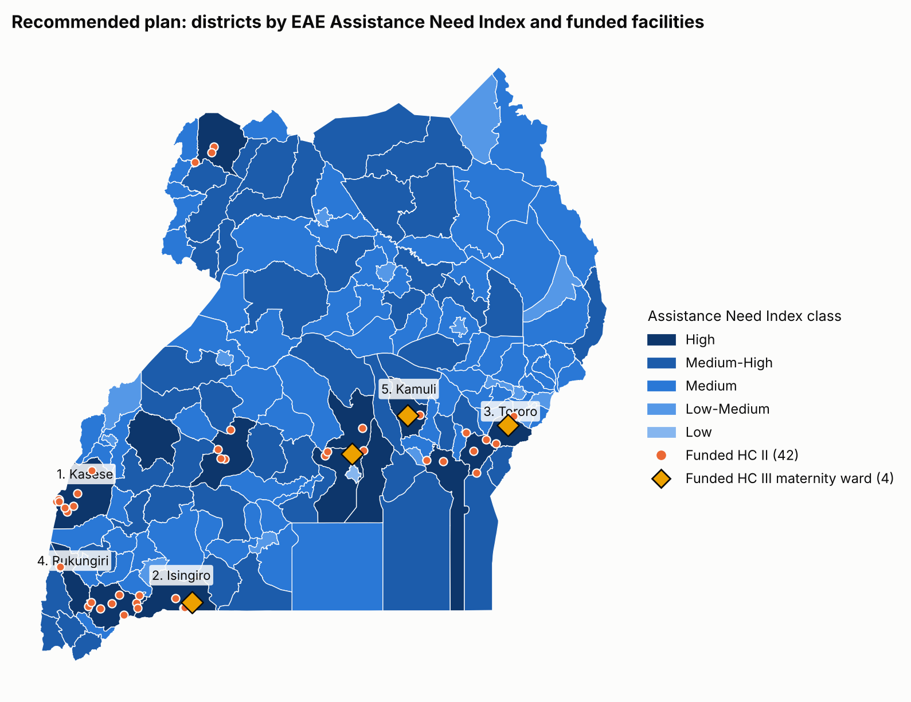
Our plan for the $1,000,000
4 + 42
13
maternity wards + small health centres
districts, all high need
347,000
$2.86
people live near them
per person
Maternity wards first: in Isingiro, Tororo, Wakiso, Kamuli. None of the 46 has power today.
Notes:
Our plan powers the 4 maternity wards with no power in the high-need districts first, then 42 small health centres. About 347,000 people live near them.

Slide 8
Need versus value for money
Plan | Health centres | Maternity wards | People reached | Cost per person | In high-need districts
Need first | 47 | 7 | 186,756 | $5.33 | 47 of 47
Cheapest per person | 47 | 0 | 635,820 | $1.56 | 12 of 47
High need, small centres only | 53 | 0 | 384,013 | $2.57 | 53 of 53
Our plan | 46 | 4 | 347,341 | $2.86 | 46 of 46
Cheapest per person helps the most people, but only 12 of its 47 centres are in high-need districts.
Our plan reaches 10% fewer people than small centres only, but powers 4 maternity wards.
Need and cost do not line up: Isingiro is high need and cheap ($3.81 a person); Obongi costs $93.
Our rule: need chooses the districts, cost chooses the health centres.
Notes:
We compared four ways to spend the money. The cheapest per person reaches the most people but mostly outside the high-need districts. Our plan gives up some people to power maternity wards.

Slide 9
What if costs go up or down?
Solar cost from $2,346 per kW (35% cheaper) to $5,413 per kW (50% dearer)
35% cheaper: 79 health centres, 477,000 people.
50% dearer: 27 health centres, 252,000 people.
Always funded: the 4 maternity wards. Only the number of small centres changes.
A 20% change in cost means 9 to 15 more or fewer health centres.
Notes:
If solar costs 35% less, we can power 79 health centres. If it costs 50% more, only 27. The four maternity wards are funded in every case.

Slide 10
What could change our answer, and next steps
What could change the answer
Next steps for the Ministry
Power needs are estimates, not measured.
Some health centres may have been connected since 2023.
The map shows big power lines only, not the local poles.
"People reached" means people living nearby, not patients.
Costs come from only two projects.
Fund the 4 maternity wards and 42 small health centres ($869,000).
Keep $124,000 aside for maintenance.
Visit each site first to check its power and size the system.
Ask UEDCL to connect health centres that sit next to power lines.
Next phase: the big maternity units in Mayuge and Kyenjojo.
Bottom line: power the 4 maternity wards and 42 small health centres now, and check each site first.
Full sources are in the report: WRI (Sinclair-Lecaros et al., 2023), Energy Access Explorer, WHO et al. (2023), Green Empowerment et al. (2023), UBOS (2023).
Notes:
Our numbers are estimates, so the first step is to visit each site. Then fund the plan, keep the maintenance money aside, and work with UEDCL where a power line is close.

