Slide 1
Container-based SDLC
HLD, Use cases and products review
Roger Carhuatocto
v1.1

Slide 2
Secure Software Development Life Cycle (SSDLC)
Dev
Ops
01. PLAN
02. CODE
03. BUILD
04. TEST
05. RELEASE
06. DEPLOY
07. OPERATE
08. MONITOR
DevSecOps
Threat Modeling
SAST
SCA
DAST
SCA
IAST (SAST+DAST)
Configuration Drift
RASP
PKI
RASP
PKI
Security Monitoring
Misuse Cases
Configuration Drift
Configuration Drift
Performance Testing
Consistency in Environments
Secrets Management
Secrets Management
Application Monitoring
Abuse Cases
Consistency in Environments
Infrastructure (Cloud) Testing
SCA
WAF
*-IDS
WAF
*-IDS
Performance Testing
Compliance Testing
Resilience and Chaos Testing
Version 1

Slide 3
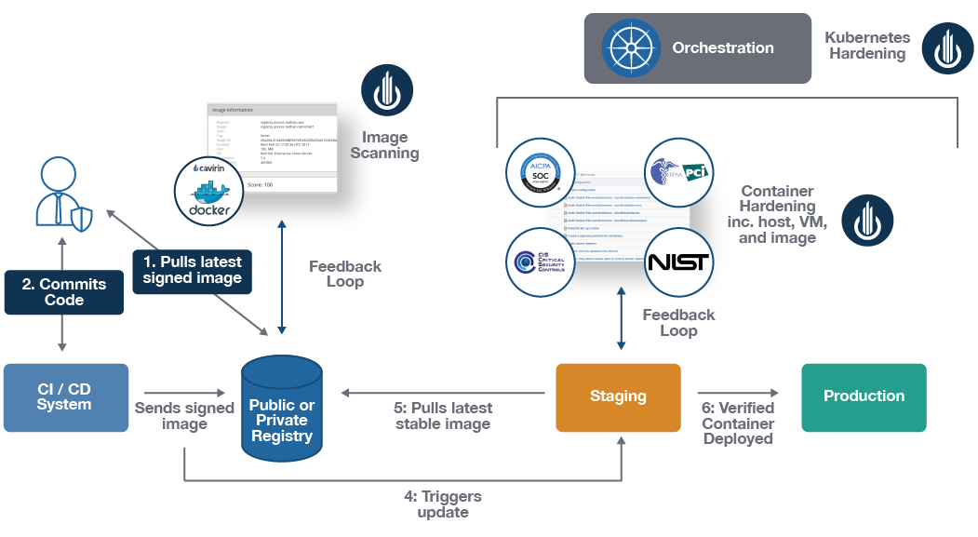
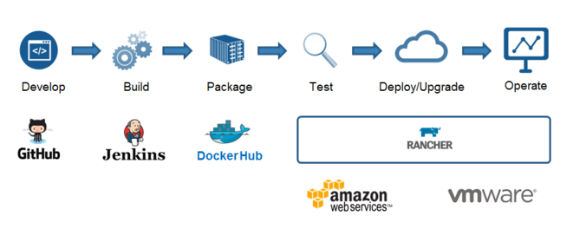

Slide 4

1. HLD, key components
Kubernetes (node worker)
CI/CD
Ingress Controller
LB, Proxy or Gateway
Namespace
Service
SysOps
Pod
Pod
Edge Proxy
3
Pod
Sidecar
Sidecar
Sidecar
4
Secrets Management Agent
App
Container
App
Container
App
Container
VM or Kubernetes
1
Secrets
Management
Server
API
Secrets
VM
App
LB, Proxy or Gateway
App
Monolith App
6
Access
Control
AuthN
Config
Library
AuthZ
2
Single Source of Truth
Service Registry
5
Identities

Slide 5
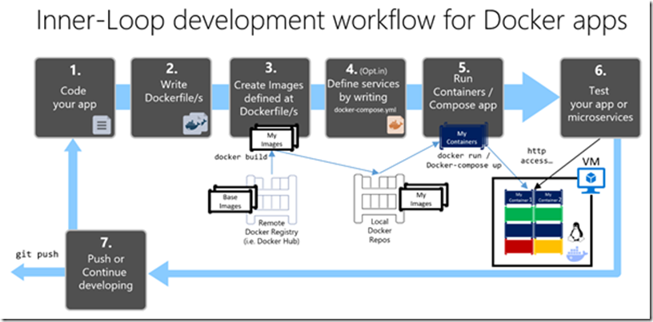
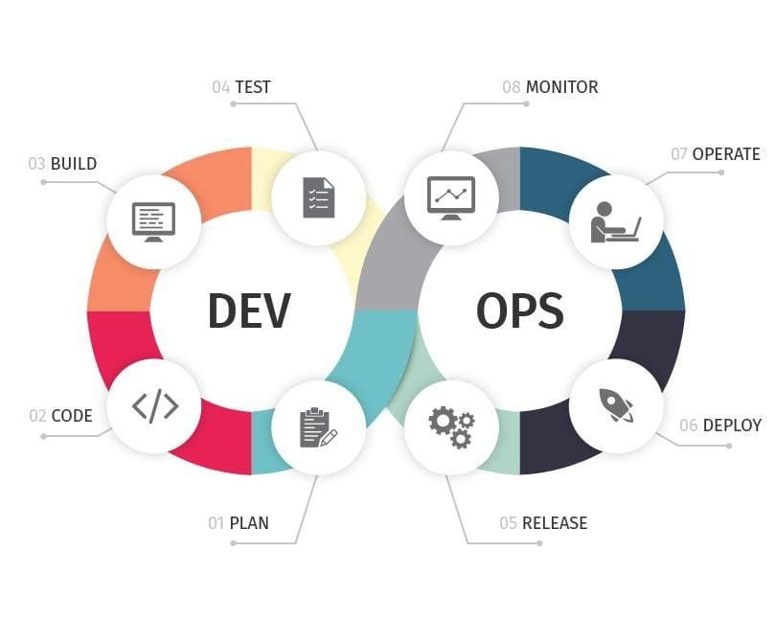
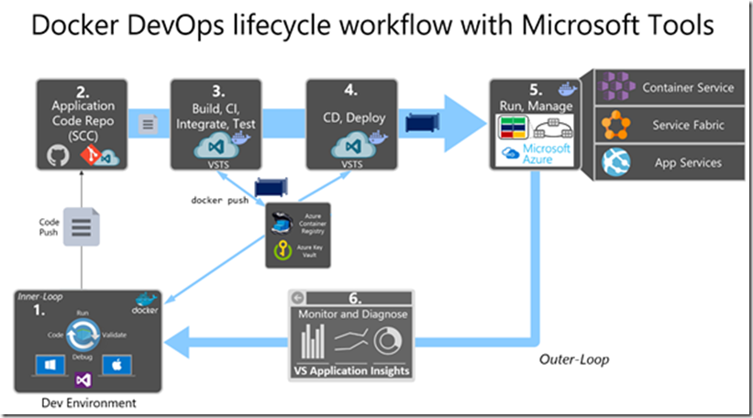
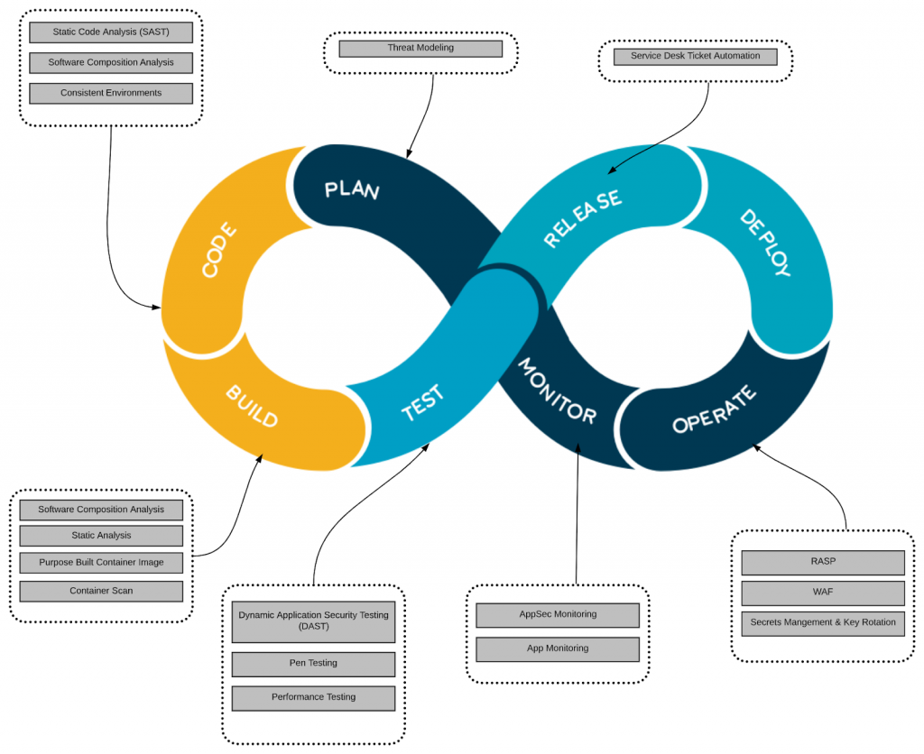
https://dev.to/ashokisaac/devops-in-3-sentences-17c4

Slide 6
https://dev.to/ashokisaac/devops-in-3-sentences-17c4
https://www.firstpointgroup.com/devops-to-devsecops/

Slide 7
2. Use cases
Use Cases
[a] Set/create Secret (secretId - appId):
Before CI/CD the Config and Secrets should be defined and ACL (what, who), Policies (how, when), etc.
Generally this task is automated.
[b] Application retrieves Secret:
Authenticate/Authorize application (Microservice allocated in Container, multiple containers in Pod or one Monolith Application.
Retrieve secret.
Deploy secret.
Validate secret.
Load/inject secret.
[c] Validate secret:
In any moment that the secret is used, its integrity and validity should be checked.
[d] Renew secret:
Secrets should be rotated (renewed) frequently and automatically without any system disruption.
[e] Revoke secret:
In case of security compromise, breaking glass implementation, or as good practice, the secrets should be short-lived and/or should be revoked before providing new one or before decommissioning the application that uses it.
Secrets Management System
1
4
Secrets
Management
Server
Secrets Management Agent
API
Secrets
3
Sidecar
Secrets Management’s API Layer
6
Access
Control
2
AuthN
Config
Library
AuthZ
Single Source of Truth
Service Registry
5
Identities
Secrets Management’s Management Plane

Slide 8
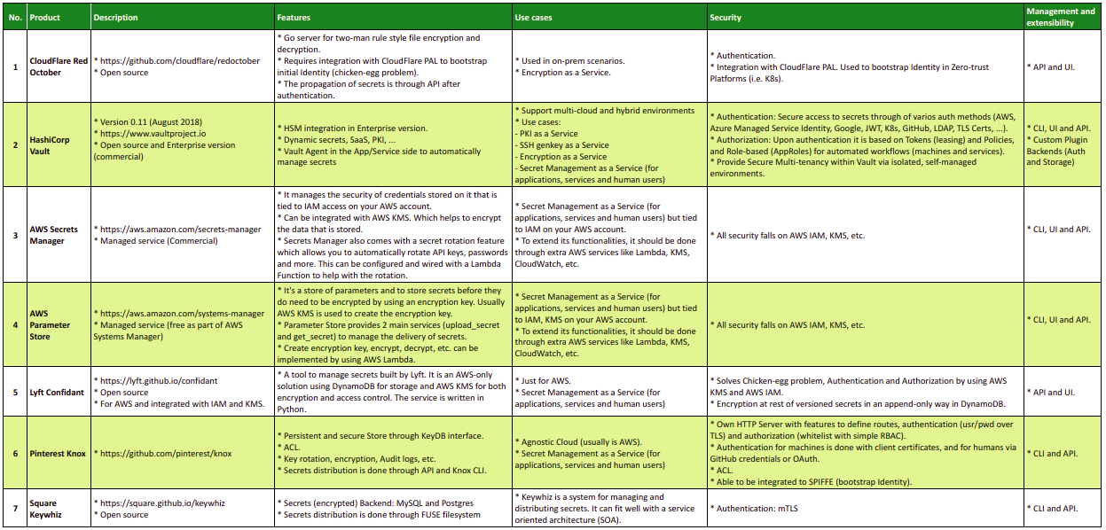
3. Products review

