Slide 1
Chilcano’s clipart
V5

Slide 2



Service Mesh Ref Arch
Organization
Cluster
Data Plane
Edge Load
Balancer
Application
Load Balancer
Service₁
Service₃
Pod₁
Service₂
Pod₃
Pod₁
Pod₂
Pod₁
Pod₂
Pod₂
Pod₂
Sidecar
Pod₂
Sidecar
µS₁
Sidecar
µS₃
µS₂
IAM (IdM,
Authn, Authz)
Control Plane
Observability
(Monitoring & Metrics)
PKI
HSM &
Crypto Services
Secrets
Management
Runtime
Security
Message Oriented Middleware
MySQL

Slide 3
Service Mesh Ref Arch
Organization
Cluster
Data Plane
Users
Edge Load
Balancer
Application
Load Balancers
(Proxy, Gateway,
Ingress)
Service₁
Service₃
Service₃
Pod₁
Service₂
Pod₃
Pod₁
Pod₂
Pod₁
Pod₂
Pod₂
Pod₂
Sidecar
Pod₂
Sidecar
µS₁
Sidecar
µS₃
µS₂
IAM (IdM,
Authn, Authz)
SysOps
Control Plane
Observability
(Monitoring & Metrics)
PKI
HSM &
Crypto Services
Secrets
Management
Runtime
Security
Message Oriented Middleware
MySQL

Slide 4
Service Mesh Ref Arch
Organization
Cluster
Data Plane
Users
Edge Load
Balancer
Application
Load Balancer
(Proxy, Ingress,
Gateway)
Service₁
Service₃
Service₃
Pod₁
Service₂
Pod₃
Pod₁
Pod₂
Pod₁
Pod₂
Pod₂
Pod₂
Sidecar
Pod₂
Sidecar
µS₁
Sidecar
µS₃
Kubernetes
Control Plane
µS₂
SysOps
Control Planes
IAM (IdM,
Authn, Authz)
Observability
(Monitoring & Metrics)
PKI
HSM &
Crypto Services
Secrets
Mngmt
Runtime
Security

Slide 5



Kubernetised Weapp – TLS everywhere
Organization
Cluster
Data Plane
Users
x.509
TLS
TLS
TLS
Edge Load
Balancer
Application
Load Balancer
(Proxy, Ingress,
Gateway)
Service₁
Service₃
Pod₁
Service₂
Pod₃
Pod1
Pod2
Pod1
Pod₂
Pod2
Pod2
x.509
Sidecar
Pod2
Sidecar
µS₁
Sidecar
µS₃
Kubernetes
Control Plane
µS₂
Segmentation
SysOps
Control Planes
IAM (IdM,
Authn, Authz)
Observability
(Monitoring & Metrics)
PKI
HSM &
Crypto Services
Secrets
Mngmt
Runtime
Security
TLS
x.509
x.509
Crypto
Functions
Crypto
Keys
M I N I M U M V I A B L E S E C U R I T Y – T L S E V E R Y W H E R E

Slide 6
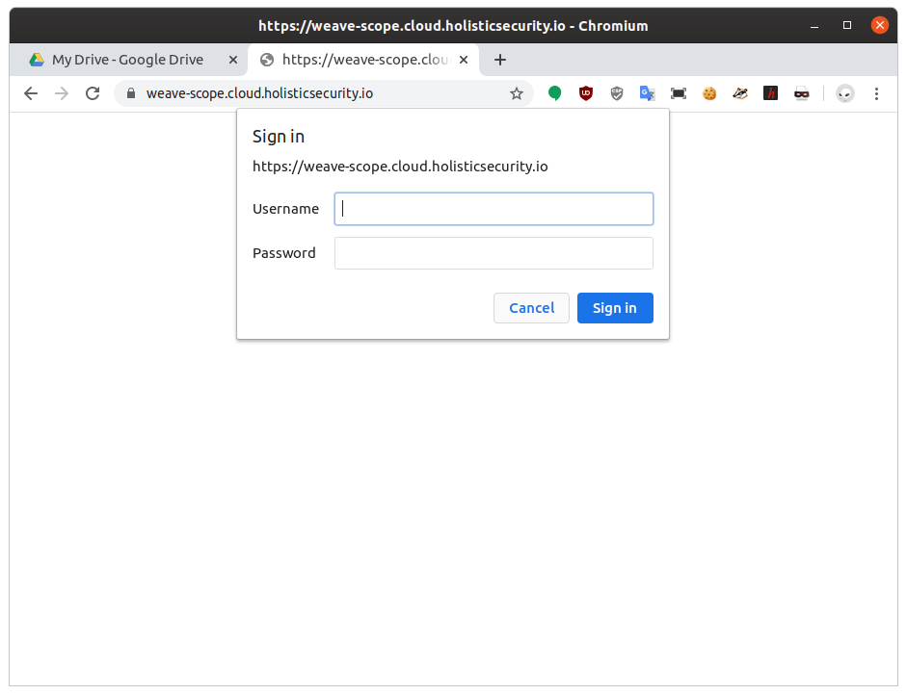

Kubernetised Weapp – TLS everywhere
M I N I M U M V I A B L E S E C U R I T Y – T L S E V E R Y W H E R E

Slide 7
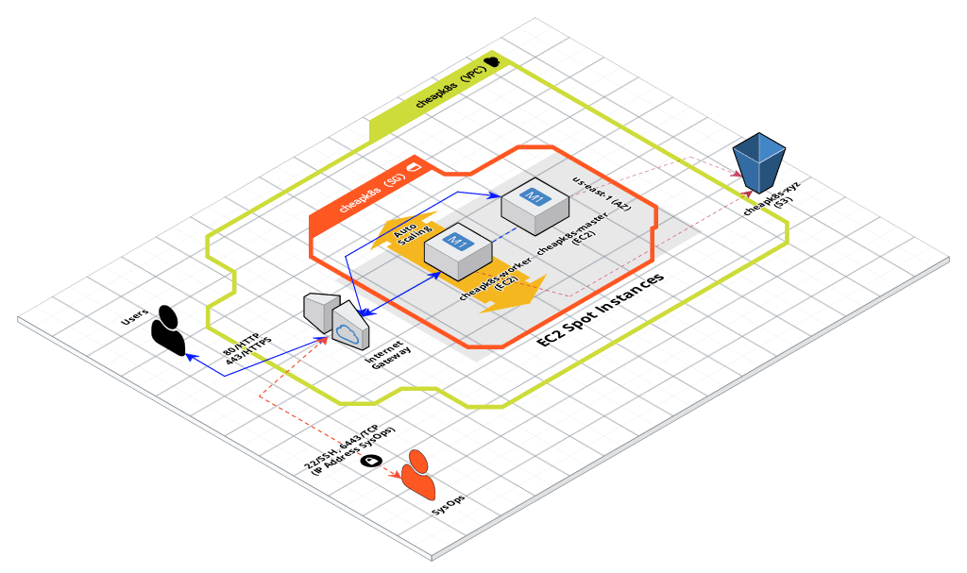
Service Mesh Ref Arch

Slide 8



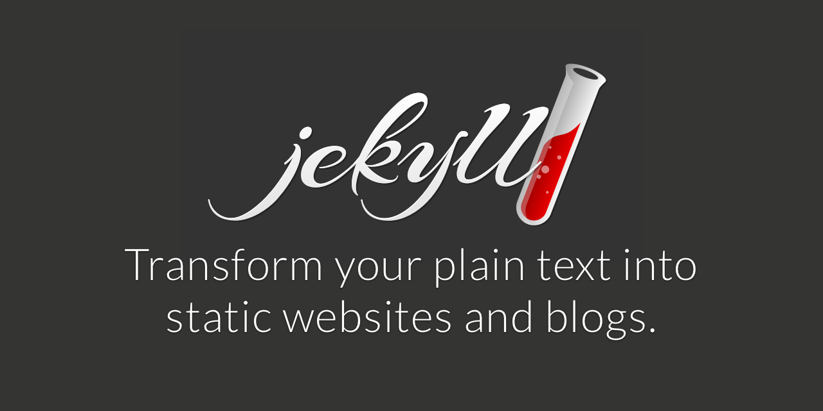


Slide 9
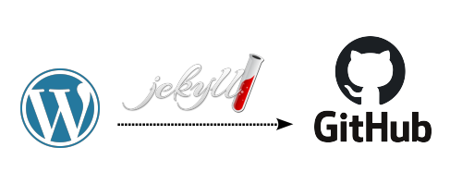

Jekyll Look&Feel
Markdown Posts
XML
HTML
Python
Markdown

Slide 10
xxx
Secure Software Development Life Cycle (SSDLC)
Dev
Ops
01. PLAN
02. CODE
03. BUILD
04. TEST
05. RELEASE
06. DEPLOY
07. OPERATE
08. MONITOR
DevSecOps
Threat Modeling
SAST
SCA
DAST
SCA
IAST (SAST+DAST)
Configuration Drift
RASP
PKI
RASP
PKI
Security Monitoring
Misuse Cases
Configuration Drift
Configuration Drift
Performance Testing
Consistency in Environments
Secrets Management
Secrets Management
Application Monitoring
Abuse Cases
Consistency in Environments
Infrastructure (Cloud) Testing
SCA
WAF
*-IDS
WAF
*-IDS
Performance Testing
Compliance Testing
Resilience and Chaos Testing
Version 1

Slide 11
Secure Software Development Life Cycle (SSDLC)
Dev
Ops
01. PLAN
02. CODE
03. BUILD
04. TEST
05. RELEASE
06. DEPLOY
07. OPERATE
08. MONITOR
DevSecOps
Threat Modeling
SAST
SCA
DAST
SCA
IAST (SAST+DAST)
Configuration Drift
RASP
PKI
RASP
PKI
Security Monitoring
Misuse Cases
Configuration Drift
Configuration Drift
Performance Testing
Consistency in Environments
Secrets Management
Secrets Management
Application Monitoring
Abuse Cases
Consistency in Environments
Infrastructure (Cloud) Testing
SCA
WAF
*-IDS
WAF
*-IDS
Performance Testing
Compliance Testing
Resilience and Chaos Testing
Version 1
Dev (Data Science)
Ops
01.
PLAN
02. DATA MANAGEMENT
03. MODELING
04. EXECUTION
05.
TUNING
06.
DEPLOY
07.
OPERATE
08.
MONITOR
MLOps
Gather requirements
Data Acquisition, Wrangling, Exploration & Cleaning
Model Requirements
CI
Inference
ChatOps
NLP
Algorithmic IT Operations
Hypothesis
Model Training & Validation
Training at Scale
Anomaly Detection
ML-based Incident Management
Initial Modeling
ETL & Data Lake

