Slide 1
Clipart - Blog

Slide 3


http://blcr00:81/intixportal
https://blcr00:444/intixportal
Apache 2.2.11
http://blcr00/intixportal
WinXP
mod_jk/1.2.31 (1026297)
Apache/2.2.11 (Win32)
DAV/2
mod_ssl/2.2.11
OpenSSL/0.9.8i
PHP/5.2.9
mod_jk/1.2.31
Liferay Portal (6.0.5 CE)
http://lfr01:8080/intixportal
WinXP
Liferay Portal (6.0.5 CE)
http://lfr02:8080/intixportal
WinXP
AJP Port: 9090
HTTP Port: 8080
SSL Port: 8443
mod_jk:
mod_proxy:

Slide 4
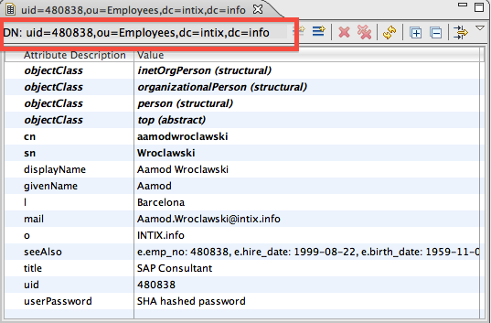
User: aamodwroclawski
Password: test
Liferay Portal (6.0.5 CE)
http://lfr01:8080/intixportal
WinXP
SSO
Alfresco ECM (3.4c CE)
http://alfr01:8080/alfresco
WinXP
CAS Server (3.3.5)
CentOS
https://directorysrv1:8080/cas-server-3.3.5
Virtual Directory Server (2.0)
CentOS
ldap://directorysvr1:10389

Slide 5
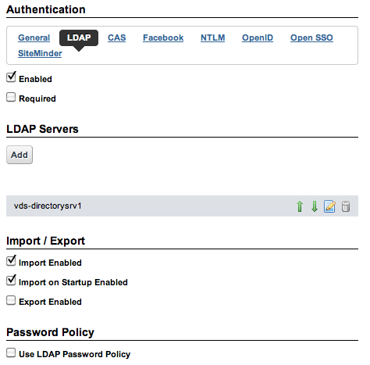
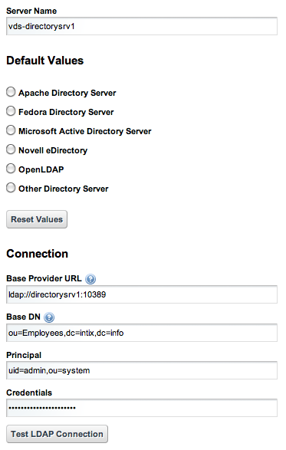
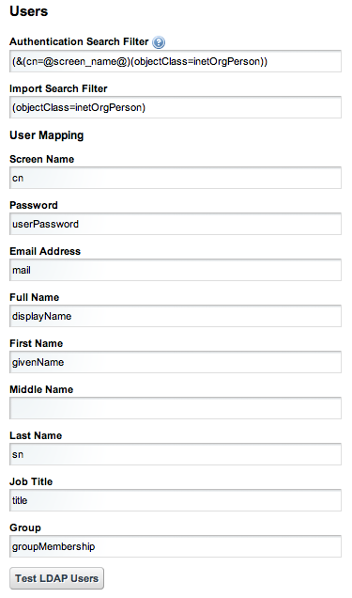
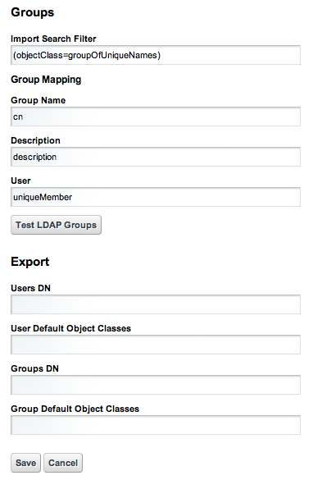
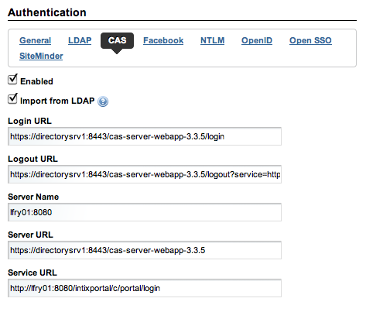

Slide 6

kns-lfry0
SSH server port 22
kns
SSH server port 2121
kns-db1
MySQL server port 3306
Puertos locales
SSH server port 2122
MySQL server port: 2123
LDAP server port: 2124
kns-ldap0
LDAP server port 389

Slide 7
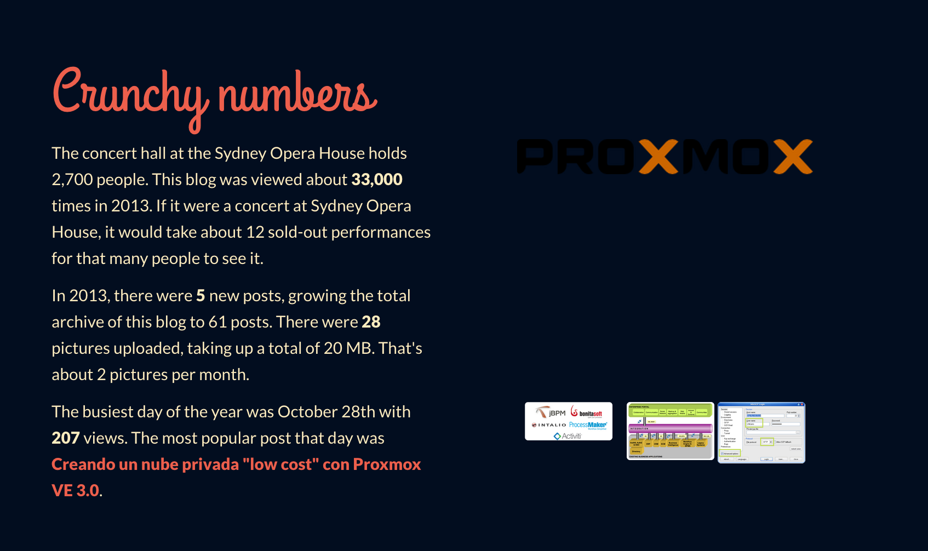


Slide 8


Slide 9
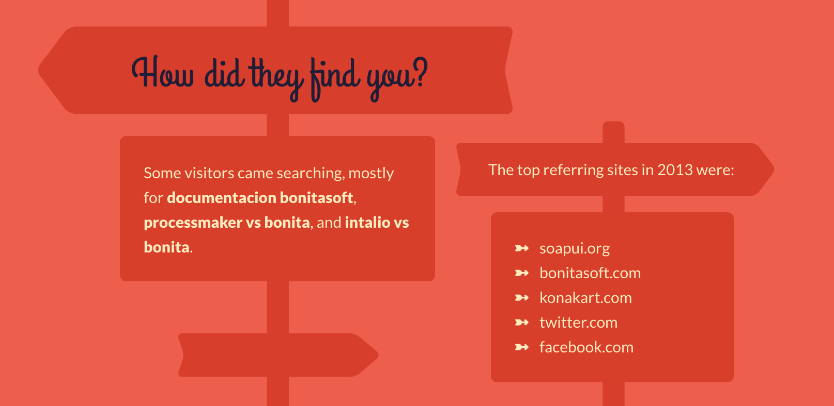

Slide 10
