Slide 1
Chilcano’s clipart
V5

Slide 2



Service Mesh Ref Arch
Organization
Cluster
Data Plane
Edge Load
Balancer
Application
Load Balancer
Service₁
Service₃
Pod₁
Service₂
Pod₃
Pod₁
Pod₂
Pod₁
Pod₂
Pod₂
Pod₂
Sidecar
Pod₂
Sidecar
µS₁
Sidecar
µS₃
µS₂
IAM (IdM,
Authn, Authz)
Control Plane
Observability
(Monitoring & Metrics)
PKI
HSM &
Crypto Services
Secrets
Management
Runtime
Security
Message Oriented Middleware
MySQL

Slide 3
Service Mesh Ref Arch
Organization
Cluster
Data Plane
Users
Edge Load
Balancer
Application
Load Balancers
(Proxy, Gateway,
Ingress)
Service₁
Service₃
Service₃
Pod₁
Service₂
Pod₃
Pod₁
Pod₂
Pod₁
Pod₂
Pod₂
Pod₂
Sidecar
Pod₂
Sidecar
µS₁
Sidecar
µS₃
µS₂
IAM (IdM,
Authn, Authz)
SysOps
Control Plane
Observability
(Monitoring & Metrics)
PKI
HSM &
Crypto Services
Secrets
Management
Runtime
Security
Message Oriented Middleware
MySQL

Slide 4
Service Mesh Ref Arch
Organization
Cluster
Data Plane
Users
Edge Load
Balancer
Application
Load Balancer
(Proxy, Ingress,
Gateway)
Service₁
Service₃
Service₃
Pod₁
Service₂
Pod₃
Pod₁
Pod₂
Pod₁
Pod₂
Pod₂
Pod₂
Sidecar
Pod₂
Sidecar
µS₁
Sidecar
µS₃
Kubernetes
Control Plane
µS₂
SysOps
Control Planes
IAM (IdM,
Authn, Authz)
Observability
(Monitoring & Metrics)
PKI
HSM &
Crypto Services
Secrets
Mngmt
Runtime
Security

Slide 5



Kubernetised Weapp – TLS everywhere
Organization
Cluster
Data Plane
Users
x.509
TLS
TLS
TLS
Edge Load
Balancer
Application
Load Balancer
(Proxy, Ingress,
Gateway)
Service₁
Service₃
Pod₁
Service₂
Pod₃
Pod1
Pod2
Pod1
Pod₂
Pod2
Pod2
x.509
Sidecar
Pod2
Sidecar
µS₁
Sidecar
µS₃
Kubernetes
Control Plane
µS₂
Segmentation
SysOps
Control Planes
IAM (IdM,
Authn, Authz)
Observability
(Monitoring & Metrics)
PKI
HSM &
Crypto Services
Secrets
Mngmt
Runtime
Security
TLS
x.509
x.509
Crypto
Functions
Crypto
Keys
M I N I M U M V I A B L E S E C U R I T Y – T L S E V E R Y W H E R E

Slide 6
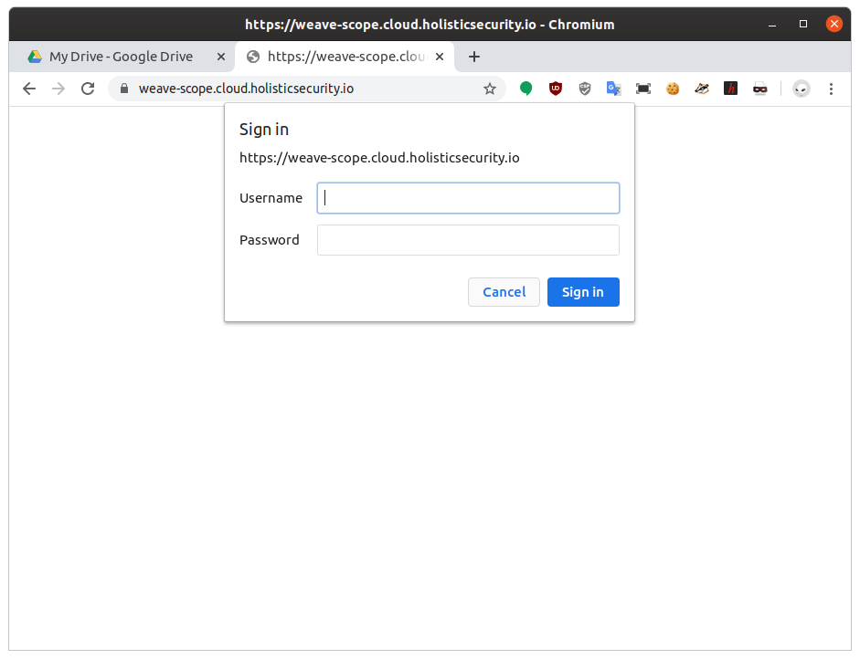

Kubernetised Weapp – TLS everywhere
M I N I M U M V I A B L E S E C U R I T Y – T L S E V E R Y W H E R E

Slide 7
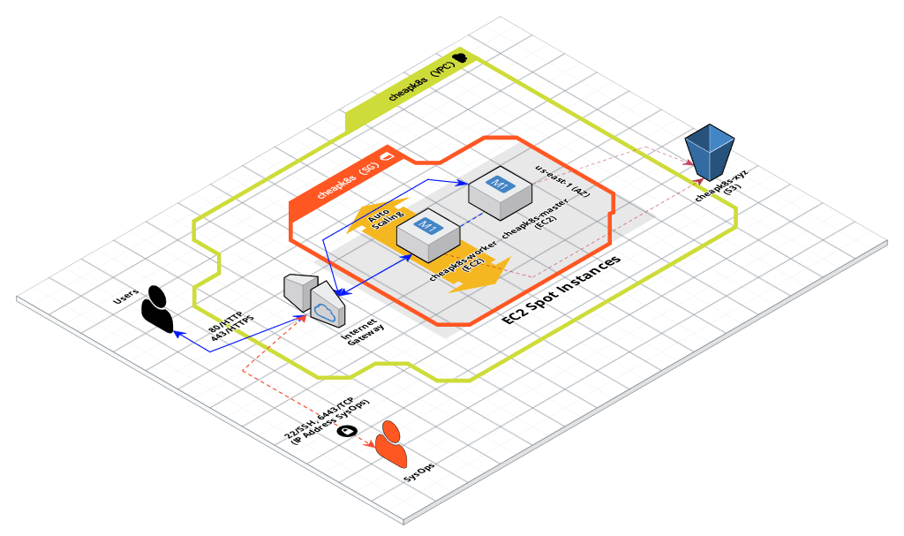
Service Mesh Ref Arch

Slide 8










Slide 9




Jekyll Look&Feel
Markdown Posts
XML
HTML
Python
Markdown
LocalStack
JEST

Slide 10
xxx
Secure Software Development Life Cycle (SSDLC)
Dev
Ops
01. PLAN
02. CODE
03. BUILD
04. TEST
05. RELEASE
06. DEPLOY
07. OPERATE
08. MONITOR
DevSecOps
Threat Modeling
SAST
SCA
DAST
SCA
IAST (SAST+DAST)
Configuration Drift
RASP
PKI
RASP
PKI
Security Monitoring
Misuse Cases
Configuration Drift
Configuration Drift
Performance Testing
Consistency in Environments
Secrets Management
Secrets Management
Application Monitoring
Abuse Cases
Consistency in Environments
Infrastructure (Cloud) Testing
SCA
WAF
*-IDS
WAF
*-IDS
Performance Testing
Compliance Testing
Resilience and Chaos Testing
Version 1

Slide 11


Affordable Remote DevOps Desktop
AWS
VPC
DevOps
Engineer
Security Group
SSH
SSH
Remote DevOps
Desktop
EC2 Spot
Thin Local
Desktop
Able
to open
more ports

Slide 12

Affordable Remote DevOps Desktop
AWS
VPC
DevOps
Engineer
Security Group
SSH
SSH
Remote DevOps
Desktop
EC2 Spot
Thin Local
Desktop
Able
to open
more ports

Slide 13




Cloud IDE for the masses
User
AWS
VPC
Security Group
HTTP
HTTP
EC2 Instance
Code-Server
SSH
SSH
Cloud IDE
(Web App)
SysAdmin/DevOps
Model & Provision Cloud App

Slide 14
Secure Software Development Life Cycle (SSDLC)
Dev
Ops
01. PLAN
02. CODE
03. BUILD
04. TEST
05. RELEASE
06. DEPLOY
07. OPERATE
08. MONITOR
DevSecOps
Threat Modeling
SAST
SCA
DAST
SCA
IAST (SAST+DAST)
Configuration Drift
RASP
PKI
RASP
PKI
Security Monitoring
Misuse Cases
Configuration Drift
Configuration Drift
Performance Testing
Consistency in Environments
Secrets Management
Secrets Management
Application Monitoring
Abuse Cases
Consistency in Environments
Infrastructure (Cloud) Testing
SCA
WAF
*-IDS
WAF
*-IDS
Performance Testing
Compliance Testing
Resilience and Chaos Testing
Version 1
Dev (Data Science)
Ops
01.
PLAN
02. DATA MANAGEMENT
03. MODELING
04. EXECUTION
05.
TUNING
06.
DEPLOY
07.
OPERATE
08.
MONITOR
MLOps
Gather requirements
Data Acquisition, Wrangling, Exploration & Cleaning
Model Requirements
CI
Inference
ChatOps
NLP
Algorithmic IT Operations
Hypothesis
Model Training & Validation
Training at Scale
Anomaly Detection
ML-based Incident Management
Initial Modeling
ETL & Data Lake

Slide 15





Sidecar
SIDECAR
SIDECAR
SIDECAR
LOAD BALANCER
API GATEWAY
REVERSE PROXY
µS
µS
µS
µS
µS
WEB APP
APP
APP
APP
SIDECAR
SIDECAR
SIDECAR
µS
µS
µS
µS
µS
µS
Proxy Pattern, a single pattern with multiple implementations

Slide 16
Sidecar
1) Defense in depth:
Distributed firewall, Security Layer in the last mile.
2) Fail safe:
Also as Adapter Pattern provides standard interface that define common and proved features: healthcheck, readiness, liveness, config, TLS termination, circuit breaker, etc.
3) Least privilege:
Able to bootstrap credentials to establish a trusted data plane. Denied communications with µS without sidecar.
4) Separation of duties:
Able to create segments based previous bootstrapped credentials and business domains.
SIDECAR
µS
SIDECAR
µS
5) Economy of mechanism:
Sidecar’s purpose is to reduce complexity of main application. Sidecar offload that complexity from main application.
6) Complete mediation:
Sidecar is the single entry point to main application. All incoming communication to main application are checked.
SIDECAR
µS
SIDECAR
µS
7) Open design:
All sidecars are managed through its standard and public API.
8) Last common mechanism:
Sidecars can load a type of configuration according the role of main application.
SIDECAR
µS
SIDECAR
µS
9) Psychological acceptability:
A standard and mature RESTful API helps to its smooth adoption.
10) Weakest link:
Fault injection to simulate service disruption and make it reliable and resilient.
11) Leveraging existing components:
Also as Ambassador Pattern, It provides a standard and homogeneous proxy to get a knew application interface, in this way avoid increase the attack surface of multiple different applications.

Slide 17
CDK Simple PHP App
AWS
Docker Hub
VPC
amazon/amazon-ecs-sample
SG
HTTP
HTTP
ALB
HTTP
ECS Cluster
Simple PHP App
Docker

Slide 18
CDK Simple PHP App
AWS
Docker Hub
VPC
python:3.7-alpine
SG
HTTP
HTTP
ALB
HTTP
ECS Cluster
Dockerfile
Flask (frontend)
AWS ECR
Redis (backend)
redis:alpine
AWS
CloudMap

Slide 19
Cloud IDE in EC2, AMI, userData
AWS
AMI
VPC
Ubuntu
SG
HTTP
HTTP
EC2 Instance
Linux Packages
Users
SSH
SSH
Code-Server
(NodeJS App)
DEB
CloudFormation
UserData script
SysAdmin

