Slide 1

Healthy Sleep Tips
1.Stick to a sleep schedule
2.Practice a relaxing bedtime ritual
3.If you have trouble sleeping, avoid naps, especially in the afternoon.
4.Exercise daily
5.Evaluate your room
6.Sleep on a comfortable mattress and pillows
7.Use bright light to help manage your circadian rhythms

Slide 2
8.Avoid alcohol, cigarettes, and heavy meals in the evening
9.Wind down
10.If you can't sleep, go into another room and do something relaxing until you feel tired
11.If you’re still having trouble sleeping
Adjust the Lighting
Exposure to bright, artificial light before bedtime can disrupt the production of melatonin, the hormone that helps shift your body into sleep mode. Install an affordable dimmer for your ceiling light. Then, about an hour before bed, soften the glow for a better night’s sleep.

Slide 3
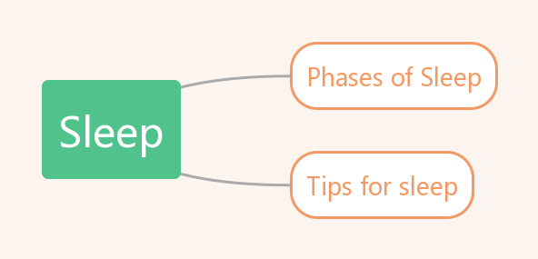

Slide 4
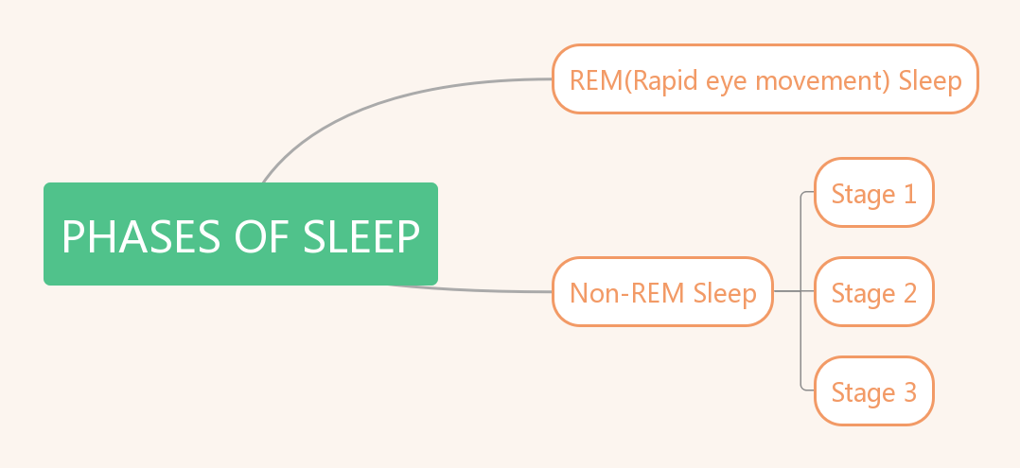

Slide 5
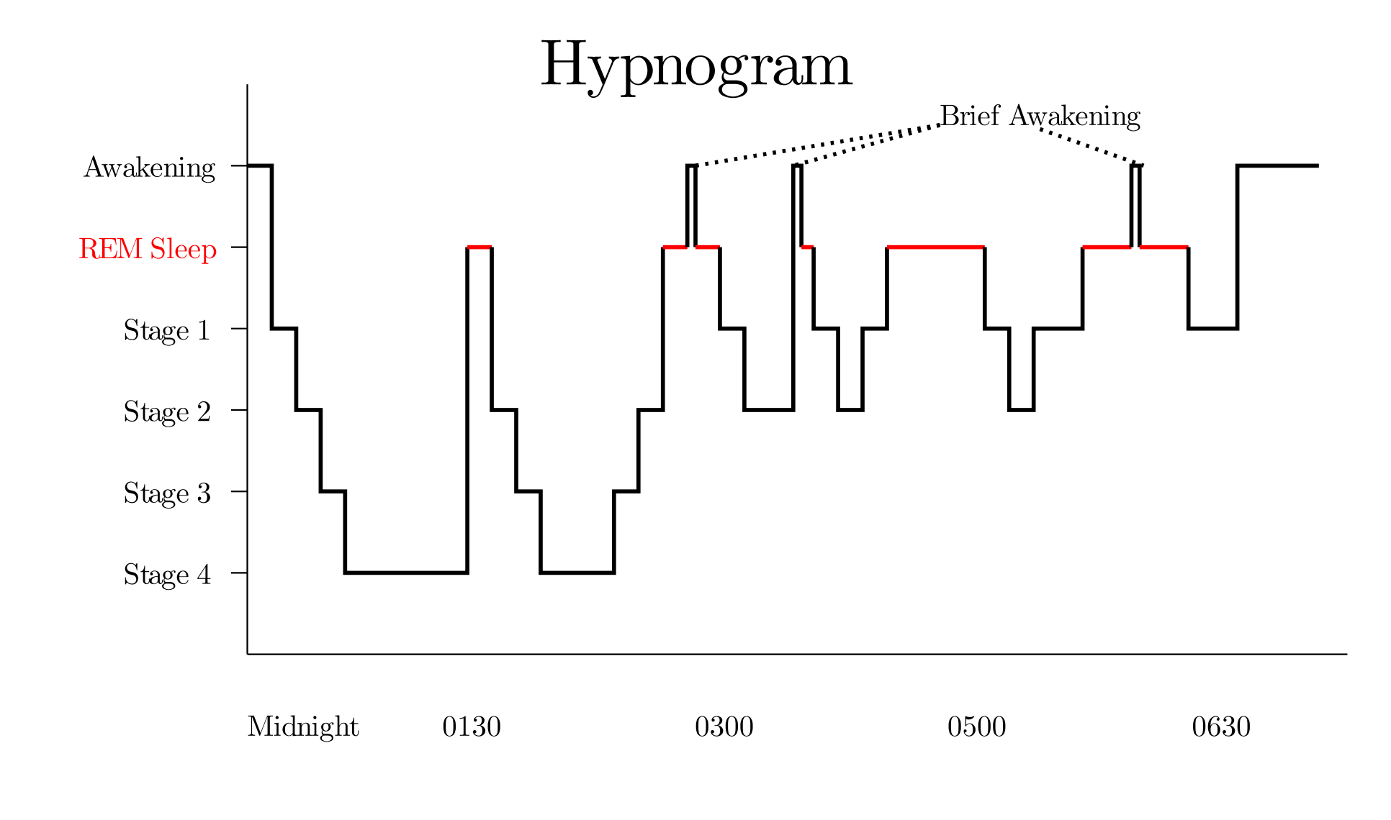
｛
Non-REM Sleep
I:REM Sleep
II:Non-REM Sleep:
Stage 1

Slide 6
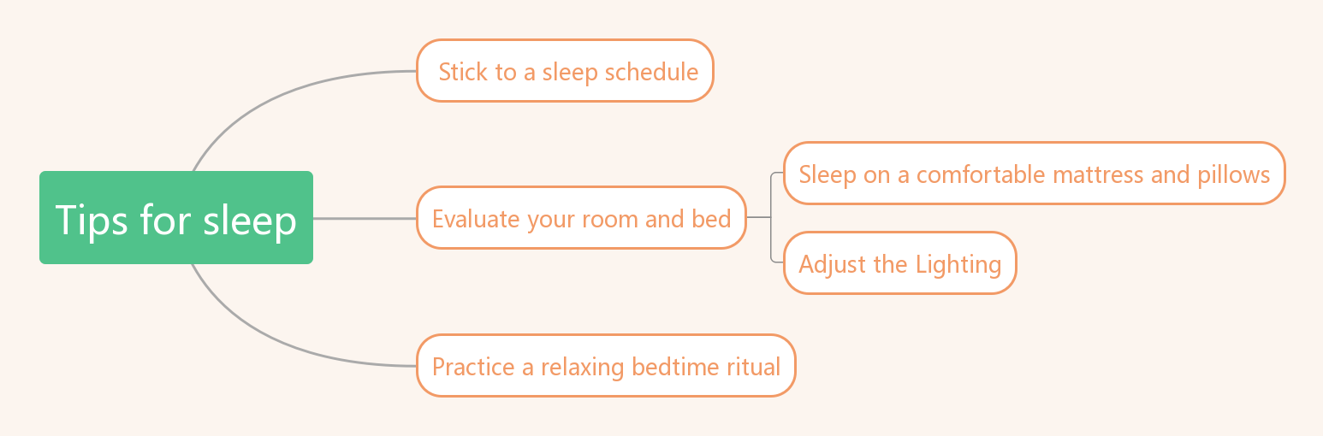

Slide 7
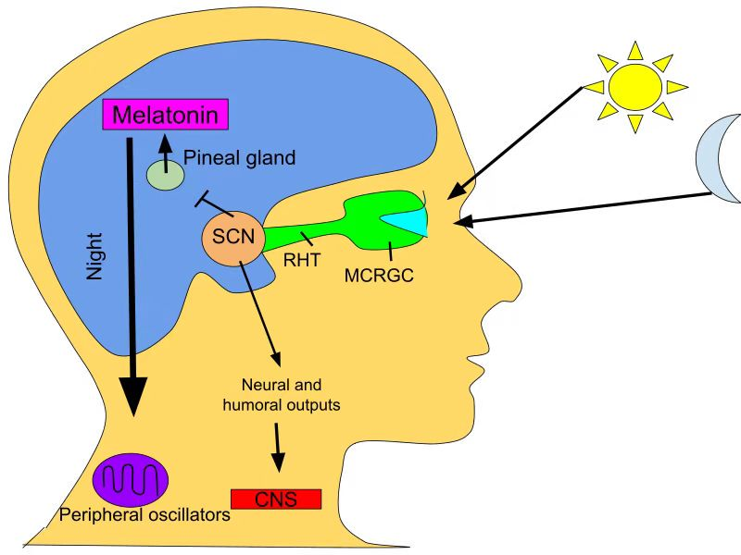
Melatonin

Slide 8
