Slide 1
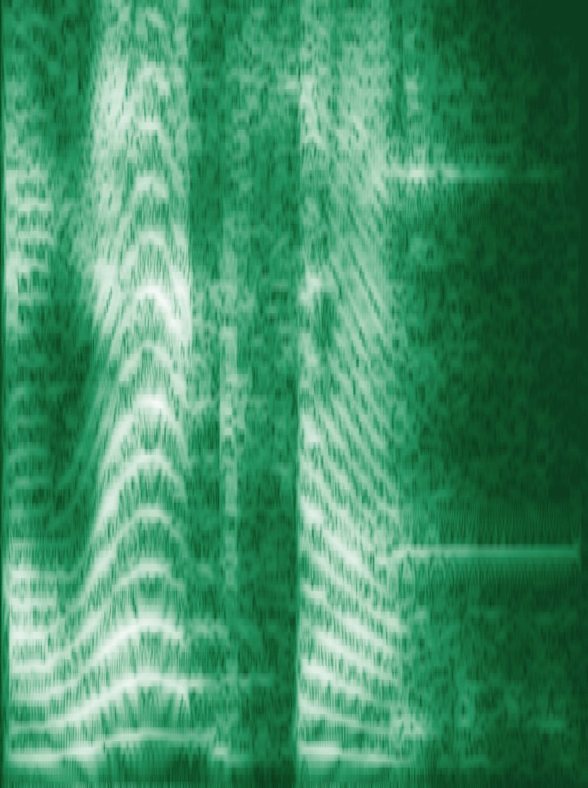

GUEST WORKSHOP · UNIVERSITY OF MELBOURNE
Speech Analytics
Bootcamp
A hands-on introduction to voice analytics for behavioural research
Prof. Christian Hildebrand
University of St.Gallen (HSG) · Visiting Professor, CUHK
Wednesday, 11 November 2026 · 13:00–15:30
Spectrogram of a frustrated “AAAlexaa” (workshop data)
Notes:
Welcome. 2.5 hours: ~55 min concepts, ~50 min hands-on, then voice agents, ethics and your own ideas. Everything is on the course website: slides, notebook, audio.

Slide 2
Who is talking to you today
WHO
WHAT
HOW
Role
Research
Approach
• Full Professor of Marketing Analytics & Vice Dean, HSG
• Executive Director, Institute of Behavioral Science & Technology
• Visiting Professor, CUHK
• Consumer behaviour in interactions with AI
• Voice, conversational agents, agentic marketplaces
• New behavioural methods
• Paper → Model → Demo → Repo
• voiceR on CRAN (Busquet & Hildebrand)
• Open code for every workshop
My one-liner: I try to make the unmeasurable measurable, and voice is one of the richest places to do that.
Notes:
Keep this to one minute. The point: I come at voice from consumer behaviour, and I build tools (voiceR) so others can use the methods.

Slide 3
Today’s agenda · Wed, 11 Nov 2026 · 13:00–15:30
13:00
Welcome & why voice (incl. live Alexa demo)
15′
13:15
Theory & measurement: speech, features, validity
40′
13:55
Break · open the notebook and test your audio
10′
14:05
Audacity warm-up: see and hear the differences
10′
14:15
Hands-on lab in R: calm vs. angry (Exercises 1–3)
40′
14:55
From analytics to voice agents · consent, privacy, bias
20′
15:15
Idea sprint (Exercise 4) & wrap-up
15′
Lecture
Demo
Hands-on
Sprint
Break
Notes:
Times are guides. If the lab runs long, compress Part 4 to the agent loop and the ethics slide.

Slide 4
By 15:30 you will be able to …
1
2
3
4
Argue for voice
Map features to constructs
Run a minimal pipeline
Design with voice
Explain why voice is a distinct behavioural data source and where it adds value over text and self-report.
Link pitch, loudness, spectral, voice-quality and timing features to psychological states, and name the main validity threats.
Load audio, plot waveforms and spectrograms, trim, extract features and compare conditions in R.
Sketch how voice enters your own studies as IV, DV or mediator, including via voice agents.

Slide 5
Why voice?
PART 1
Voice as a behavioural data layer: the how, not just the what

Slide 6
What can a voice tell us?
MOMENTARY
STABLE
PERCEIVED
States
Traits
Attributions
• Emotion and arousal
• Stress and cognitive load
• Spontaneous reactions before reflection
• Personality and confidence
• Dominance and competence
• Physicality (e.g., body size)
• Trust and warmth
• Persuasiveness
• Likeability of people and machines
Why now: smart speakers, voice assistants and LLM voice agents make voice data cheap to collect at scale, yet most behavioural researchers lack the tools to use it.
Notes:
Ask the room first: what did you infer about the last person who called you, before they said why?

Slide 7
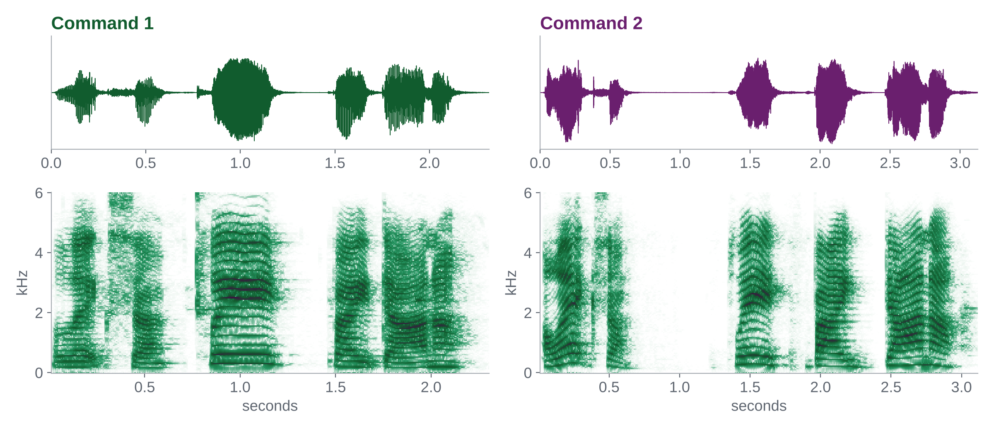
Live demo · same words, different meaning
EXTRACTED FEATURES
Cmd 1
Cmd 2
Duration (s)
2.31
3.13
Vocal breaks
45%
52%
Loudness (sone)
16.2
18.1
Mean F0 (Hz)
222
271
Mean HNR
6.19
5.51
▶ Command 1
▶ Command 2
Source: Hildebrand, Efthymiou, Busquet et al. (2020), Journal of Business Research. Figure: spectrograms of the original workshop files.
Notes:
Play alexa_video.mp4 (data/1_alexa) or the two commands. Ask: what changed between command 1 and 2? Then reveal the features on the right. Duration, pauses, loudness and pitch all move with frustration.

Slide 8
From self-reports to voice analytics
WHAT PEOPLE SAY THEY FEEL
HOW PEOPLE SOUND WHILE THEY FEEL IT
Traditional self-reports
Voice analytics
• Depend on willingness and ability to report
• Retrospective and filtered by reflection
• Ordinal scales (e.g., Likert) with response styles
• Interrupt the experience they measure
• Captures physiological change during the experience
• Continuous, fine-grained measures over time
• Collected without stopping the task
• But: not objective by default; it needs a measurement model
Voice complements, rather than replaces, self-report. Use both and test convergence.

Slide 9
Three ways voice enters a study
INDEPENDENT VARIABLE
DEPENDENT VARIABLE
MEDIATOR / MODERATOR
Voice as IV
Voice as DV
Voice as mechanism
Manipulate a vocal cue and measure an outcome.
E.g., does the vocal-tract length of an AI voice change product congruency and ad performance? (Efthymiou et al. 2024)
Manipulate a condition and measure the voice.
E.g., does a failing voice assistant raise users’ pitch and loudness? (Hildebrand et al. 2020)
Test whether a vocal feature carries an effect.
E.g., does vocal arousal mediate the effect of a service failure on complaint intentions?
Efthymiou, Hildebrand, de Bellis & Hampton (2024), Journal of Interactive Marketing 59(2); Hildebrand et al. (2020), JBR 121; Hildebrand, Cascio Rizzo & Berger (2026), Current Opinion in Psychology.
Notes:
This is the slide to come back to in the idea sprint at the end.

Slide 10
Theory & measurement
PART 2
From air pressure to psychological constructs, and where validity breaks

Slide 11
The speech chain: production → transmission → perception
Brain
Lungs & vocal folds
Vocal tract
Air, room & device
Listener or model
→
→
→
→
Intention, content and the motor plan for speech
The source: airflow and vibration set F0 (pitch)
The filter: tongue, lips and jaw shape formants
Transmission: distance, noise, mic and compression
Perception and inference about the speaker
Implication: a difference in your features can come from the speaker’s state, their anatomy or your recording set-up. Your design has to tell them apart.
Notes:
Every link adds or removes information. The microphone and the room are part of your measurement instrument.

Slide 12
The source–filter model
Source
× Filter
= Speech
→
→
Vocal folds open and close: fundamental frequency (F0), jitter, breathiness
Vocal tract resonances: formants (F1, F2 …), timbre, vowel identity
The radiated signal your microphone records
• Separating source from filter underlies most features we extract (Fant 1960)
• Pitch carries arousal and intonation; formants carry vowel identity and cues to speaker size
• Digital vocal-tract length changes how an AI voice is perceived (Efthymiou et al. 2024)
Notes:
Hum one note and change vowels: the source stays, the filter changes. Then keep the vowel and slide pitch: the filter stays, the source changes.

Slide 13
Four acoustic feature families
TIME
AMPLITUDE
FREQUENCY
SPECTRAL
FEATURES
FEATURES
FEATURES
FEATURES
Duration, pauses, speech rate, % voiced
Intensity, loudness, RMS energy, shimmer
F0 mean, range and SD, jitter, formants
HNR, spectral slope, centroid, entropy
OFTEN SIGNALS
OFTEN SIGNALS
OFTEN SIGNALS
OFTEN SIGNALS
Hesitation, fluency, cognitive load
Arousal, effort, dominance
Arousal, stress, emotion, size
Tension, roughness, harshness
Source: Hildebrand et al. (2020), Voice analytics in business research, Journal of Business Research 121, 364–374.
Notes:
Map families to constructs, not individual features. Most packages give you 100+ features; theory tells you which few should move.

Slide 14
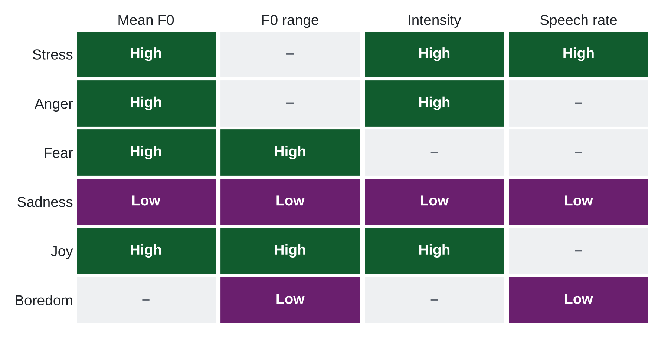
Each emotion has an acoustic signature
READ IT LIKE THIS
• High-arousal states share a profile: high F0, high intensity
• Sadness and boredom sit at the low end
• Valence (anger vs. joy) is the hard problem
Stylized after Scherer et al. (2003) and Hildebrand et al. (2020).
Notes:
Arousal is the easy part: anger, fear, joy and stress all push F0 and intensity up. Telling anger from joy (valence) is much harder from acoustics alone. That is why today’s case contrasts calm vs. angry: a clear arousal contrast.

Slide 15
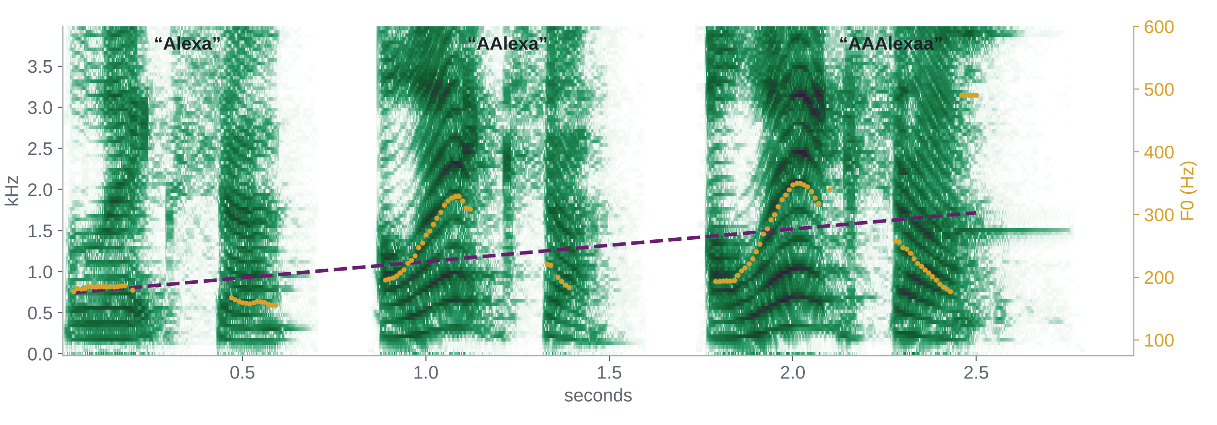
Frustration you can see: three Alexa wake words
Gold: F0 track Dashed: linear F0 trend across repetitions
▶ 1 ▶ 2 ▶ 3
Notes:
Play the three wake words. Ask which visual cue you noticed first. Then point to the rising F0 trend.

Slide 16
Mapping theory to measurement
Signal
Feature
Construct
Model
Inference
→
→
→
→
Pressure wave sampled over time
Numerical summary of the signal
Theoretical variable inferred from features
Statistical or ML link to outcomes
The claim you make, and for whom it holds
RULE OF THUMB
Never jump from a waveform to a psychological claim. Name the construct first, predict which feature families should move and in which direction, then check that they do.
Notes:
The most common reviewer complaint in voice papers: a feature is reported as if it were the construct.

Slide 17
Where construct validity breaks
Device & room
Speaker
Acted vs. spontaneous
Microphone, distance and compression shift amplitude and spectrum.
Sex, age and accent change the baseline; vocal variation is socially structured.
Posed emotion is louder and clearer than the real thing.
Content & context
Many features, few people
Ask of every result
Would it survive a new microphone, new speakers and spontaneous speech?
Words, language and task change the voice: hold them constant or model them.
100+ features and 24 speakers invite overfitting: split by speaker.
Notes:
RAVDESS, our case data, is acted speech. That makes it clean and exaggerated. Keep this in mind when we get near-perfect accuracy later.

Slide 18
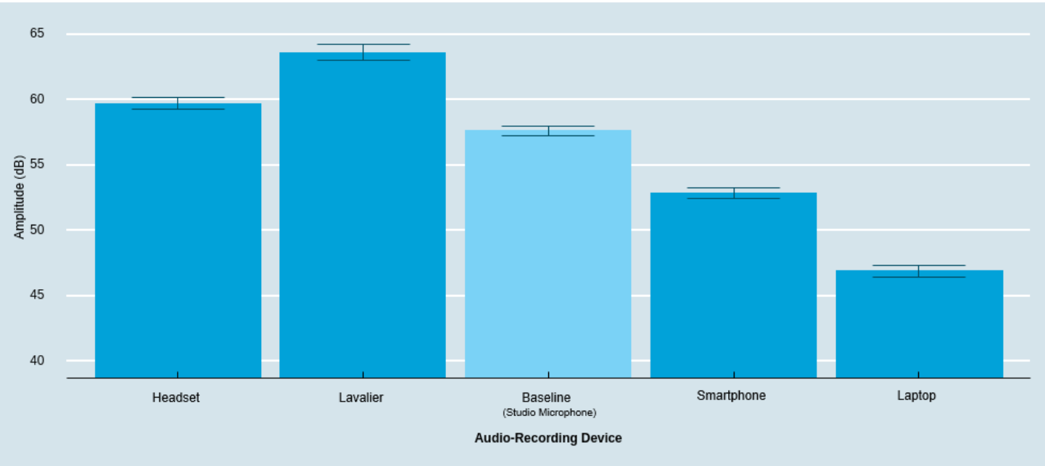
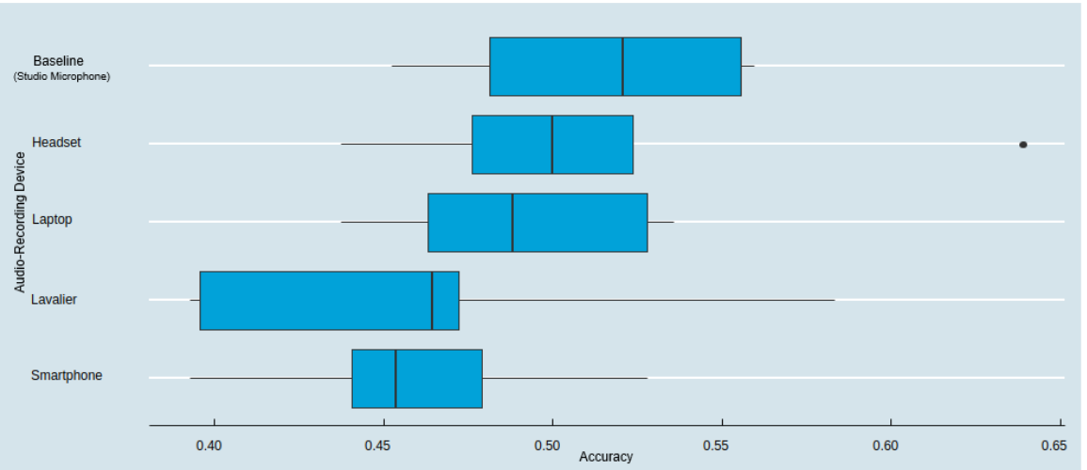
Same voices, different devices, different data
Recorded amplitude (dB) by device
Emotion-prediction accuracy by device
• Standardise device, gain and distance within a study; never mix phones, laptops and headsets freely
• Record uncompressed WAV (≥ 44.1 kHz, mono) and store device as metadata
Busquet, Efthymiou & Hildebrand (2024), Voice analytics in the wild: Validity and predictive accuracy of common audio-recording devices, Behavior Research Methods 56(3). doi.org/10.3758/s13428-023-02139-9
Notes:
Our BRM paper: identical speech recorded on five devices. Amplitude differs by roughly 15 dB across devices, and emotion-classification accuracy varies with the device. Test your equipment before a study.

Slide 19
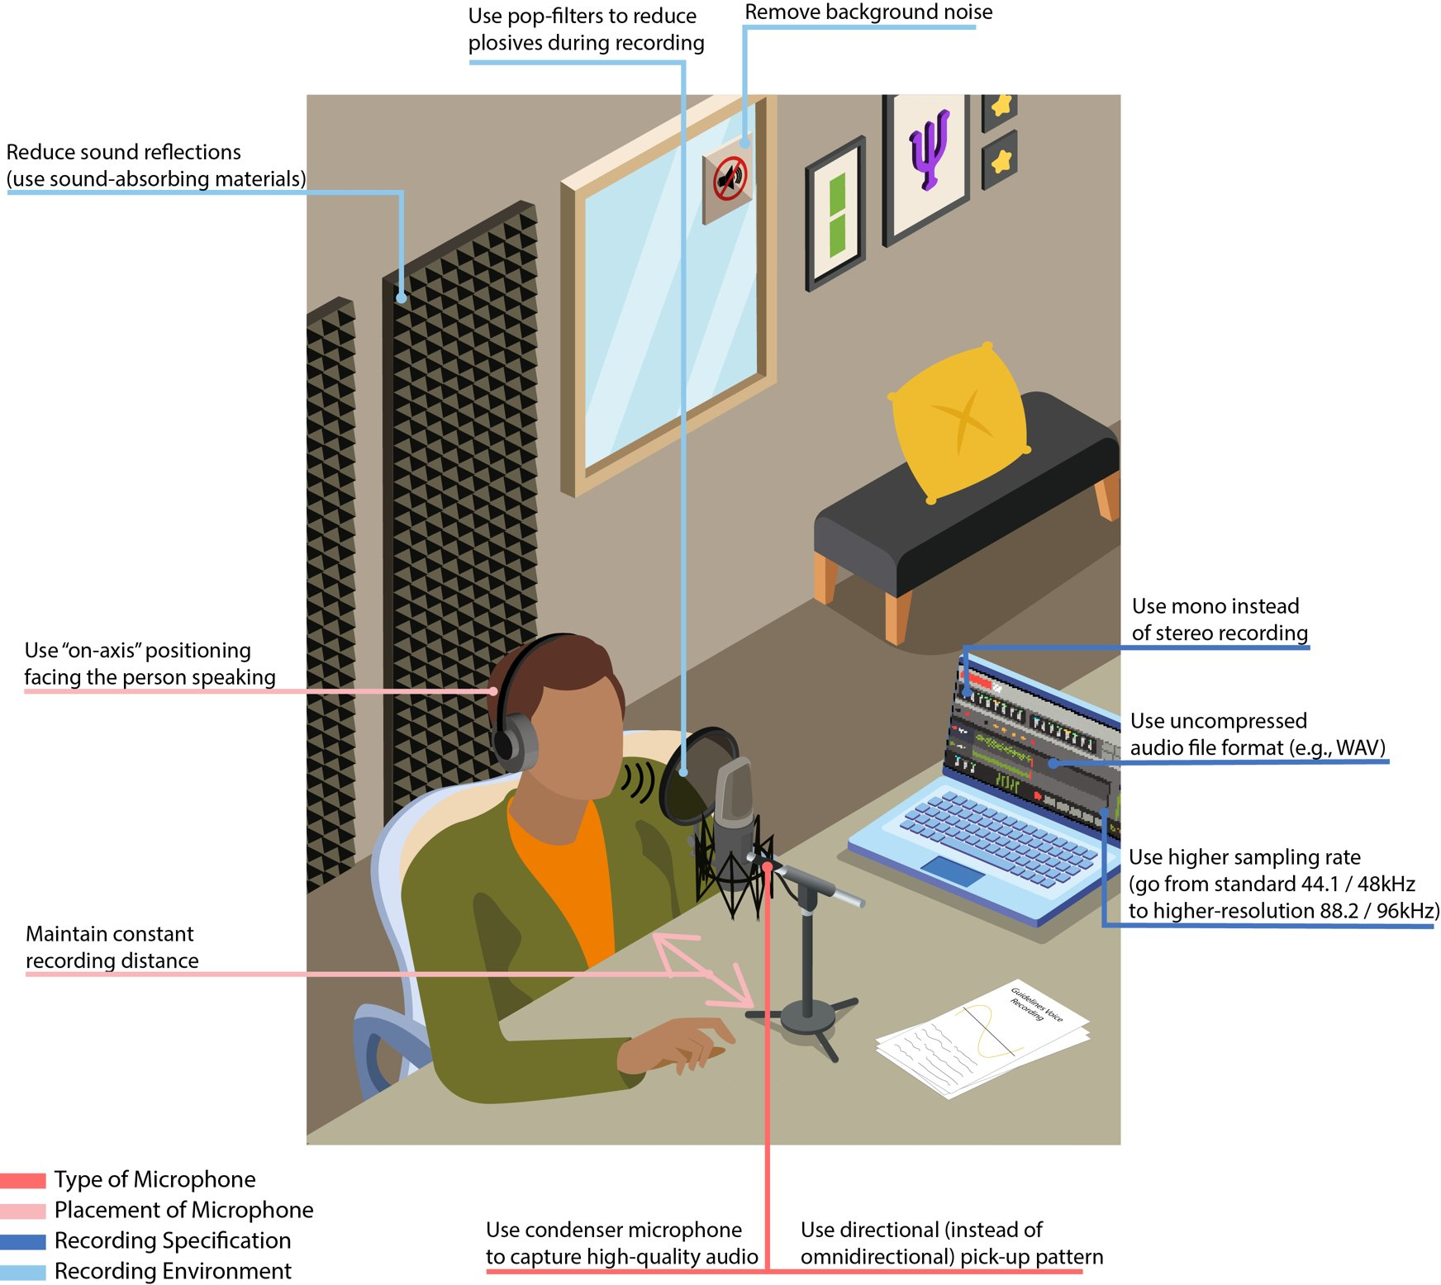
Recording guidelines in one picture
DO
DON’T
• Same device, gain, distance
• Uncompressed WAV, mono
• Quiet room, capture room tone
• Pilot and listen to every file
• Mix devices across conditions
• Analyse lossy MP3
• Let the gain clip
• Denoise aggressively before extraction
Figure: recording guidelines from Busquet, Efthymiou & Hildebrand (2024), Behavior Research Methods. doi.org/10.3758/s13428-023-02139-9

Slide 20
Part 2 takeaway
A voice is a measurement model, not a mood ring.
Features become constructs only through theory, design and validation. Now let’s get our hands on the signal.

Slide 21
Hands-on lab
PART 3
Listen → look → trim → extract → compare → predict
Notes:
Break before this: everyone opens the website, downloads the repo, opens lab/voice_lab.qmd and runs the setup chunk.

Slide 22
Audacity warm-up · see and hear the differences (10′)
1
2
3
4
5
Open & compare
Spectrogram view
Plot a spectrum
Edit, then re-check
Hear the microphone
Drag alexa_cmd1.wav and alexa_cmd2.wav into one project. Compare length, pauses, peaks.
Track menu → Spectrogram. Watch harmonics rise in the frustrated command.
Select one vowel → Analyze → Plot Spectrum. Find F0 and the formants.
Truncate Silence; change pitch by ±2 semitones and listen to what changes.
Load data/2_micTests: same speaker, 7 devices. Which roll off the highs?
Workshop site: childebrand.github.io/Melbourne-Voice-2026 Free download: audacityteam.org · menu names follow Audacity 3.x
Notes:
Demo on the projector; participants can follow in Audacity or just watch. The goal is intuition before code.

Slide 23
Lab roadmap · lab/voice_lab.qmd
0–1 · Setup
2 · Listen & look
3 · Trim
4 · Feature Extraction
5 · Prediction
6 · Bonus
→
→
→
→
→
Packages, audio check, Alexa warm-up (8′)
Oscillogram, spectrogram, bind() (Ex. 1)
timer() onsets, threshold check, extractWave()
voiceR::autoExtract() on 32 clips, compare by emotion (Ex. 2)
Speaker-independent model on 192 clips (Ex. 3)
Microphones on one scale, embeddings, speech-to-text
THE CASE
RAVDESS (Livingstone & Russo 2018): 24 actors say “Kids are talking by the door” calm and angry, at two intensities. Same words, same actors, so the voice is the only thing that changes.
Notes:
Each block in the notebook matches one box. Code is prepared; you run, read, and change the parts marked YOUR TURN.

Slide 24
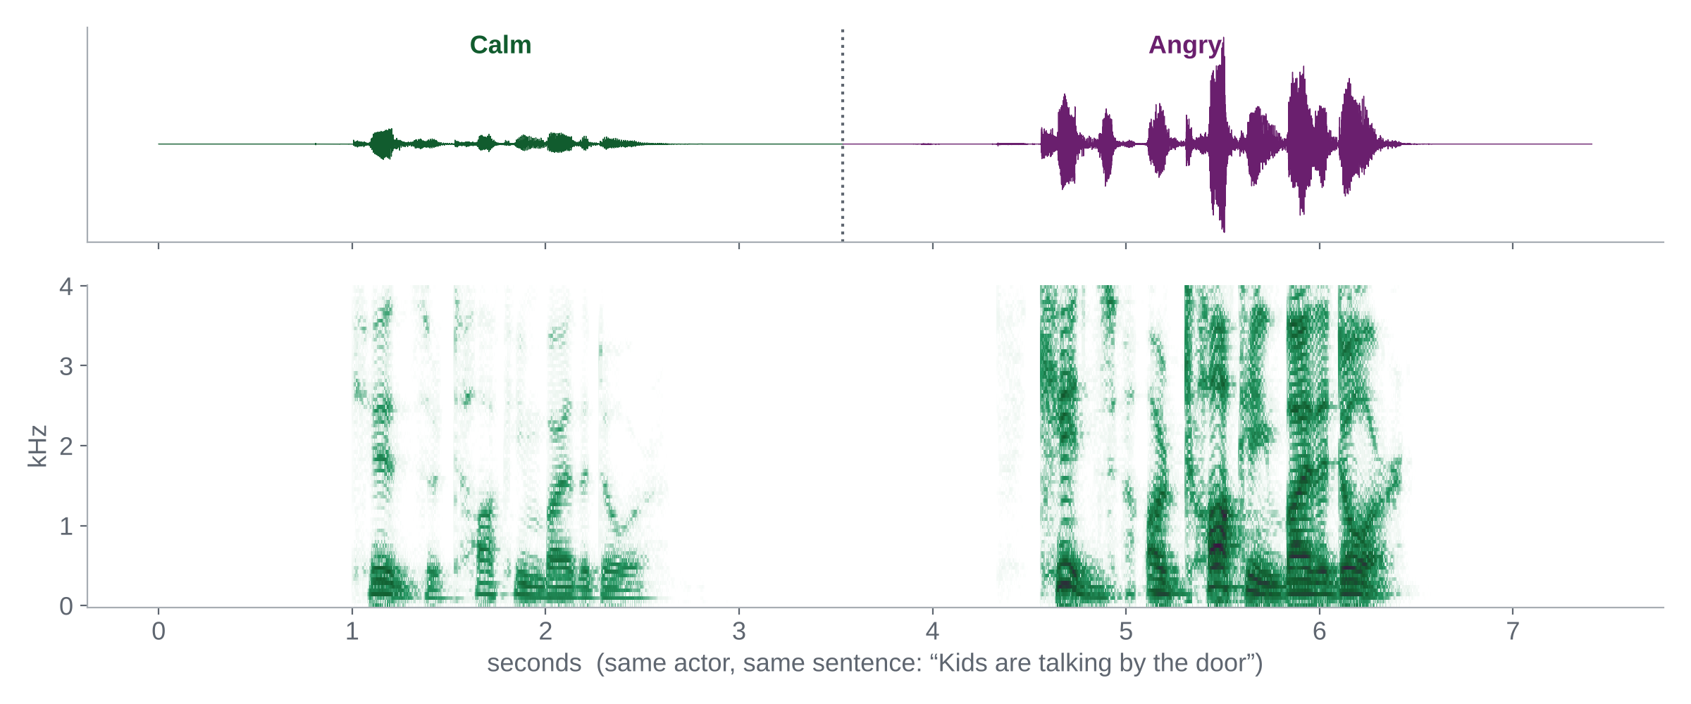
What you will see: calm vs. angry on one shared scale
▶ Calm ▶ Angry actor 01, normal intensity
Notes:
oscillo() and spectro() rescale each clip to its own maximum, so side-by-side plots hide the loudness difference. Binding the two clips puts them on one scale.

Slide 25



Exercise 1 · Listen & look
8 minutes
Pairs
Your task
1. Pick an actor (01–04). Plot calm vs. angry oscillograms and spectrograms side by side.
2. Now bind() the two clips and plot them on one shared scale. What appears that was hidden?
3. Run timer() with threshold 5 and 10. Which onset matches what you hear?
Deliverable
One sentence naming the cue that gives anger away first, and the onset threshold you would use.
Notes:
Walk the room. Typical answer: amplitude and energy in 1–4 kHz; threshold 5 catches a pre-speech artifact.

Slide 26
Exercise 2 · Feature extraction
12 minutes
Individual → pairs
Your task
1. Run voiceR::autoExtract() on the 32 trimmed clips (fileNamePattern given in the notebook).
2. Plot pitch_mean, pitch_sd, loudness_mean and HNR_mean by emotion.
3. Compare with the emotion-signature table: which predictions hold, which surprise you?
Deliverable
Which feature family separates calm from angry best, and one feature that behaved unexpectedly.
Notes:
Extraction on 32 clips takes about 1–2 minutes with parallel = TRUE. If a laptop struggles, load data/ravdess_features.csv instead.

Slide 27
Exercise 3 · Prediction
10 minutes
Pairs
Your task
1. Fit a logistic or lasso model on all 192 clips, holding out whole actors.
2. Report test AUC. Then check female vs. male and normal vs. strong intensity.
3. Name the first thing that would break if you used this model on customer calls.
Deliverable
Your AUC, the weakest subgroup, and one validity threat for field use.
Notes:
Expect near-perfect AUC. The point is the discussion: acted speech, one sentence, studio recordings.

Slide 28
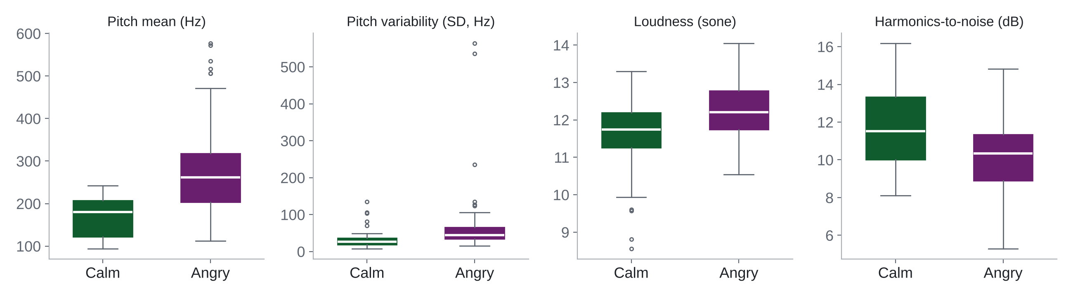
Debrief · what the full 192 clips show
• Anger raises pitch and pitch variability and lowers harmonics-to-noise: the arousal account holds
• Near-perfect accuracy here says more about acted speech than about anger detection in the wild
Features: voiceR::autoExtract(extended = TRUE) on silence-trimmed RAVDESS clips (Livingstone & Russo 2018).
Notes:
Angry: higher and more variable pitch, slightly louder, lower HNR. Lasso recovers theory-predicted markers without being told which features to use.

Slide 29
From analytics to voice agents
PART 4
What is said, how it is said, and who gets to collect it

Slide 30
Speech-to-text adds the what to the how
Speech-to-text (ASR): end-to-end models such as OpenAI Whisper turn recordings into transcripts with timestamps, in R via the openai package.
Lexical
Syntactic
Semantic
Embeddings
Word counts, type-token ratio, LIWC-style categories
Complexity, parts of speech, readability
Sentiment, topics, emotion lexicons
Dense vectors for meaning; also audio embeddings for how it sounds
Jurafsky & Martin, Speech and Language Processing (3rd ed.); Berger et al. (2020), Uniting the tribes, Journal of Marketing.
Notes:
Whisper-style models made transcription cheap. Combine linguistic and acoustic features; they often explain different variance.

Slide 31
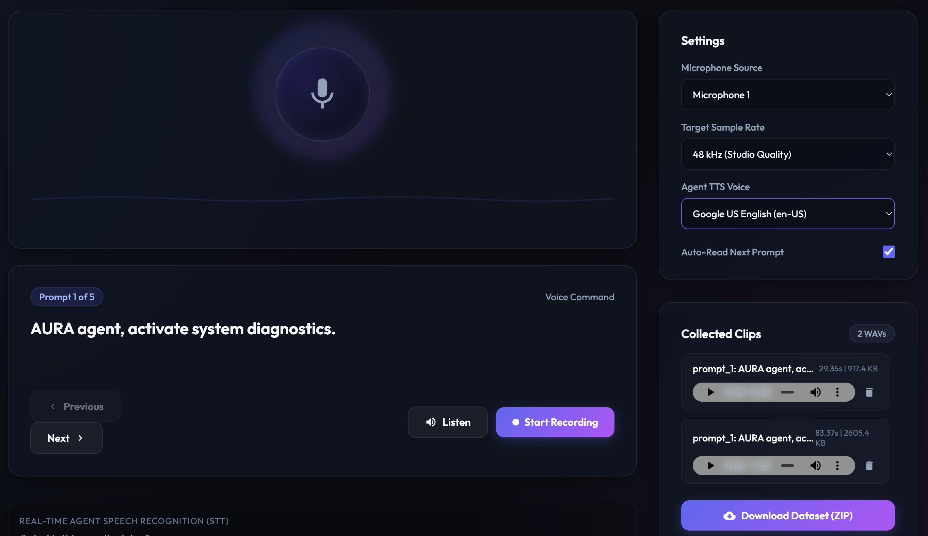
Anatomy of a voice agent for research
User speaks
STT
LLM + tools
TTS
User hears
→
→
→
→
Use it to:
Run structured voice interviews and capture audio + transcript
Manipulate the agent’s voice (pitch, rate, persona) as an IV
Log raw audio, transcript, latency, model, prompt and tool calls per turn
Fix success metrics and failure checks before you deploy
A simple agent prototyped with an AI coding tool (GSERM demo)
Notes:
Agents let you run interviews and experiments at scale and manipulate the agent’s voice as a treatment. Log everything.

Slide 32
Consent, privacy and bias
PRIVACY
MINIMISATION
VALIDITY
Voice is biometric
Sensitive content
Bias & fairness
• Treat recordings as identifiable personal data
• Consent names capture, storage and analysis
• Store audio apart from identities
• Speech can reveal health and other sensitive states
• Record only what the question needs
• Restrict and log access to raw audio
• ASR and acoustic models can underperform for some accents, ages and genders
• Audit error rates by subgroup
• Report disaggregated performance
Notes:
Voice is the most personal data most of you will ever collect. Plan the ethics before the recording.

Slide 33
Exercise 4 · Idea sprint
15 minutes
Pairs → room
Your task
1. Pick one project of yours. Where could voice be the IV, the DV or the mediator?
2. Name the construct, the feature family that should move, and in which direction.
3. Name your data source (lab, online, field, agent) and the biggest validity threat.
Deliverable
A one-sentence pitch: “We will measure ___ in voice to show ___.”
Two or three pairs share.
Notes:
Use the three-ways slide (IV/DV/mediator) as the anchor. Collect pitches on the whiteboard.

Slide 34
Wrap-up & resources
Today’s take-aways
Keep going
• Voice is a behavioural data layer: the how, not just the what
• Map feature families to constructs with theory first
• Device, speaker and acted speech are the big validity threats
• The pipeline is simple: read, look, trim, extract, model, check subgroups
Course website: childebrand.github.io/Melbourne-Voice-2026
voiceR: autoExtract(), autoReport(); install via setup script (CRAN archive)
Full RAVDESS: scripts/get_full_ravdess.R
READ
Hildebrand, Cascio Rizzo & Berger (2026), Current Opinion in Psychology
Hildebrand et al. (2020), Journal of Business Research
Busquet, Efthymiou & Hildebrand (2024), Behavior Research Methods

Slide 35
Thank you
Go listen to your data.
christian.hildebrand@unisg.ch

