Slide 1
TradingAgents: Multi-Agent LLM Financial Trading Framework
Reproduction & Extension Study
Machine Learning in Practice · Columbia University · Spring 2026
Yujia Zhang · Ruiyan Li · Yeyuxi Yi
Paper: arXiv 2412.20138 (Dec 2024)

Slide 2
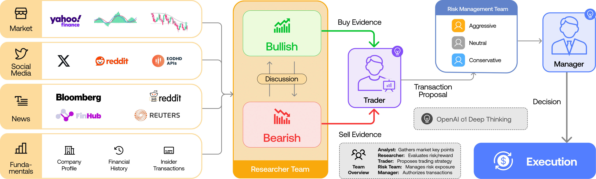
Paper Overview
Why this paper · Task · Paper's contribution
WHY THIS PAPER
PAPER'S CONTRIBUTION
▸ Cutting-edge (Dec 2024): one of the first studies to replace specialist traders with LLMs
▸ Fuses heterogeneous signals: price, news, social media, fundamentals — all in one pipeline
▸ Structured bull/bear debate is a novel LLM design pattern worth stress-testing
▸ 4 specialised teams: Analyst → Researcher → Trader → Risk Manager
▸ Bull vs. Bear debate forces the model to weigh opposing evidence before deciding
▸ Risk Management layer moderates position sizing before order execution
▸ Beats MACD, SMA, KDJ+RSI, and Buy-and-Hold on cumulative return & Sharpe ratio
TASK
Fully automated daily stock-trading decisions for a single ticker driven by a multi-agent LLM pipeline — no hand-coded signals, no human intervention.

Slide 3
Reproduction
Scope reduction · Challenges · Solutions
Scope Reduction
Original paper: 3 tickers × 3 months → Our replication: AMZN only, January 2024 (21 trading days) Reason: full replication required prohibitive LLM API cost and runtime
Challenge 1 — Stale Fundamentals Data
Problem: The Fundamentals Analyst pulled the most-recent SEC filing available at run time. Running in 2026, the API returned 2026 filings — not 2024 as needed for the backtest.
Fix: Fix: Manually downloaded the Q3 2023 10-Q and cached it for the entire backtest window.
Challenge 2 — Data Pipeline Gap + News API Bug
Problem: Paper's experiments used a curated dataset (Bloomberg, EODHD, FinnHub, Reddit) — not released with the code. The open-source fallback, yfinance, returns 2025–26 articles when queried in 2026, leaving the News Analyst with zero relevant input for a Jan 2024 backtest.
Fix: Fix: Replaced live API calls with pre-filtered static GDELT + Reddit CSV datasets for Jan 2024.
Challenge 3 — Latency
Problem: Sequential LLM calls per trading day (analyst → researcher → trader → risk) were expensive in both time and API cost.
Fix: Fix: Cached the fundamentals report across the full month (it's a single quarter's filing).
⚠ Limitation: static datasets make the system non-production-ready. The paper's live-API design is the intended architecture; ours is a faithful but frozen snapshot.

Slide 4
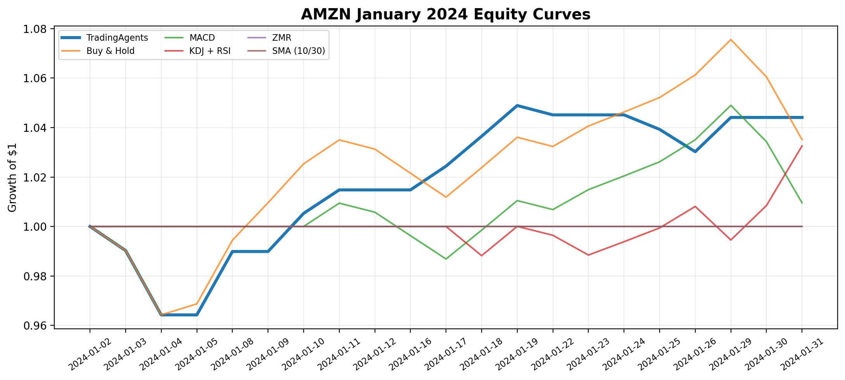
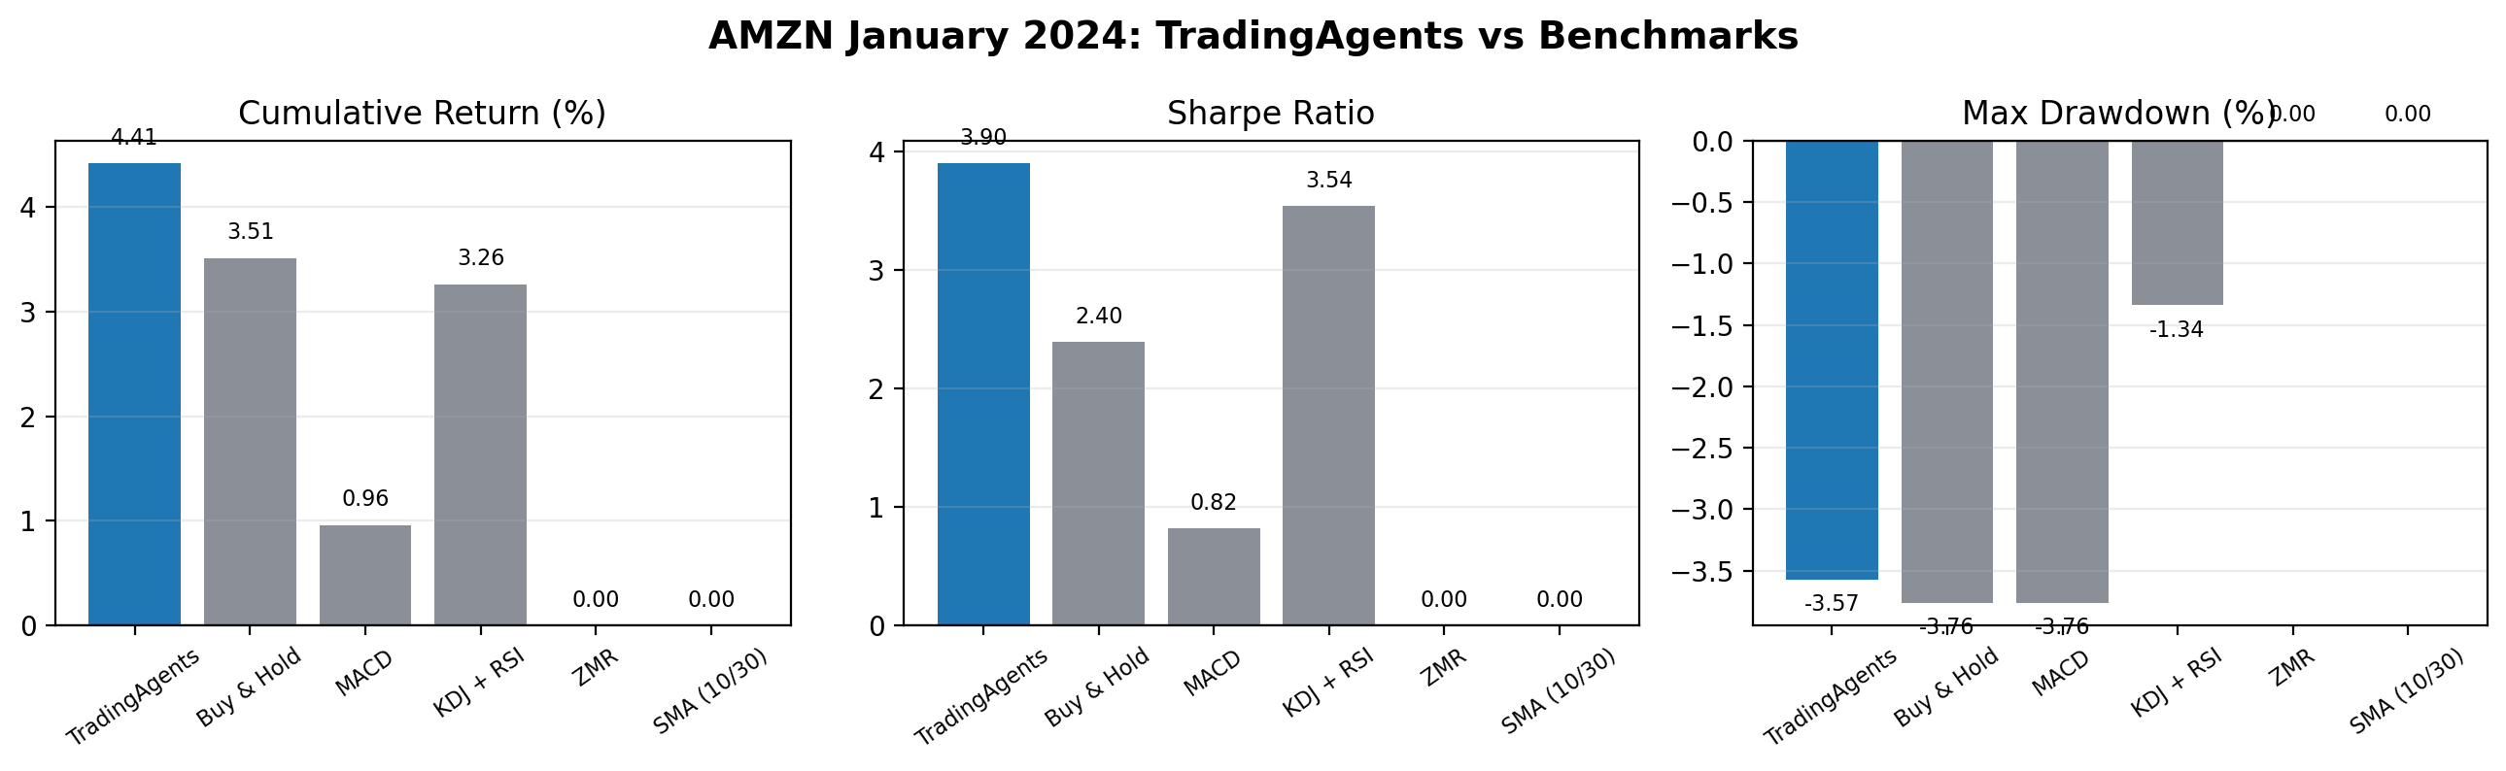
Replication Results
AMZN · January 2024 · 21 trading days
Strategy
Cum. Return
Ann. Return
Sharpe
Max DD
TradingAgents
+4.41%
+67.8%
3.90
−3.57%
Buy & Hold
+3.51%
+51.4%
2.40
−3.76%
KDJ + RSI
+3.26%
+46.9%
3.54
−1.34%
MACD
+0.96%
+12.1%
0.82
−3.76%
ZMR / SMA
0.00%
0.00%
0.00
0.00%
✓ TradingAgents beats every benchmark on return and Sharpe ratio

Slide 5
Extension: Ablation Study
What happens when we remove individual agent layers?
Full Architecture +4.41% Sharpe 3.90
No Research Debate +6.31% Sharpe 5.73
No Risk Layer −1.33% Sharpe −0.77
Buy & Hold +3.51% Sharpe 2.40
Experiment 1 — Remove Bull/Bear Research Debate
+6.31%
The bull/bear debate introduced noise and indecision into an otherwise trending market. In January 2024, AMZN was in a clear uptrend; the bearish debater consistently argued against well-founded bullish signals, forcing the trader to hedge unnecessarily. Removing the debate layer lets the Researcher pass confident, unfiltered recommendations directly — yielding stronger performance when market direction is clear.
Sharpe 5.73
▲ BETTER
Experiment 2 — Remove Risk Management Layer
−1.33%
The Risk Management team is the critical guardrail of the pipeline. Without it, the Trader executes aggressive, unchecked positions based on raw Researcher output. Even small over-confident bets compound: max drawdown worsens from −3.57% to −4.81% and cumulative return goes negative. This confirms that risk management is not redundant overhead — it is load-bearing.
Sharpe −0.77
▼ MUCH WORSE
Key Insight: Debate adds value only when market direction is uncertain. Risk management is always essential. Selectively disabling debate on trending markets may be a simple, practical way to improve framework performance.

