Slide 1

Paper: TradingAgents: Multi-Agents LLM Financial Trading Framework
Yujia Zhang, Ruiyan Li , Yeyuxi Yi

Slide 2
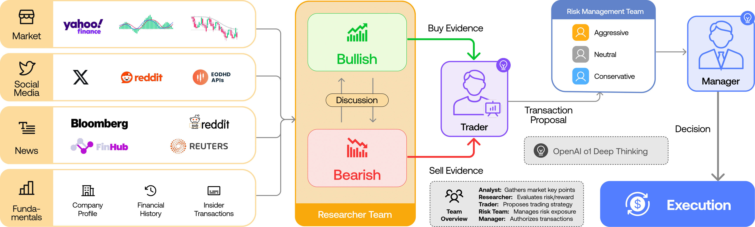
Framework

Slide 3
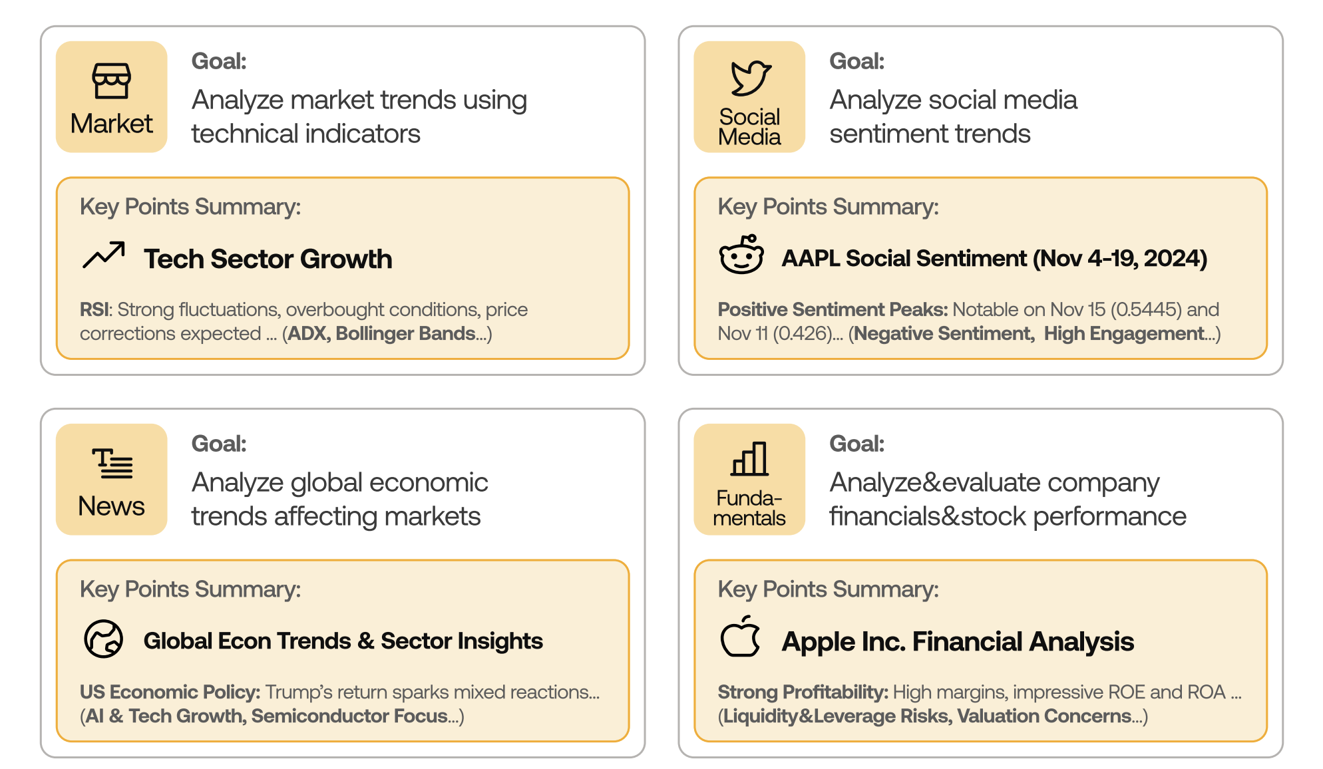
Analyst team
Four Agents
Market
Social Media
News
Fundamental

Slide 4
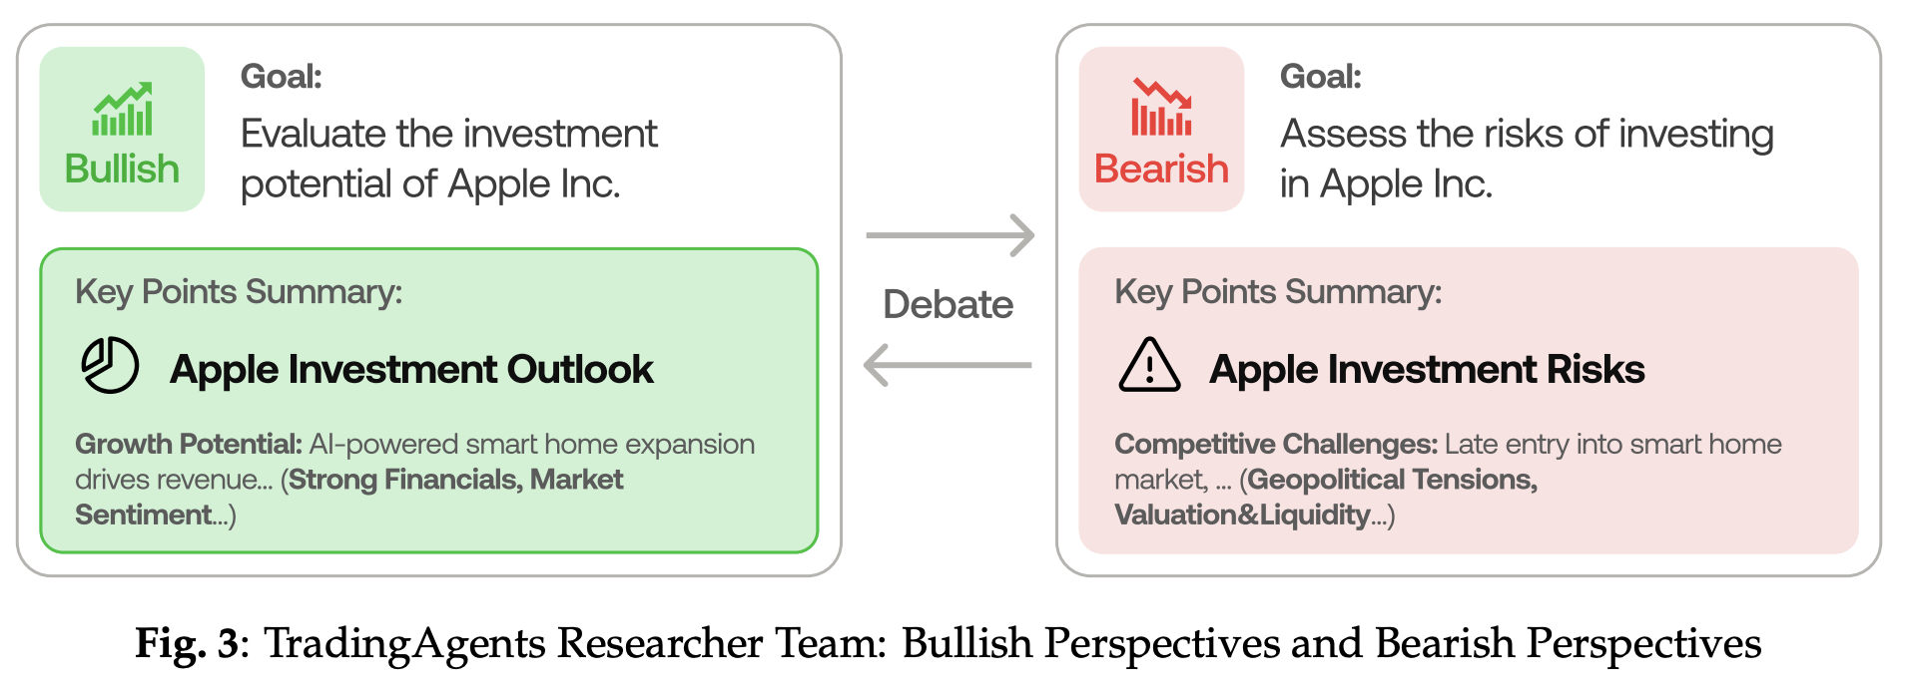
Researcher team
Evaluate the information provided by Analyst Team
Engage in multiple rounds of debate
Assess the potential risks and benefits of investment decisions

Slide 5
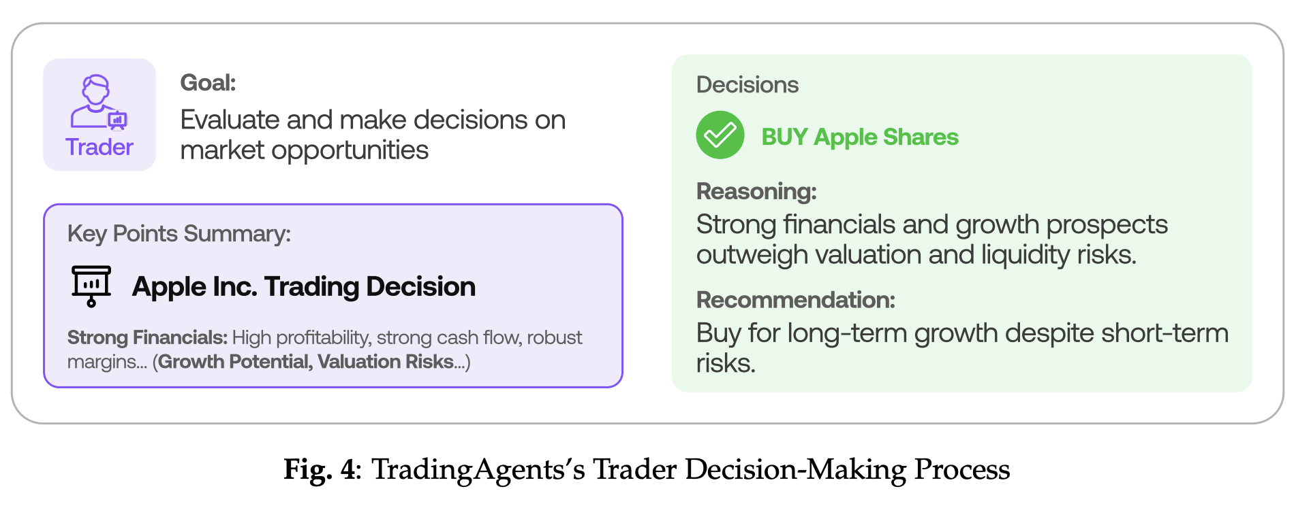
Trader team
Evaluating insights from analysts and researchers.
Deciding on the timing and size of
Placing buy or sell orders in the market
Adjusting portfolio allocations in response to market changes and new information

Slide 6
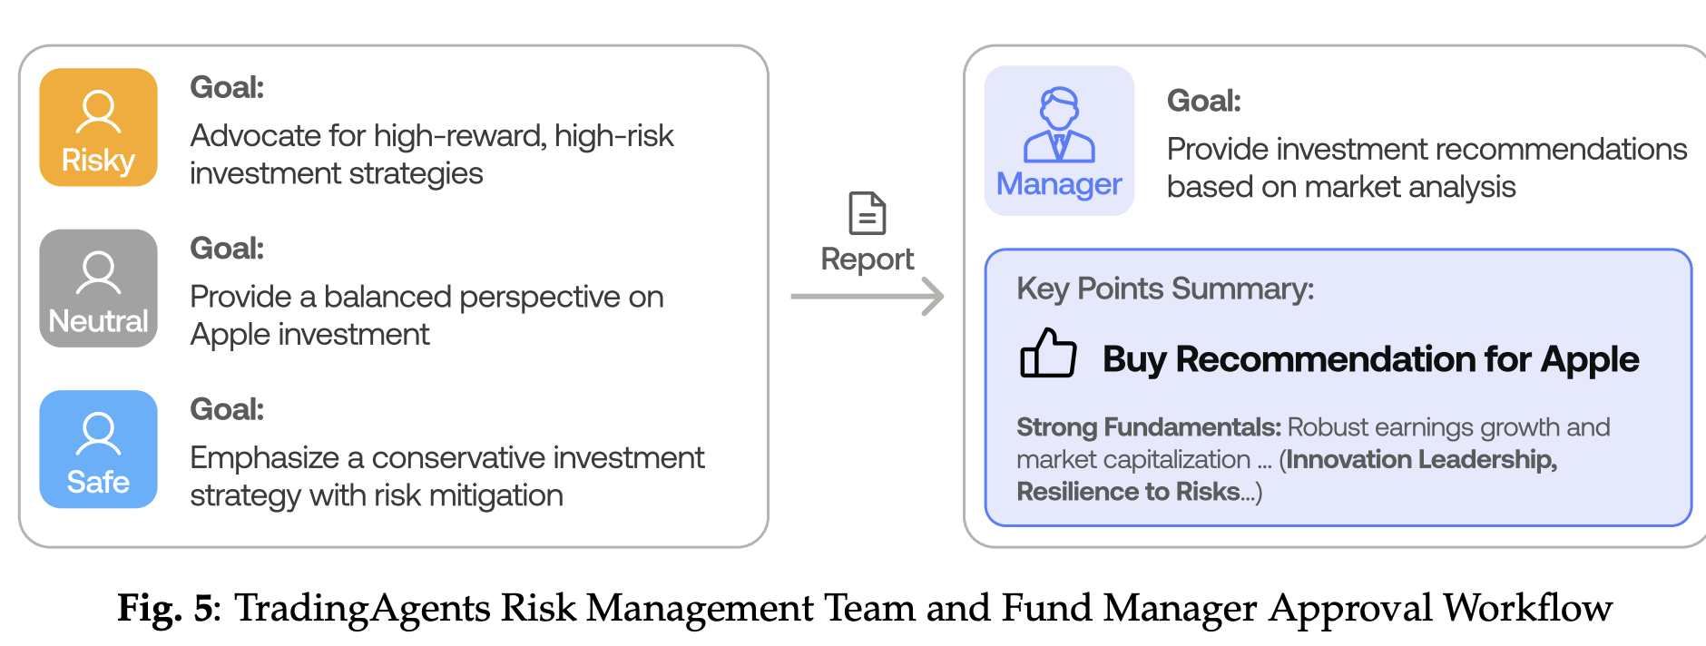
Risk Management Team => FUND MANAGER
Evaluate the information provided by Analyst Team
Engage in multiple rounds of debate
Assess the potential risks and benefits of investment decisions

Slide 7
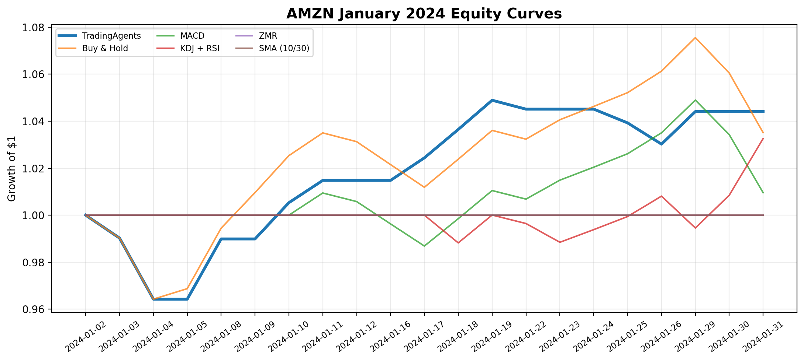
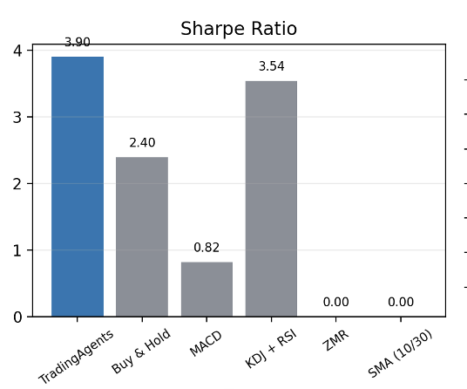
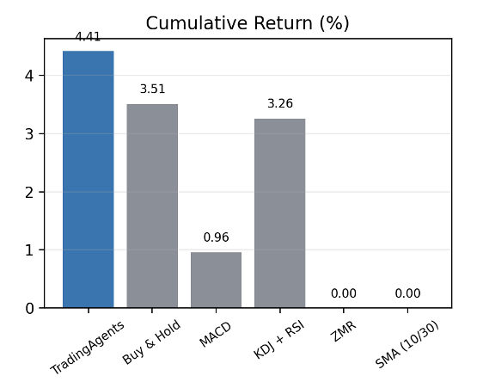
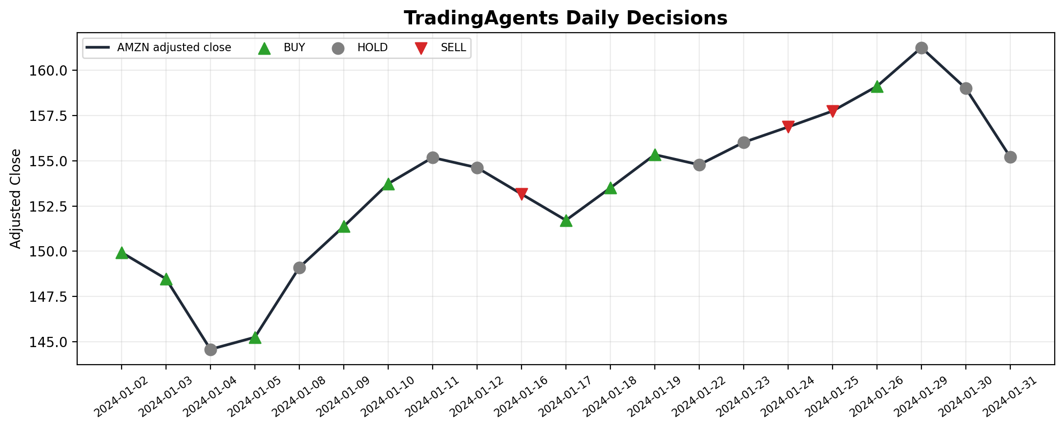
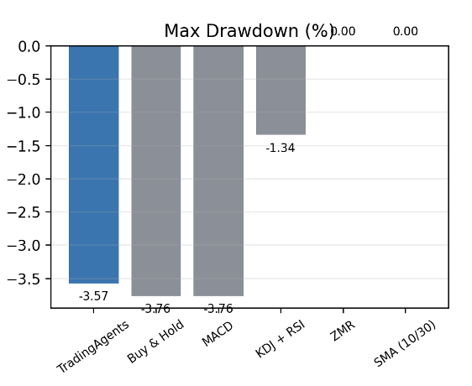
Duplication Result

Slide 8
Reasons for differences
 | Original Paper (Based on Initial Commit on June 5 2025) | Our Implementation
Quick-thinking Model | gpt-4o-mini | gemini-2.5-flash-lite
Deep-thinking Model | o4-mini | gemini-2.5-flash-lite
Financial Information | Google News, local dataset for Reddit, insider information / filings | Kaggle dataset and GDELT for news
Backtesting period | 01/01/2024 – 03/29/2024 | 01/01/2024 -- 01/31/2024

Slide 9
Extension
Full architecture: +4.41%, Sharpe 3.899
No research debate: +6.31%, Sharpe 5.731
No risk layer: -1.33%, Sharpe -0.771
Buy & Hold: +3.51%, Sharpe 2.395

