Slide 1

Real-Time Video Editor
Group Members
Mengqi Wu (Project Manager)
Matthew Schnur (Developer)
Domonic Milesi (Developer)
Arjun Mukherjee (Tester)

Slide 2
Group Members
Domonic Milesi (Developer)
Matthew Schnur (Developer)
Arjun Mukherjee (Tester)
Mengqi Wu (Project Manager)

Slide 3
Outline
The Customer
The translation
The Challenges,choices and trade-offs
Live demonstration
The solutions

Slide 4
The Customer
The Customer
The translation
The Challenges,choices and trade-offs
Live demonstration
The solutions

Slide 5
The Translation
The Customer
The Translation
The Challenges,choices and trade-offs
Live demonstration
The solutions

Slide 6
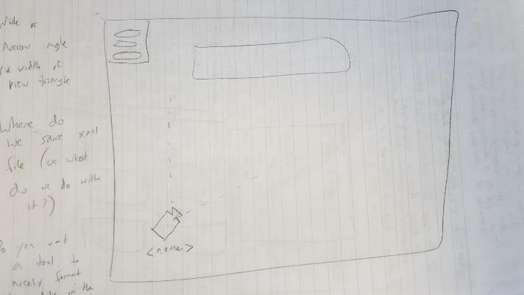
First Translation
Analyzed the customer’s end goal
Imagined our “ideal” solution to customer’s problem

Slide 7
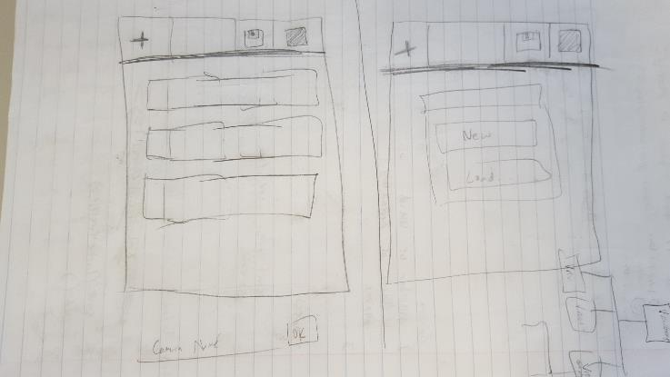
Second Translation
After the first sprint, vastly cut back scope after experiencing difficulties firsthand
Something that solved the customer’s problem but wasn’t necessarily pretty

Slide 8
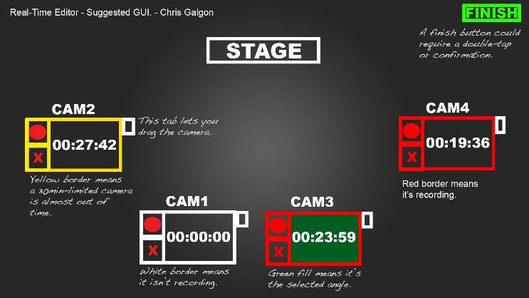
Final Translation
Customer provided us with a picture of a UI that they wanted
Attempted to realize the customer’s provided UI in our app within our limited time

Slide 9
The Challenges, Choices and Trade-offs
The Customer
The translation
The Challenges,choices and trade-offs
Live demonstration
The solutions

Slide 10
Live Demonstration
The Customer
The translation
The Challenges,choices and trade-offs
Live demonstration
The solutions

Slide 11
The Solutions
The Customer
The translation
The Challenges,choices and trade-offs
Live demonstration
The solutions

Slide 12
Thank You!!

