Slide 1
Kentucky CFSR Profile
Data Profile Period: February 2025 Data Range: Oct '19 - Mar '22 Generated: April 24, 2026

Slide 2
CFSR Round 4 Profile
Children's Bureau provides CFSR Round 4 Data Profiles every 6 months
Shows your state's risk-standardized performance (RSP) and observed performance
RSP is observed performance but with risk-adjustment
RSP is compared to the national performance to see if performance is statistically better, worse, or no different than national performance

Slide 3
CFSR Performance Summary

Slide 4
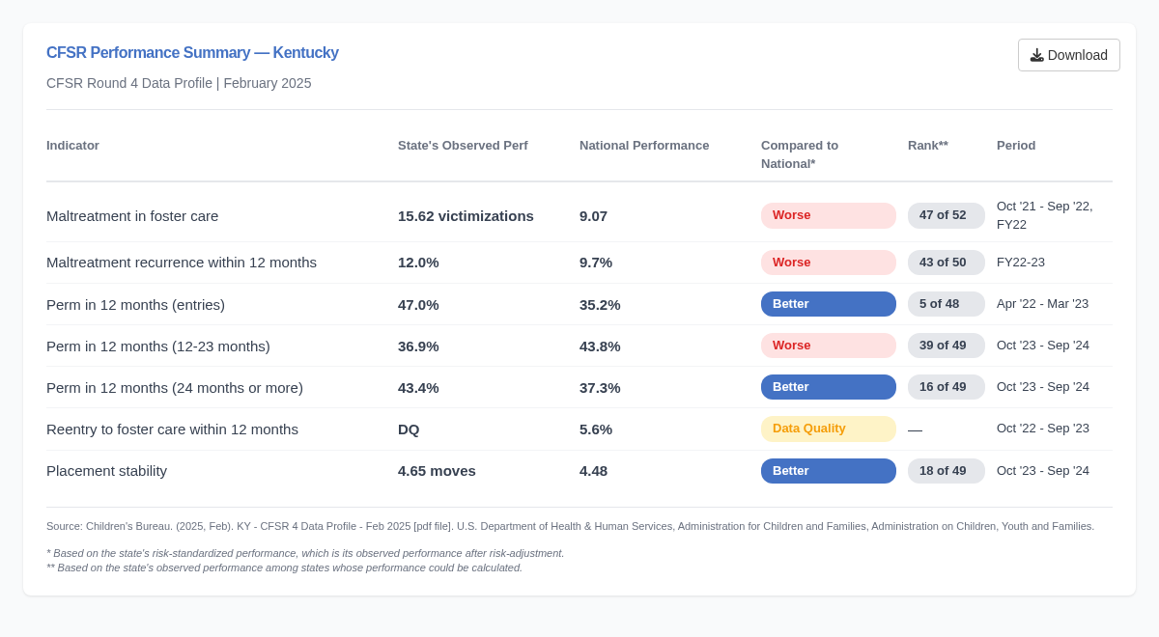
Overall Performance Summary

Slide 5
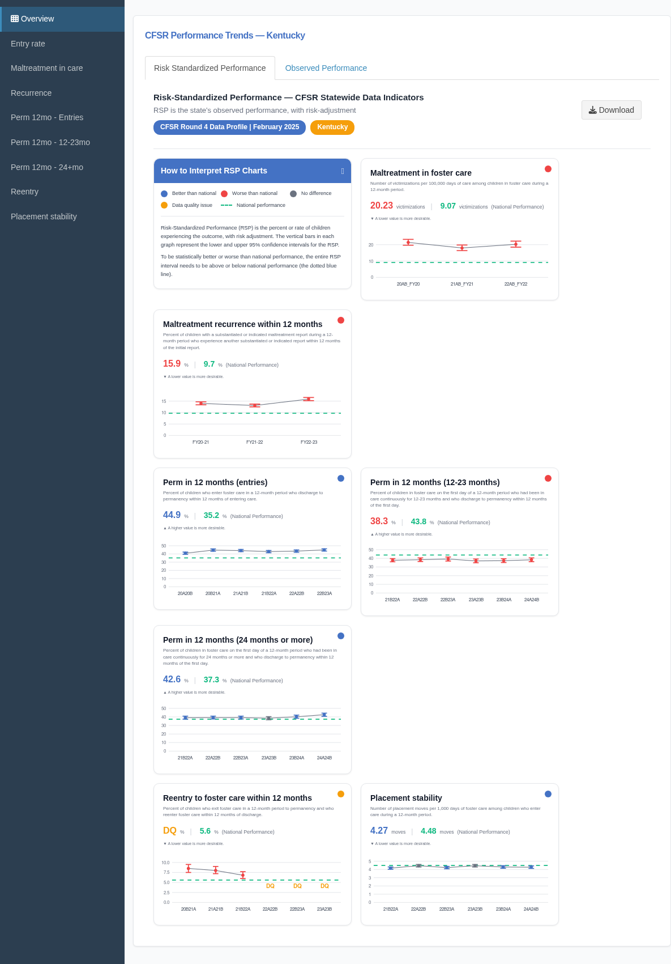
Risk-Standardized Performance Overview

Slide 6
Observed Performance Overview

Slide 7
Individual Indicators

Slide 8
Maltreatment in foster care
Kentucky ranks 46 of 51 reporting states.
Performance: 0 per 100,000.
9.07 below national standard of 9.07.
Performance meets or exceeds national standard.
Based on 0 events among 9,714 children.
Source: Children's Bureau. (2025, February). Kentucky - supplemental context data - February 2025 [Data file]. U.S. Department of Health & Human Services, Administration for Children and Families, Administration on Children, Youth and Families.
Maltreatment in care counts substantiated or indicated victimizations during foster care episodes.

Slide 9
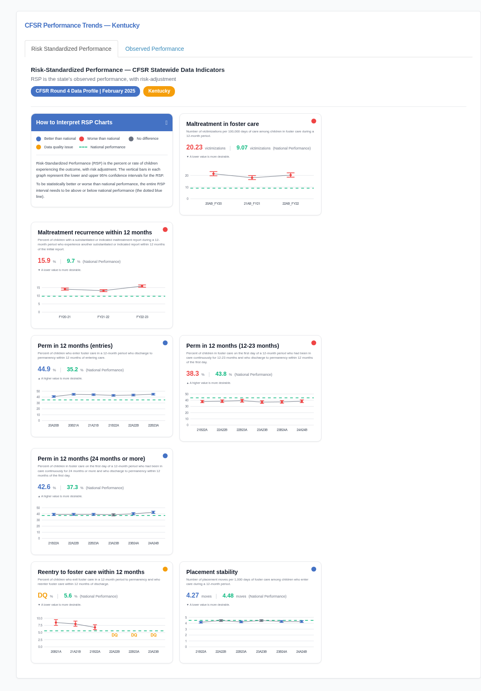
Maltreatment recurrence within 12 months
Kentucky ranks 41 of 52 reporting states.
Performance: 13%.
3.3% above national standard of 9.7%.
Performance below national standard.
Based on 12 events among 92 children.
Source: Children's Bureau. (2025, February). Kentucky - supplemental context data - February 2025 [Data file]. U.S. Department of Health & Human Services, Administration for Children and Families, Administration on Children, Youth and Families.
Recurrence measures children with a new substantiated or indicated report within 12 months of an initial report.

Slide 10
Foster care entry rate
Kentucky ranks 45 of 52 reporting states.
Performance: 1.59 per 1,000.
Based on 6 events among 3,781 children.
Source: Children's Bureau. (2025, February). Kentucky - supplemental context data - February 2025 [Data file]. U.S. Department of Health & Human Services, Administration for Children and Families, Administration on Children, Youth and Families.
Entry rate reflects how often children in the state enter foster care relative to the child population.

Slide 11
Perm in 12 months (entries)
Kentucky ranks 8 of 52 reporting states.
Performance: 71.4%.
36.2% above national standard of 35.2%.
Performance meets or exceeds national standard.
Based on 5 events among 7 children.
Source: Children's Bureau. (2025, February). Kentucky - supplemental context data - February 2025 [Data file]. U.S. Department of Health & Human Services, Administration for Children and Families, Administration on Children, Youth and Families.
Permanency within 12 months of entry reflects timely exits to reunification, adoption, or guardianship.

Slide 12
Perm in 12 months (12-23 months)
Kentucky ranks 40 of 52 reporting states.
Performance: 0%.
43.8% below national standard of 43.8%.
Performance below national standard.
Based on 0 events among 2 children.
Source: Children's Bureau. (2025, February). Kentucky - supplemental context data - February 2025 [Data file]. U.S. Department of Health & Human Services, Administration for Children and Families, Administration on Children, Youth and Families.
This cohort had been in care 12–23 months continuously as of the first day of the 12-month period.

Slide 13
Perm in 12 months (24 months or more)
Kentucky ranks 26 of 52 reporting states.
Performance: 75%.
37.7% above national standard of 37.3%.
Performance meets or exceeds national standard.
Based on 3 events among 4 children.
Source: Children's Bureau. (2025, February). Kentucky - supplemental context data - February 2025 [Data file]. U.S. Department of Health & Human Services, Administration for Children and Families, Administration on Children, Youth and Families.
This cohort had been in care 24 months or more continuously as of the first day of the 12-month period.

Slide 14
Reentry to foster care within 12 months
Kentucky ranks 43 of 52 reporting states.
Performance: 37.5%.
31.9% above national standard of 5.6%.
Performance below national standard.
Based on 3 events among 8 children.
Source: Children's Bureau. (2025, February). Kentucky - supplemental context data - February 2025 [Data file]. U.S. Department of Health & Human Services, Administration for Children and Families, Administration on Children, Youth and Families.
Reentry counts children who return to foster care within 12 months after a discharge to permanency.

Slide 15
Placement stability
Kentucky ranks 28 of 51 reporting states.
Performance: 10 per 1,000.
5.52 above national standard of 4.48.
Performance below national standard.
Based on 6 events among 600 children.
Source: Children's Bureau. (2025, February). Kentucky - supplemental context data - February 2025 [Data file]. U.S. Department of Health & Human Services, Administration for Children and Families, Administration on Children, Youth and Families.
Placement stability summarizes moves per 1,000 days in care for children entering during the period.

Slide 16
Summary — Kentucky
This deck summarizes observed CFSR profile indicators for February 2025.
Review each indicator slide with agency leadership before external distribution.
Contact: kurt@childmetrix.com
Acknowledgments: Children's Bureau CFSR Round 4 Data Profile; ChildMetrix.

