Slide 1
Collaborative programming with GitHub
Jon Clucas
MoBI Retreat | Tuesday 27 February 2024

Slide 2

Collaborative programming with GitHub
Why?
What?
How?
Danger?
Help?

Slide 3
General advice
Commit often.
Keep the content of each commit as single-purpose as possible.
Write clear commit messages describing the content of the commits.
Develop separate features in separate branches. These branches can be cascaded or from the same commit-in-common.
Review as many PRs as makes sense for you.
Review the project’s community files (e.g., CONTRIBUTING, README).
Different projects have different needs at different times.
If you have a suggestion, share your suggestion.
If you have a question, ask.

Slide 4
Why?
Collaborative programming with GitHub

Slide 5
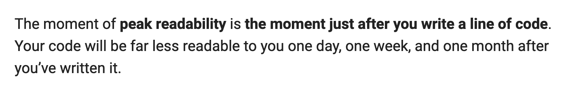
Code readability decreases with time and distance
― Hunner, Trey. “Craft Your Python Like Poetry.” Trey Hunner, July 23, 2017. https://treyhunner.com/2017/07/craft-your-python-like-poetry/.

Slide 6
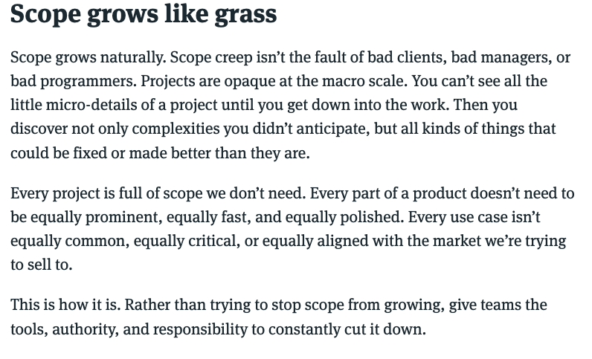
Scope is hard to manage
― Singer, Ryan. “Scope Grows like Grass.” In Shape Up: Stop Running in Circles and Ship Work That Matters, 2024. https://basecamp.com/shapeup/3.5-chapter-14#scope-grows-like-grass.

Slide 7
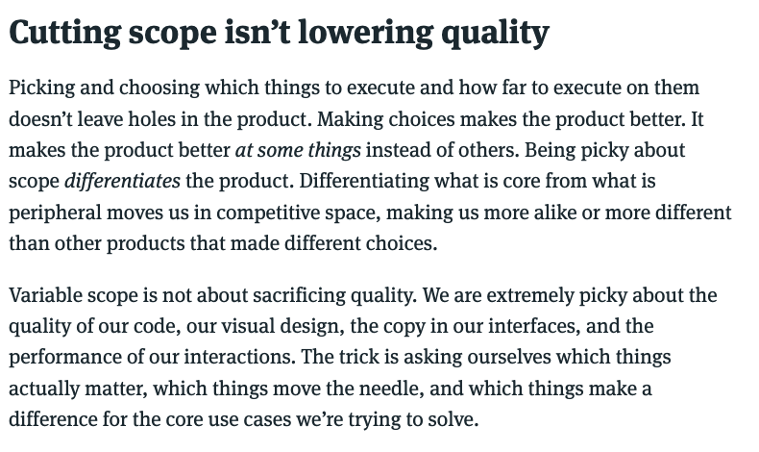
Scope needs to be managed
― Singer, Ryan. “Cutting scope isn’t lowering quality.” In Shape Up: Stop Running in Circles and Ship Work That Matters, 2024. https://basecamp.com/shapeup/3.5-chapter-14#cutting-scope-isnt-lowering-quality.

Slide 8
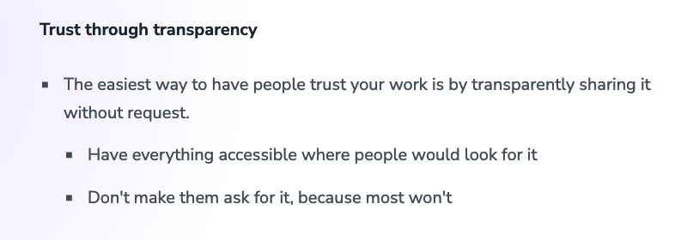
Contributions need to be trustworthy
Klinger, Andreas. “Managing People 🤯.” Andreas Klinger, February 5, 2022. https://klinger.io/posts/managing-people-🤯.

Slide 9
What?
Collaborative programming with GitHub

Slide 10


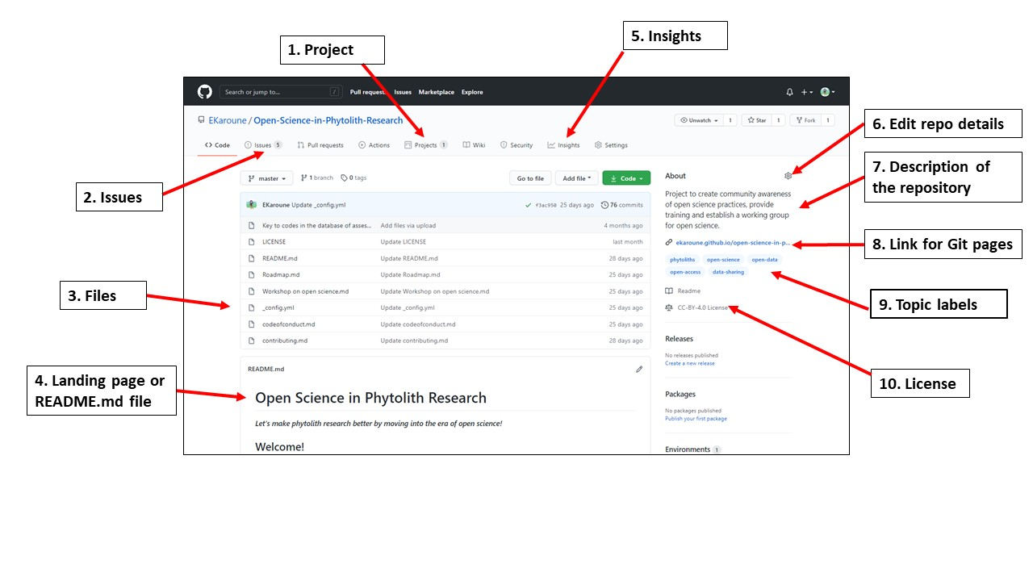
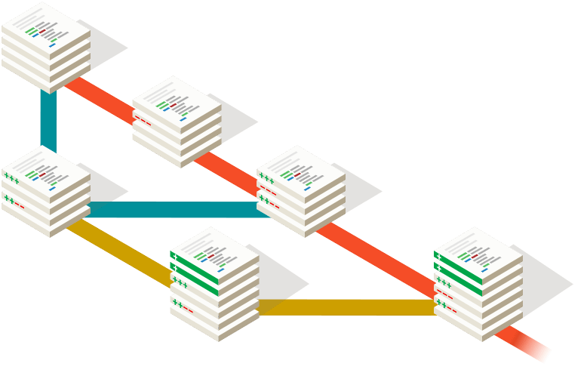
What’s the difference between git and GitHub?
― The Turing Way Community. “Using GitHub Features to Foster Collaboration.” In The Turing Way, 2024. https://the-turing-way.netlify.app/collaboration/github-novice/github-novice-features#using-github-features-to-foster-collaboration.
― Git. “Git.” https://git-scm.com/.

Slide 11
What’s the difference between git and GitHub?
Version control
Communication
Project management
― The Turing Way Community. “Using GitHub Features to Foster Collaboration.” In The Turing Way, 2024. https://the-turing-way.netlify.app/collaboration/github-novice/github-novice-features#using-github-features-to-foster-collaboration.
― Git. “Git.” https://git-scm.com/.

Slide 12
How?
Collaborative programming with GitHub
Readability Counts.
Special cases aren't special enough to break the rules.
Although practicality beats purity.
― Peters, Tim. “PEP 20 – The Zen of Python.” Python Enhancement Proposals, August 22, 2004. https://peps.python.org/pep-0020/#the-zen-of-python.

Slide 13
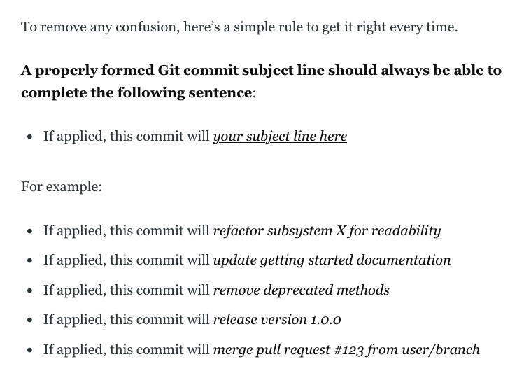
― Beams, Chris. “How to Write a Git Commit Message.” cbeams, August 31, 2014. https://cbea.ms/git-commit/.

Slide 14
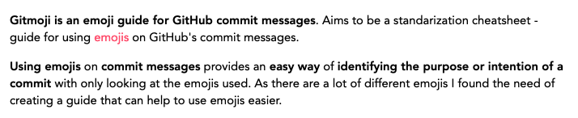
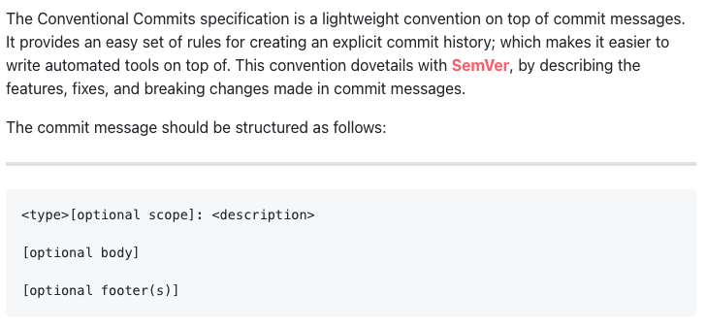
Follow the project’s existing style
― Cuesta, Carlos. “About.” gitmoji. https://gitmoji.dev/about.
― Conventional Commits. “Conventional Commits 1.0.0 Summary.” Conventional Commits. https://www.conventionalcommits.org/en/v1.0.0/#summary.

Slide 15
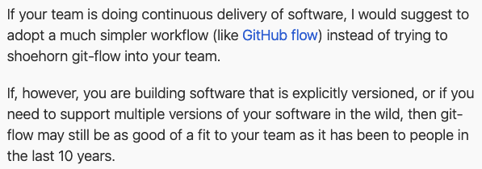
Follow the project’s existing style
― Driessen, Vincent. “A Successful Git Branching Model: Note of Reflection.” nvie.com, March 5, 2020. http://nvie.com/posts/a-successful-git-branching-model/.

Slide 16
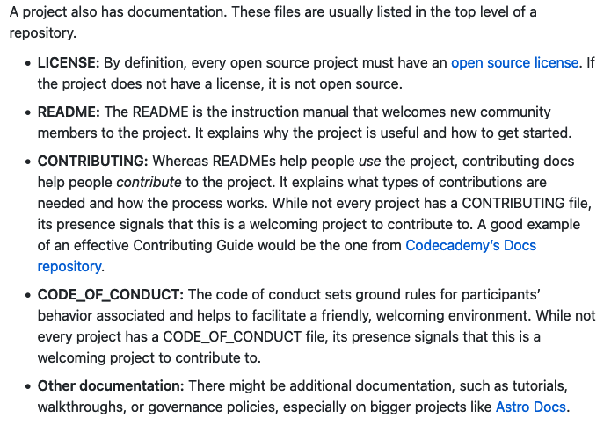
Follow the project’s existing style
― Open Source Guides. “Anatomy of an Open Source Project.” How to Contribute to Open Source, February 8, 2024. https://opensource.guide/how-to-contribute/#anatomy-of-an-open-source-project.

Slide 17
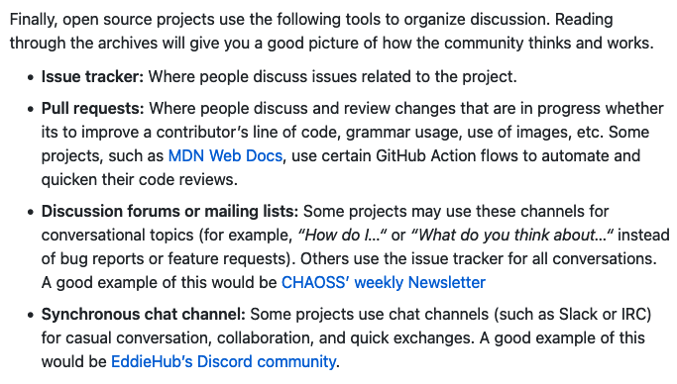
Follow the project’s existing style
― Open Source Guides. “Anatomy of an Open Source Project.” How to Contribute to Open Source, February 8, 2024. https://opensource.guide/how-to-contribute/#anatomy-of-an-open-source-project.

Slide 18
Danger?
Collaborative programming with GitHub

Slide 19

What if I mess something up?
As long as what was working was committed,
Git makes permanent irreversible changes hard to do by design.
GitHub has features like ”branch protection rules” to add further friction to publishing unintentional changes.

Slide 20
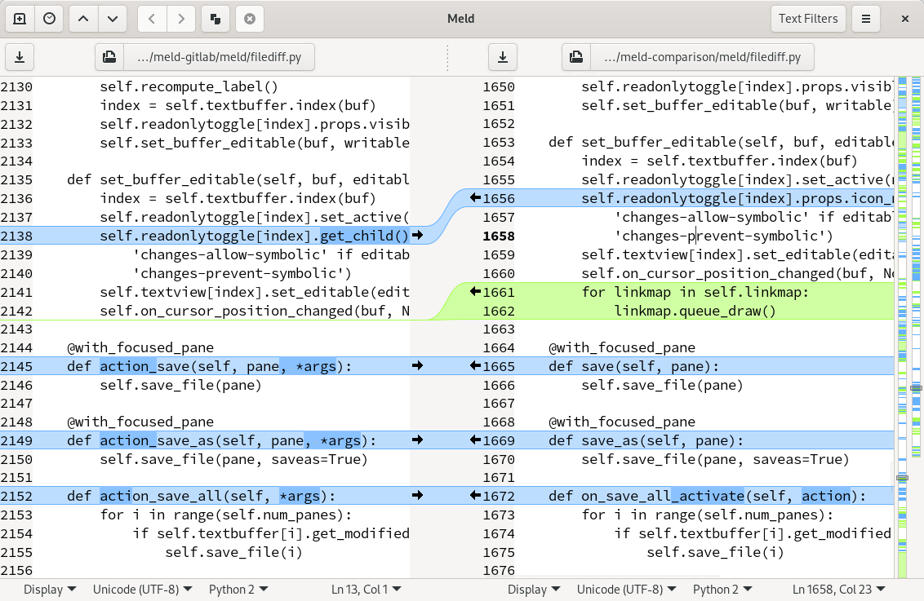
This merge conflict resolution is a nightmare.
Merge conflict resolutions are absolutely necessary.
Conflicts arise when parallel changes are made to the same code and git can’t tell how those changes should interact or affect each other.
Find a tool that works for you.
I adore Meld (https://meldmerge.org)

Slide 21
Help?
Collaborative programming with GitHub

Slide 22
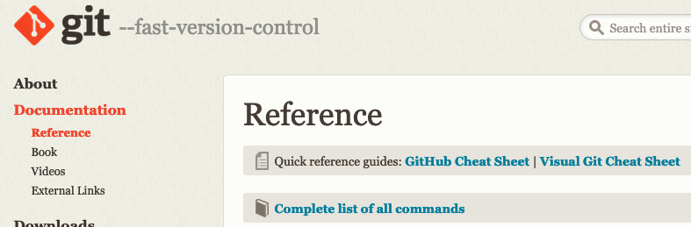
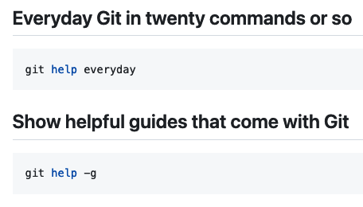

Official git documentation
― Git. “Reference.” Git. https://git-scm.com/docs.
― git-tips. “Git-Tips.” 2024. git.io/git-tips.
― Chacon, Scott, and Ben Straub. Pro Git. 2nd ed. Apress, 2014. https://git-scm.com/book/en/v2.

Slide 24
Template Guidelines
Add a specific program logo in place of the general Child Mind Institute logo by editing the master slide. Make sure to keep the new logo in the same location and approximate size as the placeholder logo.
Use Arial as the font throughout your presentation (defaulted in template).
Only use the Child Mind Institute color palette (defaulted as “Theme Colors” in template)
Take advantage of the title, section, and end slides to organize your presentation.

