Slide 1
Collaborative programming with GitHub
Jon Clucas
MoBI Retreat | Monday 26 February 2024

Slide 2
General advice
Commit often.
Keep the content of each commit as single-purpose as possible.
Write clear commit messages describing the content of the commits.
Develop separate features in separate branches. These branches can be cascaded or from the same commit-in-common.
Review as many PRs as makes sense for you.
Review the project’s community files (e.g., CONTRIBUTING, README).
Different projects have different needs at different times.
If you have a suggestion, share your suggestion.
If you have a question, ask.

Slide 3

Collaborative programming with GitHub
Why?
What?
How?
Danger?
Help?

Slide 4
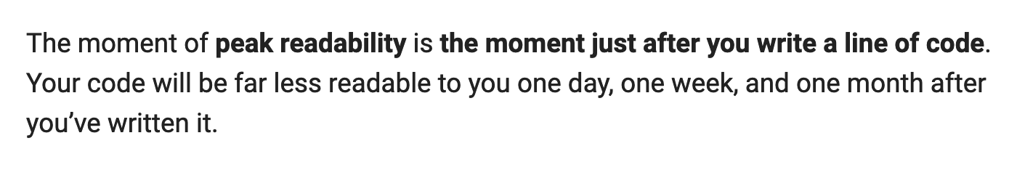
Code readability decreases with time and distance
― Hunner, Trey. “Craft Your Python Like Poetry.” Trey Hunner, July 23, 2017. https://treyhunner.com/2017/07/craft-your-python-like-poetry/.

Slide 5
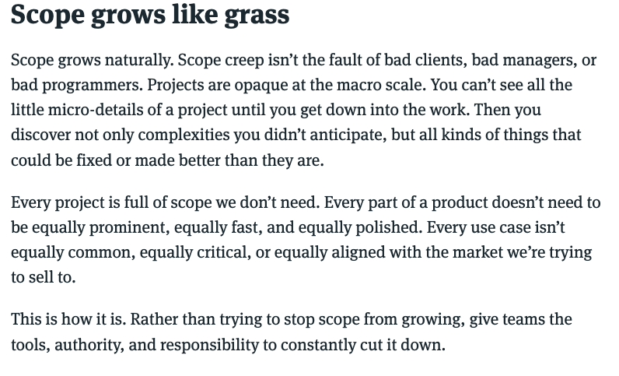
Scope is hard to manage
― Singer, Ryan. “Scope Grows like Grass.” In Shape Up: Stop Running in Circles and Ship Work That Matters, 2024. https://basecamp.com/shapeup/3.5-chapter-14#scope-grows-like-grass.

Slide 6
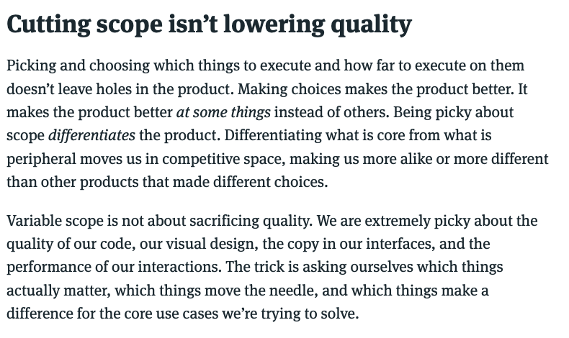
Scope needs to be managed
― Singer, Ryan. “Cutting scope isn’t lowering quality.” In Shape Up: Stop Running in Circles and Ship Work That Matters, 2024. https://basecamp.com/shapeup/3.5-chapter-14#cutting-scope-isnt-lowering-quality.

Slide 7
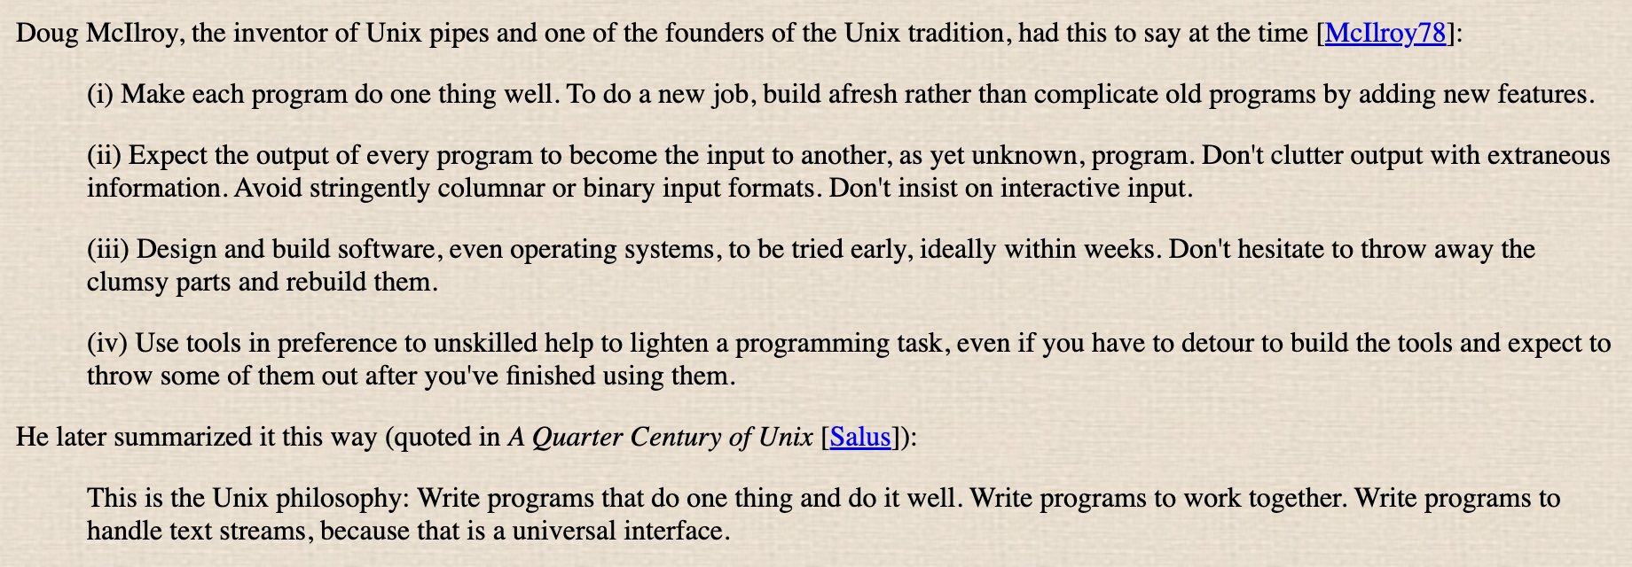
Scope needs to be managed
― Raymond, Eric Steven. “Basics of the Unix Philosophy.” In The Art of Unix Programming, Revision 1.0., 2003. http://www.catb.org/~esr/writings/taoup/html/ch01s06.html.

Slide 8
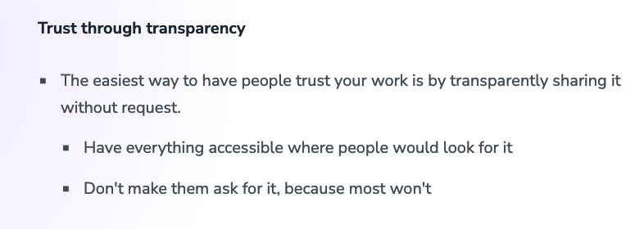
Contributions need to be trustworthy
Klinger, Andreas. “Managing People 🤯.” Andreas Klinger, February 5, 2022. https://klinger.io/posts/managing-people-🤯.

Slide 9
Why?
Code readability decreases with time and distance.
Scope is hard to manage.
Scope needs to be managed.
Contributions need to be trustworthy.

Slide 10

Collaborative programming with GitHub
Why?
What?
How?
Danger?
Help?

Slide 11


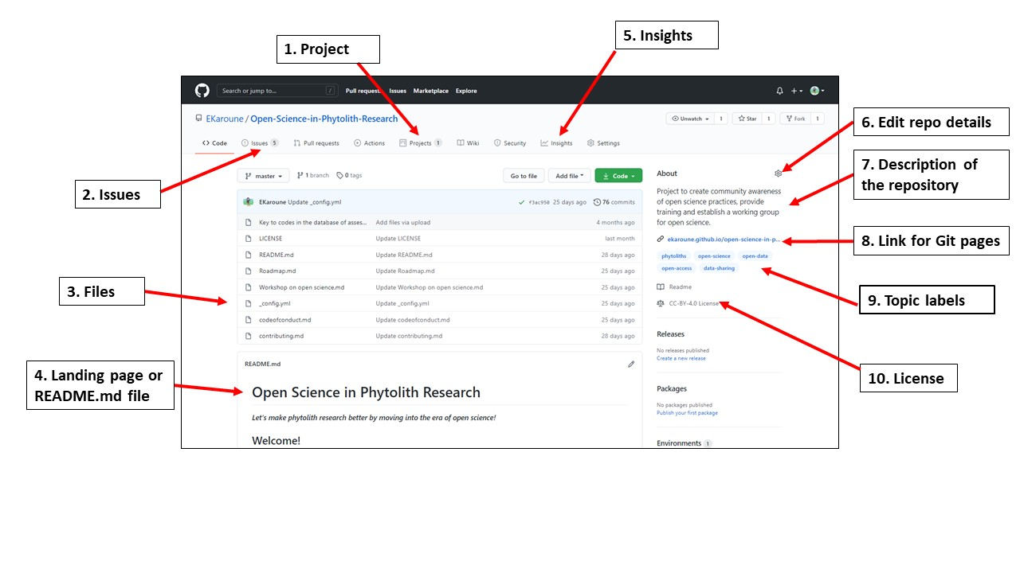
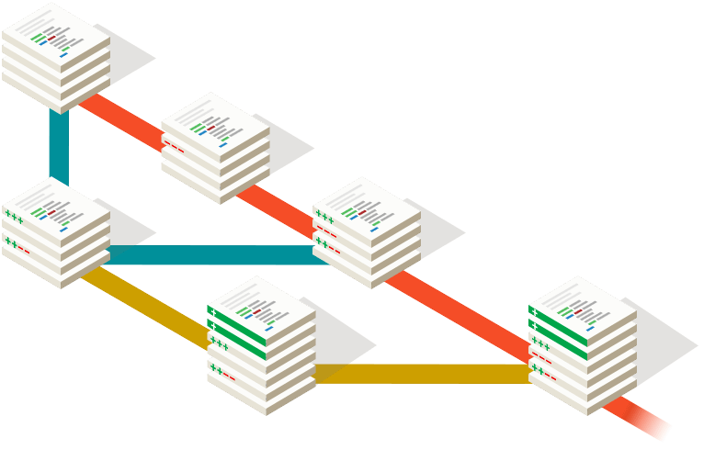
What’s the difference between git and GitHub?
― The Turing Way Community. “Using GitHub Features to Foster Collaboration.” In The Turing Way, 2024. https://the-turing-way.netlify.app/collaboration/github-novice/github-novice-features#using-github-features-to-foster-collaboration.
― Git. “Git.” https://git-scm.com/.

Slide 12
What’s the difference between git and GitHub?
Version control
Communication
Project management
― The Turing Way Community. “Using GitHub Features to Foster Collaboration.” In The Turing Way, 2024. https://the-turing-way.netlify.app/collaboration/github-novice/github-novice-features#using-github-features-to-foster-collaboration.
― Git. “Git.” https://git-scm.com/.

Slide 13
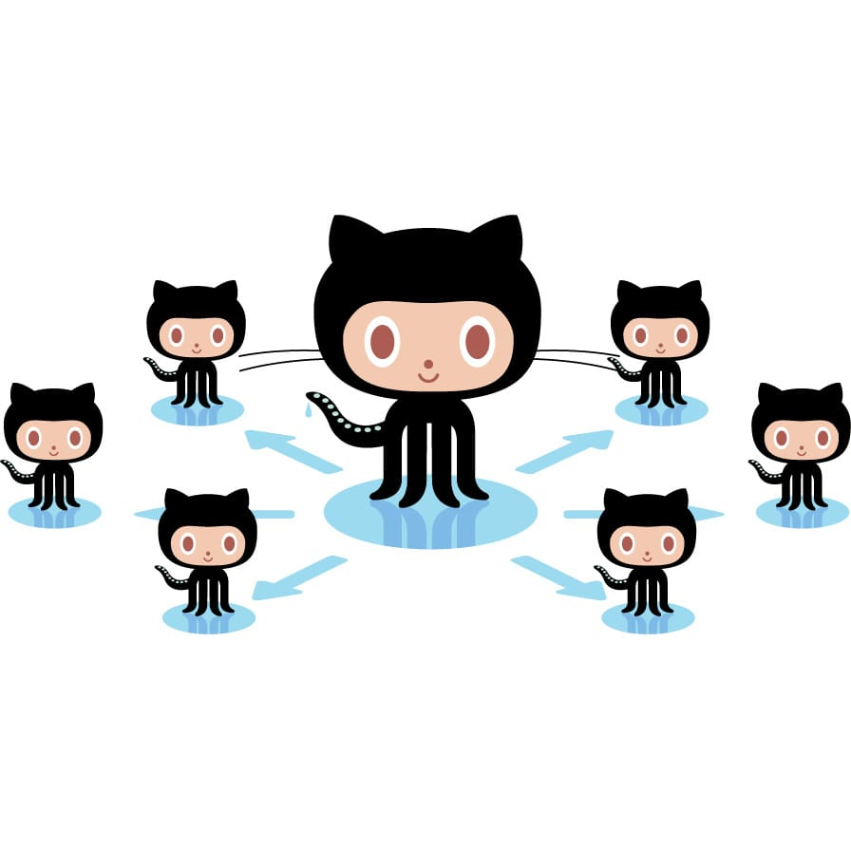
Collaborative programming with GitHub
Why?
What?
How?
Danger?
Help?

Slide 14
How?
Readability counts.
Special cases aren't special enough to break the rules.
Although practicality beats purity.
― Peters, Tim. “PEP 20 – The Zen of Python.” Python Enhancement Proposals, August 22, 2004. https://peps.python.org/pep-0020/#the-zen-of-python.

Slide 15
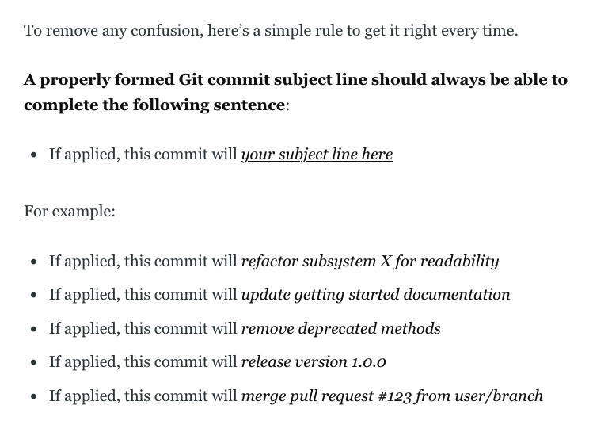
― Beams, Chris. “How to Write a Git Commit Message.” cbeams, August 31, 2014. https://cbea.ms/git-commit/.

Slide 16
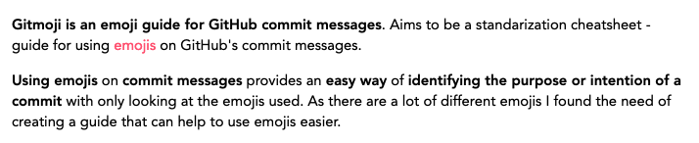
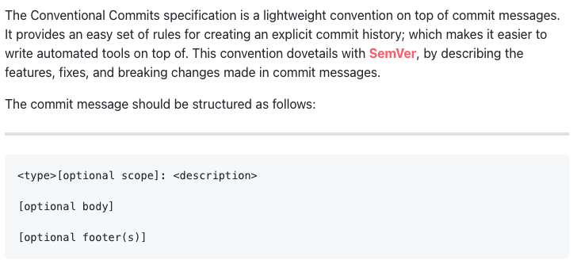
Follow the project’s existing style
― Cuesta, Carlos. “About.” gitmoji. https://gitmoji.dev/about.
― Conventional Commits. “Conventional Commits 1.0.0 Summary.” Conventional Commits. https://www.conventionalcommits.org/en/v1.0.0/#summary.

Slide 17
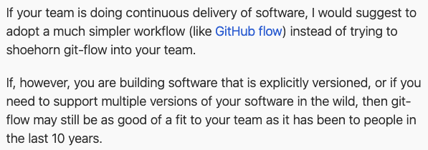
Follow the project’s existing style
― Driessen, Vincent. “A Successful Git Branching Model: Note of Reflection.” nvie.com, March 5, 2020. http://nvie.com/posts/a-successful-git-branching-model/.

Slide 18
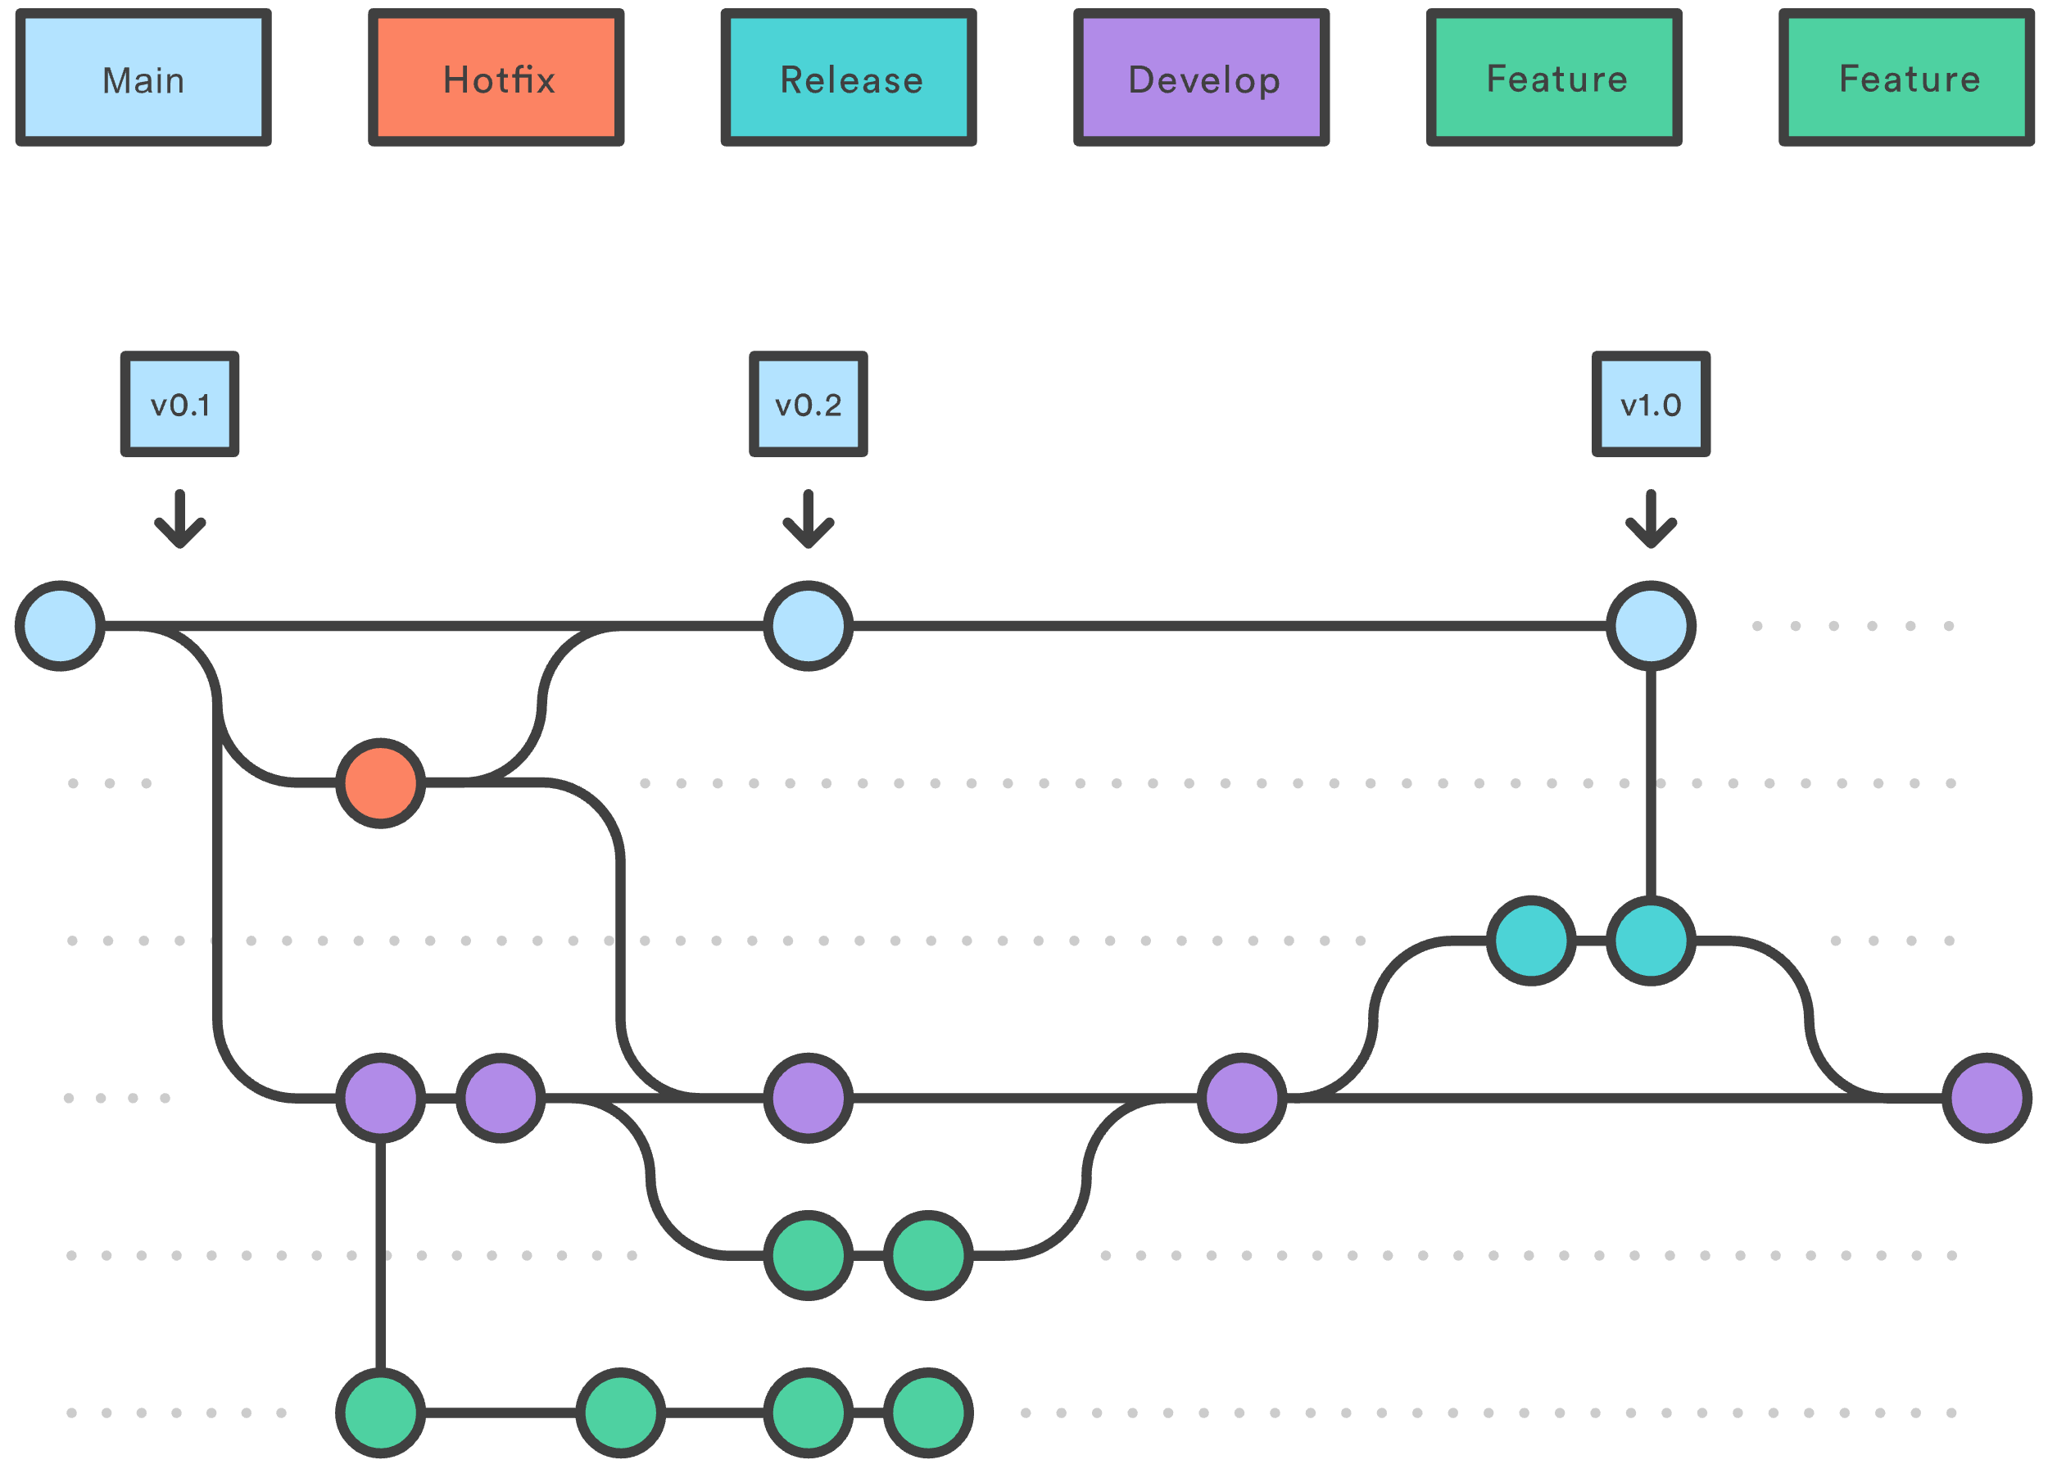
Gitflow
― Atlassian. “Gitflow Workflow.” Software Development, 2024. https://www.atlassian.com/git/tutorials/comparing-workflows/gitflow-workflow.

Slide 19

GitHub Flow
― Atlassian. “Git Feature Branch Workflow.” Software Development, 2024. https://www.atlassian.com/git/tutorials/comparing-workflows/feature-branch-workflow.

Slide 20
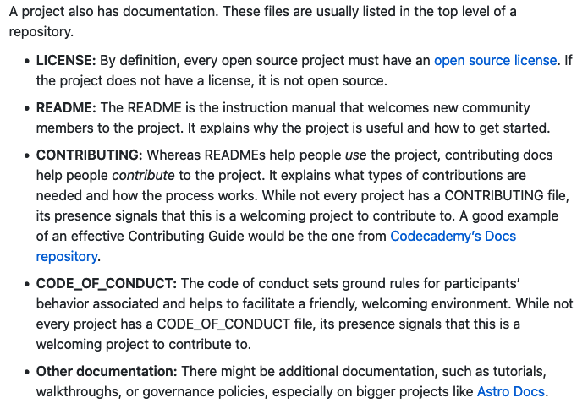
Follow the project’s existing style
― Open Source Guides. “Anatomy of an Open Source Project.” How to Contribute to Open Source, February 8, 2024. https://opensource.guide/how-to-contribute/#anatomy-of-an-open-source-project.

Slide 21
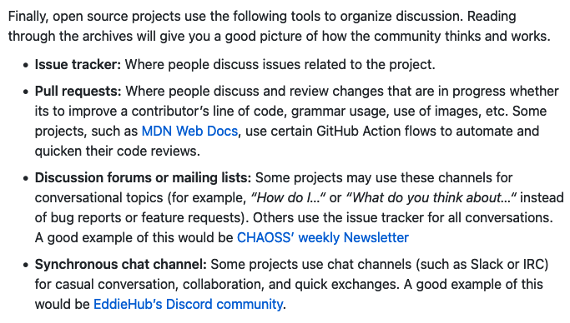
Follow the project’s existing style
― Open Source Guides. “Anatomy of an Open Source Project.” How to Contribute to Open Source, February 8, 2024. https://opensource.guide/how-to-contribute/#anatomy-of-an-open-source-project.

Slide 22
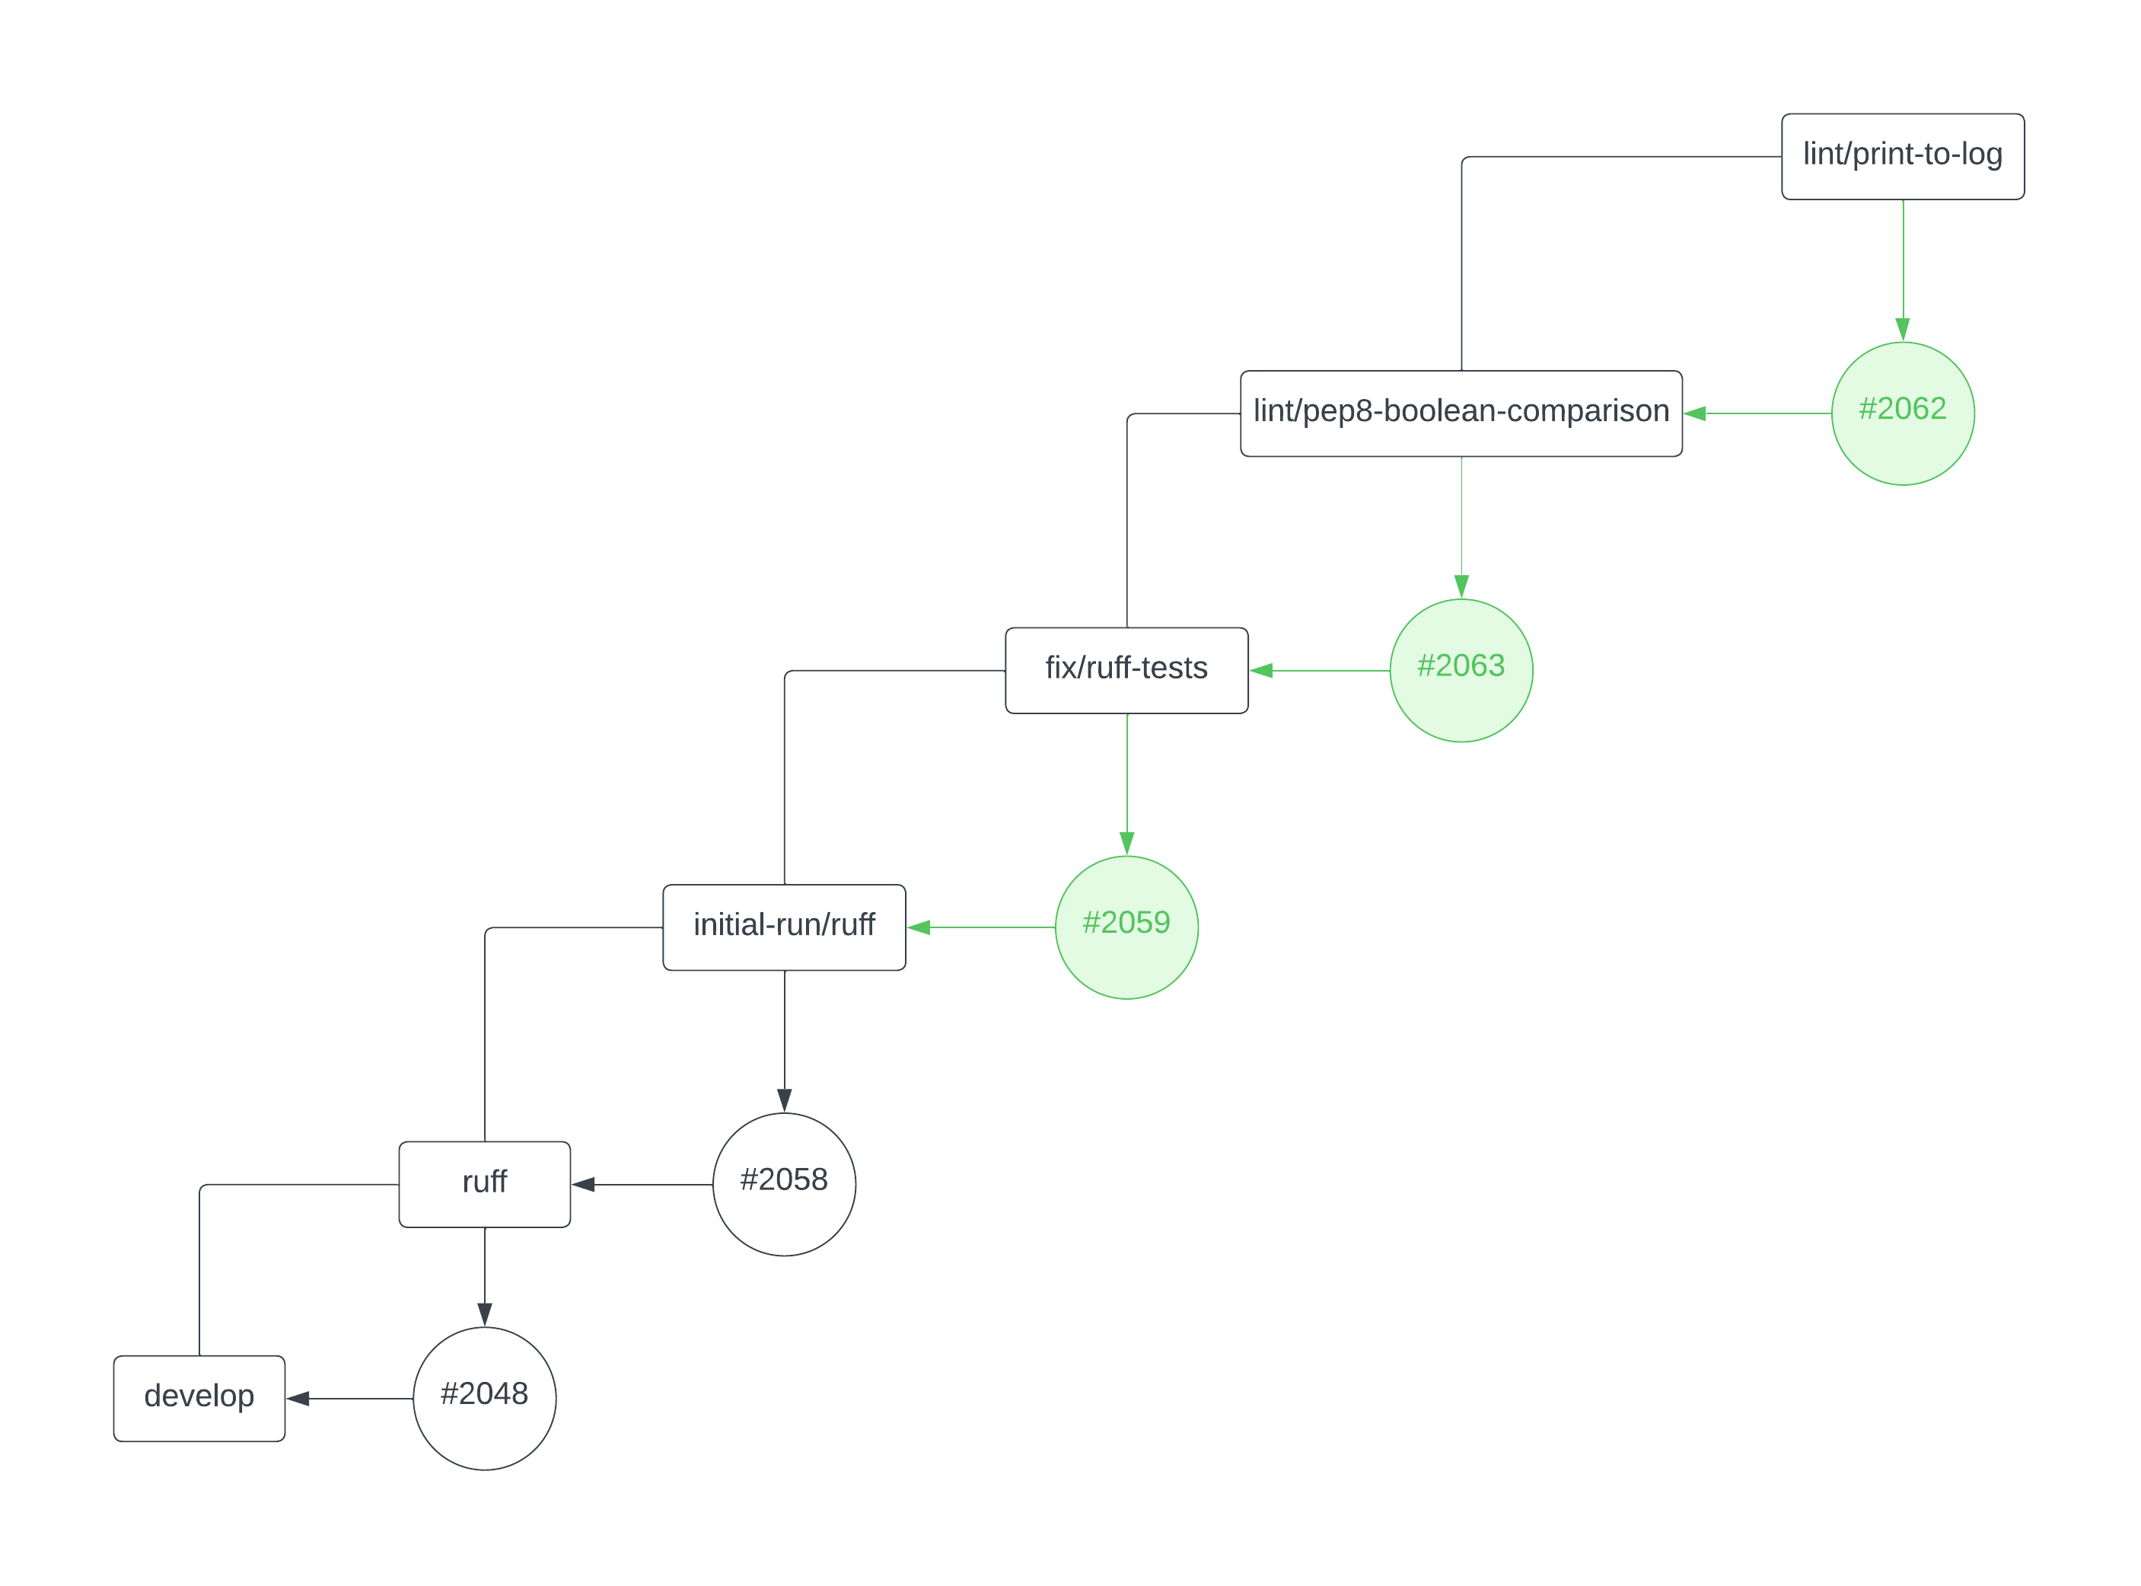
example cascade of pull requests for related feature branches

Slide 23

Collaborative programming with GitHub
Why?
What?
How?
Danger?
Help?

Slide 24

What if I mess something up?
As long as what was working was committed,
Git makes permanent irreversible changes hard to do by design.
GitHub has features like ”branch protection rules” to add further friction to publishing unintentional changes.

Slide 25
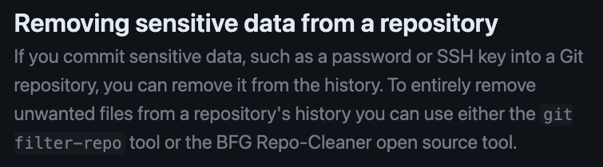
What if I need to permanently delete a mistake?
― GitHub, Inc. “Removing Sensitive Data from a Repository.” GitHub Docs. https://docs.github.com/en/authentication/keeping-your-account-and-data-secure/removing-sensitive-data-from-a-repository.

Slide 26
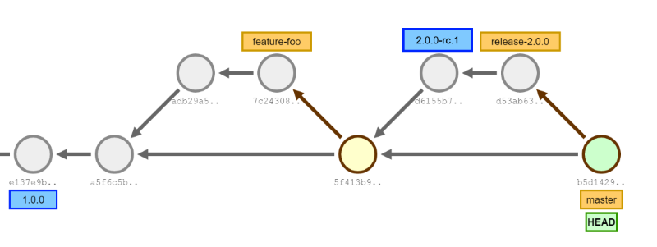
SHAs (grey) and branches (yellow) and tags (blue) …
― Git Tools. “Branching Strategies.” In GitVersion Documentation: Learn, 2022. https://gitversion.net/docs/learn/branching-strategies/.
Note: the arrows here and in the Git Pro book point to sources, reverse-chronologically.

Slide 27
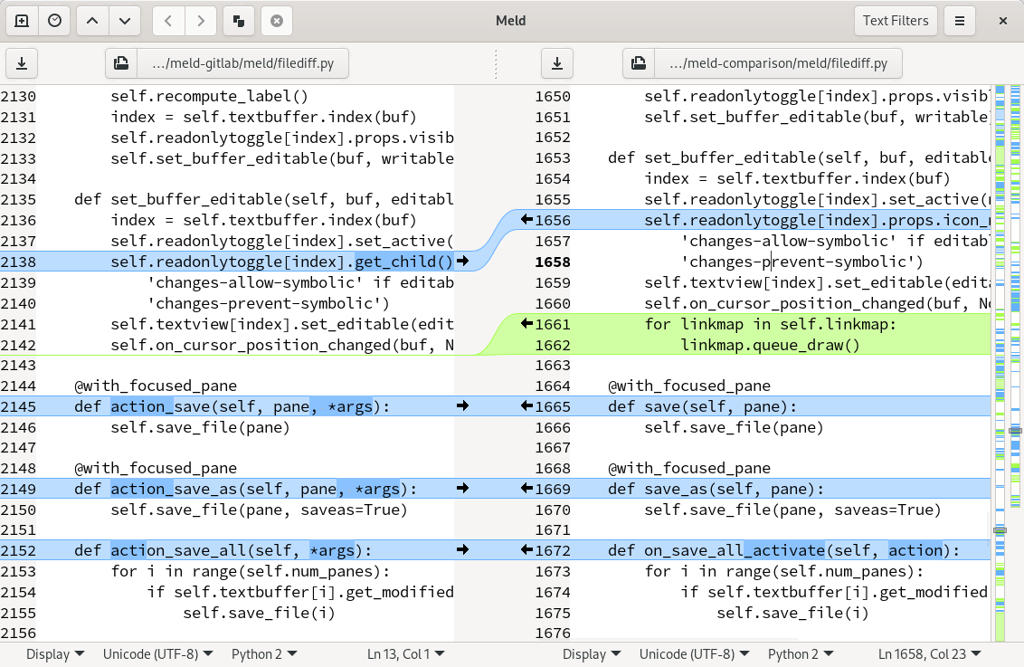
This merge conflict resolution is a nightmare.
Merge conflict resolutions are absolutely necessary.
Conflicts arise when parallel changes are made to the same code and git can’t tell how those changes should interact or affect each other.
Find a tool that works for you.
I adore Meld (https://meldmerge.org)

Slide 28

Collaborative programming with GitHub
Why?
What?
How?
Danger?
Help?

Slide 29
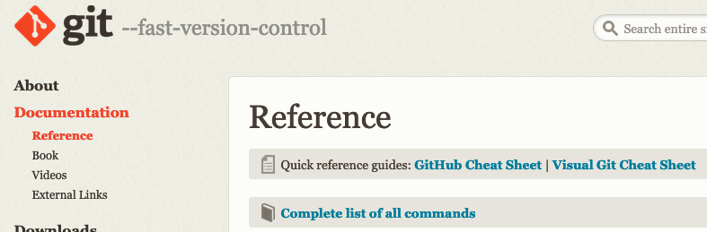
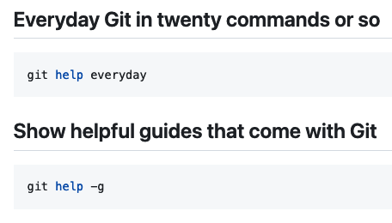

official git documentation
― Git. “Reference.” Git. https://git-scm.com/docs.
― git-tips. “Git-Tips.” 2024. git.io/git-tips.
― Chacon, Scott, and Ben Straub. Pro Git. 2nd ed. Apress, 2014. https://git-scm.com/book/en/v2.

Slide 30
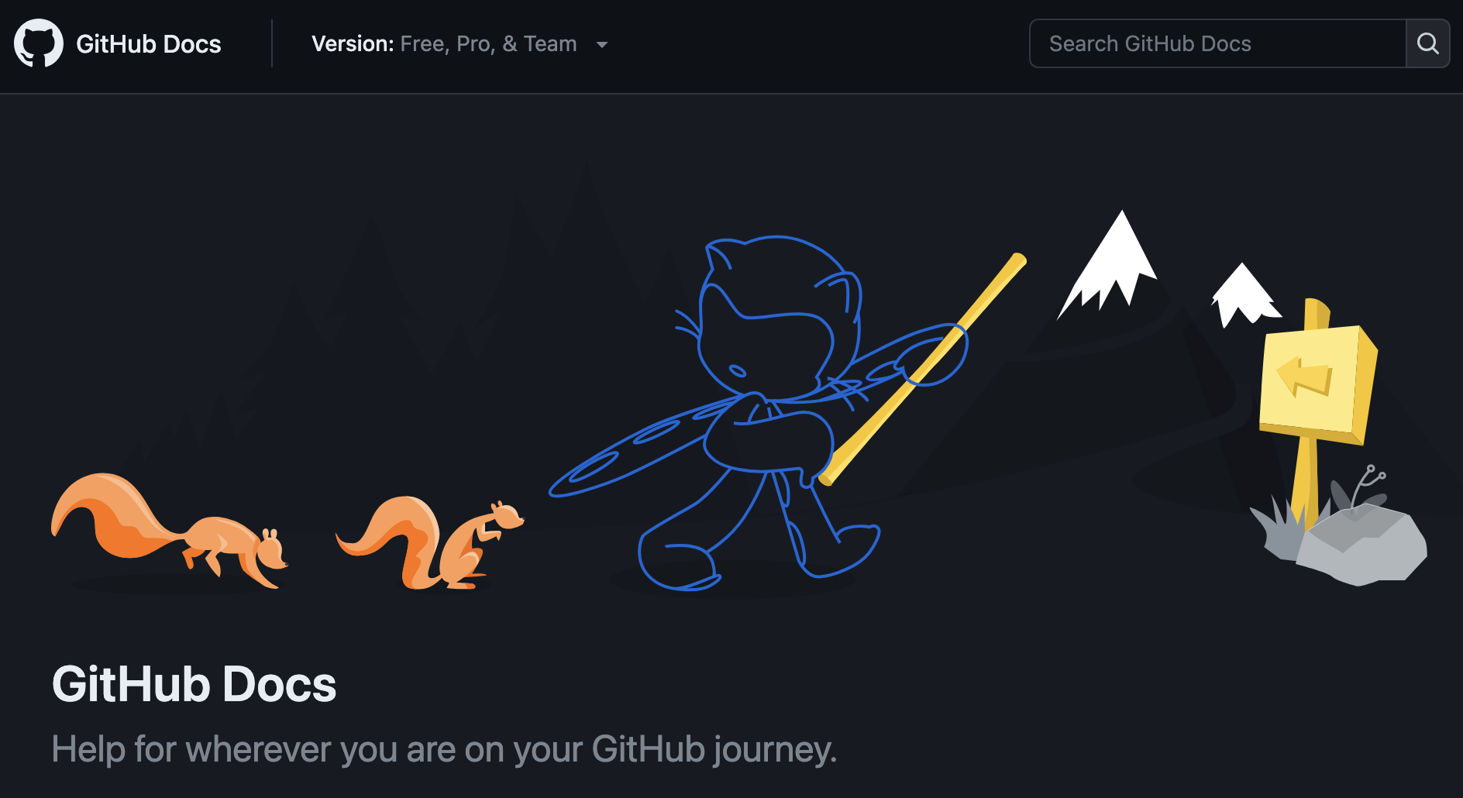

official GitHub documentation
― GitHub, Inc. “GitHub Docs.” GitHub Docs, 2024. https://docs.github.com.
― GitHub, Inc. “GitHub Skills,” 2023. https://skills.github.com/.

Slide 31

Thank you for your time and attention.
This and all other octocat illustrations in this presentation from Octodex (octodex.github.com)

