Slide 1
Code Version Control
Trainer: Huynh Quang Tan (thuynh49)

Slide 2
Agenda
Version Control Concepts
Version Control Tools
GIT Basics
GIT Branches
Code Version Tags
Tools in GIT
Git Bash
GitHub
GitLab
Q & A
Practice

Slide 3
Course Objectives
At the end of the course, you will have acquired sufficient knowledge to:
Understand the Version control concepts, tools and workflows
Manage the version of source code or files on GIT and SVN repositories
Practice the basic operations on Version control system
Do the branching and merging on Version control repositories

Slide 4
Course Audience and Prerequisite
The course is for freshers and newcomers
The following are prerequisites to Version control and Collaboration tools:
Windows
Computer skills
File management
Teamwork

Slide 5
Version Control Concepts

Slide 6
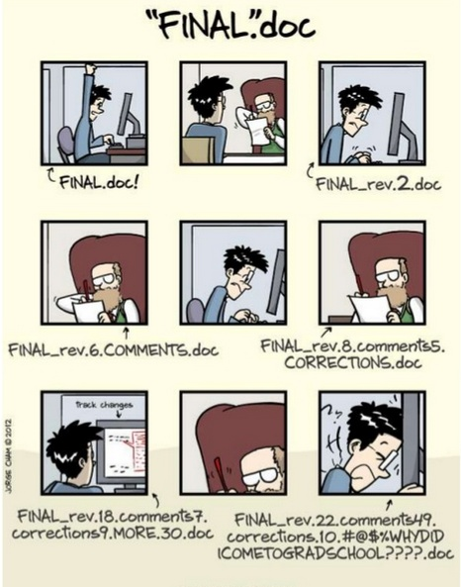
Scenario
Notes:
Asking questions

Slide 7
What is Version Control?
Method to centrally store files
Record a copy per change
Log who, when, where, what
Recover files if something wrong
Also called as revision control / source control

Slide 8
Why Version Control?
Ability to back-up
Integrate sources / sub systems
Collaboration with other people
Troubleshooting
Productivity

Slide 9
How it helps you …
Change code in small steps
Log changes in versions
Feel safe when changing code
Easy to try out things

Slide 10
How it helps team...
Allow team to work on same source base
Handle collision by merging function
Answer who did what
Team work productivity

Slide 11
Version Control System
Tool to manage file changes
Three types
Localized
Centralized
Distributed
Also called
Revision control software
Version management software
Source control software
Configuration management software

Slide 12
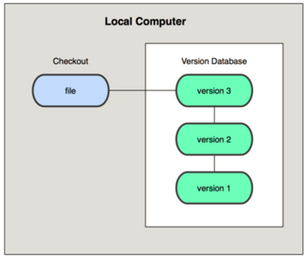
Localized Version Control System
Check out files on Local computer
Notes:
A simple database that kept all the changes to files under revision control

Slide 13
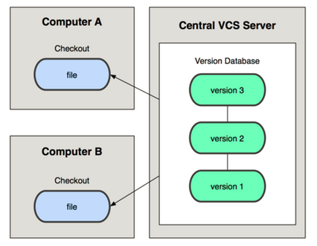
Centralized Version Control System
Check out files from Remote server
Notes:
People needed to collaborate with developers on other systems - a single server that contains all the versioned files. e.g. CVS, Subversion, Perforce
If the server goes down, nobody can collaborate or see different versions.
If the drive in the server is corrupted, everything is lost.

Slide 14







Centralized Tools
Notes:
client-server model, developers use a shared single repository

Slide 15
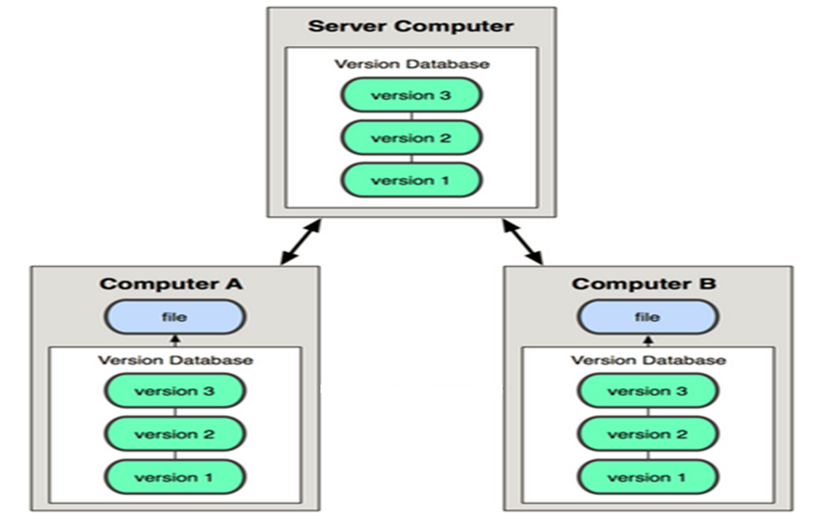
Distributed Version Control System
Check out files from Server or from peer
Notes:
Clients fully mirror the repository. Thus if any server dies, and these systems were collaborating via it, any of the client repositories can be copied back up to the server to restore it. Every checkout is really a full backup of all the data.

Slide 16





Distributed Tools

Slide 17
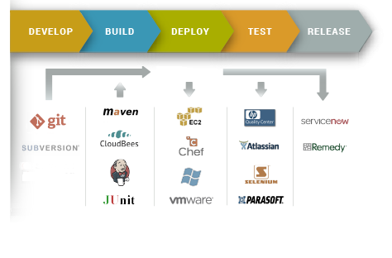
Version Control in Real World
Continuous Integration (CI) process

Slide 18
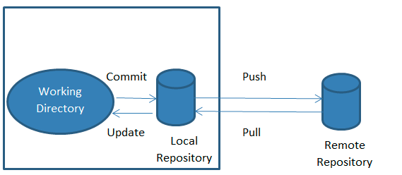
Version Control Vocabulary
Repository
Server
Client
Working Copy
Version control basic operation
Notes:
Repository Where files’ current and historical data are stored.
• Server A machine serving the repository.
• Client The client machine connecting to the server.
• Working copy Local copy where the developer changes the code.

Slide 19
Basic Operations
Add
Change
Commit
Revert
Update
Tags
…
Version control basic operation

Slide 20

What is branch?
Copy of current tree / workspace
Support parallel development

Slide 21
Version Control Tool: Git

Slide 22
GIT
Distributed Version Control System
Multiple redundant repository
Each dev have a copy of repository & history
Community support and use widespread currently
Reference at https://git-scm.com/downloads

Slide 23
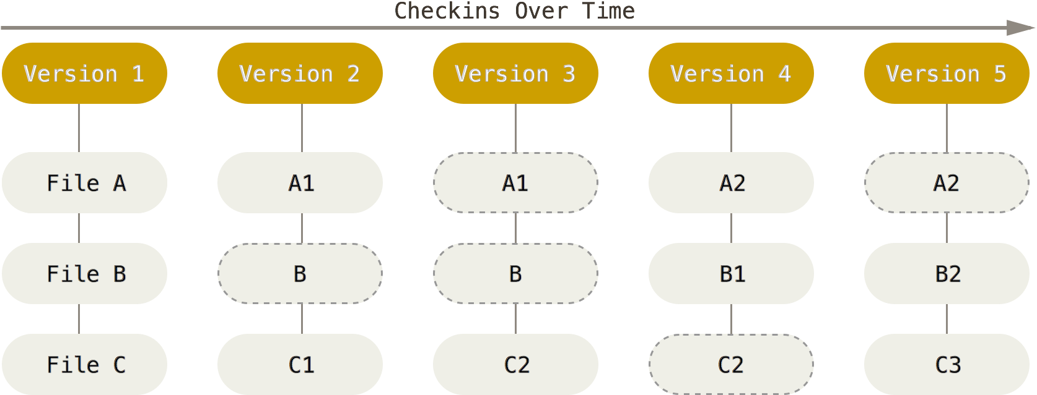
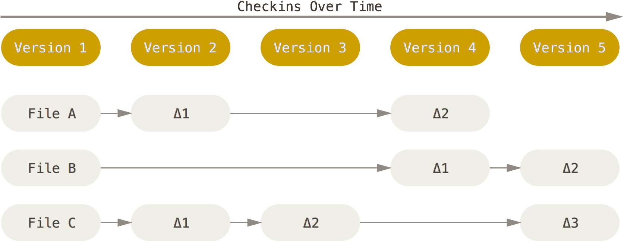
GIT & Not GIT behavior
Stores Snapshot of files
Stores List changed files (NOT GIT)
GIT check in (top) and not GIT check in (bottom)

Slide 24
Why GIT?
Best branching & merging mechanism
Work offline
Easy switch, no checkouts
Data Assurance
Undo mistake
Free Opensource

Slide 25
Git Basics

Slide 26
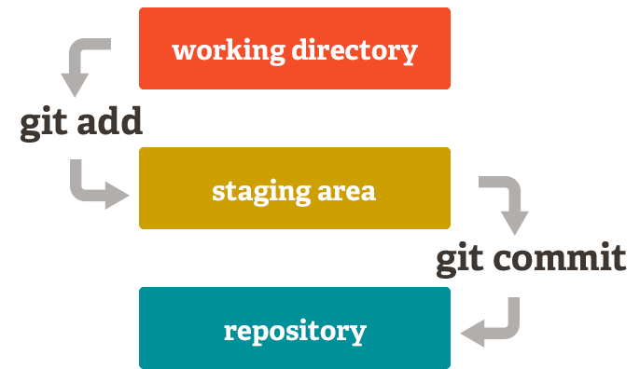
The three stages of GIT
The basic Git workflow:
Create: You get files in your working directory.
Stage: adding snapshots of them to your staging area.
Commit: takes the files in the staging area and stores that snapshot permanently to your Git directory.
GIT commit workflow

Slide 27

GIT Common Basic Commands
Add
branch
checkout
clone
commit
diff
init
log
merge
pull
push
status
rm
mv
Add file a:
git add a
Commit file a:
git commit –m ‘add a’
Push file a to server:
git push origin master
GIT basic commands

Slide 28
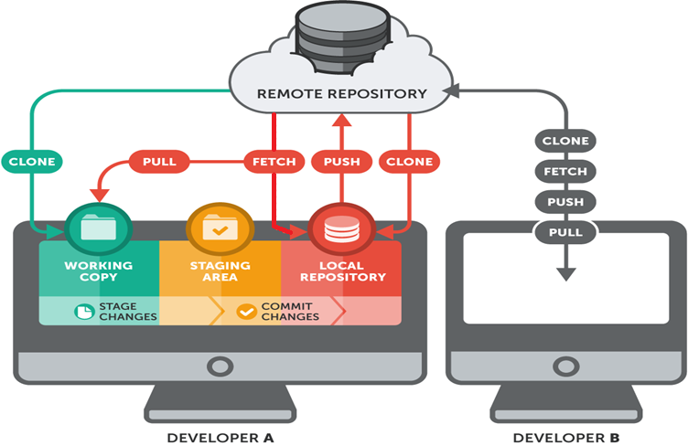
GIT workflow
GIT clone, fetch, push and pull from server

Slide 29
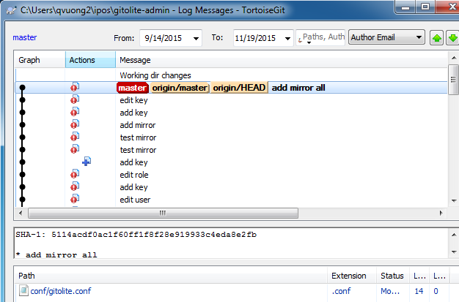
Git Basics - Viewing the Commit History
How to view history
Limit log output
Use GUI to visualize history

Slide 30
Git Basics
Summary
Know how to create repository
How to make, stage and commit changes
Ways to view the history of changes

Slide 31
Git Branches

Slide 32
Branches on Git
What is branch?
A branch is a lightweight movable pointer to the commits
The default branch name is master
Create a branch
Create and check out a new branch: git checkout –b test
Switch to an existing branch
Check out ‘master’ branch: git checkout master

Slide 33
Branches on Git – Merging
Merging
Combine two branches i.e.: master and test
Command on master branch: git merge test
Resolving merge conflicts
Control the different between two branches.
Managing branches
Show branches with command: git branch

Slide 34

Git Branches
Default Branch
master
Create new branch
git branch develop-v1
Create and switch to new branch
git checkout –b develop-v3
Switch to branch and merge existing branch as well
git merge develop-v3 master

Slide 35
Branches on Git
Summary
Covered basic branching and merging in Git.
Create, switch between branches and merge / rebase local branches
Share branches by pushing them to a shared server

Slide 36
Code Version Tags

Slide 37
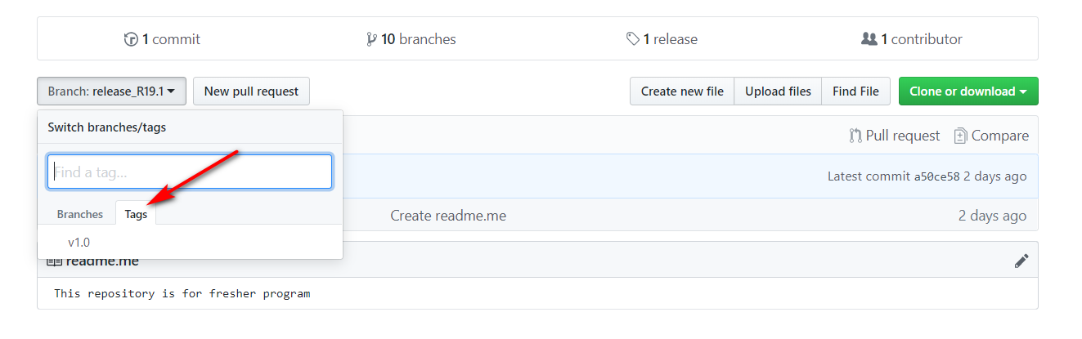
Code Version Tags

Slide 38
Tools in Git
Notes:
you’ll see how to work with Git in a distributed environment as a contributor and an integrator. That is, you’ll learn how to contribute code successfully to a project and make it as easy on you and the project maintainer as possible, and also how to maintain a project successfully with a number of developers contributing.

Slide 39

Git Installation
Download TortoiseGit from URL:https://tortoisegit.org/download/
Choose your version 32bit or 64bit OS.
Double click TortoiseGit-1.8.15.0-64bit.msi to install it.

Slide 40
Git Demo
Create and manage a file version on Git repository
Notes:
Clone a repository from Git server
Create a new file
Add to local repo and commit to staging area
Push to Git server
Pull/fetch repository from server
Branching and Merging

Slide 41
GitBash
Notes:
you’ll see how to work with Git in a distributed environment as a contributor and an integrator. That is, you’ll learn how to contribute code successfully to a project and make it as easy on you and the project maintainer as possible, and also how to maintain a project successfully with a number of developers contributing.

Slide 42
Git Commands
Notes:
Clone a repository from Git server
Create a new file
Add to local repo and commit to staging area
Push to Git server
Pull/fetch repository from server
Branching and Merging

Slide 43
GitHub

Slide 44

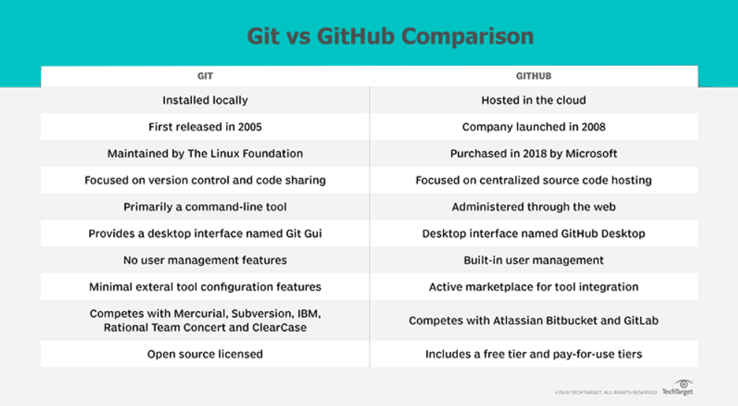
Git vs GitHub

Slide 45
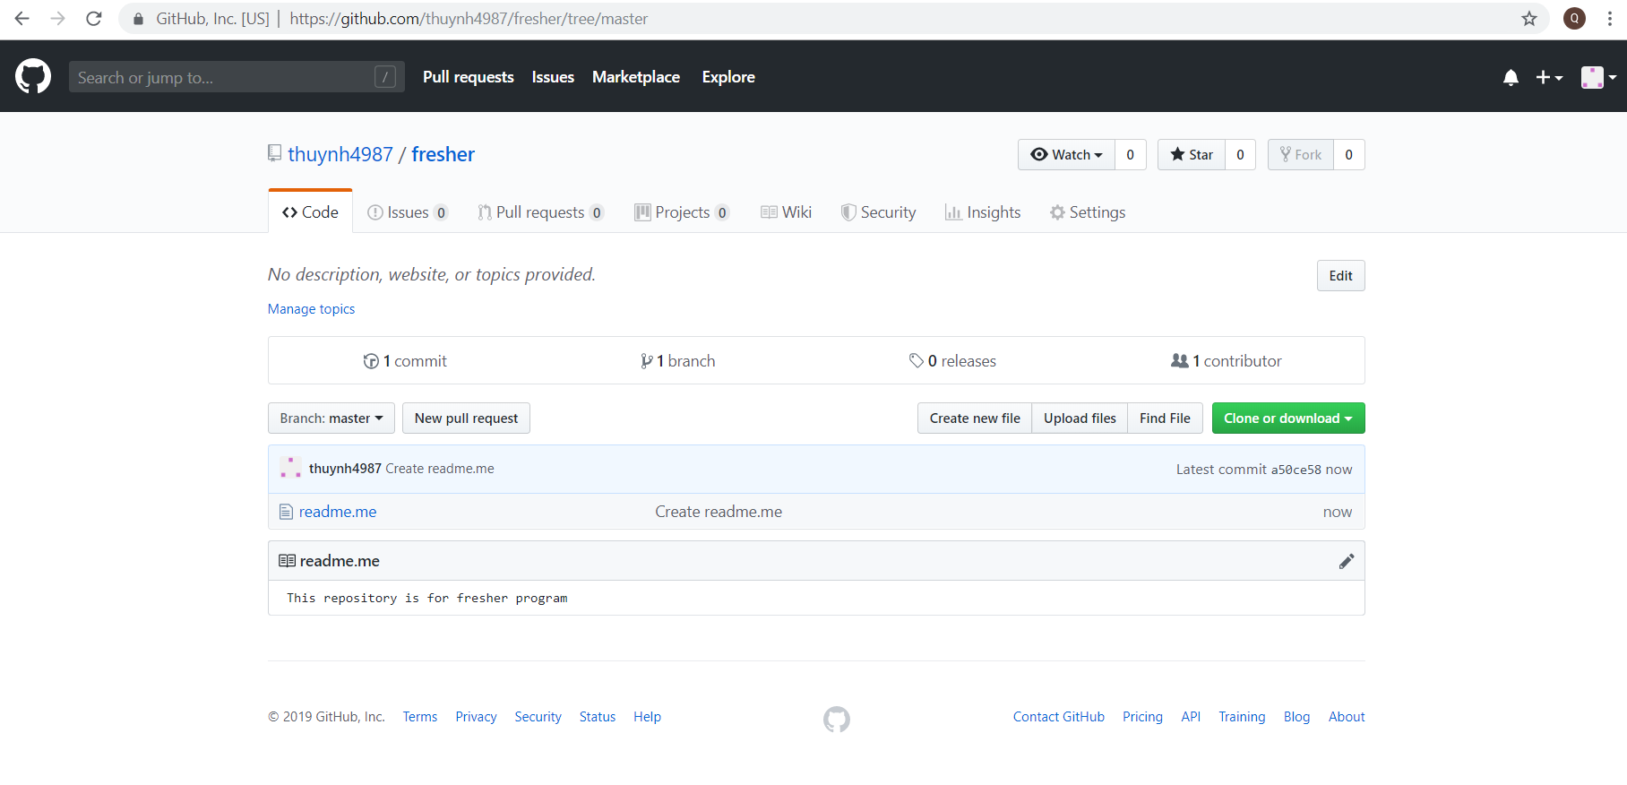
Github Repository

Slide 46
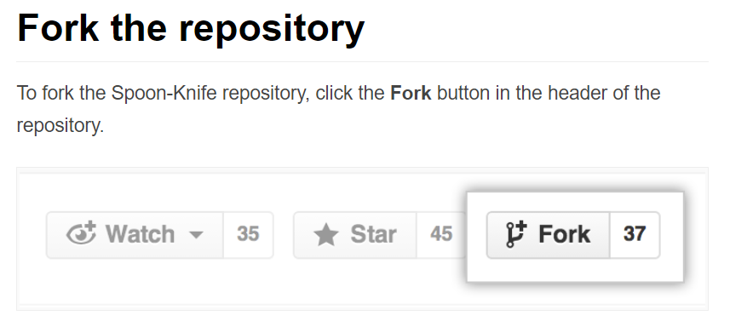
Github Fork

Slide 47
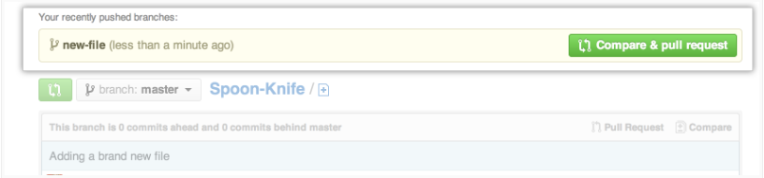
Github Pull Request

Slide 48
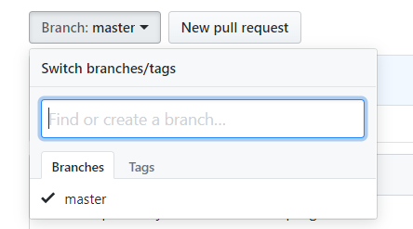
Github Branch

Slide 49
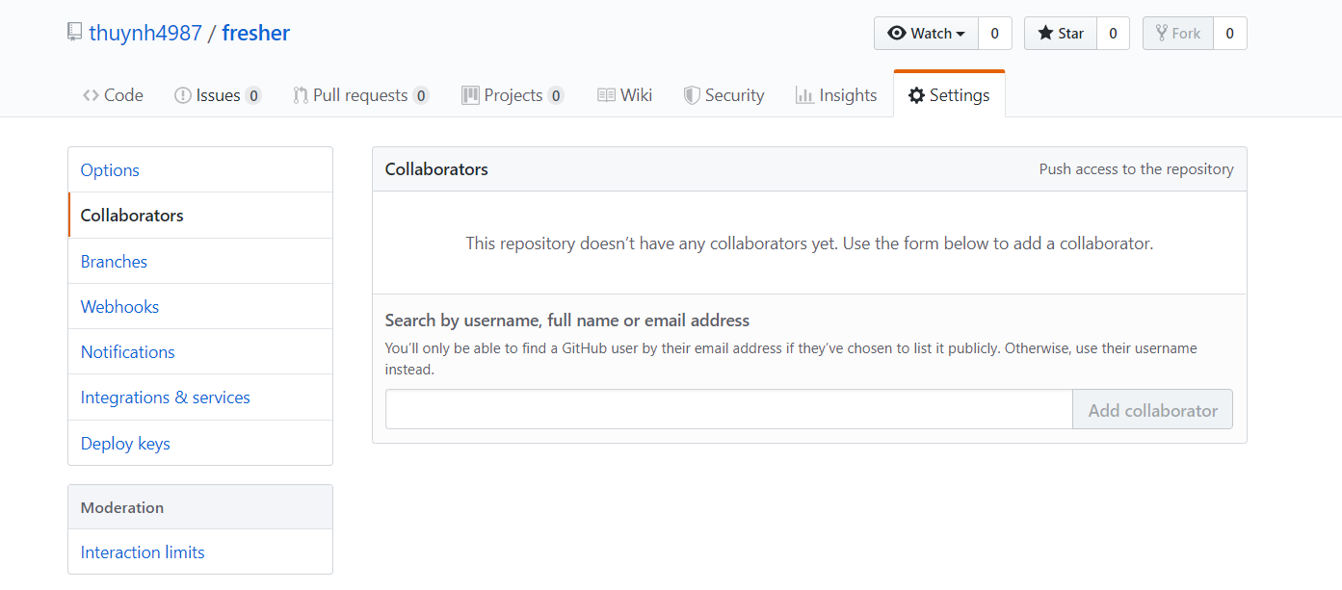
Github Collaborator

Slide 50
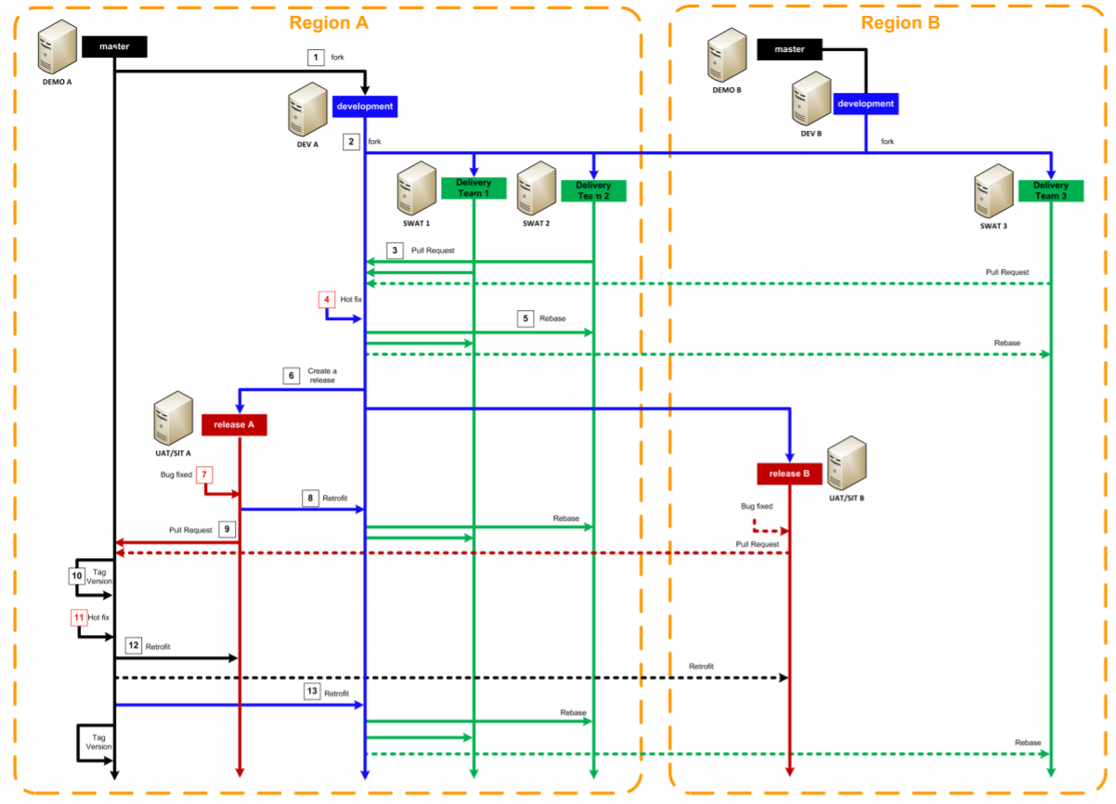
GitHub Process

Slide 51
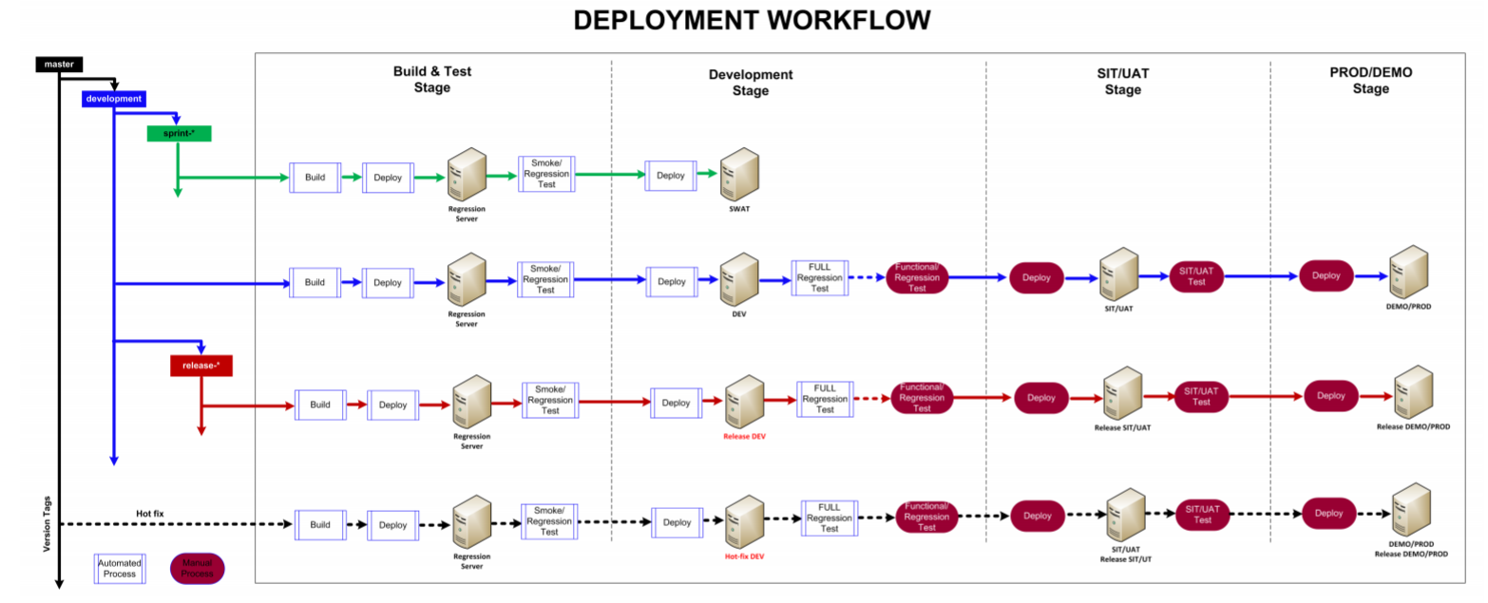
Deployment Process

Slide 52
GitLab

Slide 53

GitLab Outstanding Features
Self-hosted
Built-in CI
Lower Prices – Free Private Repos – Free Docker Registry

Slide 54
References
Version Control:
https://www.atlassian.com/git/tutorials/what-is-version-control
GIT:
https://git-scm.com/downloads
GITHUB
https://guides.github.com/
https://usersnap.com/blog/gitlab-github/

Slide 55
Questions & Answer

Slide 56
Practice

Slide 57
Basic Exercises
Register GitHub account on https://github.com/ (Final project Github Repos)
Creating GitHub Repos
Download and Install TortoiseGit
Clone code from GitHub Repos to local PC
Create new code files in the cloned repo.
Add and commit new code files to remote repo.
Push new code files to GitHub.
Create GitHub Branches
Push new code files to GitHub Branches
Fork and Clone code files from other account’s GitHub Repos
Create pull request to other account’s GitHub Repos
Add collaborators to GitHub Repos

Slide 58
Study Cases
Dealing with code conflicts
2 or more DEV members clone code from the same Github repo
Dev members update different code to the same code file
Dev members commit and push this code file to the same Github repo
Solution:
Always pull latest code before commit and push new code files to Github Repos to minimize conflict probability
Conflicts on the same code file: Comparing and merging code manually

Slide 59
Study Cases
Code retrofit
Github Repos have many branches (ex: Master, Development, Release1, etc.)
Master: production env
Development: ongoing code development
Release1: SIT/UAT envs
Dev team wants to fix bugs on Master branch
Solution:
Pickup bug files from Master branch and merge them manually to Release1 branch, update new code on this branch and deploy them on Master branch later
This bug files also will be merged manually to Development branch to secure the stability of future Release branches.

Slide 60
Study Cases
Git revert and reset
Revert code to previous commits
Reset code to previous commits

Slide 61
Thank You!

Slide 62
Revision History
Date | Version | Description | Updated by | Reviewed and Approved By
Aug 10, 2015 | 0.5 | Ready for review | Thien Tran | Quang Tran
Nov 26, 2015 | 1.0 | Ready for review | Quan Vuong | Quang Tran
Aug 2017 | 2.0 | Retheme with DXC template |  | Quang Tran
July 2019 | 3.0 | Updating contents with Gihub and Study Cases | Huynh Quang Tan

