Slide 1
JIRA Agile for Scrum Framework
Trainer: Mai Nguyen

Slide 2
Course Objectives
At the end of the course, you will acquire sufficient knowledge of JIRA Agile tool and be able to start applying it into your project
Knowledge to gain from the course include:
Backlog Management
Sprint Planning / Tracking
Epic Planning / Tracking
Version Planning / Tracking
Working with Issues (Epic, User Story, Task)
Agile Reports
Notes:
Product Owner owns these activities
The team involves in the last activity

Slide 3
Course Audience and Prerequisite
The course is for everyone who work in a project
Pre-requisites:
Basic knowledge of Agile Process
Notes:
Product Owner owns these activities
The team involves in the last activity

Slide 4
Assessment Disciplines
Class Participation: 70%
Practice: 30%
Passed Score: 80%
Notes:
Product Owner owns these activities
The team involves in the last activity

Slide 5
Course Administration
In order to complete the course you must
Sign in the Class Attendance List
Participate in the course and complete assignment
Provide your feedback in the End of Course Evaluation
Notes:
Product Owner owns these activities
The team involves in the last activity

Slide 6
Duration and Course Timetable
Course Duration: 3 hours
Tool Introduction: 2 hours
Practice: 1 hour
Notes:
Product Owner owns these activities
The team involves in the last activity

Slide 7
Agenda
JIRA Agile Introduction
JIRA Agile with Scrum
Practice
Q & A

Slide 8
JIRA Agile Introduction

Slide 9
JIRA Agile Overview
JIRA Agile is
A tool for Agile framework
Available as a downloadable package and on-demand service
With JIRA Agile , the team can
Create and maintain product backlog
Estimate user stories
Build a sprint backlog
Identify velocity
Visualize team activity
Report on team progress
JIRA Agile can integrate with Confluence, Bamboo, Jenkins, Git, Stash, Crucible, etc.

Slide 10
JIRA Agile Concepts
Level 1
Project Categories
Projects
Level 2
Components (sub-section)
Versions (milestones)
Level 3
Issues (Epics, User Stories)
Level 4
Sub-Tasks
Sub-Tasks
Sub-Tasks
Sub-Tasks

Slide 11
JIRA Agile with Scrum

Slide 12
Scrum Framework Overview
Game Phase
Sprint Planning Meeting
Daily Standup Meeting
Backlog Refinement Meeting
Sprint Review Meeting
Sprint Retrospective Meeting
Pre-game Phase
Create product backlog
Post-game Phase
Closure
Scrum Roles: Product Owner, Scrum Master, Team (System Administrator, Project Lead, Development Team, etc.)

Slide 13
Administrative Tasks

Slide 14
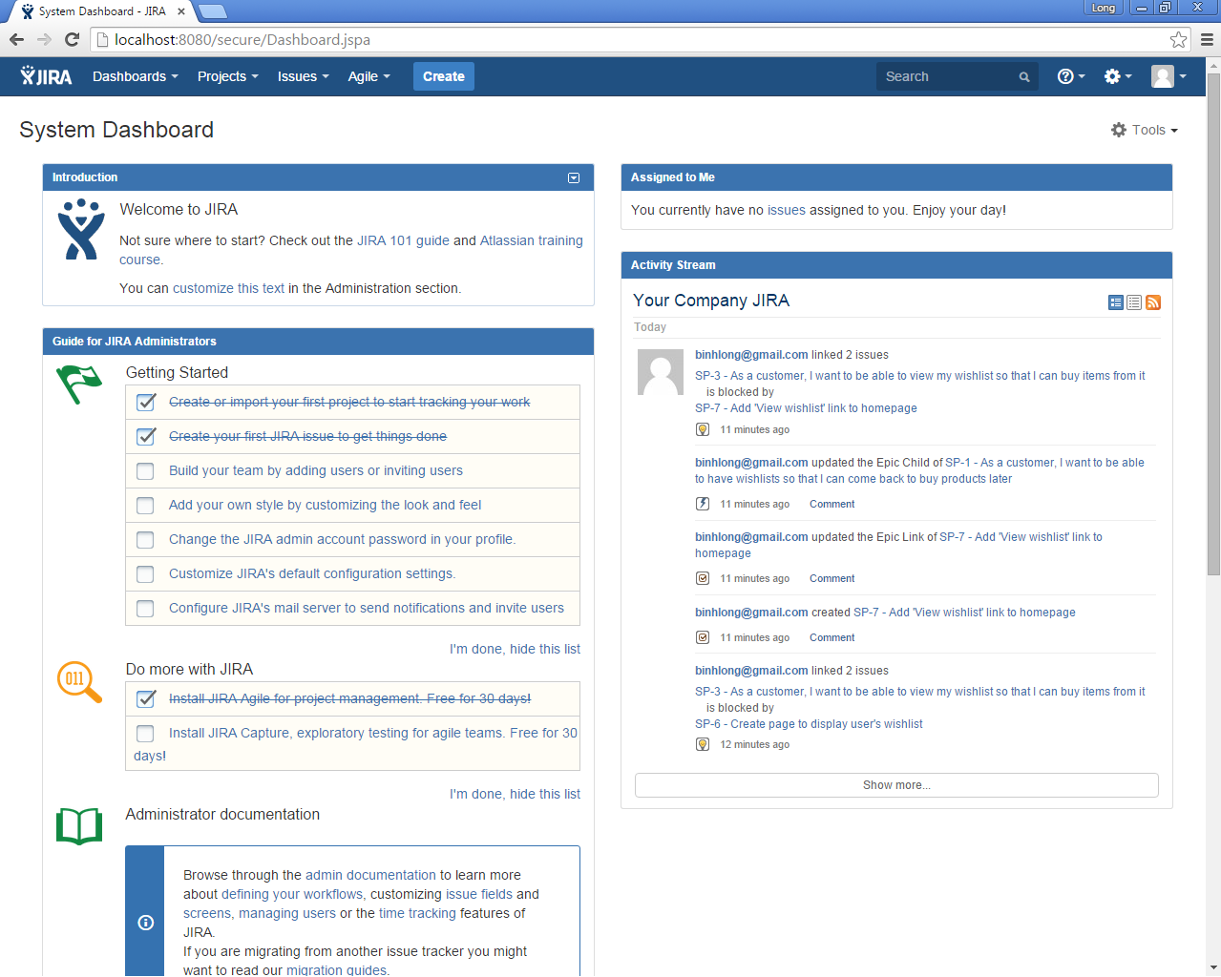
System Administrator – Dashboard
Dashboards is the first screen user see when logging in to the system
Dashboard can be configured to display many different types of information, depending on areas of interest

Slide 15
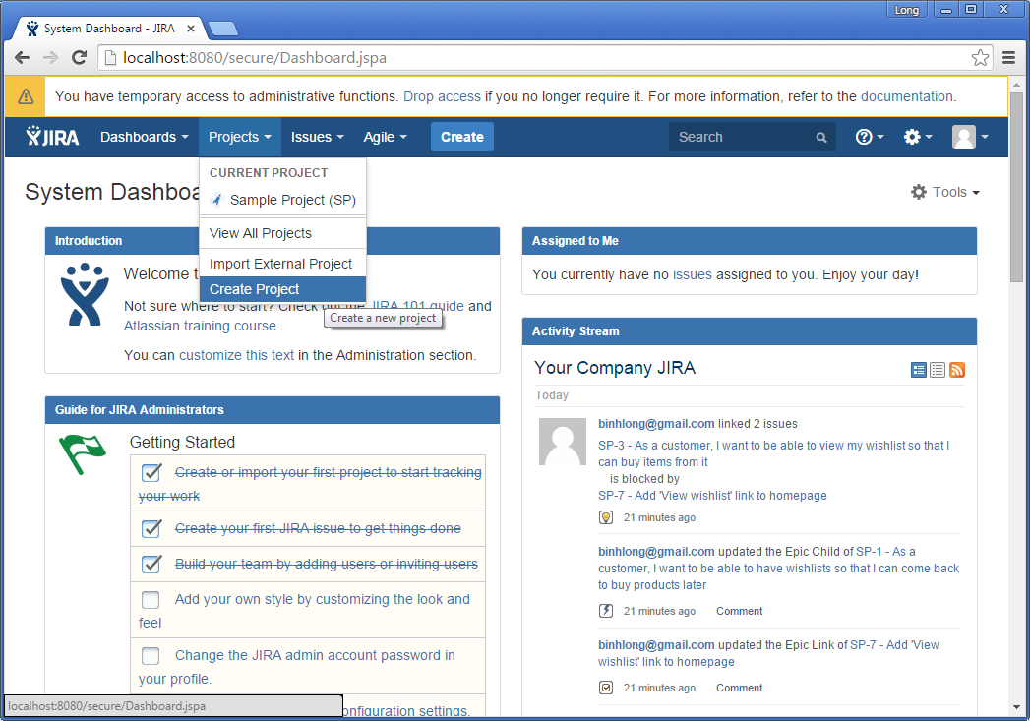
System Administrator – Create Project
Create a new project

Slide 16
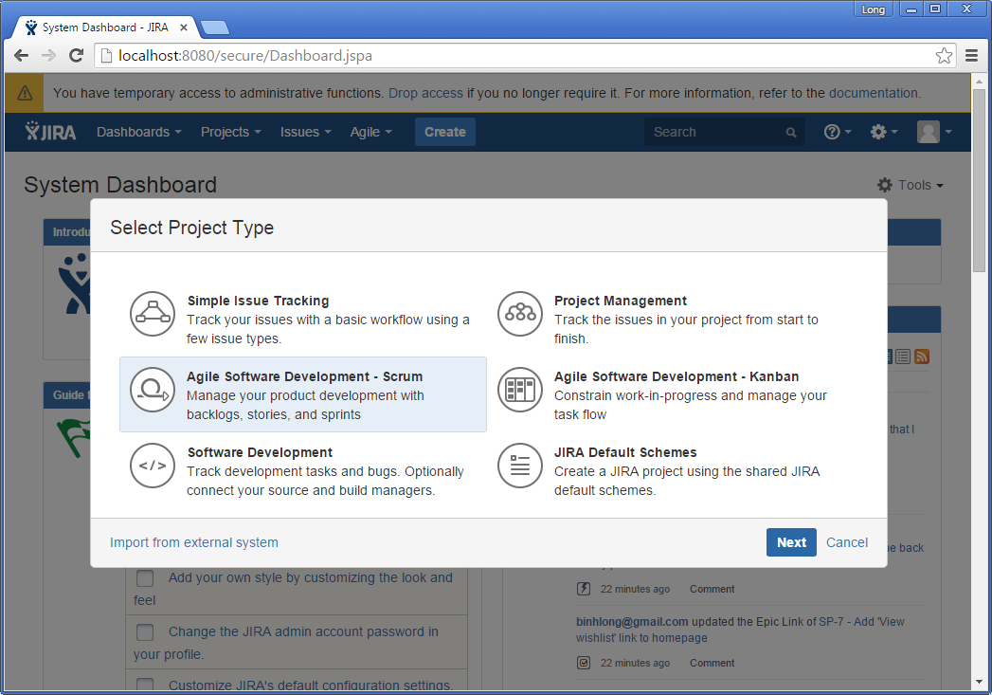
System Administrator – Create Project – Select Project Type
Create a Scrum project

Slide 17
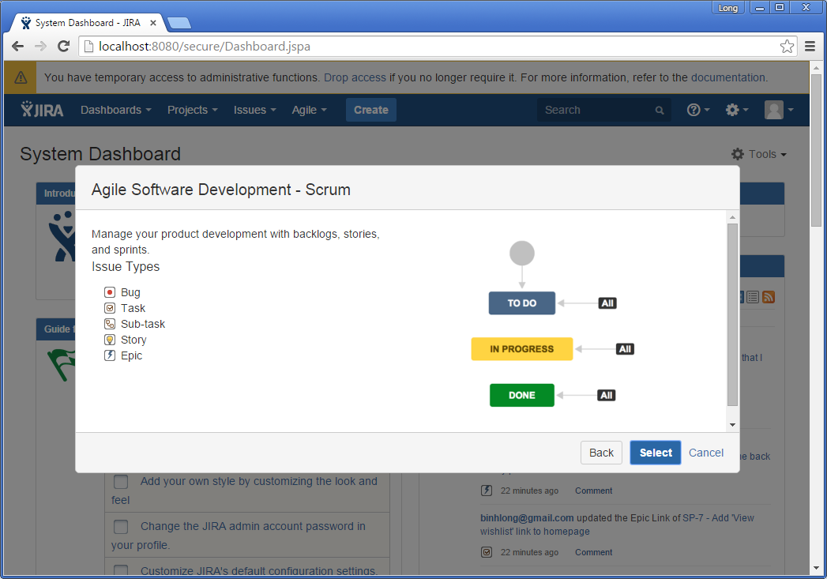
System Administrator – Create Project – Review Workflow
Review a workflow of a selected project type

Slide 18
Scrum Simplified Workflow
Has three default steps for Scrum boards: To Do, In Progress, Done
Allows issues to be dragged freely between columns
Displays no screens on any transitions – all transitions will happen instantly
Automatically sets a resolution of 'Done' when issues are transitioned to the 'successful' column
Notes:
Number of columns is customizable .
Every project uses either a JIRA Workflow or a Simplified Workflow to control the transitioning of issues from one status to another. The workflow determines which statuses are available
Every board can represent one or more projects, however Simplified Workflow can only be used if a board represents a single project. Every project uses either a JIRA Workflow or a Simplified Workflow to control the transitioning of issues from one status to another. The workflow determines which statuses are available.
If your project was created together with a board via the JIRA Agile Getting Started page, it will probably be using a Simplified Workflow. If your project was created via JIRA, it will be using a JIRA Workflow.

Slide 19
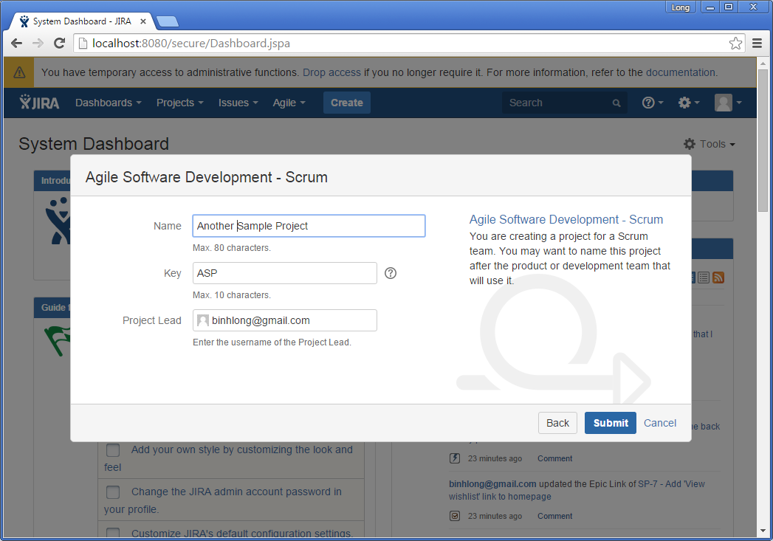
System Administrator – Create Project – Enter Properties
Enter project name, project key, and specify the lead

Slide 20
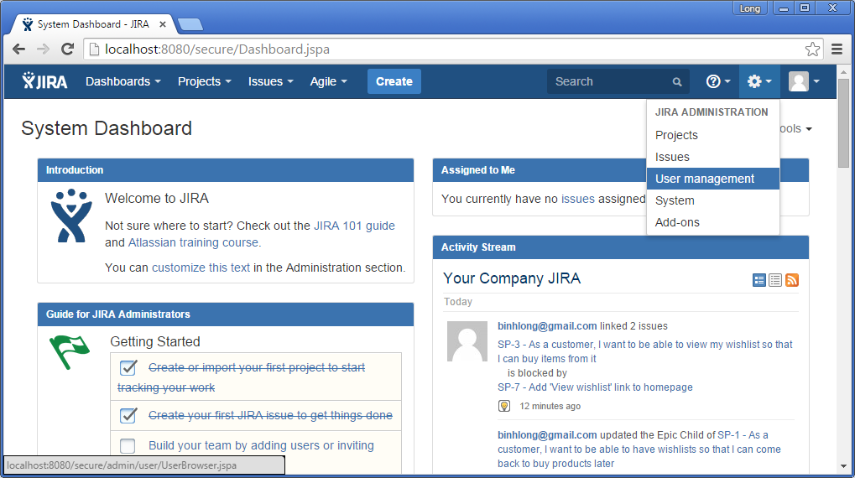
System Administrator – User Management
Select User Management to add/edit/delete users

Slide 21
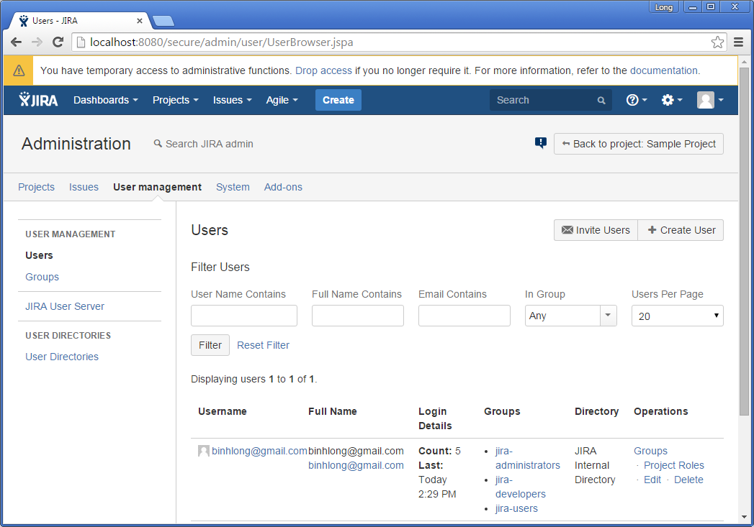
System Administrator – User Management – List All Users
Display list of all available users

Slide 22
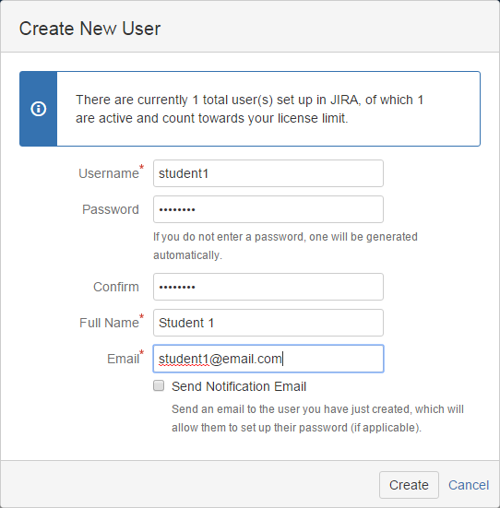
System Administrator – User Management – Create User
Enter user’s properties to create a new user

Slide 23
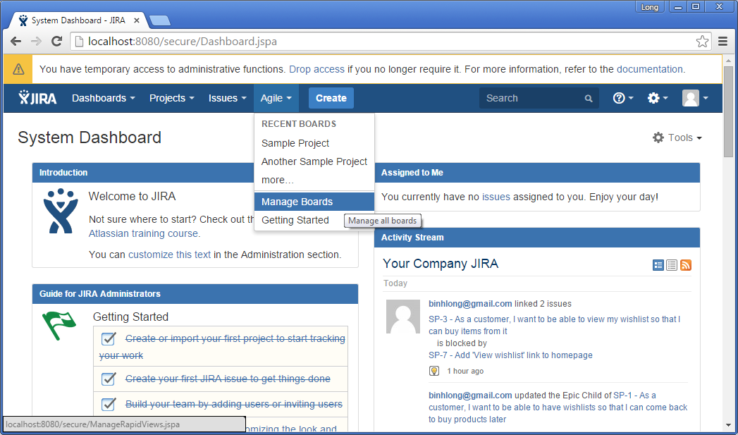
Project Lead – Manage Board
Project lead can configure board properties

Slide 24
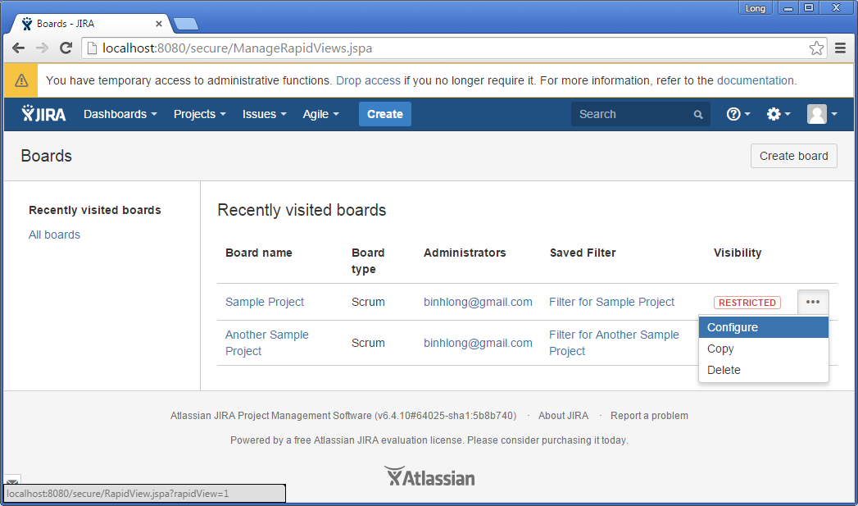
Project Lead – Manage Board
Project lead can configure board properties

Slide 25
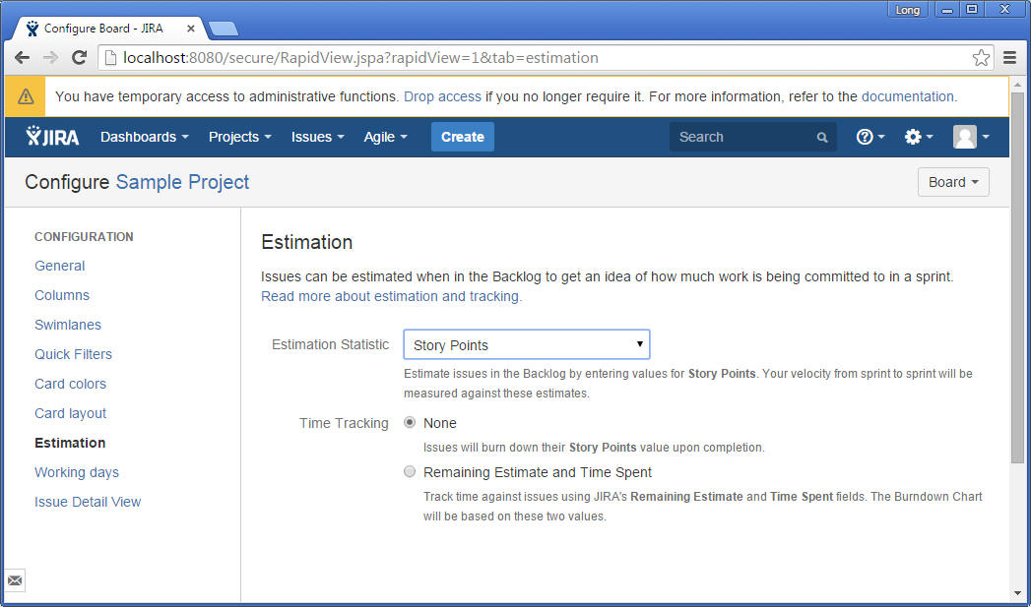
Project Lead – Manage Board – Estimation
Many Scrum teams estimate stories in Story Points, then track tasks using hours
By default, your Scrum board will use Story Points for estimation, and will also use Story Points for tracking
JIRA Agile has the flexibility to set your estimation and tracking statistics differently, depending on what best suits your team

Slide 26
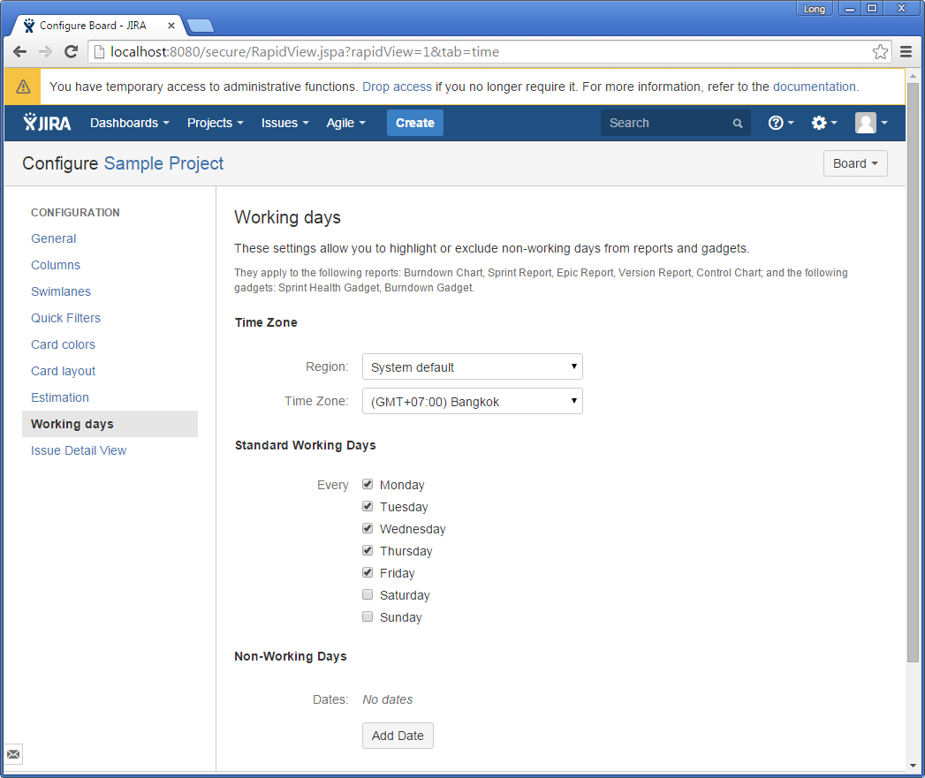
Project Lead – Manage Board – Working Days
Select Working Days and Non-Working Days

Slide 27
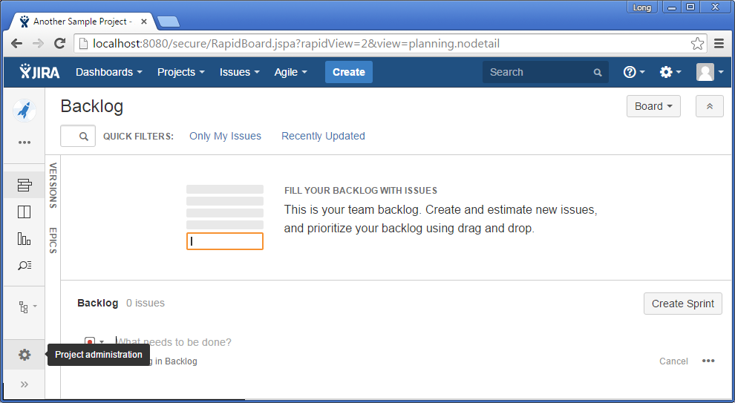
Project Lead – Project Administration
View Project Administration area

Slide 28
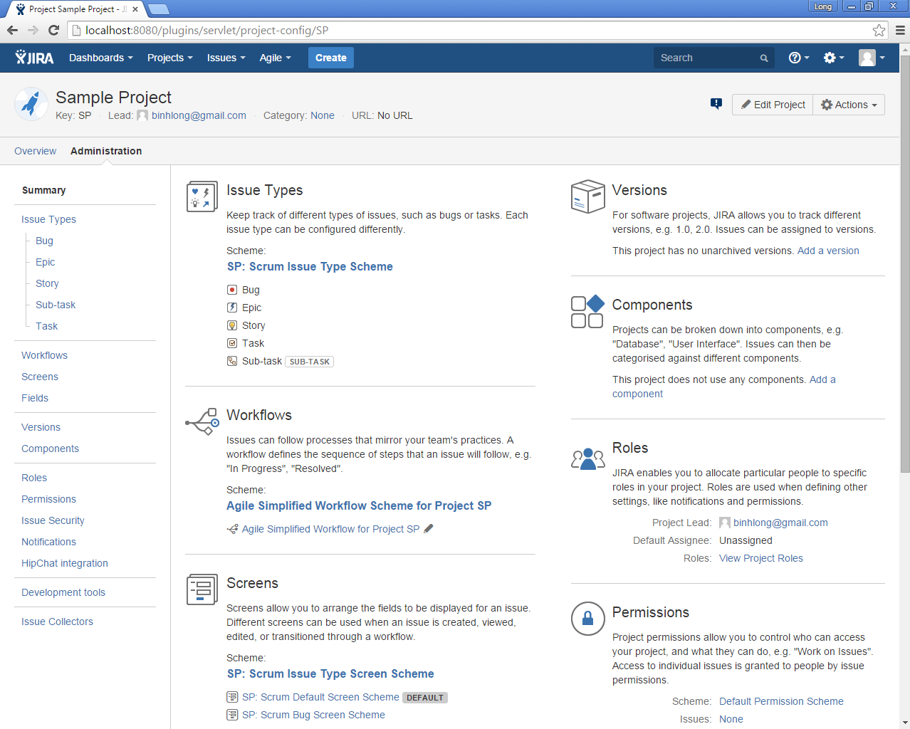
Project Lead – Project Roles
View Project Roles

Slide 29
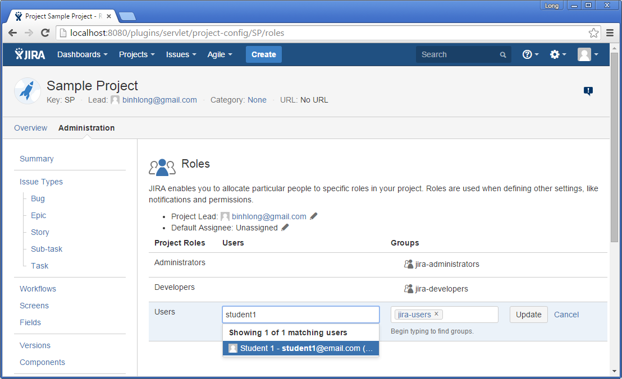
Project Lead – Project Roles – Add an User
Add an user to a selected role

Slide 30
Project Lead – Version Management
A version is a set of features and fixes released together as a single update to your product

Slide 31
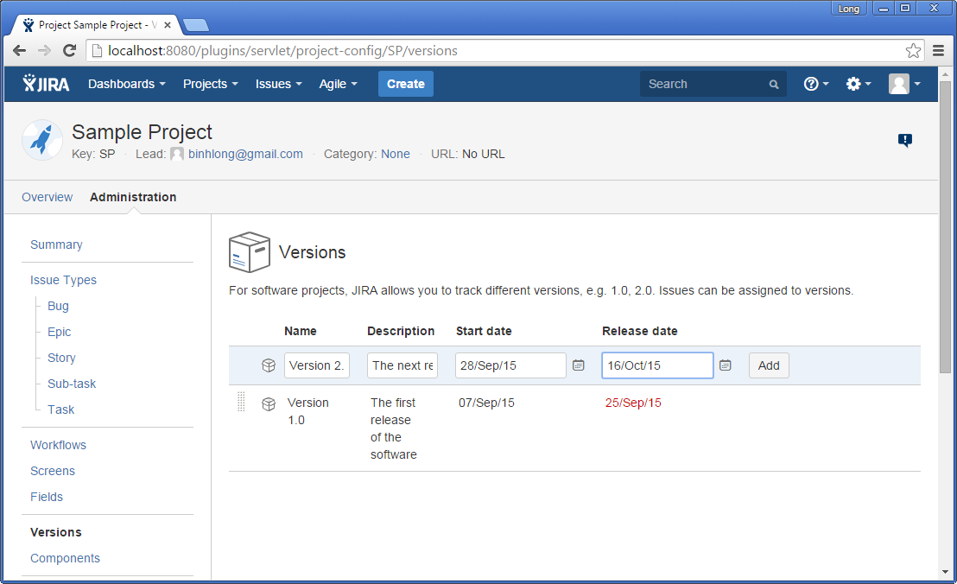
Project Lead – Version Management…
Add/update/delete versions of a project

Slide 32
Product Backlog Management

Slide 33
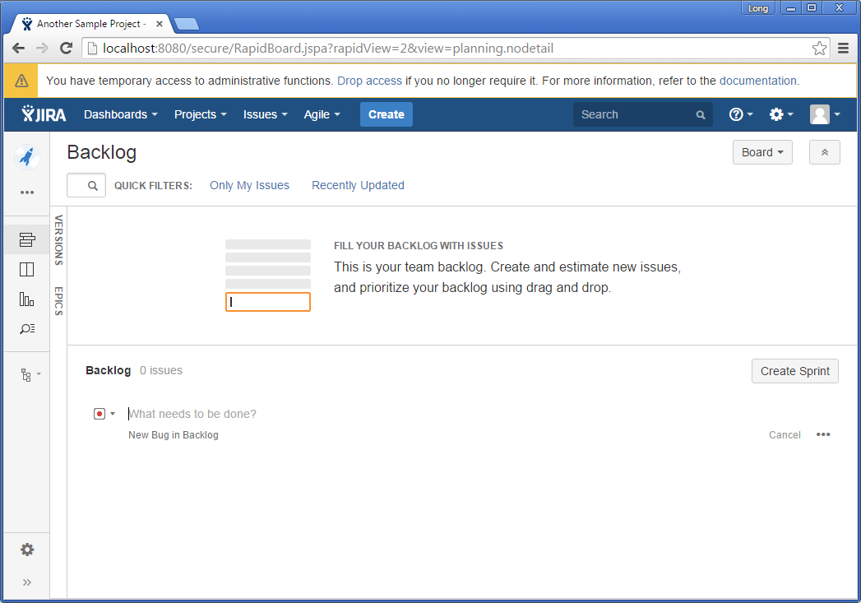
Product Owner – Manage Product Backlog
Product Backlog: A list of all desired work on the project in terms of user stories
Product Owner can add/edit/delete/prioritize product backlog items

Slide 34
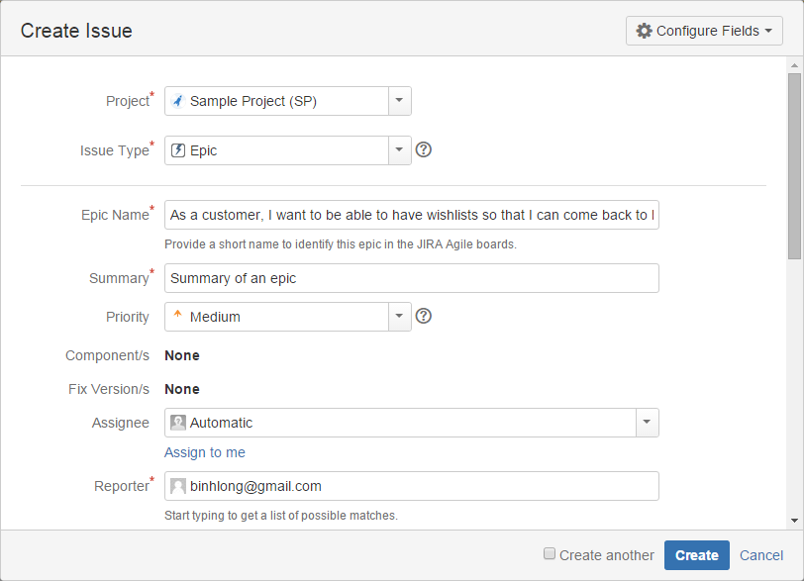
Product Owner – Create Epic
An epic is essentially a large user story that can be broken down into a number of smaller stories
It may take several sprints to complete an epic

Slide 35
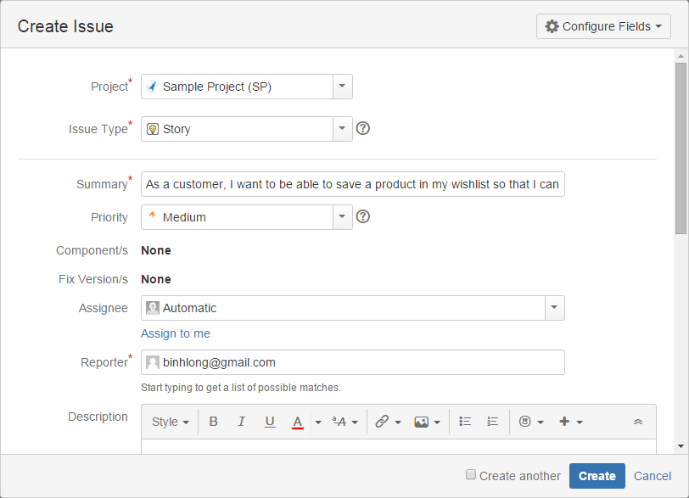
Product Owner – Create User Story
User Story: A convenient format for expressing the requirement
Create a user story

Slide 36
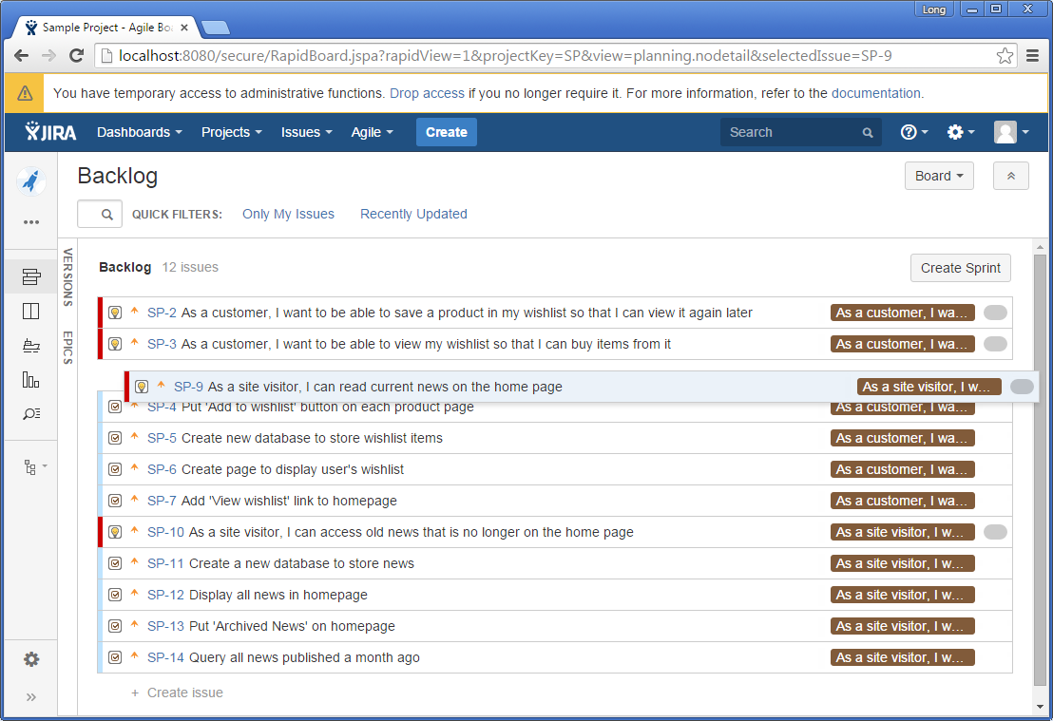
Product Owner – Rank (Prioritize) User Story
Drag and drop to prioritize a user story

Slide 37
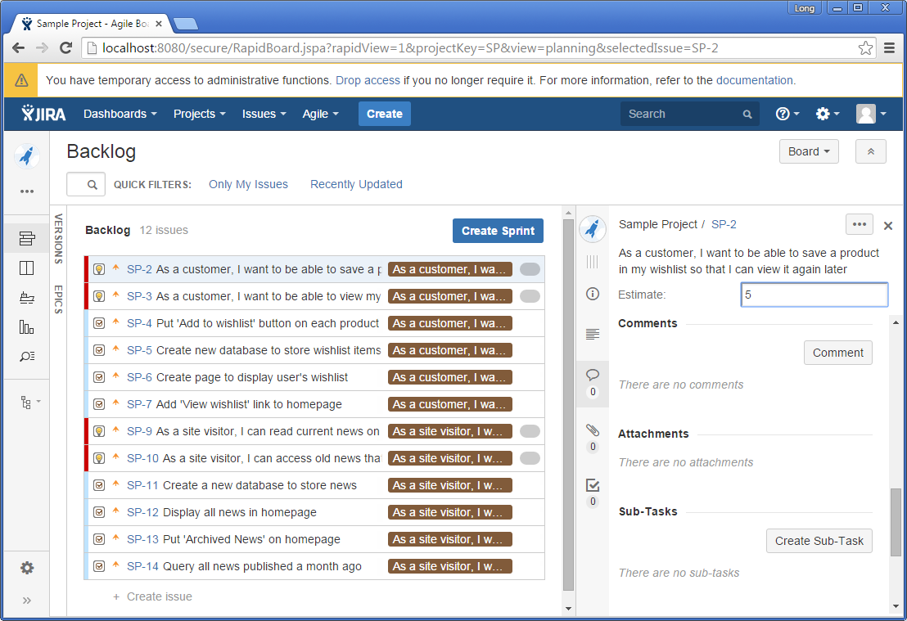
Scrum Team – Estimate User Story
Estimating stories in your backlog helps you to predict how long portions of the backlog might take to be delivered
To enter an Estimate for each issue, click the issue key to display the issue details at the right of the screen, then type in the Estimate field.
Estimation is all about Velocity

Slide 38
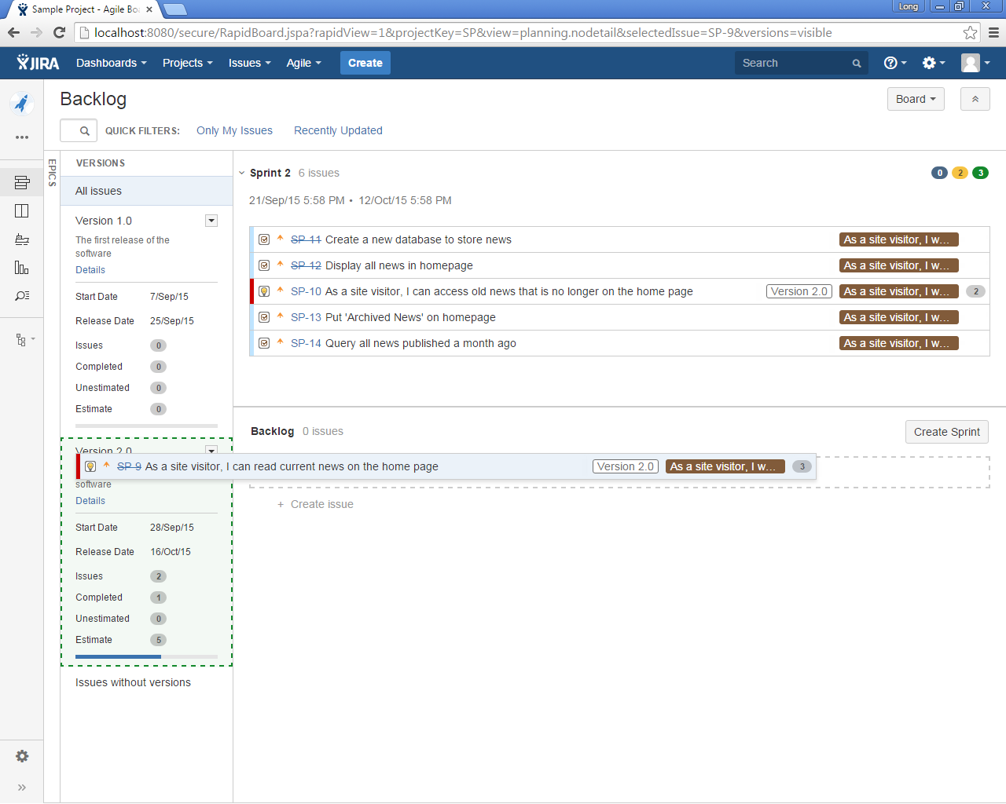
Product Owner – Add User Story to Version
Drag and drop a user story to version to at it to a specific version

Slide 39
Sprint Planning and Tracking

Slide 40
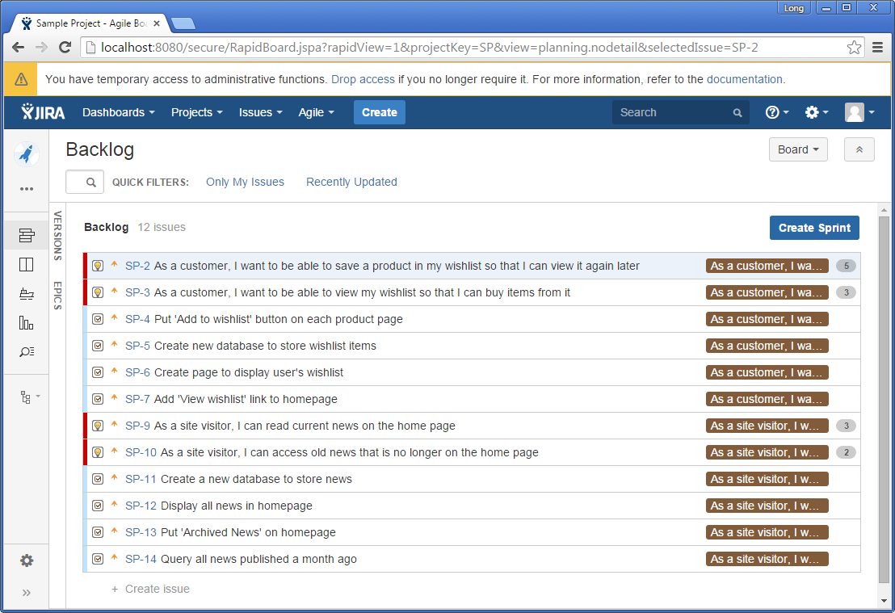
Scrum Master – Create Sprint
A sprint is a short (ideally two to four weeks) period in which the development team implements and delivers a discrete product increment
Once you have chosen which issues are to be included in your next sprint, you are ready to start the sprint

Slide 41
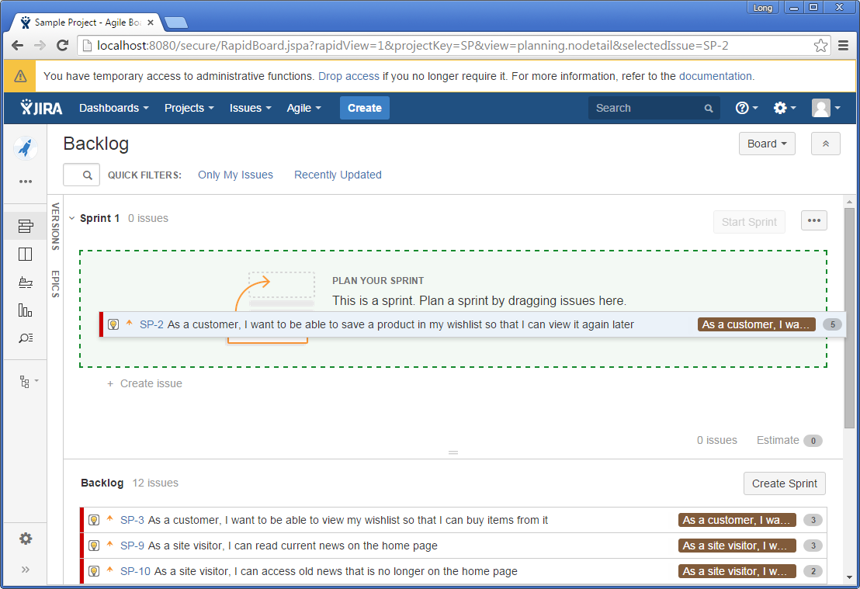
Scrum Team – Select Sprint Backlog Items
Sprint Backlog: An overview of the development work
Drag and drop product backlog items to sprint backlog

Slide 42
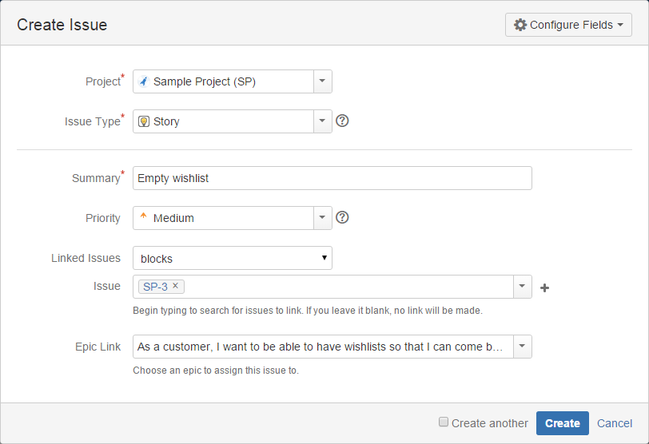
Scrum Team – Create Task
Task: A specific development work that can be pulled by team member
Create a task associated with a user story

Slide 43
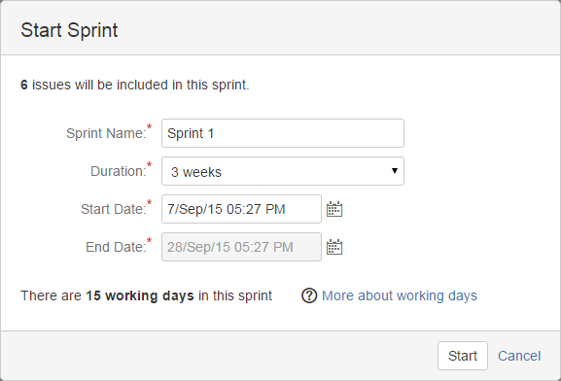
Scrum Master – Start Sprint
Enter a sprint properties to start a sprint

Slide 44
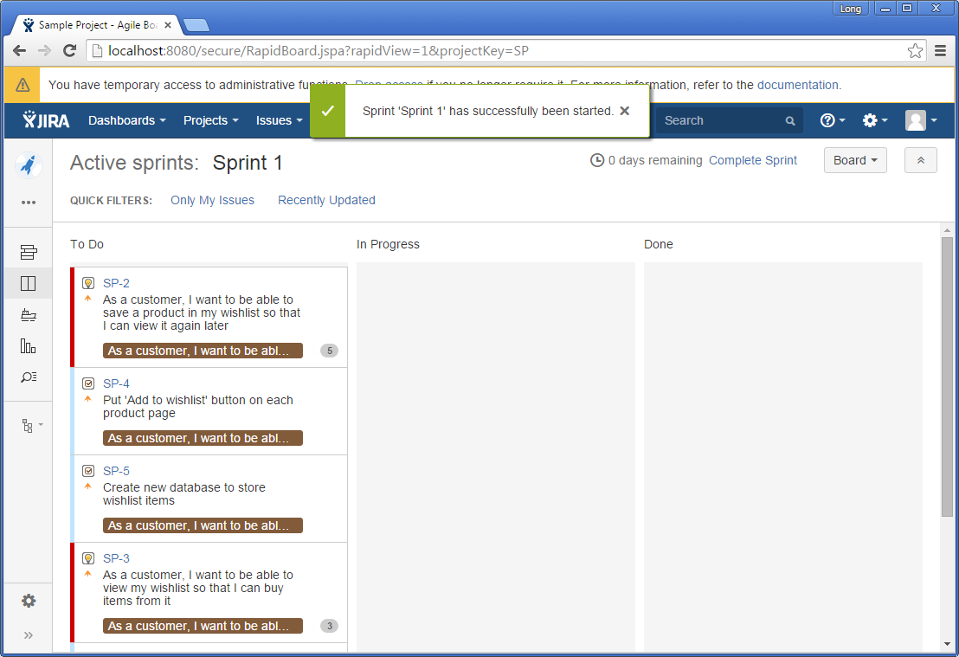
Scrum Master – Start Sprint…
A sprint is started successfully

Slide 45
Working with User Stories & Tasks

Slide 46
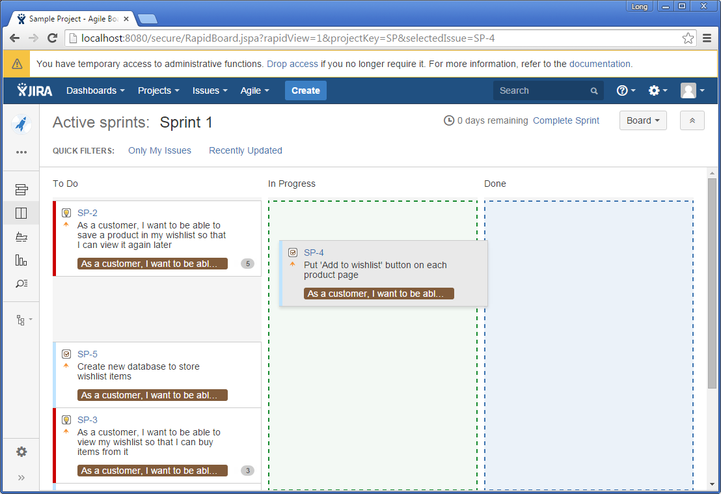
Scrum Team – Signup for Work
Signup for a work by drag it from To Do and drop to In Progress

Slide 47
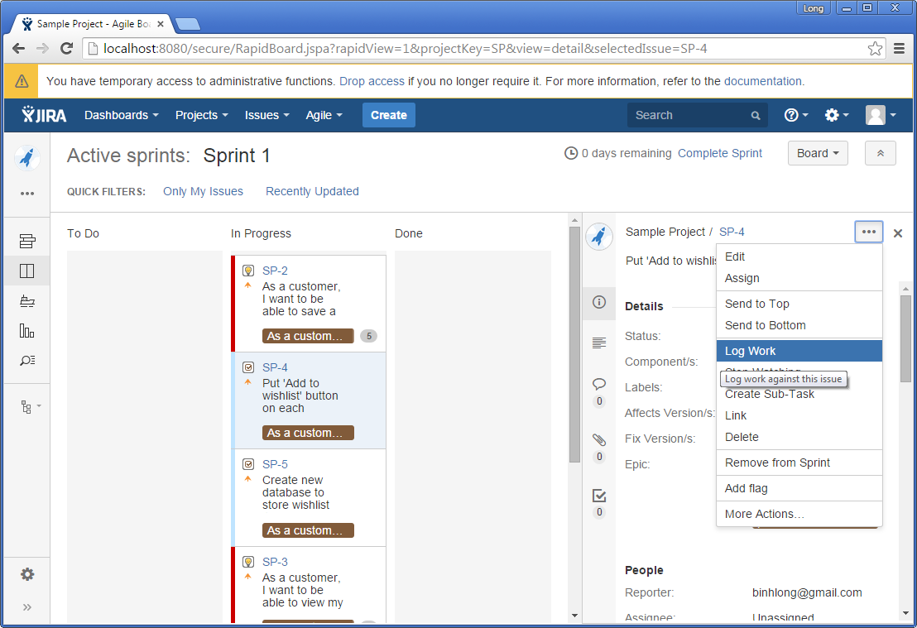
Scrum Team – Update Work Status
Update status of a work

Slide 48
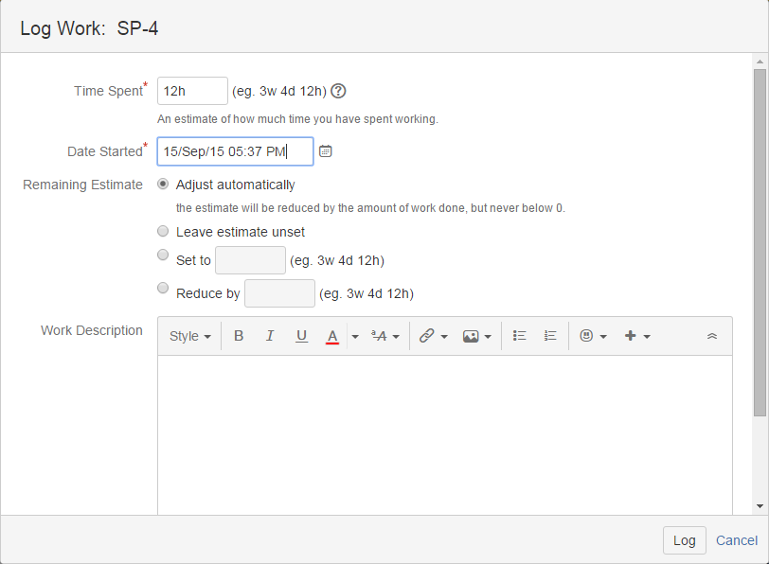
Scrum Team – Update Work Status…
Log time spent for a work

Slide 49
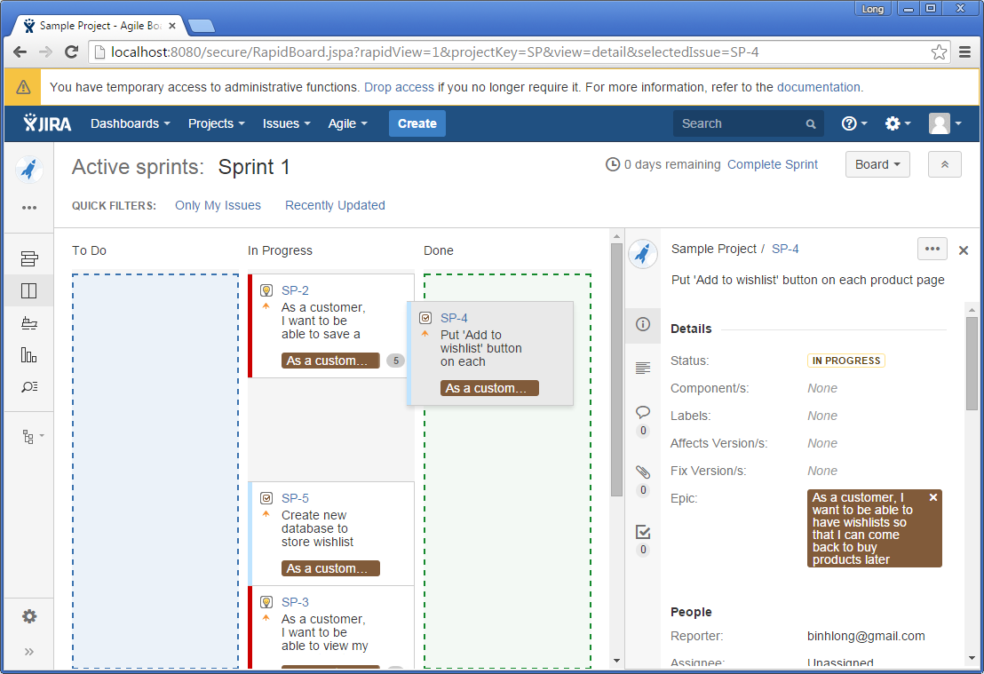
Scrum Team – Update Work Status…
Move a work to Done if it is completed

Slide 50
Agile Reports

Slide 51
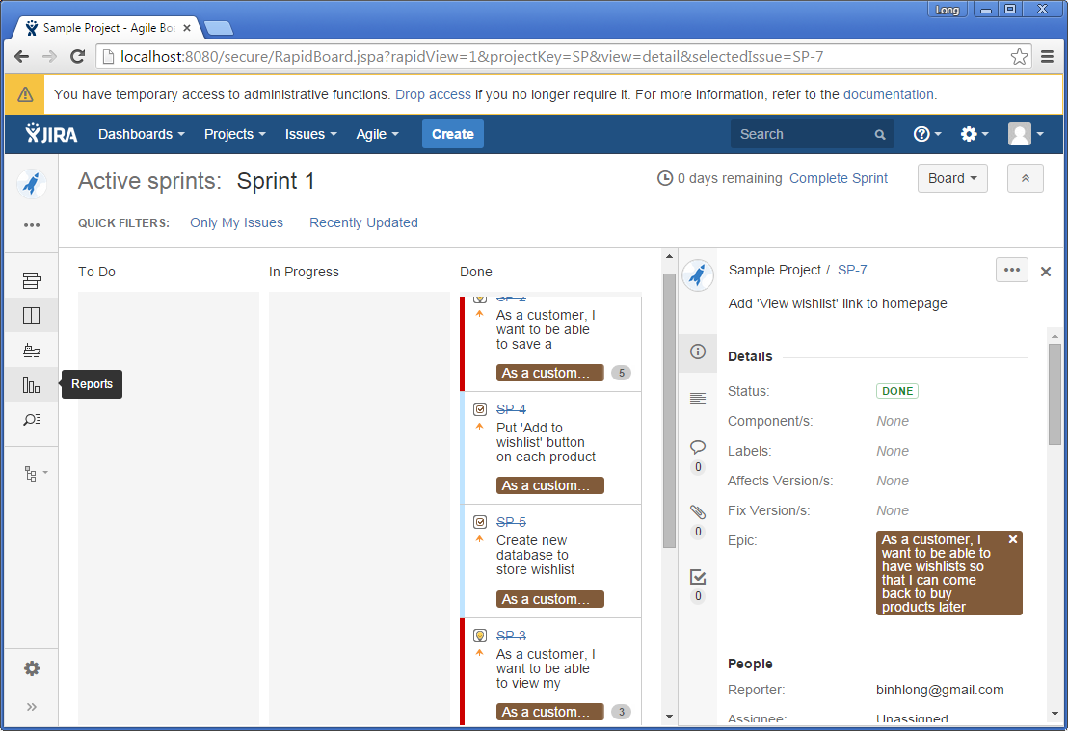
Scrum Team – Access Reports
Agile reports are accessible at anytime

Slide 52
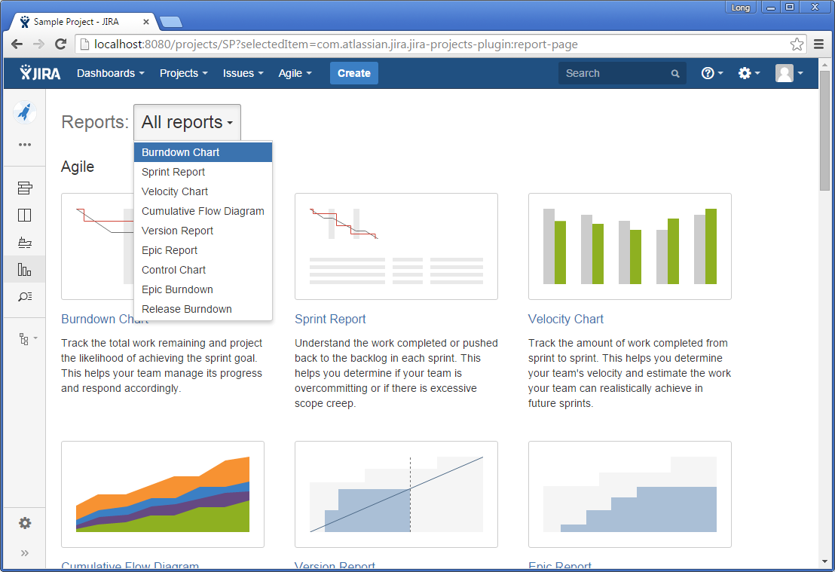
Scrum Team – Reports Repository
Various reports are available

Slide 53
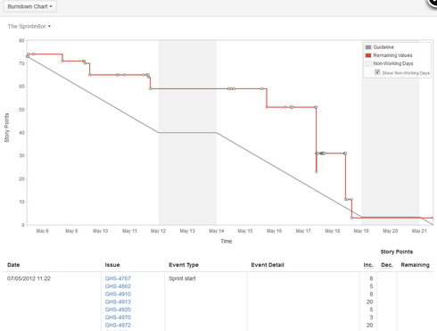
Scrum Team – Burndown Chart
Show the actual and estimated amount of work to be done in a sprint
Help you to project the likelihood of achieving the sprint goal

Slide 54
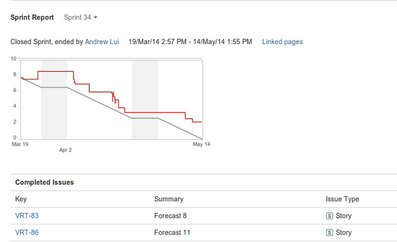
Scrum Team – Sprint Report
Show the list of issues in each sprint. It is useful for your Sprint Retrospective meeting and also for mid-sprint progress checks
Help you to project the likelihood of achieving the sprint goal

Slide 55
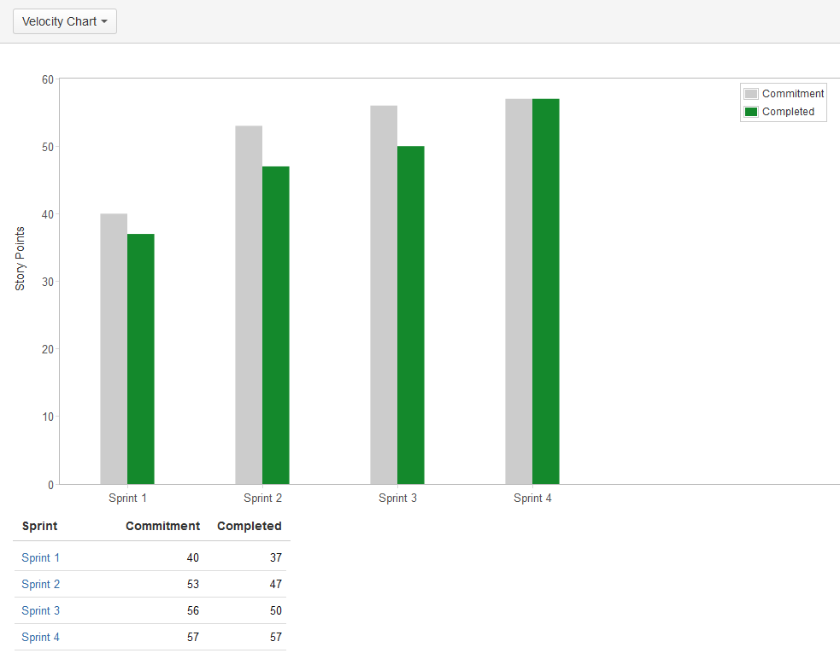
Scrum Team – Velocity Chart
Show the amount of value delivered in each sprint, enabling you to predict the amount of work the team can commit to in future sprints
Help you to project the likelihood of achieving the sprint goal

Slide 56
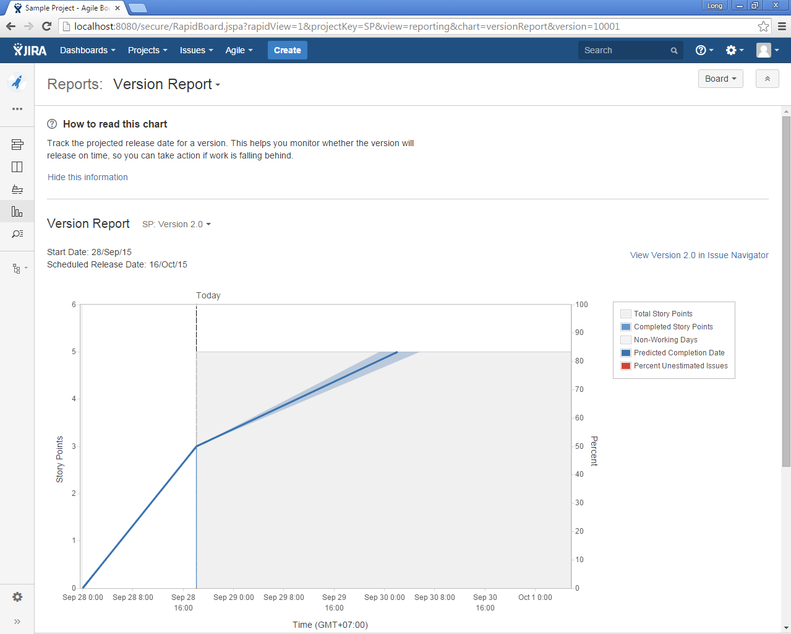
Scrum Team – Version Report
View Version Report

Slide 57
Sprint Review

Slide 58
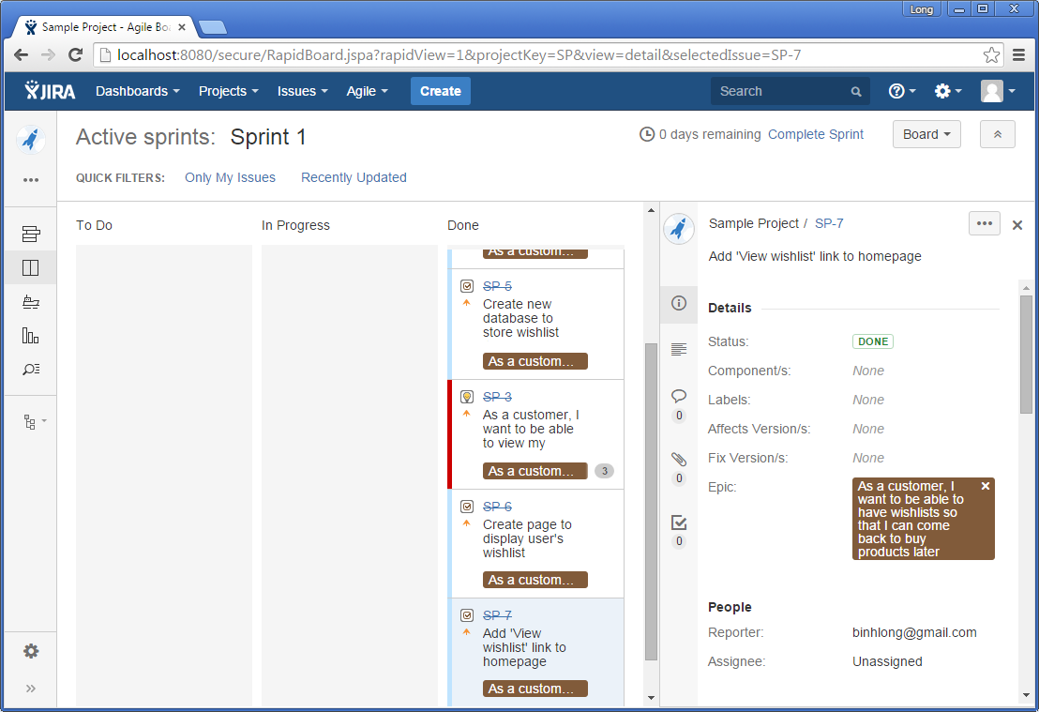
Scrum Master – Complete Sprint
If everything is done, a sprint can be completed

Slide 59
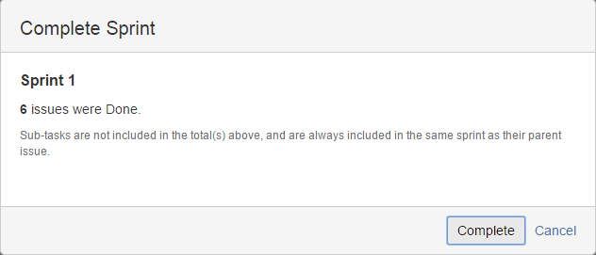
Scrum Master – Complete Sprint
Complete a sprint
Notes:
Review meeting and demo

Slide 60
Sprint Retrospective

Slide 61
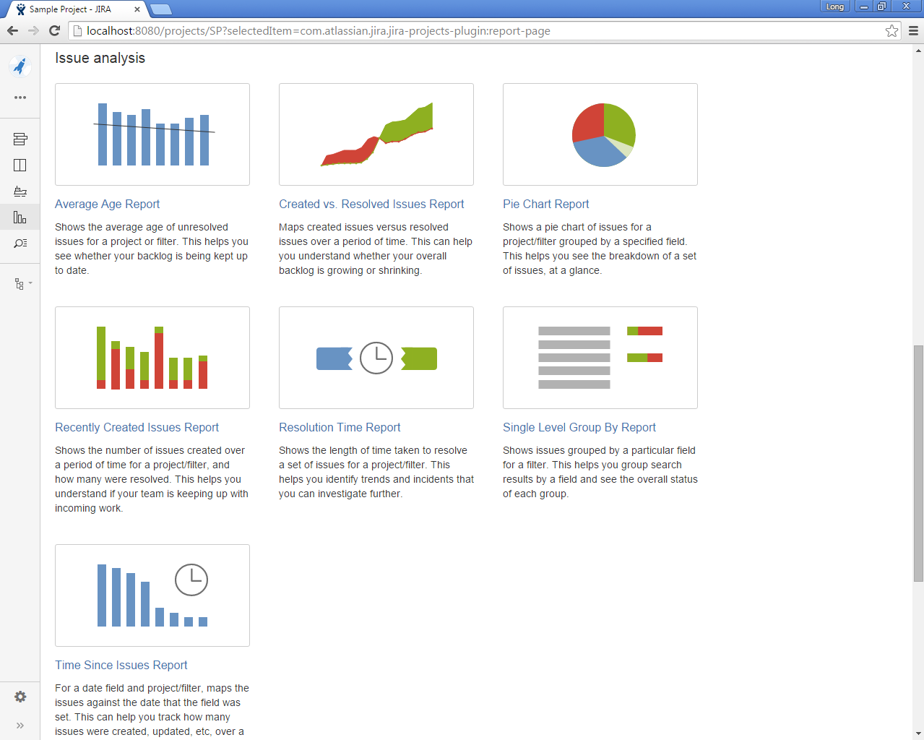
Scrum Master – Issue Analysis Reports
Issue Analysis Reports should be reviewed during retrospective
Notes:
Experience of team members

Slide 62
Practice

Slide 63
Environment
URL: http://20.203.132.38:8080
Account:
Username: student<1-20>
Password: student<1-20>
Project: My Student Project

Slide 64
Exercise
Tracking / Monitoring
Update user stories / tasks details
Transit tasks through its statuses
Version Management
Create version
Assign user stories to a version
Report
Complete a sprint
View Burndown chart
View Velocity report
Backlog Management
Create epics
Create user stories from an epic
Estimate user stories
Prioritize user stories
Create tasks from a user story
Assign tasks to team member
Sprint Management
Create sprint
Assign user stories to a sprint
Start a sprint
Update task status

Slide 65
Question & Answer

Slide 66
Thank You!

Slide 67
Revision History
Date | Version | Description | Updated by | Reviewed and Approved By
29 Sep 2015 | 1.0 | Initial version | Long Truong | Khanh Lam, Ngoc Do
Aug 2017 | 2.0 | Re-theme a slide deck using DXC template |  | Quang Tran, Long Truong

