Slide 1
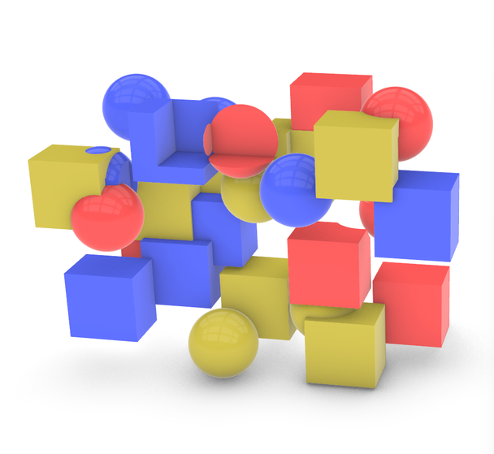
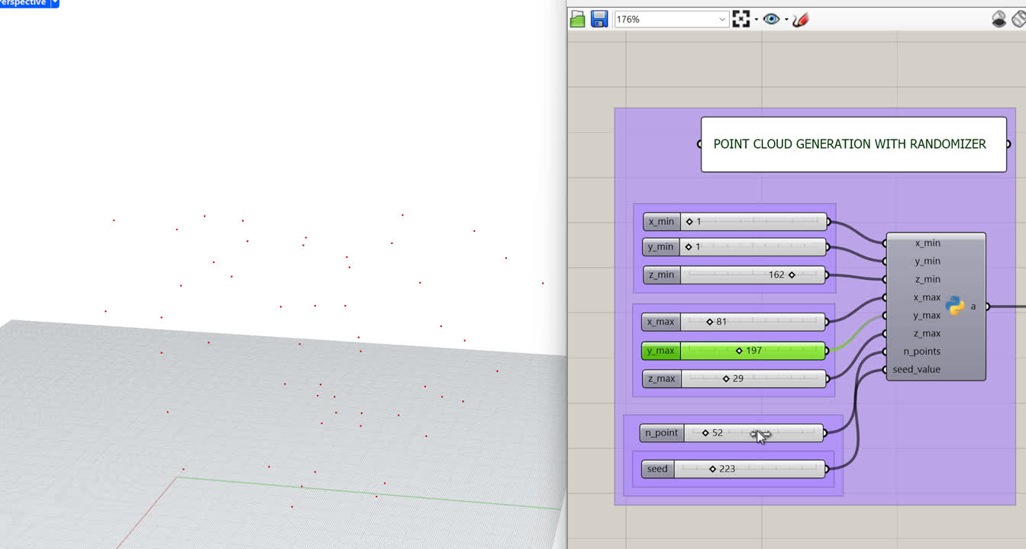
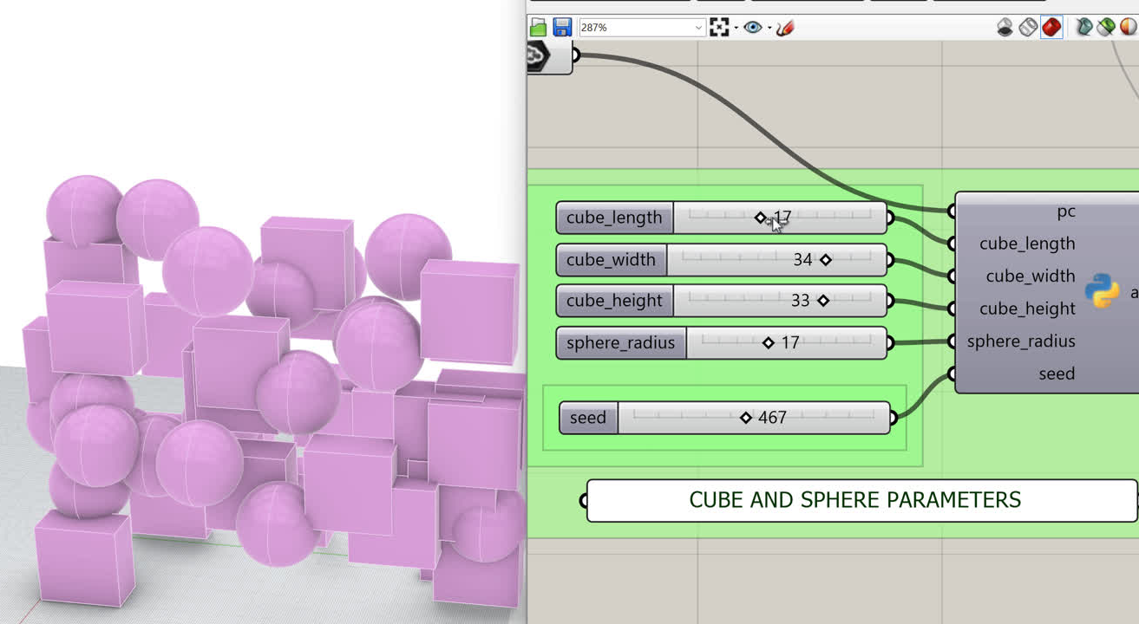
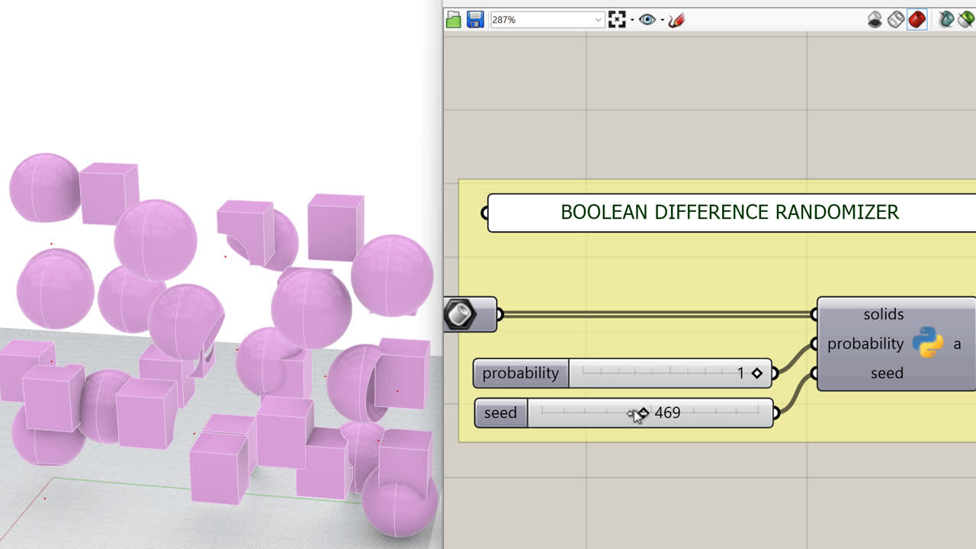
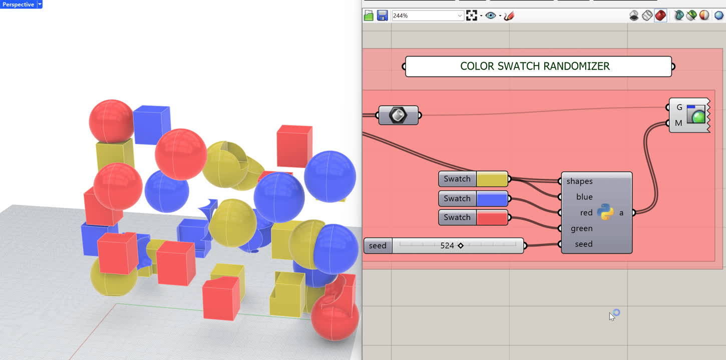
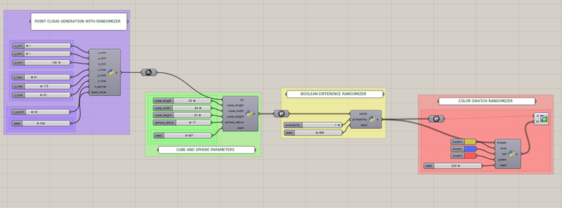
Assignment 1
Bauhaus 3D composition created with the script.
Generation of a point cloud with domain parameters, number of points and a seed randomizer.
Generation of cubes and spheres and parameters to modify them and a seed randomizer.
Grasshopper script.
A boolean difference randomizer. Solids touching each other are selected randomly.
Color randomizer. Color swatches can be selected by the user and a seed slider randomizes the color attribution.
Computational Design and Fabrication 1 (WiSe 2026/2027)
Lily-Mei Fournier

