Slide 1
ZOMATO RESTAURANT
EXPANSION ANALYSIS
🍴
Where should Zomato open its next restaurants?
A data-backed view on market gaps, quality benchmarks, and cost positioning.
↗
CHILIKA PRIYADARSINI JENA
01 SEPTEMBER 2026
zomato
better food for more people

Slide 2
PROBLEM STATEMENT
I started with one simple question: What does the current restaurant landscape tell us?
I explored where restaurants are concentrated, how the industry has evolved, and where customer response is strongest.
From there, I identified less-saturated markets with growth potential, while analyzing pricing, cuisine trends, and customer preferences.
I also examined how online delivery and table booking influence restaurant performance.
Finally, I brought these insights together to develop practical recommendations for expansion, pricing, cuisine selection, and service strategy.
RESTAURANTS
COUNTRIES
9,551
15
Dataset records
Markets represented
OVERALL RATING
VOTES / RESTAURANT
2.89
157
Average across dataset
Average votes
Core decision lens: growth potential + customer response + cost control

Slide 3
DATA OVERVIEW
RECORDS
KEY FIELDS
TIME SPAN
SERVICES
9,551
17+
2010–2018
2
Restaurant-level observations
Country, city, cuisine, price, rating, votes
Opening-year analysis
Table booking + online delivery
DATA PREPARATION
Before looking for insights, I first made sure the data was ready to tell the right story.
I standardized country, city, and categorical fields for consistent analysis.
I extracted the opening year to understand how the restaurant landscape evolved.
I normalized cost and currency fields and reviewed missing or zero values.
I created rating quality bands to make customer feedback easier to interpret.
Finally, I built pivot-style summaries across country, year, price range, cuisine, and service adoption to uncover key patterns.

Slide 4
ANALYTICAL METHODOLOGY
CLEAN
PROFILE
COMPARE
PRIORITIZE
RECOMMEND
01
02
03
04
05
Standardize text, dates, categories and numeric fields.
Measure restaurant counts, ratings, votes and costs.
Benchmark countries, price bands, cuisines and services.
Screen lower-competition markets using scale + rating signals.
Convert patterns into expansion and operating actions.
ANALYTICAL TOOLS
Once the data was ready, I focused on turning it into meaningful insights.
I used pivot tables and conditional aggregation to compare markets and uncover key patterns.
I applied AVERAGE and SUMPRODUCT-based calculations to derive targeted measures.
I used charts to bring concentration, trends, and rating differences into focus.
Finally, I used conditional formatting to highlight restaurants in promising markets.

Slide 5
UNDERSTANDING THE RESTAURANT LANDSCAPE
India accounts for 8,652 restaurants—far ahead of every other market.
RESTAURANTS BY COUNTRY
The First Insight…
As I explored the data, one important pattern quickly stood out: India dominates the dataset.
This means restaurant counts alone cannot tell us which markets are truly attractive.
So, I looked beyond market size and considered both competition and customer response, especially in smaller markets.
This highlighted an opportunity to screen international markets for more sustainable expansion.

Slide 6
RESTAURANT OPENINGS REMAINED BROADLY STABLE
Peak: 1,102 openings in 2018
Low: 1,022 openings in 2012
A Steady Market…
Looking at restaurant openings over time, I found that the market remained relatively stable.
Openings fluctuated within a relatively narrow range.
There was no sustained collapse in restaurant openings, indicating continued market activity.
2018 recorded the highest annual count, suggesting that market activity remained strong toward the end of the period.

Slide 7
INDIA SHOWS A LARGE AFFORDABLE-MARKET BASE
388 restaurants in India are in Price Range 4
When I looked at the price segments, one clear pattern stood out: most restaurants operate in the lower-to-mid price ranges.
Price Range 1 dominates with 4,295 restaurants.
Price Range 2 adds another 2,858 restaurants, making these the core market segments.
Premium Range 4 is much smaller, indicating a more selective premium segment.
Interestingly, average ratings rise with price range, suggesting a potential premium-quality opportunity.

Slide 8
CUSTOMER ENGAGEMENT VARIES SHARPLY BY MARKET
Indonesia leads this comparison at ~772 average votes
Next, I looked at votes as an indicator of customer engagement across markets.
Votes provide a useful proxy for engagement, but I considered them alongside overall market size.
Singapore recorded the lowest average votes among the markets compared.
Higher engagement can help validate demand, while lower competition can create better entry economics.

Slide 9
LOOKING BEYOND SCALE: SMALLER MARKETS WITH STRONGER RATINGS
PHILIPPINES
INDONESIA
TURKEY
22 restaurants
21 restaurants
34 restaurants
4.47
4.30
4.30
Avg rating
Avg rating
Avg rating
NEW ZEALAND
UAE
SOUTH AFRICA
40 restaurants
60 restaurants
60 restaurants
4.26
4.23
4.21
Avg rating
Avg rating
Avg rating
Recommended core markets: Canada • Singapore • Sri Lanka • Australia

Slide 10
TARGET CITIES REVEAL SPECIFIC LOW-COMPETITION OPPORTUNITIES
CANADA
Chatham-Kent • Consort • Vineland Station • Yorkton
SINGAPORE
Bukit Timah • Singapore River • Tanglin
SRI LANKA
Colombo • Colombo 01 • Colombo 02 • Fort
AUSTRALIA
Armidale • Balingup • Beechworth • Palm Cove • Tanunda • Victor Harbor

Slide 11
RECOMMENDED MARKETS ALREADY SHOW GOOD RESTAURANT QUALITY
Overall average across the four core markets: 3.69
Quality is validated across all four markets, with room for selective growth
Sri Lanka records the highest average rating at 3.87.
Australia follows at 3.66, while Canada and Singapore stand at 3.58.
All four markets are classified as Good under the project’s Quality framework.
Market entry should be focused on areas where quality is established and saturation remains manageable.

Slide 12
STRONG RESTAURANT QUALITY EXTENDS BEYOND THE LARGEST MARKETS
Quality is not limited to the biggest markets—several smaller markets show strong restaurant ratings.
The Philippines leads with an impressive 4.5 average rating.
Indonesia, New Zealand and Turkey follow closely at 4.3, showing consistently strong customer satisfaction.
South Africa, UAE and the UK also maintain solid ratings of 4.1–4.2.
Takeaway: Strong ratings across diverse markets suggest that quality-led markets can be attractive expansion opportunities.

Slide 13
WIN CUSTOMERS THROUGH THE RIGHT CUISINE AND DIGITAL EXPERIENCE
CUISINE
DIGITAL SERVICES
Focus on high-potential cuisines: Modern Indian, European, Rajasthani, Seafood, Indian and Mediterranean.
Modern Indian stands out, combining a strong ~4.37 average rating with high customer engagement.
Less crowded cuisines tend to perform better, creating an opportunity to differentiate.
Online delivery lifts ratings: 3.29 vs 2.75 without delivery.
Table booking performs even better: 3.48 vs 2.81 without the service.
Both services are strongly associated with higher customer ratings in the dataset.
Recommendation: launch new restaurants with an intentional cuisine proposition plus online delivery and table booking.
Premium positioning is also supported by the data: average rating increases from ~2.4 in Price Range 1 to ~3.8 in Price Range 4.

Slide 14
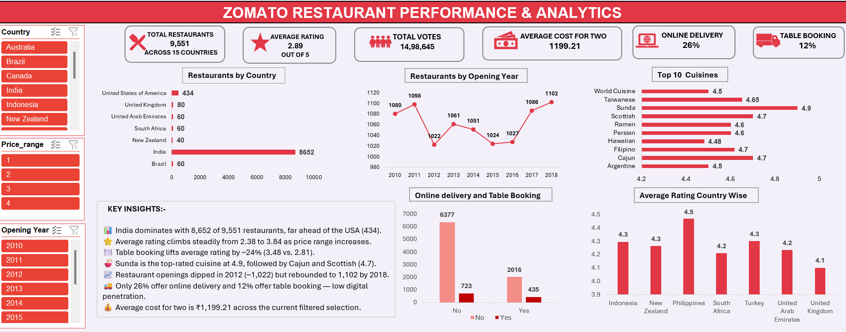
MANAGEMENT DASHBOARD: TURNING INSIGHTS INTO ACTION

Slide 15
FROM INSIGHT TO ACTION: WHERE SHOULD ZOMATO FOCUS NEXT
From market opportunity to successful expansion
1. Start with the strongest markets
→ Begin where the analysis already shows promise: Canada, Singapore, Sri Lanka and Australia. These markets combine good restaurant quality with attractive expansion potential.
2. Then find the right cities
→ A country alone is not enough. Identify cities where customer demand is strong, ratings are healthy and competition is still manageable.
3. Validate before committing capital
→ Before investing heavily, assess the local landscape: how many restaurants exist, which cuisines fit local demand, pricing levels and the strength of competitors.
4. Start small, then scale
→ Enter through a focused pilot, measure customer response and business performance, and use those results to decide where to expand further.
The strategy is simple: choose the right market, pinpoint the right city, validate the opportunity, and scale only where the numbers prove it.
1
2
3
4
Bottom line: move from “where are there restaurants?” to “where can we win with a differentiated, high-quality offer?”

Slide 16
CONCLUSION
KEY TAKEAWAY
The analysis points to a selective expansion strategy—prioritizing markets with strong restaurant quality, manageable competition, and clear opportunities to differentiate.
SOURCE / ACKNOWLEDGEMENT
Zomato restaurant dataset and project workbook supplied for the analysis.
Spreadsheet Project Guidelines / PPT Sample Approach supplied with the project.
Analysis based on cleaned project data and the stated pivot-table summaries.
THANK YOU — QUESTIONS WELCOME

