Slide 2

Chapter Goals
To learn about computers and programming
To compile and run your first Java program
To recognize compile-time and run-time errors
To describe an algorithm with pseudocode

Slide 3
Computer Programs
Computers are programmed to perform many different tasks.
Computers execute very basic instructions in rapid succession.
A computer program is a sequence of instructions and decisions.
Programming is the act of designing and implementing computer programs.
The physical computer and peripheral devices are collectively called the hardware.
The programs the computer executes are called the software.

Slide 4
Self Check 1.1
What is required to play a music CD on a computer?
Answer: A program that reads the data on the CD and sends output to the speakers and the screen.

Slide 5
Self Check 1.2
Why is a CD player less flexible than a computer?
Answer: A CD player can do one thing — play music CDs. It cannot execute programs.

Slide 6
Self Check 1.3
What does a computer user need to know about programming in order to play a video game?
Answer: Nothing

Slide 7
The Anatomy of a Computer
Central processing unit (CPU) performs
Program control
Data processing
Storage
Memory (Primary storage)
Secondary storage
Peripherals
To interact with human users
Networks

Slide 8
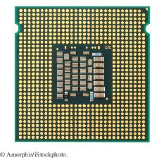
Central Processing Unit
Figure 1 Central Processing Unit

Slide 9
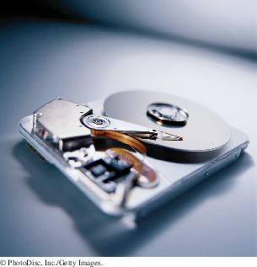
A Hard Disk
Figure 2 Hard Disk

Slide 10
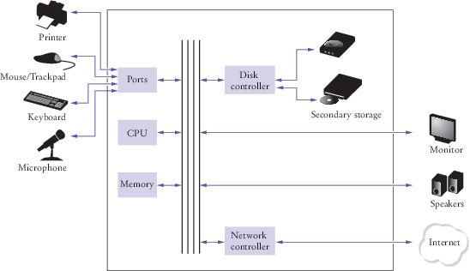
Schematic Diagram of a Computer
Figure 3 Schematic Design of a Personal Computer

Slide 11
Self Check 1.4
Where is a program stored when it is not currently running?
Answer: In secondary storage, typically a hard disk.

Slide 12
Self Check 1.5
Which part of the computer carries out arithmetic operations, such as addition and multiplication?
Answer: The central processing unit.

Slide 13
Self Check 1.6
A modern smartphone is a computer, comparable to a desktop computer. Which components of a smartphone correspond to those shown in Figure 5 (Schematic Diagram of a Computer)?
Answer: A smartphone has a CPU and memory, like any computer. A few smartphones have keyboards. Generally, the touchpad is used instead of a mouse. Secondary storage is in the form of a solid state drive. Of course, smartphones have a display, speaker, and microphone. The network connection uses the wireless radio to connect to a cell tower.

Slide 14
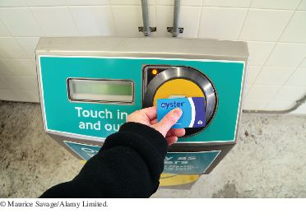
Computers are Everywhere
This transit card contains a computer.

Slide 15
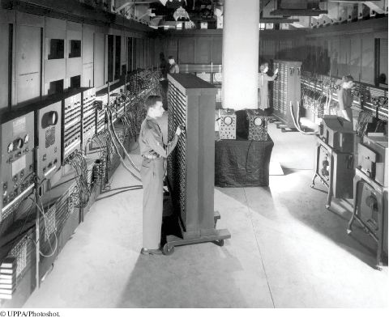
The ENIAC
The ENIAC

Slide 16
The Java Programming Language
Safe
Portable
Platform-independent
Distributed as instructions for a virtual machine
Vast set of library packages
Designed for the Internet

Slide 17
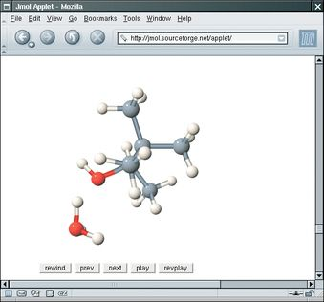
Applet on a Web Page
Figure 4 An Applet for Visualizing Molecules Running in a Browser Window (http://jmol.sourceforge.net/)

Slide 18
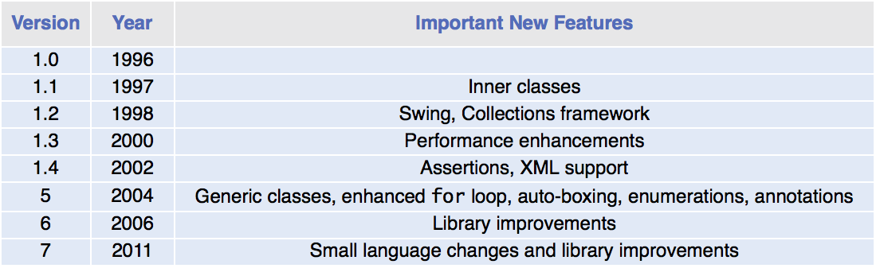
Java Versions

Slide 19
Self Check 1.7
What are the two most important benefits of the Java language?
Answer: Safety and portability.

Slide 20
Self Check 1.8
How long does it take to learn the entire Java library?
Answer: No one person can learn the entire library – it is too large.

Slide 21
Becoming Familiar with Your Programming Environment
An editor is a program for entering and modifying text, such as a Java program.
Java is case sensitive.
Java compiler translates source code into class files.
Class files contain instructions for the Java virtual machine.

Slide 22
Becoming Familiar with Your Programming Environment
Start the Java development environment.
Write a simple program.
Run the program.
Organize your work.

Slide 23
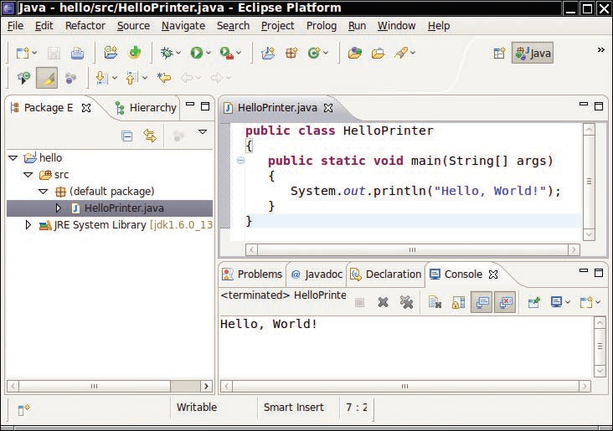
Becoming Familiar with Your Programming Environment
Figure 5 Running the HelloPrinter Program in an Integrated Development Environment

Slide 24
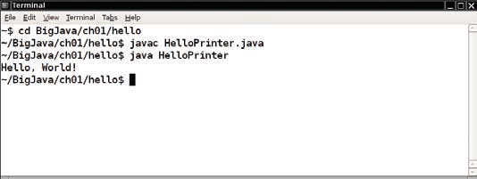
Becoming Familiar with Your Programming Environment
Figure 6 Running the HelloPrinter Program in a Console Window

Slide 25
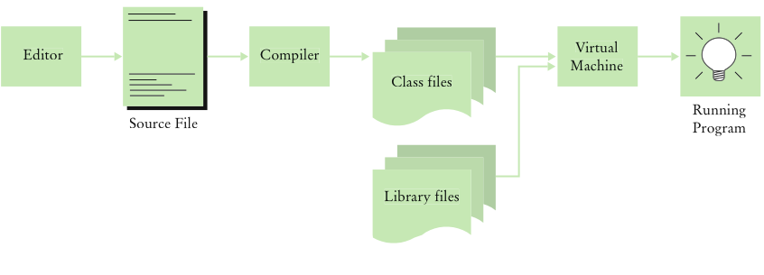
Becoming Familiar with Your Programming Environment
Figure 7 From Source Code to Running Program

Slide 26
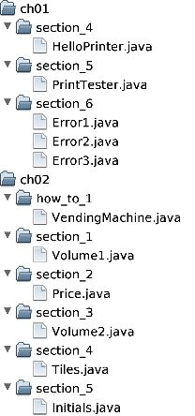
Becoming Familiar with Your Programming Environment
Figure 8 A Folder Hierarchy

Slide 27
Self Check 1.9
Where is the HelloPrinter.java file stored on your computer?
Answer: The answer varies among systems. A typical answer:
/home/dave/cs1/hello/HelloPrinter.java or
c:\Users\Dave\Workspace\hello\HelloPrinter.java

Slide 28
Self Check 1.10
What do you do to protect yourself from data loss when you work on programming projects?
Answer: You back up your files and folders.

Slide 29
Section_4/HelloPrinter.java
1 public class HelloPrinter
2 {
3 public static void main(String[] args)
4 {
5 // Display a greeting in the console window
6
7 System.out.println("Hello, World!");
8 }
9 }

Slide 30
Analyzing Your First Program: Class Declaration
Classes are the fundamental building blocks of Java programs:
Declaration of a class called HelloPrinter
public class HelloPrinter
In Java, every source file can contain, at most one public class.
The name of the public class must match the name of the file containing the class:
Class HelloPrinter must be contained in a file named HelloPrinter.java

Slide 31
Analyzing Your First Program: Methods
Each class contains declarations of methods.
Each method contains a sequence of instructions.
A method contains a collection of programming instructions that describe how to carry out a particular task.
A method is called by specifying the method and its arguments.

Slide 32
Analyzing Your First Program: main Method
Every Java application contains a class with a main method
When the application starts, the instructions in the main method are executed
Declaring a main method
public static void main(String[] args)
{
. . .
}

Slide 33
Analyzing Your First Program: Statements
The body of the main method contains statements.
Our method has a single statement:
System.out.println("Hello, World!");
It prints a line of text:
Hello, World!

Slide 34
Analyzing Your First Program: Method Call
A method call:
System.out.println("Hello, World!");
A method call requires:
The method you want to use (in this case, System.out.println)
Any values the method needs to carry out its task enclosed in parentheses (in this case, "Hello, World!")
The technical term for such values is arguments

Slide 35
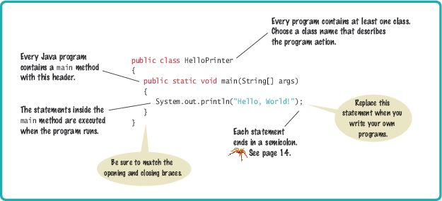
Syntax 1.1 Java Program

Slide 36
Analyzing Your First Program: Strings
String: a sequence of characters enclosed in double quotation marks:
"Hello, World!"

Slide 37
Analyzing Your First Program: Printing
You can print numerical values
System.out.println(3 + 4);
evaluates the expression 3 + 4
displays the number 7.
System.out.println method prints a string or a number and then starts a new line.
The sequence of statements
System.out.println("Hello");
System.out.println("World!");
Prints two lines
Hello
World!
There is a second method, System.out.print, that you can use to print an item without starting a new line

Slide 38
Self Check 1.11
How do you modify the HelloPrinter program to greet you instead?
Answer: Change World to your name (here, Dave):
System.out.println("Hello, Dave!");

Slide 39
Self Check 1.12
How would you modify the HelloPrinter program to print the word "Hello" vertically?
Answer:
System.out.println("H");
System.out.println("e");
System.out.println("l");
System.out.println("l");
System.out.println("o");

Slide 40
Self Check 1.13
Would the program continue to work if you replaced line 7 with this statement?
System.out.println(Hello);
Answer: No. The compiler would look for an item whose name is Hello. You need to enclose Hello in quotation marks:
System.out.println("Hello");

Slide 41
Self Check 1.14
What does the following set of statements print? System.out.print("My lucky number is"); System.out.println(3 + 4 + 5);
Answer: The printout is My lucky number is12. It would be a good idea to add a space after the is.

Slide 42
Self Check 1.15
What do the following statements print? System.out.println("Hello");
System.out.println("");
System.out.println("World");
Answer:
Hello
a blank line
World

Slide 43
Errors
A compile-time error (syntax error)
is a violation of the programming language rules
detected by the compiler.
System.ou.println("Hello, World!");
A run-time error (logic error)
causes a program to perform an action that the programmer did not intend.
System.out.println("Hello, Word!");

Slide 44
Errors
Exception - a type of run-time error
Generates an error message from the Java virtual machine
This statement
System.out.println(1 / 0)
Generates this run-time error message
"Division by zero"

Slide 45
Self Check 1.16
Suppose you omit the "" characters around Hello, World! from the HelloPrinter.java program. Is this a compile-time error or a run-time error?
Answer: This is a compile-time error. The compiler will complain that it does not know the meanings of the words Hello and World.

Slide 46
Self Check 1.17
Suppose you change println to printline in the HelloPrinter.java program. Is this a compile-time error or a run-time error?
Answer: This is a compile-time error. The compiler will complain that System.out does not have a method called printline.

Slide 47
Self Check 1.18
Suppose you change main to hello in the HelloPrinter.java program. Is this a compile-time error or a run-time error?
Answer: This is a run-time error. It is perfectly legal to give the name hello to a method, so the compiler won't complain. But when the program is run, the virtual machine will look for a main method and won't find one.

Slide 48
Self Check 1.19
When you used your computer, you may have experienced a program that "crashed" (quit spontaneously) or "hung" (failed to respond to your input). Is that behavior a compile-time error or a run-time error?
Answer: It is a run-time error. After all, the program had been compiled in order for you to run it.

Slide 49
Self Check 1.20
Why can't you test a program for run-time errors when it has compiler errors?
Answer: When a program has compiler errors, no class file is produced, and there is nothing to run.

Slide 50
Problem Solving: Algorithm Design
Algorithm: A sequence of steps that is:
unambiguous
executable
terminating

Slide 51
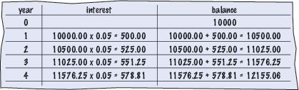
An Algorithm for Solving an Investment Problem
The problem:
You put $10,000 into a bank account that earns 5 percent interest per year. How many years does it take for the account balance to be double the original
Calculating by hand

Slide 52

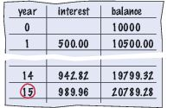
An Algorithm for Solving an Investment Problem - continued
The steps in the algorithm
Start with a year value of 0, a column for the interest, and a balance of $10,000.
Repeat the following steps while the balance is less than $20,000
Add 1 to the year value.
Compute the interest as balance x 0.05 (i.e., 5 percent interest).
Add the interest to the balance.
Report the final year value as the answer.

Slide 53
Pseudocode
Pseudocode: An informal description of of a sequence of steps for solving a problem
Describe how a value is set or changed:
total cost = purchase price + operating cost
Multiply the balance value by 1.05.
Remove the first and last character from the word.
Describe decisions and repetitions:
If total cost 1 < total cost 2
While the balance is less than $20,000
For each picture in the sequence

Slide 54
Pseudocode - continued
Use indentation to indicate which statements should be selected or repeated:
For each car
operating cost = 10 x annual fuel cost
total cost = purchase price + operating cost
Indicate results:
Choose car1.
Report the final year value as the answer.

Slide 55
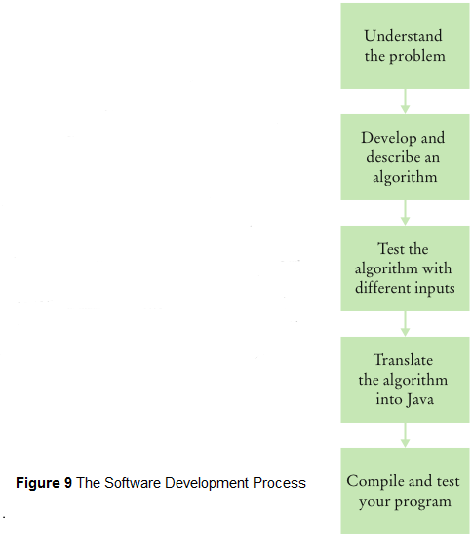
From Algorithm to Programs

Slide 56
Self Check 1.21
Suppose the interest rate was 20 percent. How long would it take for the investment to double?
Answer: 4 years:
0 10,000
1 12,000
2 14,400
3 17,280
4 20,736

Slide 57
Self Check 1.22
Suppose your cell phone carrier charges you $29.95 for up to 300 minutes of calls, and $0.45 for each additional minute, plus 12.5 percent taxes and fees. Give an algorithm to compute the monthly charge for a given number of minutes.
Answer: Is the number of minutes at most 300?
a. If so, the answer is $29.95 × 1.125 = $33.70.
b. If not,
1. Compute the difference: (number of minutes) – 300.
2. Multiply that difference by 0.45.
3. Add $29.95.
4. Multiply the total by 1.125. That is the answer.

Slide 58
Self Check 1.23
Consider the following pseudocode for finding the most attractive photo from a sequence of photos:
Pick the first photo and call it "the best so far”.
For each photo in the sequence
If it is more attractive than the "best so far”
Discard "the best so far”.
Call this photo "the best so far”.
The photo called "the best so far" is the most attractive photo in the sequence.
Is this an algorithm that will find the most attractive photo?
Answer: No. The step If it is more attractive than the "best so far" is not executable because there is no objective way of deciding which of two photos is more attractive.

Slide 59
Self Check 1.24
Suppose each photo in Self Check 23 had a price tag. Give an algorithm for finding the most expensive photo.
Answer:
Pick the first photo and call it "the most expensive so far”.
For each photo in the sequence
If it is more expensive than "the most expensive so far”
Discard "the most expensive so far”.
Call this photo "the most expensive so far”.
The photo called "the most expensive so far" is the most expensive photo in the sequence

Slide 60
Self Check 1.25
Suppose you have a random sequence of black and white marbles and want to rearrange it so that the black and white marbles are grouped together. Consider this algorithm Repeat until sorted
Locate the first black marble that is preceded by
a white marble, and switch them.
What does the algorithm do with this sequence:
Spell out the steps until the algorithm stops.
Continued

Slide 61
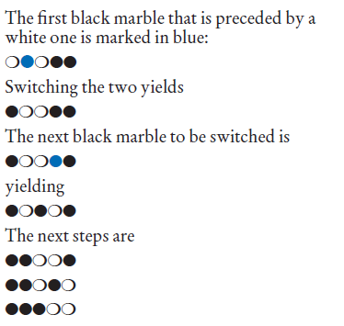
Self Check 1.25
Answer:

Slide 62
Self Check 1.26
Suppose you have a random sequence of colored marbles. Consider this pseudocode:
Repeat until sorted
Locate the first marble that is preceded by a
marble of a different color, and switch them.
Why is this not an algorithm?
Answer: The sequence doesn’t terminate. Consider the input:
The first two marbles keep getting switched.

