Slide 2

Chapter Goals
To implement while, for, and do loops
To hand-trace the execution of a program
To learn to use common loop algorithms
To understand nested loops
To implement programs that read and process data sets
To use a computer for simulations

Slide 3
The while Loop
Loops
A part of a program is repeated over and over, until a specific goal is reached
For calculations that require repeated steps
For processing input consisting of many data items

Slide 4
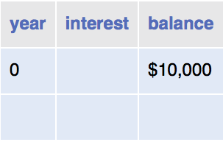
The while Loop
Investment problem You put $10,000 into a bank account that earns 5 percent interest per year. How many years does it take for the account balance to be double the original investment?
The algorithm
Start with a year value of 0, a column for the interest, and a balance of $10,000.
Repeat the following steps while the balance is less than $20,000.
Add 1 to the year value.
Compute the interest as balance x 0.05 (i.e., 5 percent interest).
Add the interest to the balance.
Report the final year value as the answer.

Slide 5

The while Loop
Because the interest earned also earns interest, a bank balance grows exponentially.

Slide 6

The while Loop
In a particle accelerator, subatomic particles traverse a loop-shaped tunnel multiple times, gaining the speed required for physical experiments.
Similarly, in computer science, statements in a loop are executed while a condition is true.

Slide 7
The while Loop
How can you “Repeat steps while the balance is less than $20,000?”
With a while loop statement
Syntax
while (condition)
{
statements
}
As long condition is true, the statements in the while loop execute.

Slide 8
The while Loop
The code:
while (balance < targetBalance)
{
year++;
double interest = balance * RATE / 100;
balance = balance + interest;
}

Slide 9
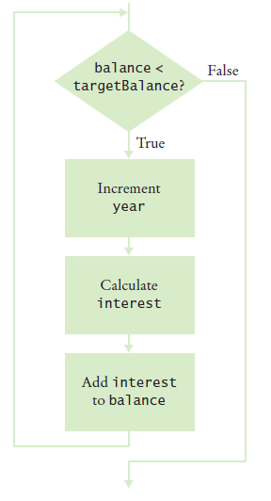
The while Loop
Figure 1 Flowchart of a while Loop

Slide 10
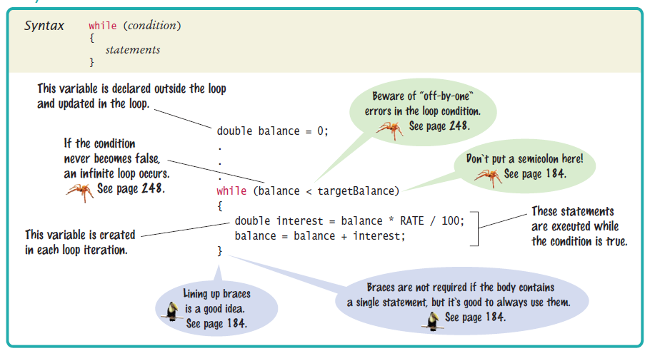
Syntax 6.1 while Statement

Slide 11
The while Loop
For a variable declared inside a loop body:
Variable is created for each iteration of the loop
And removed after the end of each iteration
while (balance < targetBalance)
{
year++;
double interest = balance * RATE / 100;
balance = balance + interest;
}
// interest no longer declared here

Slide 12
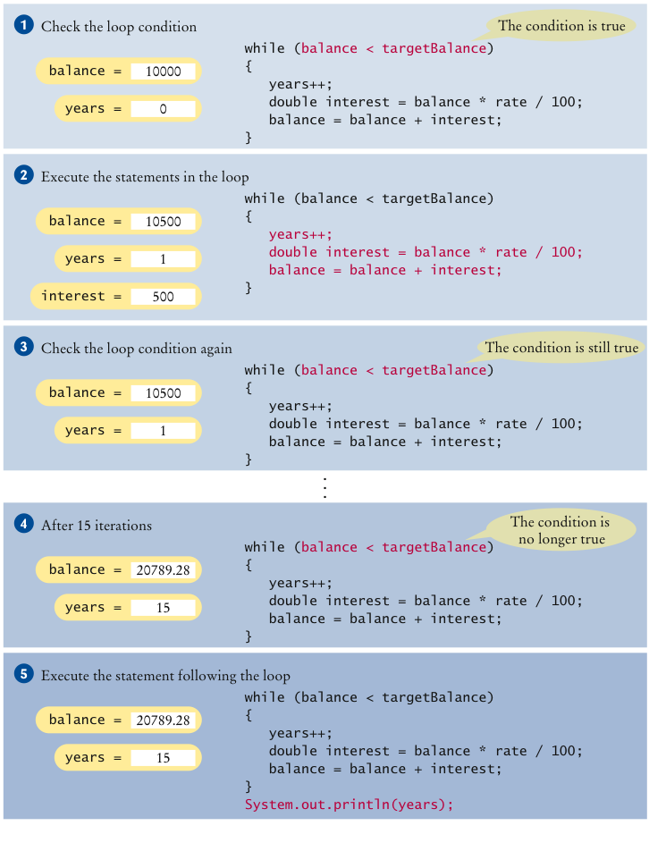
Execution of a while Loop
Step by step execution of the investment while loop:

Slide 13
section_1/Investment.java
1 /**
2 A class to monitor the growth of an investment that
3 accumulates interest at a fixed annual rate.
4 */
5 public class Investment
6 {
7 private double balance;
8 private double rate;
9 private int year;
10
11 /**
12 Constructs an Investment object from a starting balance and
13 interest rate.
14 @param aBalance the starting balance
15 @param aRate the interest rate in percent
16 */
17 public Investment(double aBalance, double aRate)
18 {
19 balance = aBalance;
20 rate = aRate;
21 year = 0;
22 }
23
Continued

Slide 14
section_1/Investment.java
24 /**
25 Keeps accumulating interest until a target balance has
26 been reached.
27 @param targetBalance the desired balance
28 */
29 public void waitForBalance(double targetBalance)
30 {
31 while (balance < targetBalance)
32 {
33 year++;
34 double interest = balance * rate / 100;
35 balance = balance + interest;
36 }
37 }
38
39 /**
40 Gets the current investment balance.
41 @return the current balance
42 */
43 public double getBalance()
44 {
45 return balance;
46 }
47
Continued

Slide 15
section_1/Investment.java
48 /**
49 Gets the number of years this investment has accumulated
50 interest.
51 @return the number of years since the start of the investment
52 */
53 public int getYears()
54 {
55 return year;
56 }
57 }

Slide 16
Section_1/InvestmentRunner.java
1 /**
2 This program computes how long it takes for an investment
3 to double.
4 */
5 public class InvestmentRunner
6 {
7 public static void main(String[] args)
8 {
9 final double INITIAL_BALANCE = 10000;
10 final double RATE = 5;
11 Investment invest = new Investment(INITIAL_BALANCE, RATE);
12 invest.waitForBalance(2 * INITIAL_BALANCE);
13 int years = invest.getYears();
14 System.out.println("The investment doubled after "
15 + years + " years");
16 }
17 }
Program Run:
The investment doubled after 15 years

Slide 17
Self Check 6.1
How many years does it take for the investment to triple? Modify the program and run it.
Answer: 23 years

Slide 18
Self Check 6.2
If the interest rate is 10 percent per year, how many years does it take for the investment to double? Modify the program and run it.
Answer: 8 years

Slide 19
Self Check 6.3
Modify the program so that the balance after each year is printed. How did you do that?
Answer: Add a statement System.out.println(balance); as the last statement in the while loop.

Slide 20
Self Check 6.4
Suppose we change the program so that the condition of the while loop is
while (balance <= targetBalance)
What is the effect on the program? Why?
Answer: The program prints the same output. This is because the balance after 14 years is slightly below $20,000, and after 15 years, it is slightly above $20,000.

Slide 21
Self Check 6.5
What does the following loop print?
int n = 1;
while (n < 100)
{
n = 2 * n;
System.out.print(n + " ");
}
Answer: 2 4 8 16 32 64 128

Slide 22
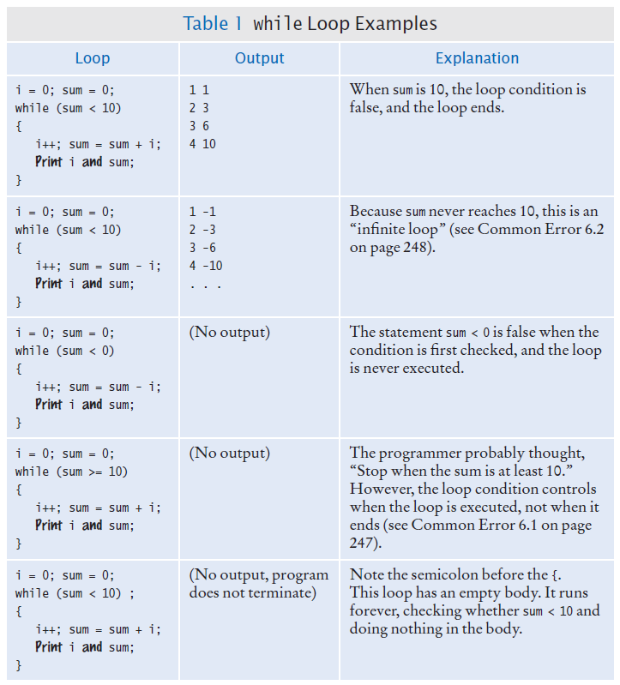
while Loop Examples

Slide 23
Common Error: Infinite Loops
Example:
forgetting to update the variable that controls the loop
int years = 1;
while (years <= 20)
{
double interest = balance * RATE / 100;
balance = balance + interest;
}
Example:
incrementing instead of decrementing
int years = 20;
while (years > 0)
{
double interest = balance * RATE / 100;
balance = balance + interest;
years++;
}
These loops run forever – must kill program

Slide 24
Common Error: Off-by-One Errors
Off-by-one error: a loop executes one too few, or one too many, times.
Example:
int years = 0;
while (balance < targetBalance)
{
years++;
balance = balance * (1 + RATE / 100);
}
System.out.println("The investment doubled after " +
year + " years.");
Should years start at 0 or 1?
Should the test be < or <= ?

Slide 25
Avoiding Off-by-One Error
Look at a scenario with simple values: initial balance: $100 interest rate: 50% after year 1, the balance is $150 after year 2 it is $225, or over $200 so the investment doubled after 2 years the loop executed two times, incrementing years each time Therefore: years must start at 0, not at 1.
interest rate: 100% after one year: balance is 2 * initialBalance loop should stop Therefore: must use < not <=
Think, don't compile and try at random

Slide 26
Problem Solving: Hand-Tracing
A simulation of code execution in which you step through instructions and track the values of the variables.
What value is displayed?
int n = 1729;
int sum = 0;
while (n > 0)
{
int digit = n % 10;
sum = sum + digit;
n = n / 10;
}
System.out.println(sum);

Slide 27
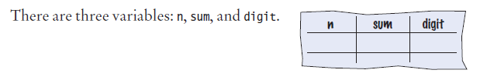
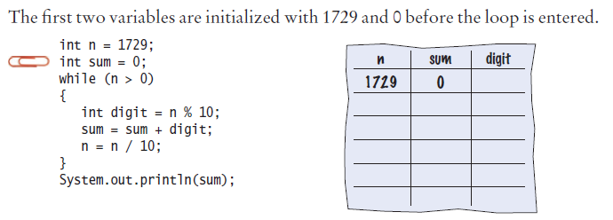
Problem Solving: Hand-Tracing - Step by Step
Step 1
Step 2

Slide 28
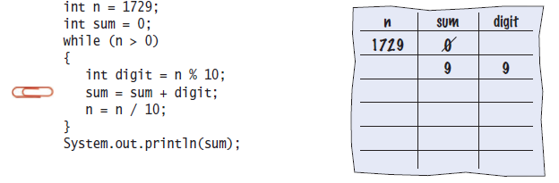
Problem Solving: Hand-Tracing - Step by Step
Step 3

Slide 29
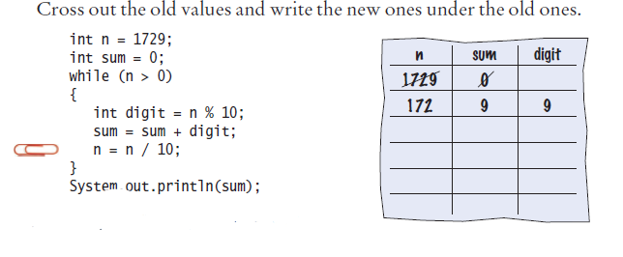
Problem Solving: Hand-Tracing - Step by Step
Step 4

Slide 30
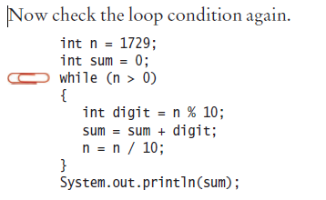
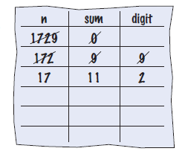
Problem Solving: Hand-Tracing - Step by Step
Step 5

Slide 31
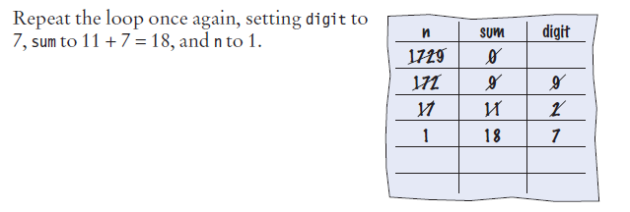
Problem Solving: Hand-Tracing - Step by Step
Step 6

Slide 32
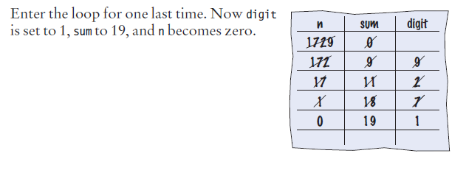
Problem Solving: Hand-Tracing - Step by Step
Step 7

Slide 33
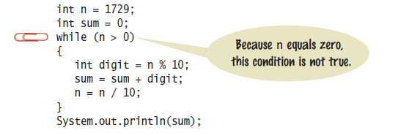
Problem Solving: Hand-Tracing - Step by Step
Step 8

Slide 34
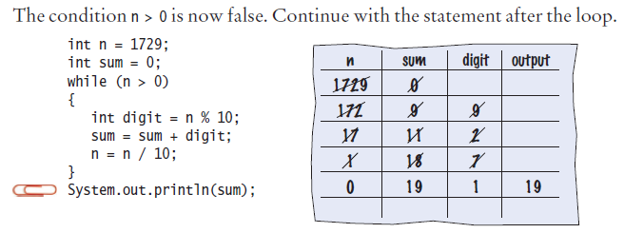
Problem Solving: Hand-Tracing - Step by Step
Step 9
Step 10 The sum, which is 19, is printed

Slide 35
Self Check 6.6
Hand-trace the following code, showing the value of n and the output.
int n = 5;
while (n >= 0)
{
n--;
System.out.print(n);
}
Answer:
n output
5
4 4
3 3
2 2
1 1
0 0
-1 -1

Slide 36
Self Check 6.7
Hand-trace the following code, showing the value of n and the output. What potential error do you notice?
int n = 1;
while (n <= 3)
{
System.out.print(n + ", ");
n++;
}
Answer:
n output
1 1,
2 1, 2,
3 1, 2, 3,
4
There is a comma after the last value. Usually, commas are between values only.

Slide 37
Self Check 6.8
Hand-trace the following code, assuming that a is 2 and n is 4. Then explain what the code does for arbitrary values of a and n.
int r = 1;
int i = 1;
while (i <= n)
{
r = r * a;
i++;
}
Answer:
a n r i
2 4 1 1
2 2
4 3
8 4
16 5
The code computes a^{n}.

Slide 38
Self Check 6.9
Trace the following code. What error do you observe?
int n = 1;
while (n != 50)
{
System.out.println(n);
n = n + 10;
}
Answer:
n output
1 1
11 11
21 21
31 31
41 41
51 51
61 61
...
This is an infinite loop. n is never equal to 50.

Slide 39
Self Check 6.10
The following pseudo-code is intended to count the number of digits in the number n:
count = 1
temp = n
while (temp > 10)
Increment count
Divide temp by 10.0
Trace the pseudocode for n = 123 and n = 100. What error do you find?
Continued

Slide 40
Self Check 6.10
Answer:
count temp
1 123
2 12.3
3 1.23
This yields the correct answer. The number 123 has 3 digits.
count temp
1 100
10.0
This yields the wrong answer. The number 100 also has 3 digits. The loop condition should have been while (temp >= 10).

Slide 41
The for Loop
To execute a sequence of statements a given number of times:
Could use a while loop controlled by a counter
int counter = 1; // Initialize the counter
while (counter <= 10) // Check the counter
{
System.out.println(counter);
counter++; // Update the counter
}
Use a special type of loop called for loop
for (int counter = 1; counter <= 10; counter++)
{
System.out.println(counter);
}
Use a for loop when a variable runs from a starting value to an ending value with a constant increment or decrement.

Slide 42
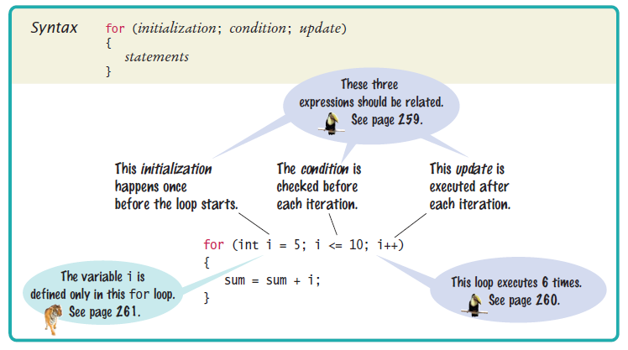
Syntax 6.2 for Statement

Slide 43
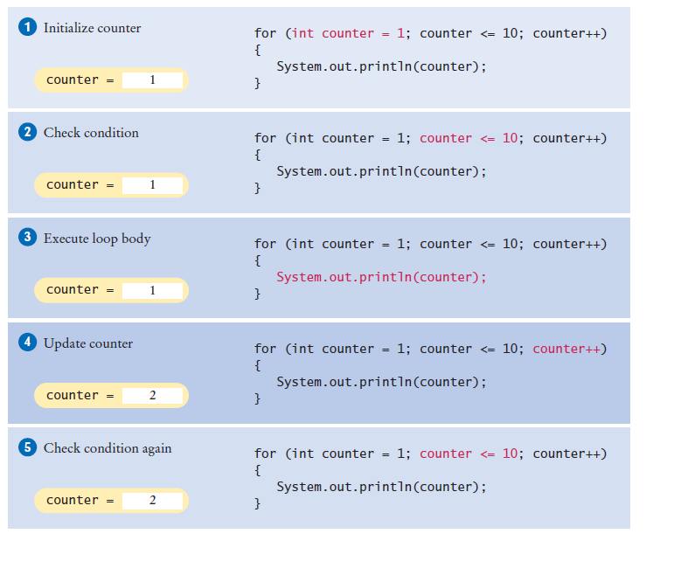
The for Loop
The initialization is executed once, before the loop is entered.
The condition is checked before each iteration.
The update is executed after each iteration.

Slide 44
The for Loop
A for loop can count down instead of up:
for (int counter = 10; counter >= 0; counter--) . . .
The increment or decrement need not be in steps of 1:
for (int counter = 0; counter <= 10; counter = counter + 2) . . .

Slide 45
The for Loop
If the counter variable is defined in the loop header,
It does not exist after the loop
for (int counter = 1; counter <= 10; counter++)
{
. . .
}
// counter no longer declared here
If you declare the counter variable before the loop,
You can continue to use it after the loop
int counter;
for (counter = 1; counter <= 10; counter++)
{
. . .
}
// counter still declared here

Slide 46
The for Loop
To traverse all the characters of a string:
for (int i = 0; i < str.length(); i++)
{
char ch = str.charAt(i);
Process ch.
}
The counter variable i starts at 0, and the loop is terminated when i reaches the length of the string.

Slide 47
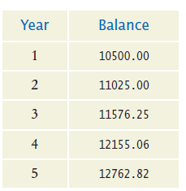
The for Loop
To compute the growth of our savings account over a period of years,
Use a for loop because the variable year starts at 1 and then moves in constant increments until it reaches the target
for (int year = 1; year <= numberOfYears; year++)
{
Update balance.
}
Table of balances:

Slide 48
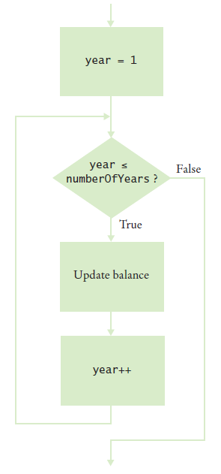
The for Loop - Flowchart
Figure 4 Flowchart of a for loop

Slide 49
section_3/Investment.java
1 /**
2 A class to monitor the growth of an investment that
3 accumulates interest at a fixed annual rate
4 */
5 public class Investment
6 {
7 private double balance;
8 private double rate;
9 private int year;
10
11 /**
12 Constructs an Investment object from a starting balance and
13 interest rate.
14 @param aBalance the starting balance
15 @param aRate the interest rate in percent
16 */
17 public Investment(double aBalance, double aRate)
18 {
19 balance = aBalance;
20 rate = aRate;
21 year = 0;
22 }
23
Continued

Slide 50
section_3/Investment.java
24 /**
25 Keeps accumulating interest until a target balance has
26 been reached.
27 @param targetBalance the desired balance
28 */
29 public void waitForBalance(double targetBalance)
30 {
31 while (balance < targetBalance)
32 {
33 year++;
34 double interest = balance * rate / 100;
35 balance = balance + interest;
36 }
37 }
38
Continued

Slide 51
section_3/Investment.java
39 /**
40 Keeps accumulating interest for a given number of years.
41 @param numberOfYears the number of years to wait
42 */
43 public void waitYears(int numberOfYears)
44 {
45 for (int i = 1; i <= numberOfYears; i++)
46 {
47 double interest = balance * rate / 100;
48 balance = balance + interest;
49 }
50 year = year + n;
51 }
52
53 /**
54 Gets the current investment balance.
55 @return the current balance
56 */
57 public double getBalance()
58 {
59 return balance;
60 }
61
Continued

Slide 52
section_3/Investment.java
62 /**
63 Gets the number of years this investment has accumulated
64 interest.
65 @return the number of years since the start of the investment
66 */
67 public int getYears()
68 {
69 return year;
70 }
71 }

Slide 53
section_3/InvestmentRunner.java
1 /**
2 This program computes how much an investment grows in
3 a given number of years.
4 */
5 public class InvestmentRunner
6 {
7 public static void main(String[] args)
8 {
9 final double INITIAL_BALANCE = 10000;
10 final double RATE = 5;
11 final int YEARS = 20;
12 Investment invest = new Investment(INITIAL_BALANCE, RATE);
13 invest.waitYears(YEARS);
14 double balance = invest.getBalance();
15 System.out.printf("The balance after %d years is %.2f\n",
16 YEARS, balance);
17 }
18 }
Program Run
The balance after 20 years is 26532.98

Slide 54
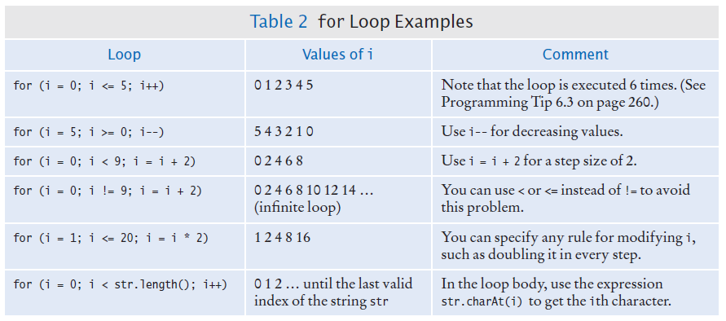
The for Loop Examples

Slide 55
Self Check 6.11
Write the for loop of the Investment class as a while loop.
Answer:
int years = 1;
while (years <= numberOfYears)
{
double interest = balance * rate / 100;
balance = balance + interest;
years++;
}

Slide 56
Self Check 6.12
How many numbers does this loop print?
for (int n = 10; n >= 0; n--)
{
System.out.println(n);
}
Answer: 11 numbers: 10 9 8 7 6 5 4 3 2 1 0

Slide 57
Self Check 6.13
Write a for loop that prints all even numbers between 10 and 20 (inclusive).
Answer:
for (int i = 10; i <= 20; i = i + 2)
{
System.out.println(i);
}

Slide 58
Self Check 6.14
Write a for loop that computes the sum of the integers from 1 to n.
Answer:
int sum = 0;
for (int i = 1; i <= n; i++)
{
sum = sum + I;
}

Slide 59
Self Check 6.15
How would you modify the InvestmentRunner.java program to print the balances after 20, 40, ..., 100 years?
Answer:
final int PERIODS = 5;
for (int i = 1; i <= PERIODS; i++)
{
invest.waitYears(YEARS);
System.out.printf( "The balance after %d years is %.2f\n”,
invest.getYears(), invest.getBalance()); }

Slide 60
The do Loop
Executes the body of a loop at least once and performs the loop test after the body is executed.
Use for input validation
To force the user to enter a value less than 100
int value;
do
{
System.out.print("Enter an integer < 100: ");
value = in.nextInt();
}
while (value >= 100);

Slide 61
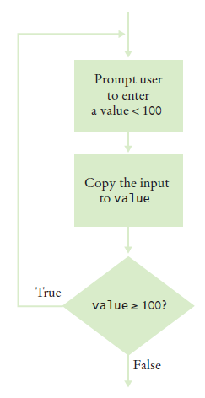
The do Loop
Figure 5 Flowchart of a do loop

Slide 62
Self Check 6.16
Suppose that we want to check for inputs that are at least 0 and at most 100. Modify the do loop for this check.
int value;
do
{
System.out.print("Enter an integer < 100: ");
value = in.nextInt();
}
while (value >= 100);
Answer: do
{
System.out.print( "Enter a value between 0 and 100: ");
value = in.nextInt();
}
while (value < 0 || value > 100);

Slide 63
Self Check 6.17
Rewrite the input check do loop using a while loop. What is the disadvantage of your solution?
int value;
do
{
System.out.print("Enter an integer < 100: ");
value =in.nextInt();
}
while (value >= 100);
Answer:
int value = 100;
while (value >= 100)
{
System.out.print("Enter a value < 100: ");
value = in.nextInt();
}
Here, the variable value had to be initialized with an artificial value to ensure that the loop is entered at least once.

Slide 64
Self Check 6.18
Suppose Java didn't have a do loop. Could you rewrite any do loop as a while loop?
Answer: Yes. The do loop
do
{
Body
}
while (condition);
is equivalent to this while loop:
boolean first = true;
while (first || condition)
{
body;
first = false;
}

Slide 65
Self Check 6.19
Write a do loop that reads integers and computes their sum. Stop when reading the value 0.
Answer:
int x;
int sum = 0;
do
{
x = in.nextInt();
sum = sum + x;
}
while (x != 0);

Slide 66
Self Check 6.20
Write a do loop that reads integers and computes their sum. Stop when reading a zero or the same value twice in a row. For example, if the input is 1 2 3 4 4, then the sum is 14 and the loop stops.
Answer:
int x = 0;
int previous;
do
{
previous = x;
x = in.nextInt();
sum = sum + x;
}
while (x != 0 && previous != x);

Slide 67

Application: Processing Sentinel Values
A sentinel value denotes the end of a data set, but it is not part of the data. If 0 can not be part of the data set
keep accepting input until a 0 finishes the sequence
If 0 is valid but no value can be negative
use -1 to indicate termination
In the military, a sentinel guards a border or passage. In computer science, a sentinel value denotes the end of an input sequence or the border between input sequences.

Slide 68
Application: Processing Sentinel Values
To compute the average of a set of salaries
use -1 to indicate termination
Inside the loop
Read the input
process it if the input is not -1
Stay in the loop while the sentinel value is not -1.
Initialize the input to something other than -1.

Slide 69
section_5/SentinelDemo.java
1 import java.util.Scanner;
2
3 /**
4 This program prints the average of salary values that are terminated with a sentinel.
5 */
6 public class SentinelDemo
7 {
8 public static void main(String[] args)
9 {
10 double sum = 0;
11 int count = 0;
12 double salary = 0;
13 System.out.print("Enter salaries, -1 to finish: ");
14 Scanner in = new Scanner(System.in);
15
16 // Process data until the sentinel is entered
17
Continued

Slide 70
section_5/SentinelDemo.java
16 // Process data until the sentinel is entered
17
18 while (salary != -1)
19 {
20 salary = in.nextDouble();
21 if (salary != -1)
22 {
23 sum = sum + salary;
24 count++;
25 }
26 }
27
28 // Compute and print the average
29
30 if (count > 0)
31 {
32 double average = sum / count;
33 System.out.println("Average salary: " + average);
34 }
35 else
36 {
37 System.out.println("No data");
38 }
39 }
40 }
Continued

Slide 71
section_5/SentinelDemo.java
Program Run
Enter salaries, -1 to finish: 10 10 40 -1 Average salary: 20

Slide 72
Application: Processing Sentinel Values
Using a Boolean variable to control a loop.
Set the variable before entering the loop
Set it to the opposite to leave the loop.
System.out.print("Enter salaries, -1 to finish: ");
boolean done = false;
while (!done)
{
value = in.nextDouble();
if (value == -1)
{
done = true;
} else
{
Process value
}
}

Slide 73
Application: Processing Sentinel Values
When any number can be an acceptable input
Use a sentinel value that is not a number (such as the letter Q)
in.hasNextDouble() returns false if the input is not a floating-point number
Use this loop
System.out.print("Enter values, Q to quit: ");
while (in.hasNextDouble())
{
value = in.nextDouble();
Process value.
}

Slide 74
Self Check 6.21
What does the SentinelDemo.java program print when the user immediately types -1 when prompted for a value?
Answer: No data

Slide 75
Self Check 6.22
Why does the SentinelDemo.java program have two checks of the form salary != -1?
Answer: The first check ends the loop after the sentinel has been read. The second check ensures that the sentinel is not processed as an input value.

Slide 76
Self Check 6.23
What would happen if the declaration of the salary variable in SentinelDemo.java was changed to
double salary = -1;
Answer: The while loop would never be entered. The user would never be prompted for input. Because count stays 0, the program would then print "No data".

Slide 77
Self Check 6.24
In the last example of this section, we prompt the user "Enter values, Q to quit: " What happens when the user enters a different letter?
Answer: The nextDouble method also returns false. A more accurate prompt would have been: "Enter values, a key other than a digit to quit: " But that might be more confusing to the program user who would need to ponder which key to choose.

Slide 78
Self Check 6.25
What is wrong with the following loop for reading a sequence of values?
System.out.print("Enter values, Q to quit: ");
do
{
double value = in.nextDouble();
sum = sum + value;
count++;
}
while (in.hasNextDouble());
Answer: If the user doesn't provide any numeric input, the first call to in.nextDouble() will fail.

Slide 79
The “Loop and a Half” Problem
Sometimes termination condition of a loop can only be evaluated in the middle of the loop. There are different approaches:
Use a Boolean variable
boolean done = false;
while (!done)
{
String input = in.next();
if (input.equals("Q"))
{
done = true;
}
else
{
Process data.
}
}

Slide 80
The “Loop and a Half” Problem
Additional approaches:
Combine an assignment and a test in the loop condition
while (!(input = in.next()).equals("Q"))
{
Process data.
}
Exit the loop from the middle
public void processInput(Scanner in)
{
while (true)
{
String input = in.next();
if (input.equals("Q"))
{
return;
}
Process data.
}
}

Slide 81

Problem Solving: Storyboards
A storyboard consists of annotated sketches for each step in an action sequence.
Developing a storyboard for your program helps you understand the inputs and outputs that are required for a program.
Use a storyboard to answer questions about how the program should react to different inputs.

Slide 82
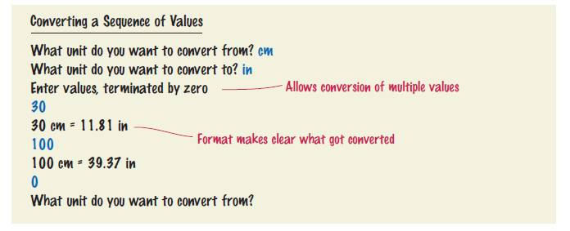
Problem Solving: Storyboards
Storyboarding for a problem to convert units of measurement.
Show how to deal with potential confusion:

Slide 83
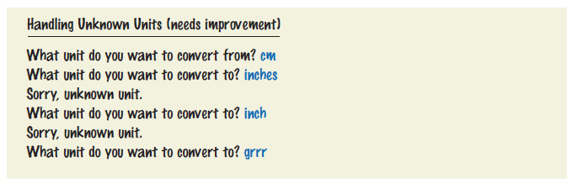
Problem Solving: Storyboards
Demonstrate error handling:

Slide 84
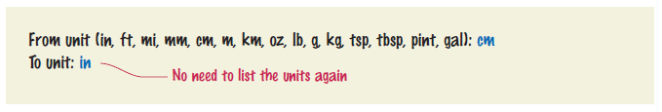
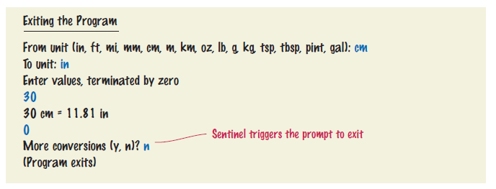
Problem Solving: Storyboards
An approach to avoid some errors:
How will we exit the program:

Slide 85
Self Check 6.26
Provide a storyboard panel for a program that reads a number of test scores and prints the average score. The program only needs to process one set of scores. Don't worry about error handling.
Answer: Computing the average
Enter scores, Q to quit: 90 80 90 100 80 Q
The average is 88
(Program exits)

Slide 86
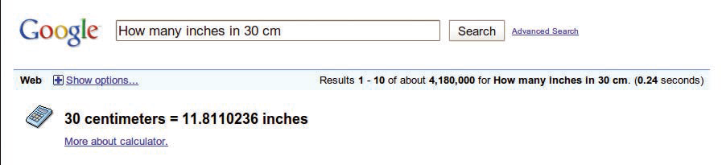
Self Check 6.27
Google has a simple interface for converting units. You just type the question, and you get the answer.
Make storyboards for an equivalent interface in a Java program. Show a scenario in which all goes well, and show the handling of two kinds of errors.
Continued

Slide 87
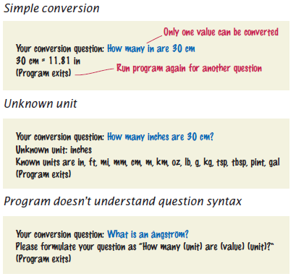
Self Check 6.27
Answer:

Slide 88
Self Check 6.28
Consider a modification of the program in Self Check 26. Suppose we want to drop the lowest score before computing the average. Provide a storyboard for the situation in which a user only provides one score.
Answer: One score is not enough
Enter scores, Q to quit: 90 Q
Error: At least two scores are required.
(Program exits)

Slide 89
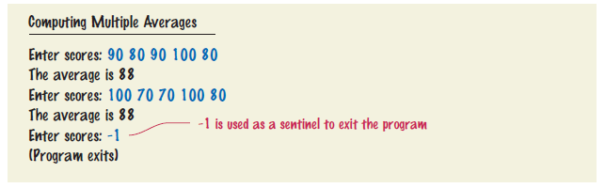
Self Check 6.29
What is the problem with implementing the following storyboard in Java?
Continued

Slide 90
Self Check 6.29
Answer: It would not be possible to implement this interface using the Java features we have covered up to this point. There is no way for the program to know when the first set of inputs ends. (When you read numbers with value = in.nextDouble(), it is your choice whether to put them on a single line or multiple lines.)

Slide 91
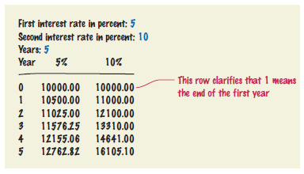
Self Check 6.30
Produce a storyboard for a program that compares the growth of a $10,000 investment for a given number of years under two interest rates.
Answer: Comparing two interest rates

Slide 92
Common Loop Algorithm: Sum and Average
Sum - keep a running total: a variable to which you add each input value:
double total = 0;
while (in.hasNextDouble())
{
double input = in.nextDouble();
total = total + input;
}
Average - count how many values you have:
double total = 0;
int count = 0;
while (in.hasNextDouble())
{
double input = in.nextDouble();
total = total + input; count++;
}
double average = 0;
if (count > 0)
{
average = total / count;
}

Slide 93
Common Loop Algorithm: Counting Matches
Count how many spaces are in a string:
int spaces = 0;
for (int i = 0; i < str.length(); i++)
{
char ch = str.charAt(i);
if (ch == ' ’)
{
spaces++;
}
}

Slide 94

Common Loop Algorithm: Counting Matches
Count how many words in the input have at most three letters:
int shortWords = 0;
while (in.hasNext())
{
String input = in.next();
if (input.length() <= 3)
{
shortWords++;
}
}
In a loop that counts matches, a counter is incremented whenever a match is found.

Slide 95

Common Loop Algorithm: Finding the First Match
Find the first space in a string. Because we do not visit all elements in the string, a while loop is a better choice than a for loop:
boolean found = false;
char ch = '?’;
int position = 0;
while (!found && position < str.length())
{
ch = str.charAt(position);
if (ch == ' ') { found = true; }
else { position++; }
}
When searching, you look at items until a match is found.

Slide 96
Common Loop Algorithm: Prompting Until a Match is Found
Keep asking the user to enter a positive value < 100 until the user provides a correct input:
boolean valid = false;
double input = 0;
while (!valid)
{
System.out.print("Please enter a positive value < 100: ");
input = in.nextDouble();
if (0 < input && input < 100) { valid = true; }
else { System.out.println("Invalid input."); }
}
The variable input is declared outside the while loop because you will want to use the input after the loop has finished.

Slide 97
Common Loop Algorithm: Maximum and Minimum
To find the largest value, update the largest value seen so far whenever you see a larger one.
double largest = in.nextDouble();
while (in.hasNextDouble())
{
double input = in.nextDouble();
if (input > largest)
{
largest = input;
}
}

Slide 98
Common Loop Algorithm: Maximum and Minimum
To find the smallest value, reverse the comparison.
double smallest = in.nextDouble();
while (in.hasNextDouble())
{
double input = in.nextDouble();
if (input < smallest)
{
smallest = input;
}
}
There must be at least one input

Slide 99

Common Loop Algorithm: Maximum and Minimum
To find the height of the tallest bus rider, remember the largest value so far, and update it whenever you see a taller one.

Slide 100

Common Loop Algorithm: Comparing Adjacent Values
Check whether a sequence of inputs contains adjacent duplicates such as 1 7 2 9 9 4 9:
double input = 0;
while (in.hasNextDouble())
{
double previous = input;
input = in.nextDouble();
if (input == previous)
{
System.out.println("Duplicate input");
}
}
When comparing adjacent values, store the previous value in a variable.

Slide 101
Self Check 6.31
What total is computed when no user input is provided in the algorithm in Section 6.7.1?
Answer: The total is zero.

Slide 102
Self Check 6.32
How do you compute the total of all positive inputs?
Answer:
double total = 0;
while (in.hasNextDouble())
{
double input = in.nextDouble();
if (input > 0) { total = total + input; }
}

Slide 103
Self Check 6.33
What are the values of position and ch when no match is found in the algorithm in Section 6.7.3?
Answer: position is str.length() and ch is unchanged from its initial value, '?'. Note that ch must be initialized with some value - otherwise the compiler will complain about a possibly uninitialized variable.

Slide 104
Self Check 6.34
What is wrong with the following loop for finding the position of the first space in a string?
boolean found = false;
for (int position = 0; !found && position < str.length(); position++)
{
char ch = str.charAt(position);
if (ch == ' ') { found = true; }
}
Answer: The loop will stop when a match is found, but you cannot access the match because neither position nor ch are defined outside the loop.

Slide 105
Self Check 6.35
How do you find the position of the last space in a string?
Answer: Start the loop at the end of string:
boolean found = false;
int i = str.length() – 1;
while (!found && i >= 0)
{
char ch = str.charAt(i);
if (ch == ' ') { found = true; }
else { i--; }
}

Slide 106
Self Check 6.36
What happens with the algorithm in Section 6.7.6 when no input is provided at all? How can you overcome that problem?
Answer: The initial call to in.nextDouble() fails, terminating the program. One solution is to do all input in the loop and introduce a Boolean variable that checks whether the loop is entered for the first time.
double input = 0;
boolean first = true;
while (in.hasNextDouble())
{
double previous = input;
input = in.nextDouble();
if (first) { first = false; }
else if (input == previous)
{
System.out.println("Duplicate input");
}
}

Slide 107
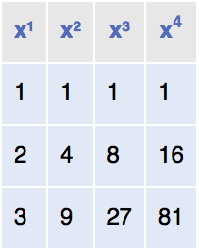
Nested Loops
One loop inside another loop.
Print a table of the powers of x, like this:
Pseudocode
Print table header.
For x from 1 to 10
Print table row.
Print new line.

Slide 108
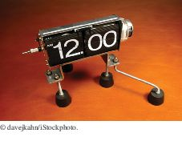
Nested Loops
To print the values for each exponent requires a second loop
For n from 1 to 4
Print x^{n}.
The hour and minute displays in a digital clock are an example of nested loops.
The hours loop 12 times, and for each hour, the minutes loop 60 times.

Slide 109
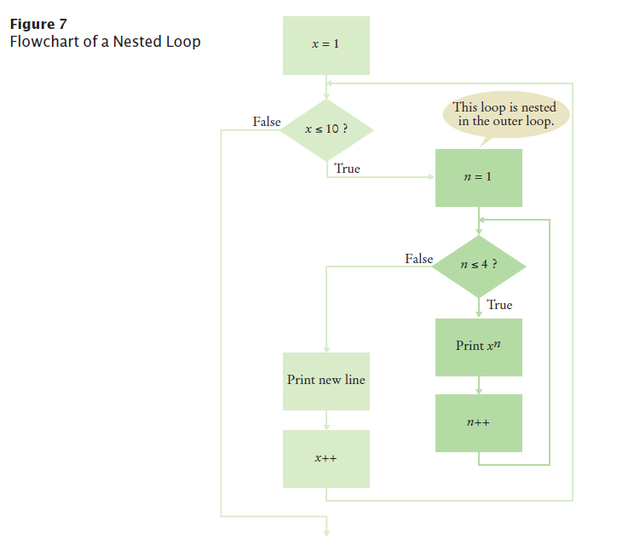
Nested Loop

Slide 110
section_8/PowerTable.java
1 /**
2 This program prints a table of powers of x.
3 */
4 public class PowerTable
5 {
6 public static void main(String[] args)
7 {
8 final int NMAX = 4;
9 final double XMAX = 10;
10
11 // Print table header
12
13 for (int n = 1; n <= NMAX; n++)
14 {
15 System.out.printf("%10d", n);
16 }
17 System.out.println();
18 for (int n = 1; n <= NMAX; n++)
19 {
20 System.out.printf("%10s", "x ");
21 }
22 System.out.println();
23
Continued

Slide 111
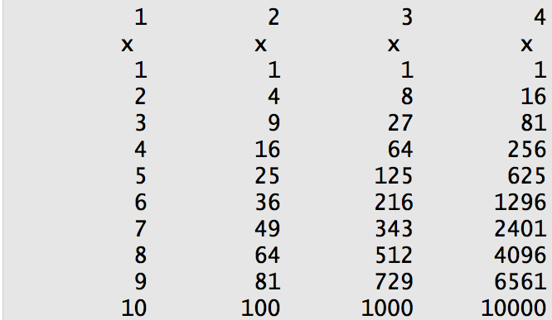
section_8/PowerTable.java
24 // Print table body
25
26 for (double x = 1; x <= XMAX; x++)
27 {
28 // Print table row
29
30 for (int n = 1; n <= NMAX; n++)
31 {
32 System.out.printf("%10.0f", Math.pow(x, n));
33 }
34 System.out.println();
35 }
36 }
37 }
Program Run

Slide 112
Self Check 6.37
Why is there a statement System.out.println(); in the outer loop but not in the inner loop?
Answer: All values in the inner loop should be displayed on the same line.

Slide 113
Self Check 6.39
If you make the change in Self Check 38, how many values are displayed?
Answer: 60: The outer loop is executed 10 times, and the inner loop 6 times.

Slide 114
Self Check 6.40
What do the following nested loops display?
for (int i = 0; i < 3; i++)
{
for (int j = 0; j < 4; j++)
{
System.out.print(i + j);
}
System.out.println();
}
Answer: 0123 1234 2345

Slide 115
Self Check 6.41
Write nested loops that make the following pattern of brackets: [][][][] [][][][] [][][][]
Answer:
for (int i = 1; i <= 3; i++)
{
for (int j = 1; j <= 4; j++)
{
System.out.print("[]");
}
System.out.println();
}

Slide 116
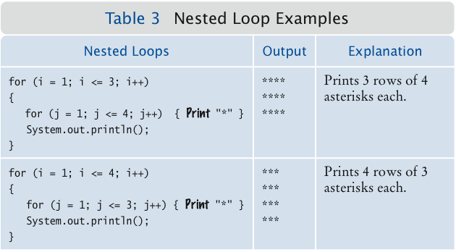
Nested Loop Examples

Slide 117
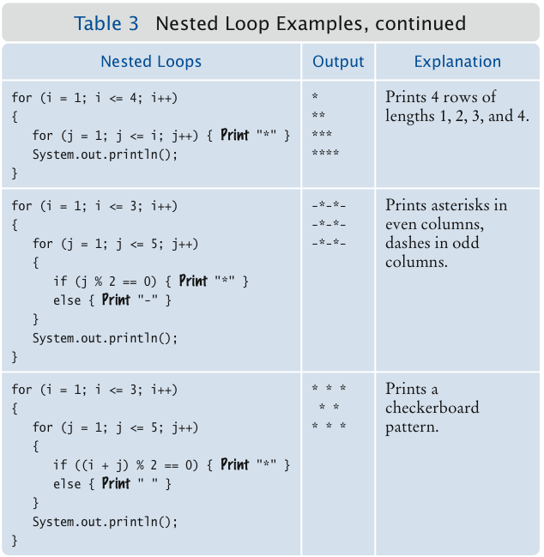
Nested Loop Examples

Slide 118
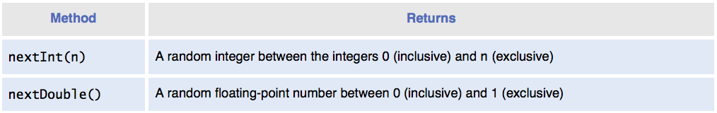
Application: Random Numbers and Simulations
In a simulation, you use the computer to simulate an activity.
You can introduce randomness by calling the random number generator.
To generate a random number
Create an object of the Random class
Call one of its methods

Slide 119
Application: Random Numbers and Simulations
To simulate the cast of a die:
Random generator = new Random()
int d = 1 + generator.nextInt(6);
The call generator.nextInt(6) gives you a random number between 0 and 5 (inclusive).
Add 1 to obtain a number between 1 and 6.

Slide 120
section_9_1/Die.java
1 import java.util.Random;
2
3 /**
4 This class models a die that, when cast, lands on a random
5 face.
6 */
7 public class Die
8 {
9 private Random generator;
10 private int sides;
11
12 /**
13 Constructs a die with a given number of sides.
14 @param s the number of sides, e.g. 6 for a normal die
15 */
16 public Die(int s)
17 {
18 sides = s;
19 generator = new Random();
20 }
21
Continued

Slide 121
section_9_1/Die.java
22 /**
23 Simulates a throw of the die
24 @return the face of the die
25 */
26 public int cast()
27 {
28 return 1 + generator.nextInt(sides);
29 }
30 }

Slide 122
section_9_1/DieSimulator.java
1 /**
2 This program simulates casting a die ten times.
3 */
4 public class DieSimulator
5 {
6 public static void main(String[] args)
7 {
8 Die d = new Die(6);
9 final int TRIES = 10;
10 for (int i = 1; i <= TRIES; i++)
11 {
12 int n = d.cast();
13 System.out.print(n + " ");
14 }
15 System.out.println();
16 }
17 }
Program Run
6 5 6 3 2 6 3 4 4 1
Second Run:
3 2 2 1 6 5 3 4 1 2

Slide 123
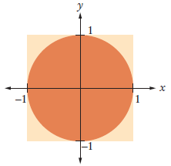
The Monte Carlo Method
Using a simulation to calculate π
Simulate shooting a dart into a square surrounding a circle of radius 1
Estimate for π is 4 x hits / tries.
To generate a random floating-point value between -1 and 1
double r = generator.nextDouble(); // 0 <= r < 1
double x = -1 + 2 * r; // -1 <= x < 1

Slide 124
section_9_2/MonteCarlo.java
1 import java.util.Random;
2
3 /**
4 This program computes an estimate of pi by simulating dart throws onto a square.
5 */
6 public class MonteCarlo
7 {
8 public static void main(String[] args)
9 {
10 final int TRIES = 10000;
11 Random generator = new Random();
12
13 int hits = 0;
14 for (int i = 1; i <= TRIES; i++)
15 {
16 // Generate two random numbers between -1 and 1
17
18 double r = generator.nextDouble();
19 double x = -1 + 2 * r;
20 r = generator.nextDouble();
21 double y = -1 + 2 * r;
22
23 // Check whether the point lies in the unit circle
24
25 if (x * x + y * y <= 1) { hits++; }
26 }
27
Continued

Slide 125
section_9_2/MonteCarlo.java
28 /*
29 The ratio hits / tries is approximately the same as the ratio
30 circle area / square area = pi / 4
31 */
32
33 double piEstimate = 4.0 * hits / TRIES;
34 System.out.println("Estimate for pi: " + piEstimate);
35 }
36 }
Program Run
Estimate for pi: 3.1504

Slide 126
Self Check 6.42
How do you simulate a coin toss with the Random class?
Answer: Compute generator.nextInt(2), and use 0 for heads, 1 for tails, or the other way around.

Slide 127
Self Check 6.43
How do you simulate the picking of a random playing card?
Answer: Compute generator.nextInt(4) and associate the numbers 0 . . . 3 with the four suits. Then compute generator.nextInt(13) and associate the numbers 0 . . . 12 with Jack, Ace, 2 . . . 10, Queen, and King.

Slide 128
Self Check 6.44
How would you modify the DieSimulator program to simulate tossing a pair of dice?
Answer: Construct two Die objects:
Die d1 = new Die(6);
Die d2 = new Die(6);
Then cast and print both of them:
System.out.println( d1.cast() + " " + d2.cast());

Slide 129
Self Check 6.45
In many games, you throw a pair of dice to get a value between 2 and 12. What is wrong with this simulated throw of a pair of dice?
int sum = 2 + generator.nextInt(11);
Answer: The call will produce a value between 2 and 12, but all values have the same probability. When throwing a pair of dice, the number 7 is six times as likely as the number 2. The correct formula is
int sum = generator.nextInt(6) +
generator.nextInt(6) + 2;

Slide 130
Self Check 6.46
How do you generate a random floating-point number >= 0 and < 100?
Answer: generator.nextDouble() * 100.0

Slide 131
Using a Debugger
Debugger: a program to execute another program and analyze its run-time behavior
A debugger lets you stop and restart your program, see contents of variables, and step through it
The larger your programs, the harder to debug them simply by inserting print commands
Debuggers can be part of your IDE (e.g. Eclipse, BlueJ) or separate programs (e.g. JSwat)
Three key concepts:
Breakpoints
Single-stepping
Inspecting variables

Slide 132
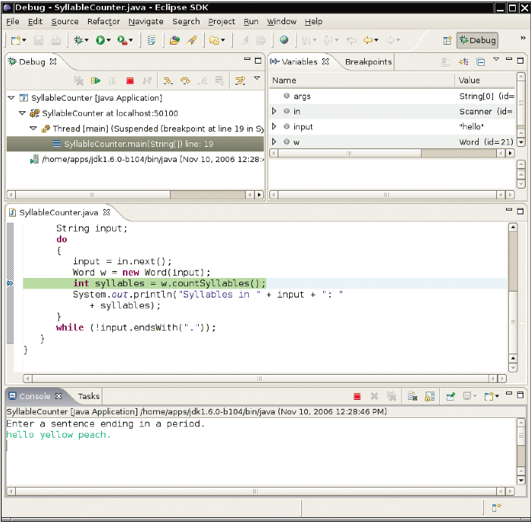
The Debugger Stopping at a Breakpoint

Slide 133
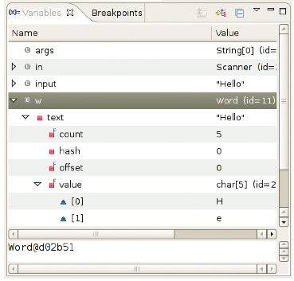
Inspecting Variables
Figure 9 Inspecting Variables

Slide 134
Debugging
Execution is suspended whenever a breakpoint is reached
In a debugger, the program runs at full speed until it reaches a breakpoint
When execution stops you can:
Inspect variables
Step through the program a line at a time
Or, continue running the program at full speed until it reaches the next breakpoint
When the program terminates, the debugger stops as well
Breakpoints stay active until you remove them
Two variations of single-step command:
Step Over: skips method calls
Step Into: steps inside method calls

Slide 135
Single-step Example
Current line:
String input = in.next();
Word w = new Word(input);
int syllables = w.countSyllables();
System.out.println("Syllables in " + input + ": " + syllables);
When you step over method calls, you get to the next line:
String input = in.next();
Word w = new Word(input);
int syllables = w.countSyllables();
System.out.println("Syllables in " + input + ": " + syllables);
However, if you step into method calls, you enter the first line of the countSyllables
method public int countSyllables()
{
int count = 0;
int end = text.length() – 1;
. . .
}

Slide 136
Self Check 6.47
In the debugger, you are reaching a call to System.out.println. Should you step into the method or step over it?
Answer: You should step over it because you are not interested in debugging the internals of the println method.

Slide 137
Self Check 6.48
In the debugger, you are reaching the beginning of a long method with a couple of loops inside. You want to find out the return value that is computed at the end of the method. Should you set a breakpoint, or should you step through the method?
Answer: You should set a breakpoint. Stepping through loops can be tedious.

Slide 138
Self Check 6.49
When using the debugger, you find that a variable has an unexpected value. How can you go backwards to see when the variable changed?
Answer: Unfortunately, most debuggers do not support going backwards. Instead, you must restart the program. Try setting breakpoints at the lines in which the variable is changed.

Slide 139
Self Check 6.50
When using a debugger, should you insert statements to print the values of variables?
Answer: No, there is no need. You can just inspect the variables in the debugger.

Slide 140
Self Check 6.51
Instead of using a debugger, could you simply trace a program by hand?
Answer: For short programs, you certainly could. But when programs get longer, it would be very time-consuming to trace them manually.

