Slide 1
CSCI – 4481 (Cryptography and data security)
Lecture slides - 3

Slide 2
today
More on historical ciphers:
- Vigenere Cipher
- Playfair Cipher
- ADFGX Cipher
- Hill Cipher

Slide 3
Motivation for polyalphabetic ciphers
Main weaknesses of mono-alphabetic substitution ciphers is that each letter in the ciphertext corresponds to only one letter in the plaintext.
Idea of a strong cipher (1460’s by Alberti):
- Use more than one cipher alphabet and switch between them while encrypting the text.
This cipher was originally invented by Giovan Battista Bellaso in 1553.
It was developed into a practical cipher by Vigenere (published in 1586).

Slide 4
vigenere cipher
This is a poly-alphabetic cipher.
It is a variant of the shift cipher, but the same letter can be replaced by different shifts.
The key is a vector of integers from 0 to 25, corresponding to letters in the alphabet.
The secrecy lies in the fact that neither the key, nor its length is known.

Slide 5

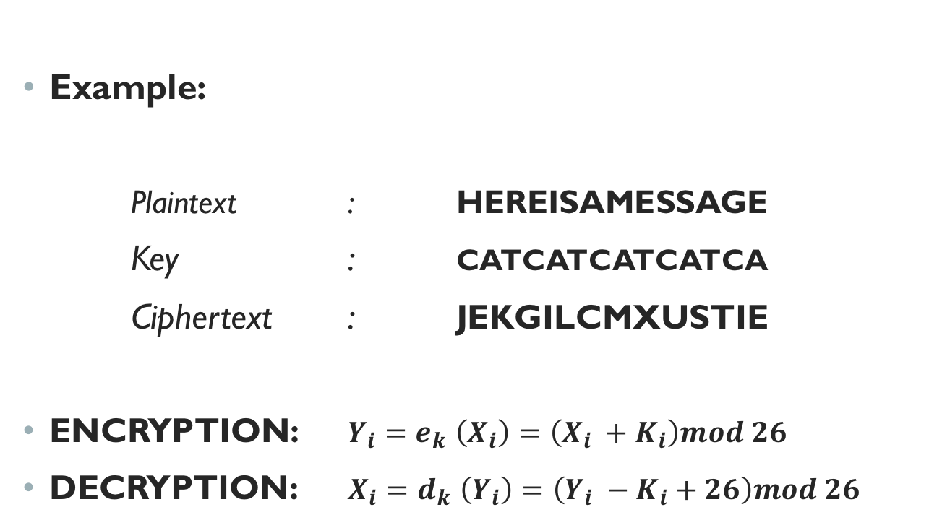

vigenere cipher – cont.
Example:
Plaintext : HEREISAMESSAGE
Key : CATCATCATCATCA
Ciphertext : JEKGILCMXUSTIE
ENCRYPTION: $Y_{i}{=e}_{k}\left(X_{i}\right)=\left(X_{i} +K_{i}\right)mod 26$
DECRYPTION: $X_{i}{=d}_{k}\left(Y_{i}\right)=\left(Y_{i} −K_{i}+26\right)mod 26$

Slide 6
vigenere cipher – cont.
Attack: Plain brute-force attack or letter frequency attack is not possible unless we know the key length, because it is a polyalphabetic cipher.
We need to find the key length to break the Vigenere cipher.
Once we find the key length, we can divide the ciphertext into those many individual shift ciphers and carry out frequency analysis for each part.

Slide 7
vigenere cipher – cont.
Attack: Plain brute-force attack or letter frequency attack is not possible unless we know the key length, because it is a polyalphabetic cipher.
We need to find the key length to break the Vigenere cipher.
Once we find the key length, we can divide the ciphertext into those many individual shift ciphers and carry out frequency analysis for each part.

Slide 8
How to find the key length?
For Vigenere, as the length of the key word increases, the letter frequency becomes more random.
An effective method to find the key length: Index of coincidence (IOC) test.

Slide 9
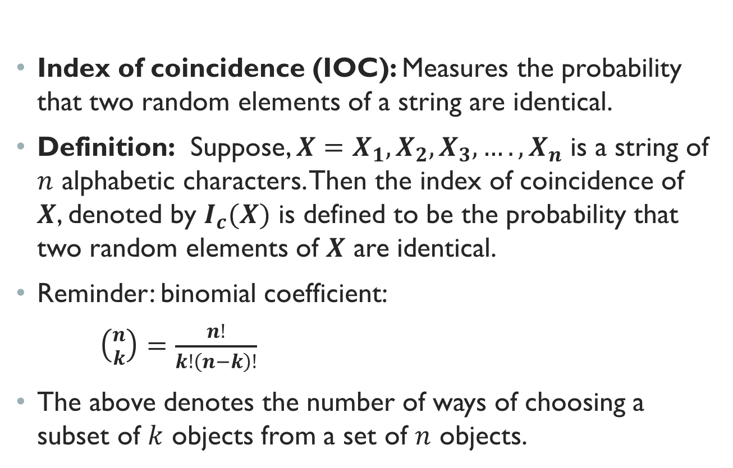
Index of coincidence test
Index of coincidence (IOC): Measures the probability that two random elements of a string are identical.
Definition: Suppose, $X=X_{1},X_{2},X_{3},….,X_{n}$ is a string of $n$ alphabetic characters. Then the index of coincidence of $X$, denoted by $I_{c}(X)$ is defined to be the probability that two random elements of $X$ are identical.
Reminder: binomial coefficient:
$\left({n \atop k}\right)=\frac{n!}{k!\left(n−k\right)!}$
The above denotes the number of ways of choosing a subset of $k$ objects from a set of $n$ objects.

Slide 10
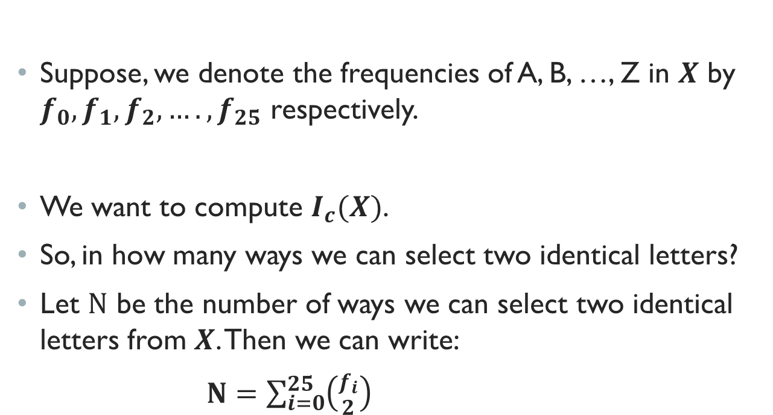
Index of coincidence test – cont.
Suppose, we denote the frequencies of A, B, …, Z in $X$ by $f_{0},f_{1},f_{2},….,f_{25}$ respectively.
We want to compute $I_{c}(X)$.
So, in how many ways we can select two identical letters?
Let $N$ be the number of ways we can select two identical letters from $X$. Then we can write:
$N=\sum_{i=0}^{25}{\left({f_{i} \atop 2}\right)}$

Slide 11
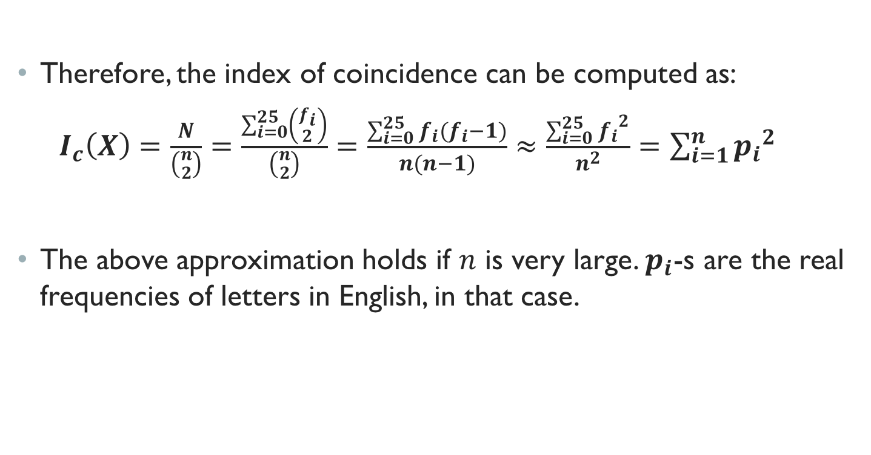
Index of coincidence test – cont.
Therefore, the index of coincidence can be computed as:
$I_{c}\left(X\right)=\frac{N}{\left({n \atop 2}\right)}=\frac{\sum_{i=0}^{25}{\left({f_{i} \atop 2}\right)}}{\left({n \atop 2}\right)}=\frac{\sum_{i=0}^{25}{f_{i}{(f}_{i}−1)}}{n(n−1)}≈\frac{\sum_{i=0}^{25}{{f_{i}}^{2}}}{n^{2}}=\sum_{i=1}^{n}{{p_{i}}^{2}}$
The above approximation holds if $n$ is very large. $p_{i}$-s are the real frequencies of letters in English, in that case.

Slide 12
Index of coincidence test – cont.
Example: Let us consider the text: THEINDEXOFCOINCIDENCE
What is the index of coincidence of the above text?
Solution: There are 21 characters with frequency of the letters as follows:
C | D | E | F | H | I | N | O | T | X
3 | 2 | 4 | 1 | 1 | 3 | 3 | 2 | 1 | 1

Slide 13

Index of coincidence test – cont.
Therefore, the index of coincidence can be computed as:
$I_{c}\left(X\right)=\frac{3 ∗ 2 + 2 ∗1 + 4 ∗3 + 1 ∗0 + 1 ∗0 + 3 ∗2 + 3 ∗2 + 2 ∗1 + 1 ∗0 + 1 ∗0}{21 ∗20}$
$=\frac{34}{420}=0.0809$
C | D | E | F | H | I | N | O | T | X
3 | 2 | 4 | 1 | 1 | 3 | 3 | 2 | 1 | 1

Slide 14
How to find the key length?
Coming back to finding the key length of Vigenere cipher, we shift the ciphertext by 1, 2, 3, …positions and for each case, we calculate the index of coincidence.
The maximum number of coincidences will be found when we shift the ciphertext by the key length (Read page 19 of Intro to Cryptography with Coding Theory).

Slide 15
How to find the key
Once the key length is found, frequency analysis can be carried out for each part of the ciphertext which is encrypted by the same letter of the key.
We can thus obtain the key very easily (see page 19 of Intro to Cryptography with Coding Theory).

Slide 16
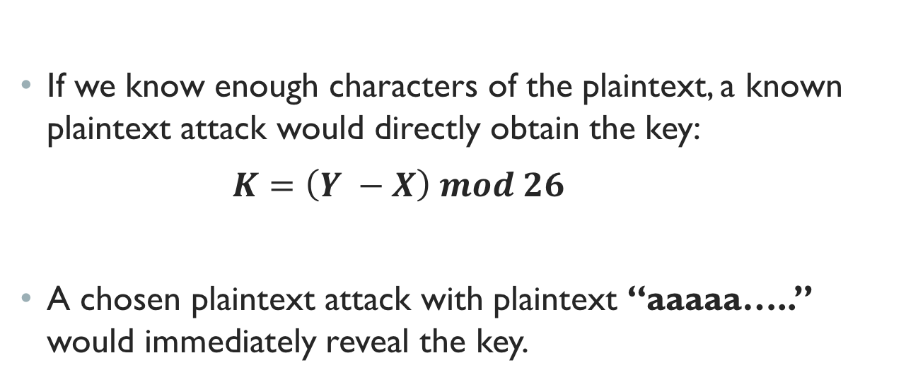
Other attacks
If we know enough characters of the plaintext, a known plaintext attack would directly obtain the key:
$K=\left(Y −X\right) mod 26$
A chosen plaintext attack with plaintext “aaaaa…..” would immediately reveal the key.

Slide 17
PLAYFAIR CIPHER
Invented around 1854 by Sir Charles Wheatstone, but it was named after his friend Playfair.
It was used by the British in World War I and Boer war.
It encrypts two letters at a time.

Slide 18
Playfair cipher Algorithm
The key for this cipher is a word, e.g., “PLAYFAIR”.
Repeated letters are removed to yield “PLAYFIR”.
Form a 5 X 5 matrix of letters from the alphabet (‘I’ and ‘J’ are treated as a single letter).
Populate the reduced key first in the matrix and then the remaining letters.

Slide 19
Playfair cipher Algorithm – cont.
P L A Y F
I R B C D
E G H K M
N O Q S T
U V W X Z
Let us encrypt: “THIS IS A COOL PLAINTEXT”.
Remove spaces and divide the text in groups of two letters: “TH IS IS AC OO LP LA IN TE XT”.

Slide 20
Playfair cipher Algorithm – cont.
If there is a doubled letter in a group, insert an ‘X’ in between them and re-group:
TH IS IS AC OX OL PL AI NT EX T
Add an extra ‘X’ in the end to complete the last group, if needed.
The resulting text:
TH IS IS AC OX OL PL AI NT EX TX
Use the matrix to encrypt each group.

Slide 21
Playfair cipher Algorithm – cont.
If there is a doubled letter in a group, insert an ‘X’ in between them and re-group:
TH IS IS AC OX OL PL AI NT EX T
Add an extra ‘X’ in the end to complete the last group, if needed.
The resulting text:
TH IS IS AC OX OL PL AI NT EX TX
Use the matrix to encrypt each group.

Slide 22
Playfair cipher Algorithm – cont.
If the two letters in the group are not in the same row/column, replace each letter by the letter that is in its row and in the column of the other letter.
If the two letters in the group are in the same row, replace each letter with the letter immediately to its right, with the matrix wrapping around from the last column to the first.
If the two letters in the group are in the same column, replace each letter with the letter immediately below it, with the matrix wrapping around from the last row to the first.

Slide 23
Playfair cipher Algorithm – cont.
Encrypted text:
QM CN CN YB SV VR LA PB ON KU SZ
To decrypt, we just reverse the process.
Attack: This cipher succumbs to a frequency analysis attack by analyzing the frequencies of digrams (two-letter combinations).

Slide 24
ADFGX cipher
Used by the British in World War – 1.
Put letters of the alphabet in a 5 X 5 matrix (‘I’ and ‘J’ are treated as one).
Columns of the matrix are labeled as ADFGX.
Each plaintext letter is replaced by the label of its row and column.
 | A | D | F | G | X
A | p | s | q | a | m
D | b | y | d | i | z
F | k | o | r | t | w
G | f | v | c | l | e
X | x | h | n | u | g

Slide 25
ADFGX cipher – cont.
Let us encrypt the word “cryptography”.
First, each letter in the plaintext is replaced by the label of its row and column.
So, we get: GF FF DD AA FG FD XX FF AG AA XD DD
Next, we choose a key, for example: UNCLE.
Label the columns by the latters of the key and put the results of the initial step into another matrix:

Slide 26
ADFGX cipher – cont.
So, we get the table shown in the right.
U | N | C | L | E
G | F | F | F | D
D | A | A | F | G
F | D | X | X | F
F | A | G | A | A
X | D | D | D

Slide 27
ADFGX cipher – cont.
Next, we re-order the columns so that the labels are in alphabetic order.
Now we read down the columns order to obtain the ciphertext:
FAXGDDGFAFFXADFADADGDFFX
C | E | L | N | U
F | D | F | F | G
A | G | F | A | D
X | F | X | D | F
G | A | A | A | F
D |  | D | D | X

Slide 28
ADFGX cipher – cont.
For decryption, we need to know the key and the original matrix.
Length of each column can be determined from the length of the key and the length of the ciphertext.
The letters are then placed into the columns which are then re-ordered to match the key.
The original matrix can be used to recover the plaintext.
The initial matrix and the key word is changed frequently.

Slide 29
Hill cipher
This is a block cipher, encrypting blocks of characters, rather than individual characters.
Invented in 1929 by Lester Hill.
We choose an integer N. Then we form an N X N matrix whose entries are integers modulo 26.
This matrix is the key with which we encrypt.
The cipher encrypts blocks of N letters at a time.

Slide 30
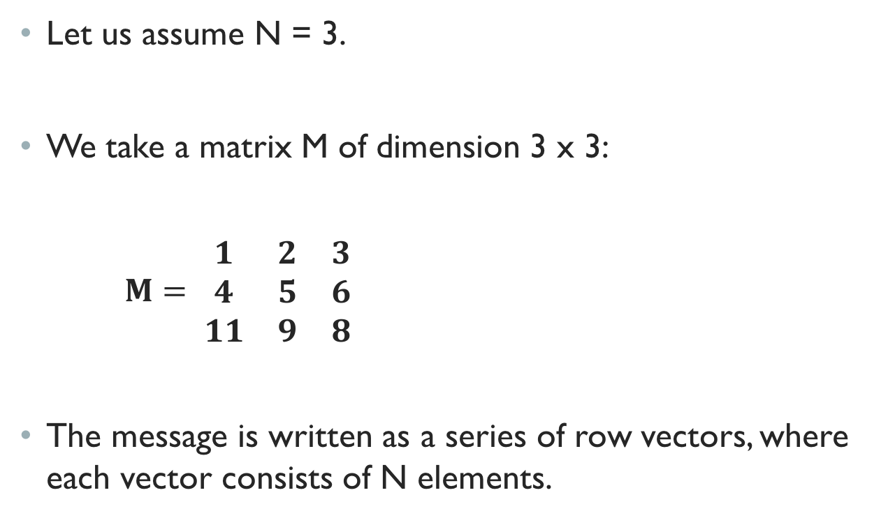
Hill cipher – cont.
Let us assume N = 3.
We take a matrix M of dimension 3 x 3:
$M= \begin{matrix}1 & 2 & 3 \\ 4 & 5 & 6 \\ 11 & 9 & 8\end{matrix}$
The message is written as a series of row vectors, where each vector consists of N elements.

Slide 31
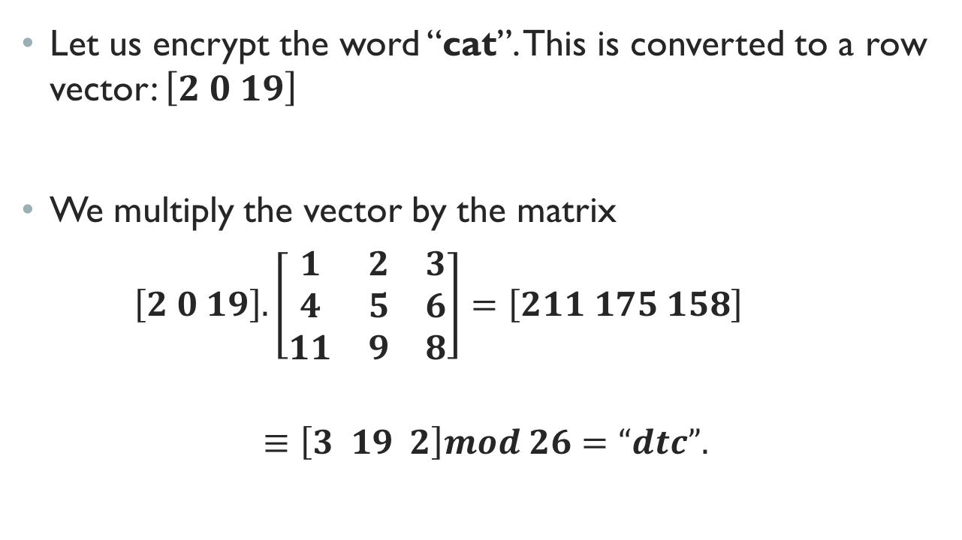
Hill cipher – cont.
Let us encrypt the word “cat”. This is converted to a row vector: $\left[2 0 19\right]$
We multiply the vector by the matrix
$\left[2 0 19\right].\left[\begin{matrix}1 & 2 & 3 \\ 4 & 5 & 6 \\ 11 & 9 & 8\end{matrix}\right]=\left[211 175 158\right]$
$$≡\left[3 19 2\right]mod 26=“dtc”.$$

Slide 32
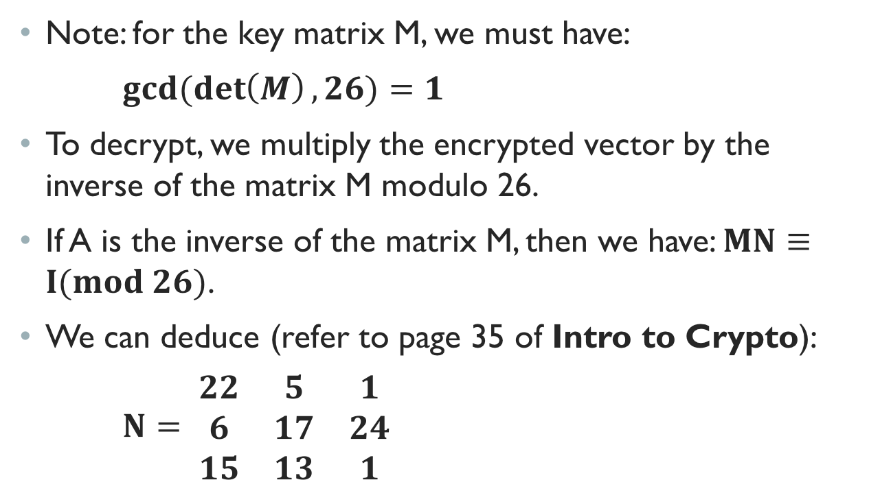
Hill cipher – cont.
Note: for the key matrix M, we must have:
$gcd⁡(\det\left(M\right), 26)=1$
To decrypt, we multiply the encrypted vector by the inverse of the matrix M modulo 26.
If A is the inverse of the matrix M, then we have: $MN≡I(mod 26)$.
We can deduce (refer to page 35 of Intro to Crypto):
$N= \begin{matrix}22 & 5 & 1 \\ 6 & 17 & 24 \\ 15 & 13 & 1\end{matrix}$

Slide 33
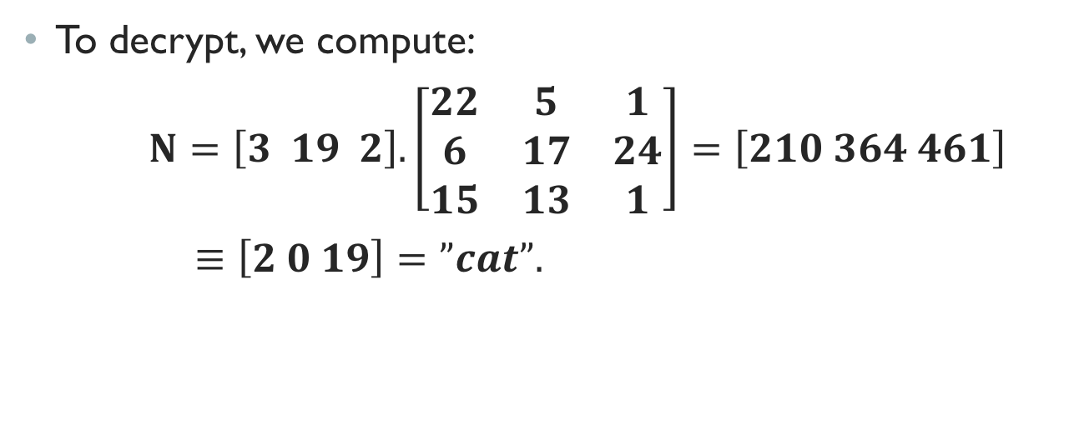
Hill cipher – cont.
To decrypt, we compute:
$N=\left[3 19 2\right].\left[\begin{matrix}22 & 5 & 1 \\ 6 & 17 & 24 \\ 15 & 13 & 1\end{matrix}\right]=\left[210 364 461\right]$
$≡\left[2 0 19\right]=”cat”.$

Slide 34
Summary
We discussed:
- Vigenere Cipher
- Playfair Cipher
- ADFGX Cipher
- Hill Cipher

