Slide 1
CSCI – 4481 (Cryptography and data security)
Slides - 4

Slide 2
today
Stream ciphers
Random numbers
One Time Pad (OTP)
Linear Congruential Generator (LCG)

Slide 3
recall
There are three main parts of the field of Cryptography
- Symmetric Cryptography
- Asymmetric Cryptography (Public Key Cryptography)
- Protocols
Symmetric Algorithms:
a) Block ciphers
b) Stream ciphers

Slide 4
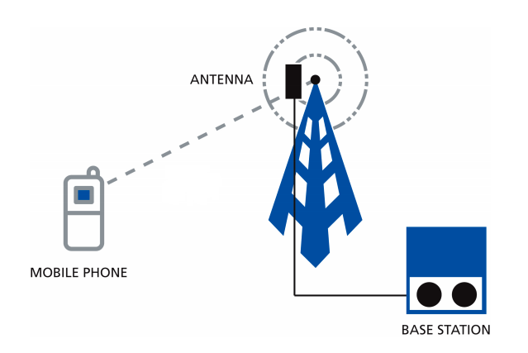
Motivation
GSM cell phones has a big application of Crypto in consumer products.
The voice is digitally transmitted after getting encrypted with a stream cipher.

Slide 5
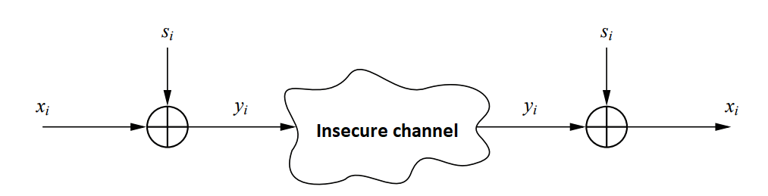
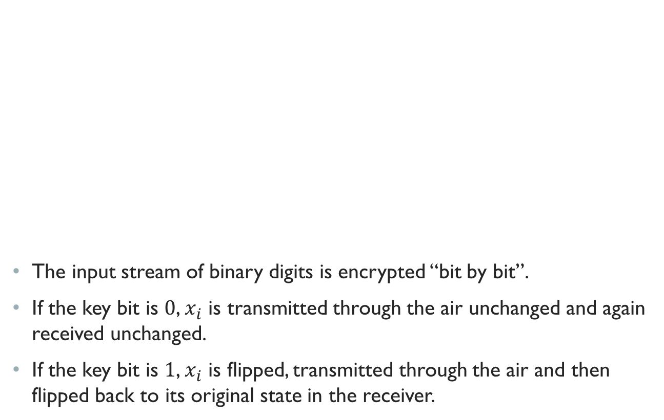
HOW THIS WORKS
The input stream of binary digits is encrypted “bit by bit”.
If the key bit is $0$, $x_{i}$ is transmitted through the air unchanged and again received unchanged.
If the key bit is $1$, $x_{i}$ is flipped, transmitted through the air and then flipped back to its original state in the receiver.

Slide 6
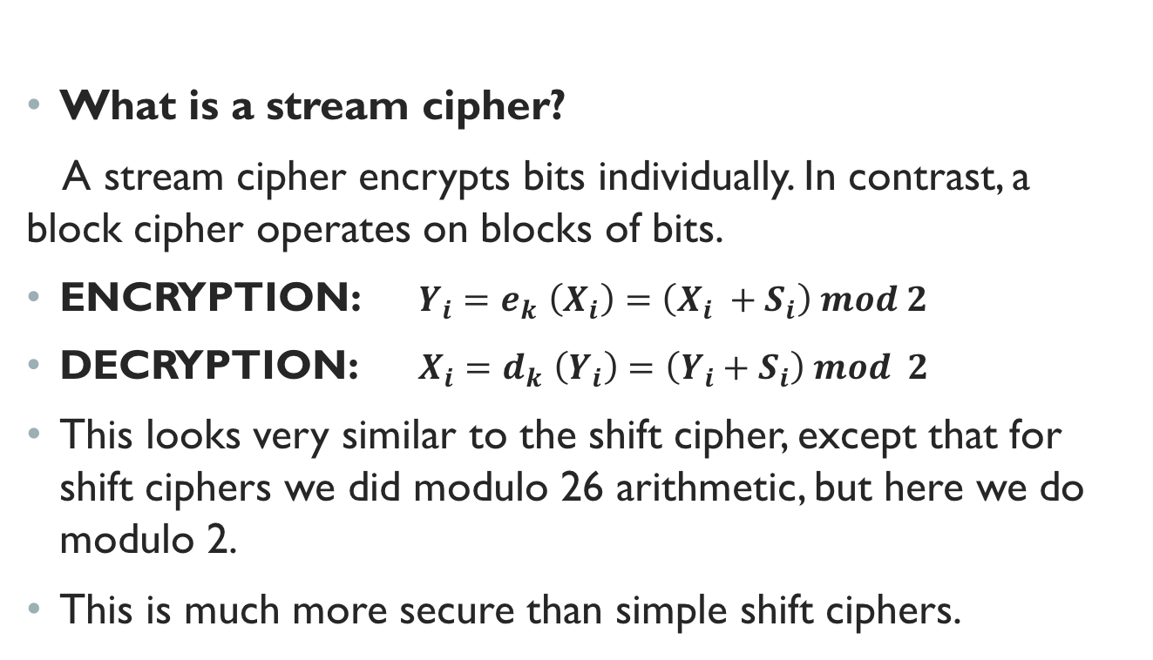
definition
What is a stream cipher?
A stream cipher encrypts bits individually. In contrast, a block cipher operates on blocks of bits.
ENCRYPTION: $Y_{i}{=e}_{k}\left(X_{i}\right)=\left(X_{i} +S_{i}\right) mod 2$
DECRYPTION: $X_{i}{=d}_{k}\left(Y_{i}\right)=\left(Y_{i}+S_{i}\right) mod 2$
This looks very similar to the shift cipher, except that for shift ciphers we did modulo 26 arithmetic, but here we do modulo 2.
This is much more secure than simple shift ciphers.

Slide 7
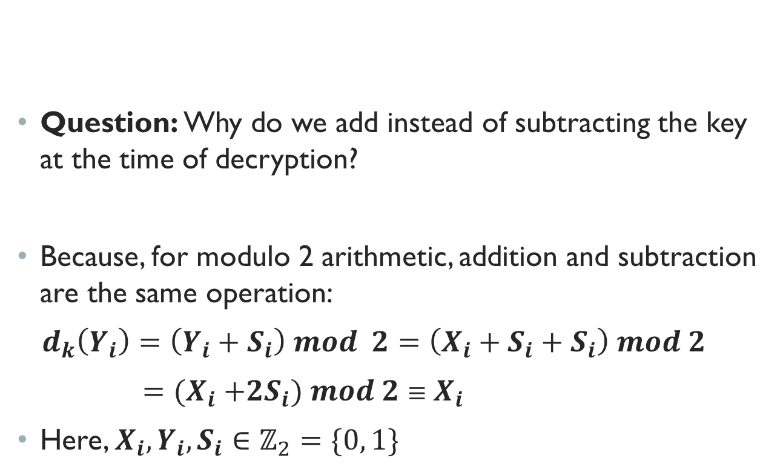
Properties
Question: Why do we add instead of subtracting the key at the time of decryption?
Because, for modulo 2 arithmetic, addition and subtraction are the same operation:
$d_{k}\left(Y_{i}\right)=\left(Y_{i}+S_{i}\right) mod 2=\left(X_{i}+S_{i}+S_{i}\right) mod 2$
${={(X}_{i} +2S}_{i}) mod 2≡X_{i}$
Here, $X_{i},Y_{i},S_{i}∈ℤ_{2}=\{0, 1\}$

Slide 8
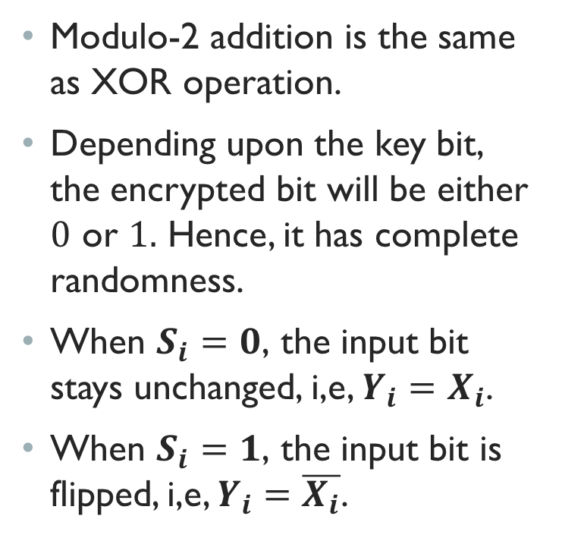
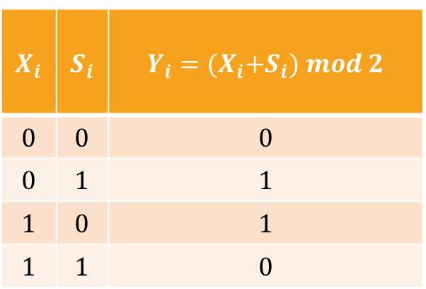
Closer look at modulo 2 addition
Modulo-2 addition is the same as XOR operation.
Depending upon the key bit, the encrypted bit will be either $0$ or $1.$ Hence, it has complete randomness.
When $S_{i}=0$, the input bit stays unchanged, i,e, $Y_{i}=X_{i}$.
When $S_{i}=1$, the input bit is flipped, i,e, $Y_{i}=\overline{X_{i}}$.
$$X_{i}$$ | $$S_{i}$$ | $$Y_{i}={(X}_{i}+S_{i}) mod 2$$
$$0$$ | $$0$$ | $$0$$
$$0$$ | $$1$$ | $$1$$
$$1$$ | $$0$$ | $$1$$
$$1$$ | $$1$$ | $$0$$

Slide 9
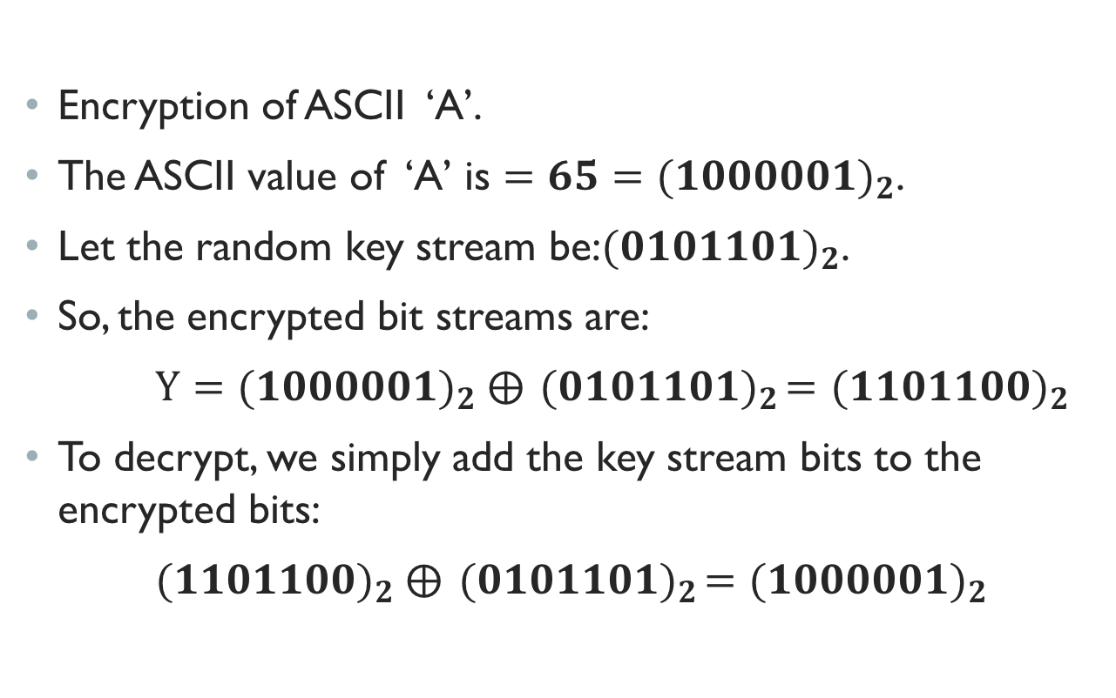
Example
Encryption of ASCII ‘A’.
The ASCII value of ‘A’ is $=65={(1000001)}_{2}$.
Let the random key stream be:${(0101101)}_{2}$.
So, the encrypted bit streams are:
$Y={(1000001)}_{2} ⨁{ (0101101)}_{2}=$ ${(1101100)}_{2}$
To decrypt, we simply add the key stream bits to the encrypted bits:
${(1101100)}_{2} ⨁{ (0101101)}_{2}=$ ${(1000001)}_{2}$

Slide 10
Random number generators (RNG)
Now the question is: how do we generate the key sequence?
The key sequence has to be completely random bits from a cryptographic perspective.
To generate the key sequence, we need a Random Number Generator (RNG).

Slide 11
Random number generators (RNG) – cont.
We distinguish between three types of RNG-s:
a. True Random Number Generators (TRNG)
b. Pseudo-Random Number Generators (PRNG)
c. Cryptographically secure PRNG-s (CPRNG)

Slide 12
Random number generators (RNG) – cont.
True Random Number Generators (TRNG): True random numbers stem from random physical processes.
For example, we can generate a sequence of true random bits by flipping an unbiased coin.
Truly random means, one sequence of random bits cannot be recreated.
Some more examples of random physical processes are: rolling of dice, thermal noise, time interval between two mouse clicks etc.
So, if we need a really unique key sequence for encryption, we’d need a TRNG.

Slide 13
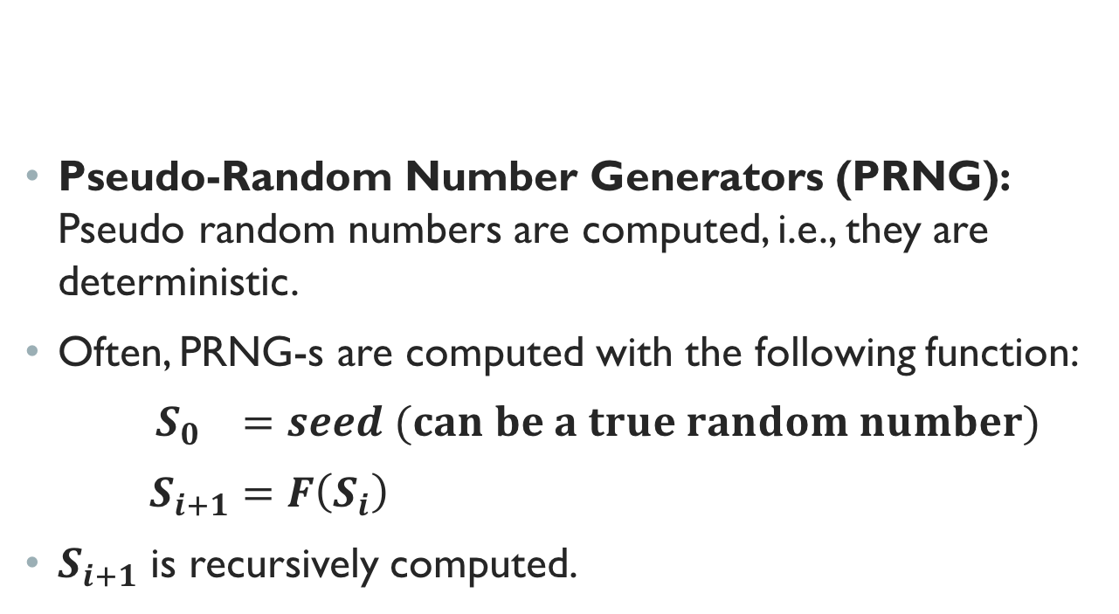
Random number generators (RNG) – cont.
Pseudo-Random Number Generators (PRNG): Pseudo random numbers are computed, i.e., they are deterministic.
Often, PRNG-s are computed with the following function:
$S_{0} =seed (can be a true random number)$
$S_{i+1}=F\left(S_{i}\right)$
$S_{i+1}$ is recursively computed.

Slide 14
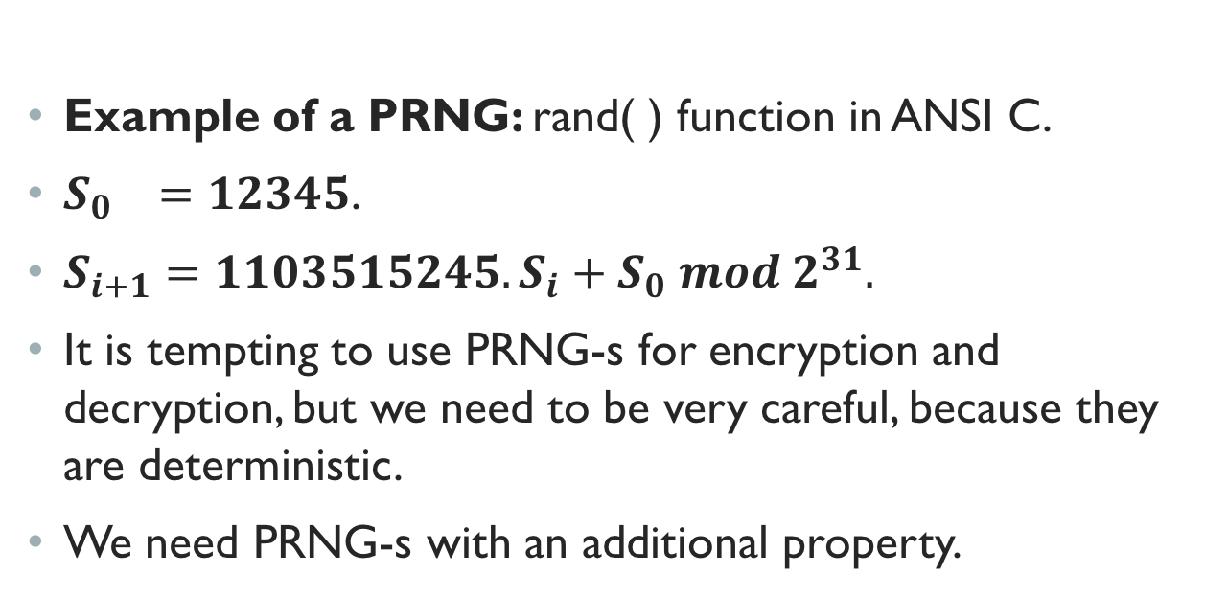
Random number generators (RNG) – cont.
Example of a PRNG: rand( ) function in ANSI C.
$S_{0} =12345$.
$S_{i+1}={1103515245.S}_{i}+S_{0} mod 2^{31}.$
It is tempting to use PRNG-s for encryption and decryption, but we need to be very careful, because they are deterministic.
We need PRNG-s with an additional property.

Slide 15
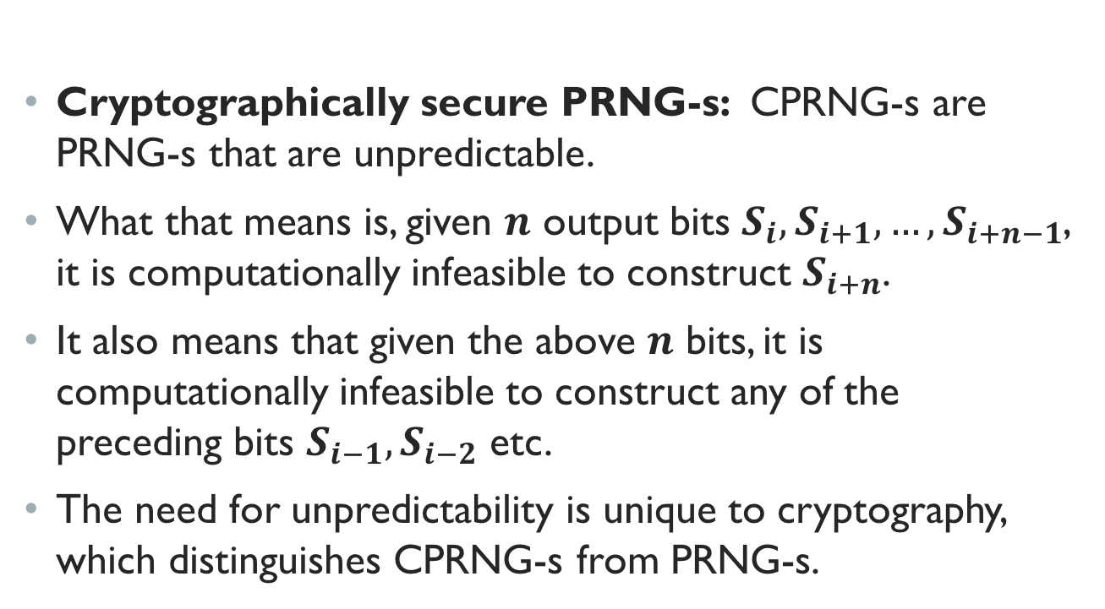
Random number generators (RNG) – cont.
Cryptographically secure PRNG-s: CPRNG-s are PRNG-s that are unpredictable.
What that means is, given $n$ output bits $S_{i},S_{i+1}, …,S_{i+n−1}$, it is computationally infeasible to construct $S_{i+n}$.
It also means that given the above $n$ bits, it is computationally infeasible to construct any of the preceding bits $S_{i−1},S_{i−2}$ etc.
The need for unpredictability is unique to cryptography, which distinguishes CPRNG-s from PRNG-s.

Slide 16
One time pad
Let us consider the ambitious goal of building a “perfect cipher”.
A perfect cipher means it is unconditionally secure.
Definition: A cryptosystem is unconditionally secure or information-theoretically secure if it cannot be broken even with infinite computational resources.
The requirement for a cipher to be unconditionally secure is tremendous.

Slide 17
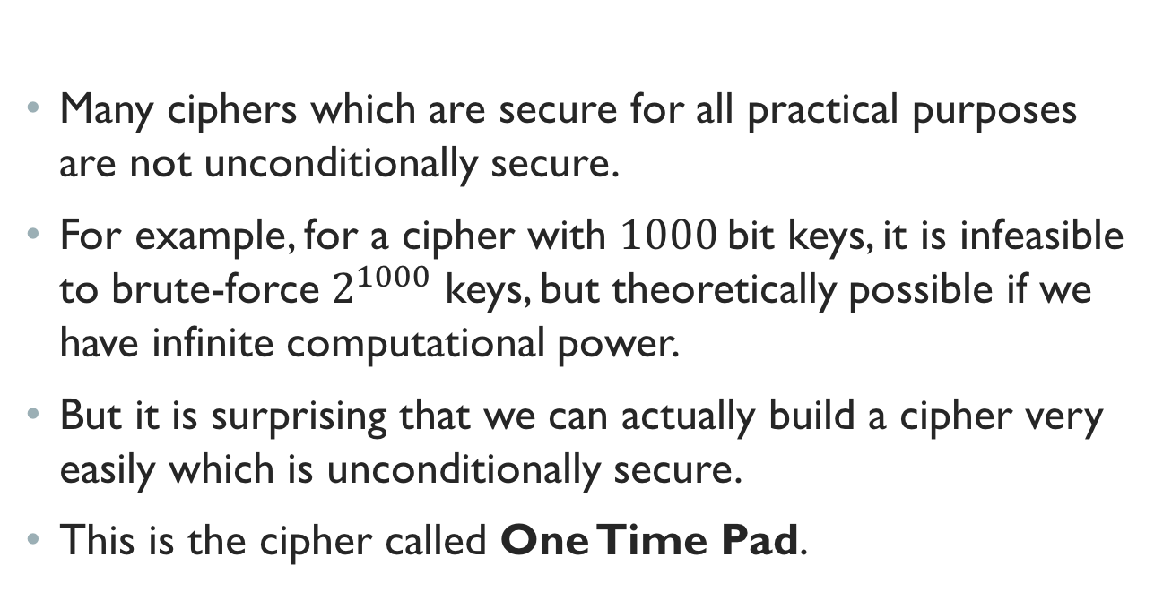
One time pad – cont.
Many ciphers which are secure for all practical purposes are not unconditionally secure.
For example, for a cipher with $1000$bit keys, it is infeasible to brute-force $2^{1000}$ keys, but theoretically possible if we have infinite computational power.
But it is surprising that we can actually build a cipher very easily which is unconditionally secure.
This is the cipher called One Time Pad.

Slide 18
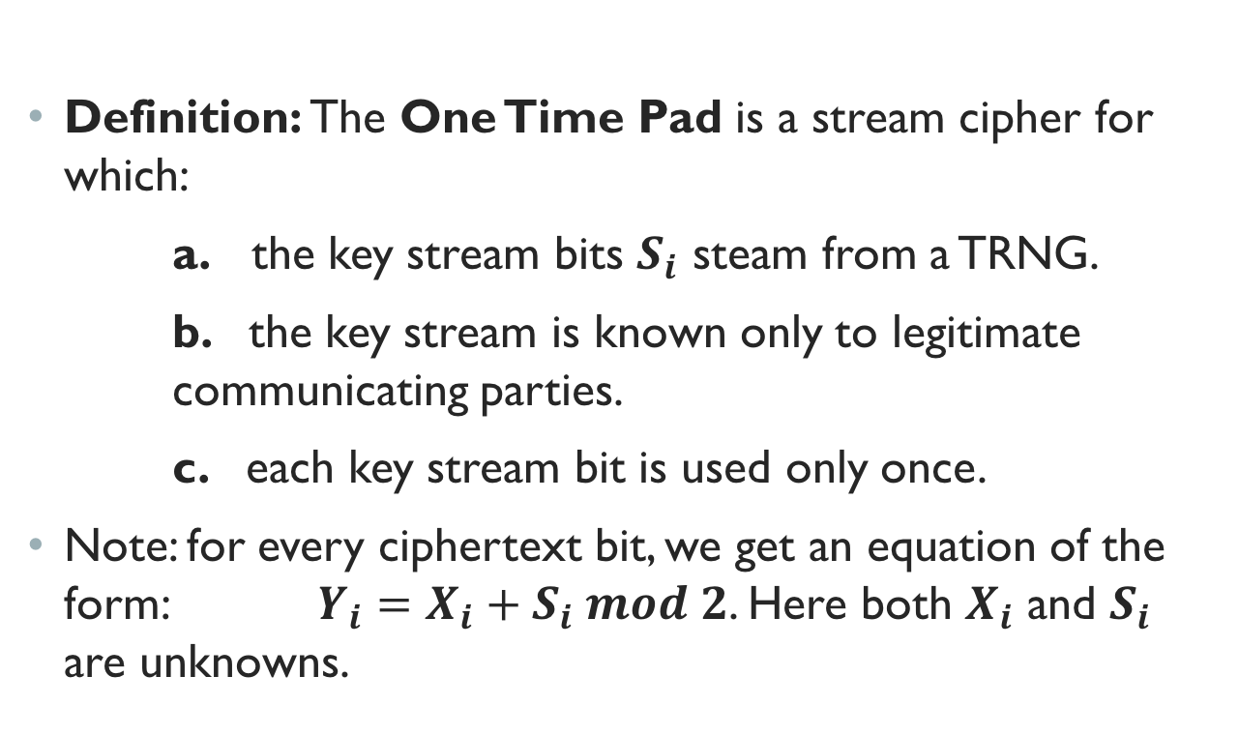
One time pad – cont.
Definition: The One Time Pad is a stream cipher for which:
a. the key stream bits $S_{i}$ steam from a TRNG.
b. the key stream is known only to legitimate communicating parties.
c. each key stream bit is used only once.
Note: for every ciphertext bit, we get an equation of the form: $Y_{i}=X_{i}+S_{i} mod 2$. Here both $X_{i}$ and $S_{i}$ are unknowns.

Slide 19
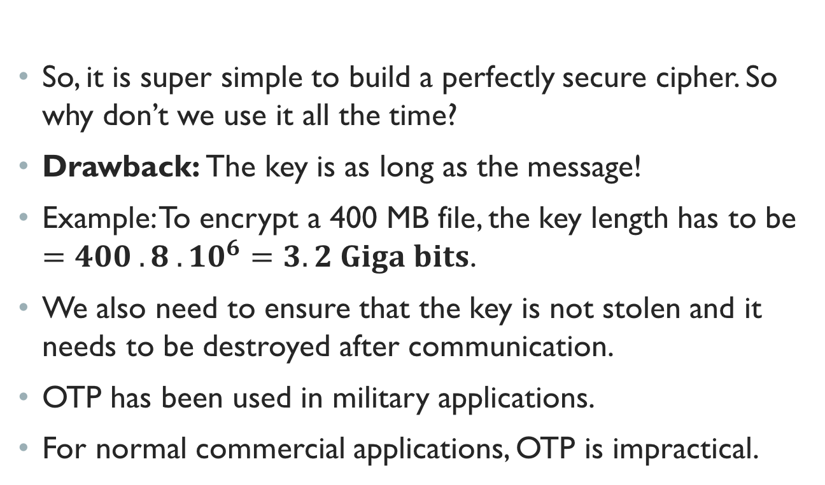
One time pad – cont.
So, it is super simple to build a perfectly secure cipher. So why don’t we use it all the time?
Drawback: The key is as long as the message!
Example: To encrypt a 400 MB file, the key length has to be $=400 . 8 . {10}^{6}=3.2 Giga bits$.
We also need to ensure that the key is not stolen and it needs to be destroyed after communication.
OTP has been used in military applications.
For normal commercial applications, OTP is impractical.

Slide 20
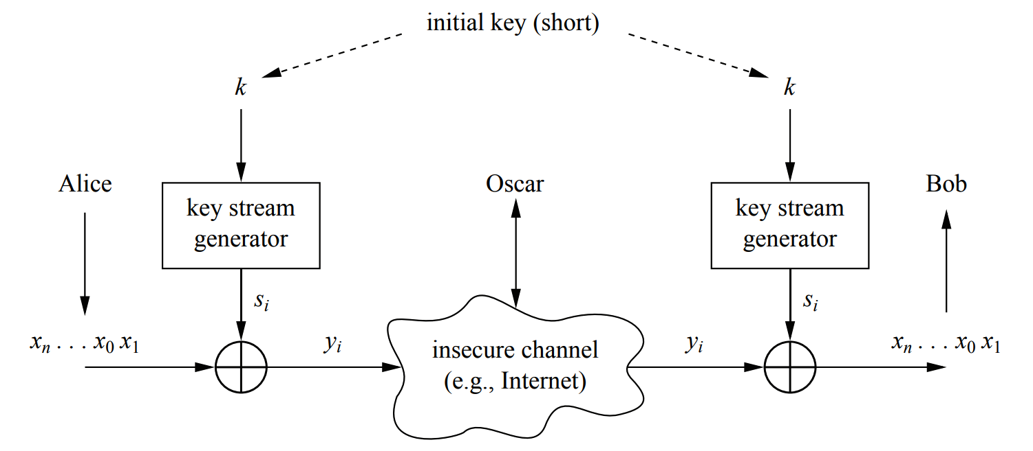
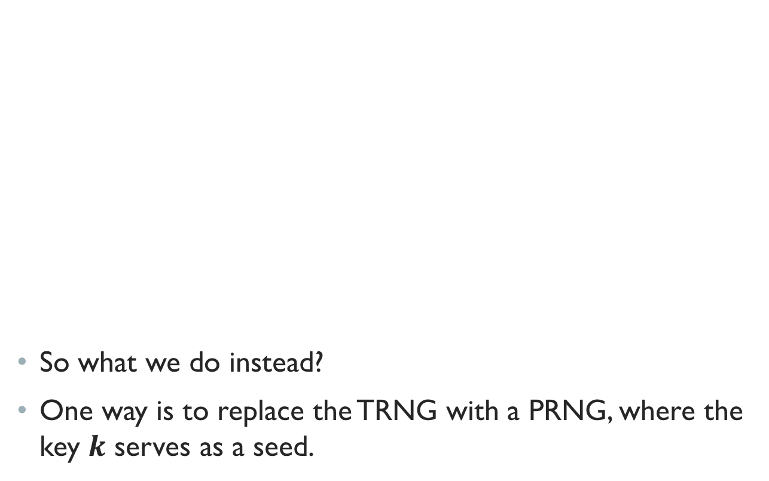
Towards practical stream ciphers
So what we do instead?
One way is to replace the TRNG with a PRNG, where the key $k$ serves as a seed.

Slide 21
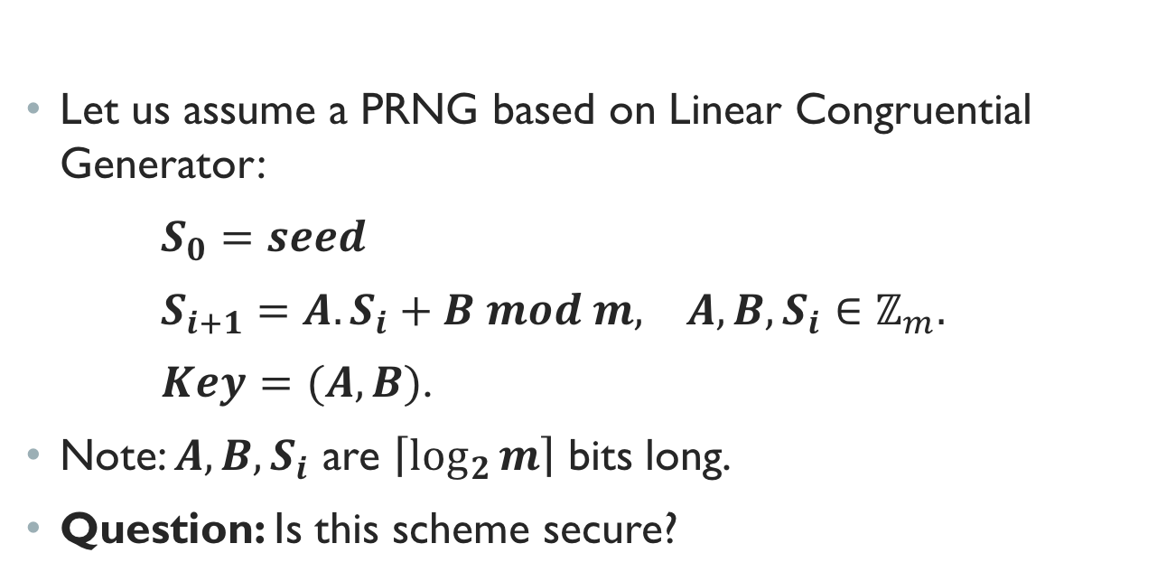
Linear congruential generator (lcg)
Let us assume a PRNG based on Linear Congruential Generator:
$S_{0}=seed$
$S_{i+1}=A.S_{i}+B mod m, A, B,S_{i}∈ℤ_{m}.$
$Key=(A, B)$.
Note: $A, B,S_{i}$ are $\left\lceil \log_{2}{m}\right\rceil$ bits long.
Question: Is this scheme secure?

Slide 22
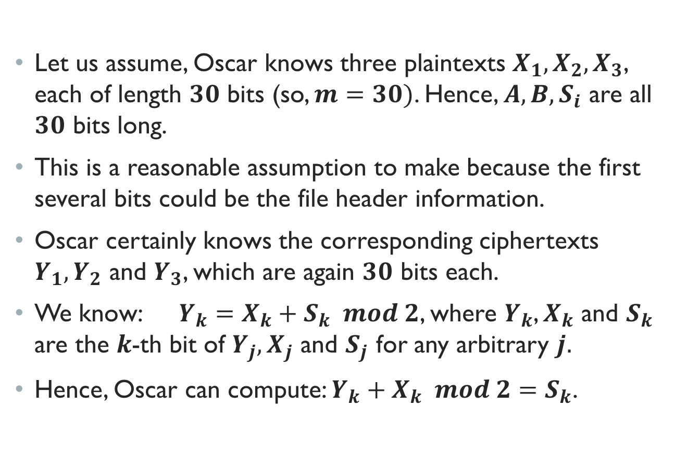
An Attack on prng
Let us assume, Oscar knows three plaintexts $X_{1},X_{2},X_{3}$, each of length $30$ bits (so, $m=30)$. Hence, ${A, B, S}_{i}$ are all $30$ bits long.
This is a reasonable assumption to make because the first several bits could be the file header information.
Oscar certainly knows the corresponding ciphertexts $Y_{1},Y_{2}$ and $Y_{3}$, which are again $30$ bits each.
We know: $Y_{k}=X_{k}+S_{k} mod 2$, where $Y_{k}$, $X_{k}$ and $S_{k}$ are the $k$-th bit of $Y_{j},X_{j}$ and $S_{j}$ for any arbitrary $j.$
Hence, Oscar can compute: $Y_{k}+X_{k} mod 2=S_{k}$.

Slide 23
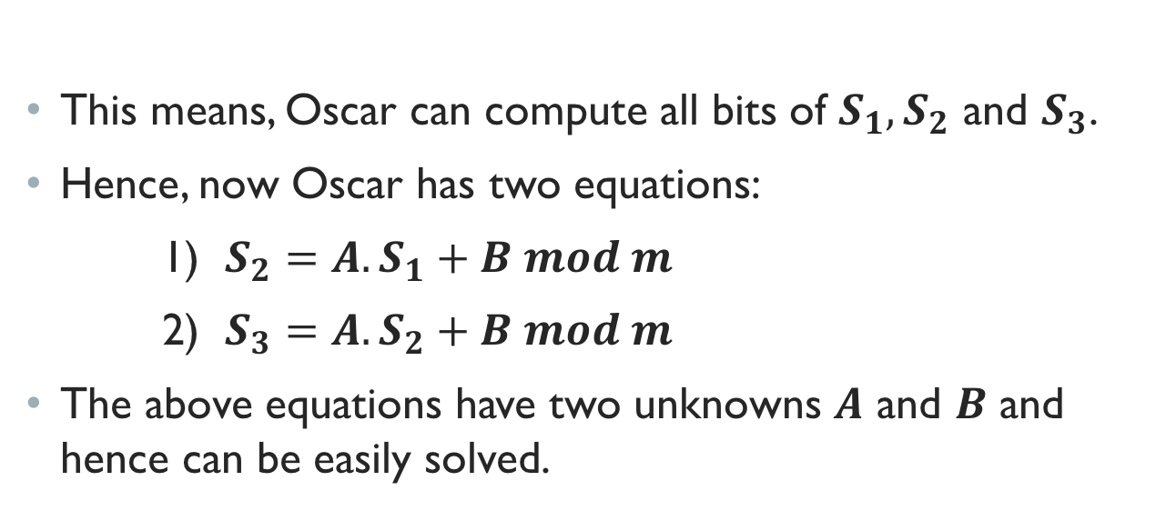
An Attack on prng - cont.
This means, Oscar can compute all bits of $S_{1},S_{2}$ and $S_{3}$.
Hence, now Oscar has two equations:
1) $S_{2}=A.S_{1}+B mod m$
2) $S_{3}=A.S_{2}+B mod m$
The above equations have two unknowns $A$ and $B$ and hence can be easily solved.

Slide 24
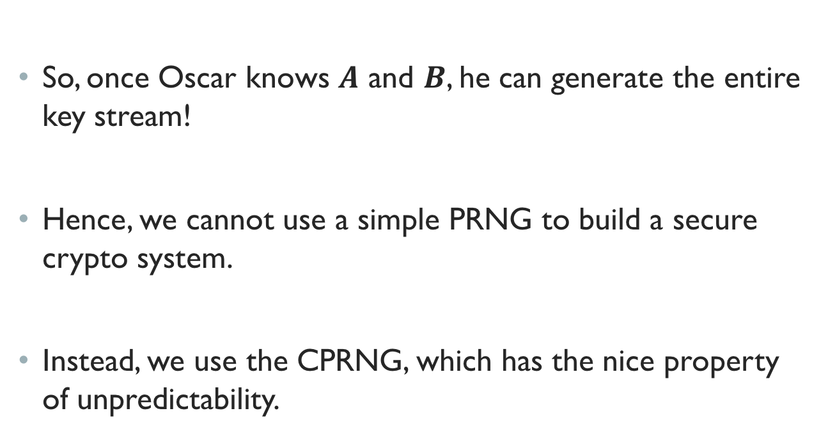
An Attack on prng - cont.
So, once Oscar knows $A$ and $B$, he can generate the entire key stream!
Hence, we cannot use a simple PRNG to build a secure crypto system.
Instead, we use the CPRNG, which has the nice property of unpredictability.

Slide 25
Summary
We discussed:
- Stream ciphers
- Random numbers
- One Time Pad (OTP)
- Linear Congruential Generator (LCG)

