Slide 1
CSCI – 4481 (Cryptography and data security)
Slides - 5

Slide 2
today
Introduction to LFSR
General LFSR and its properties
Attack on single LFSR

Slide 3
Introduction to lfsr
An elegant way to build long pseudo-random sequences is to use Linear Feedback Shift Registers (LFSR).
Goal: To build a stream cipher that is low power in hardware.
Example: A5/1 cipher which is standardized for voice encryption in GSM.
The A5/1 cipher consists of 3 LFSR-s.

Slide 4
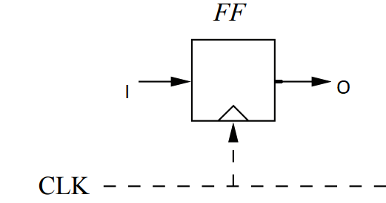
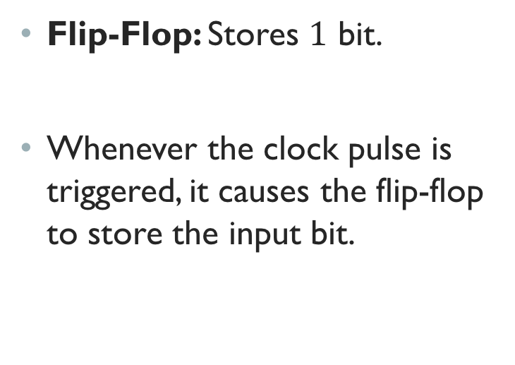
Atomic element of an lfsr
Flip-Flop: Stores $1$ bit.
Whenever the clock pulse is triggered, it causes the flip-flop to store the input bit.

Slide 5
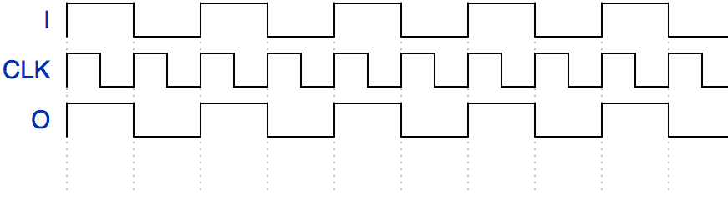
HOW Flip-flop stores a bit
Whenever the clock pulse is triggered, it causes the flip-flop to store the input bit.

Slide 6
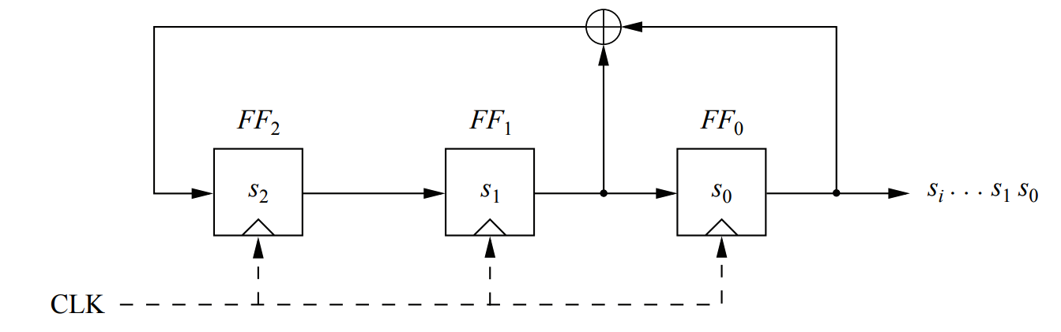
PRNG WITH AN LFSR
We compute a fresh input for the left-most flip-flop in every clock cycle.

Slide 7
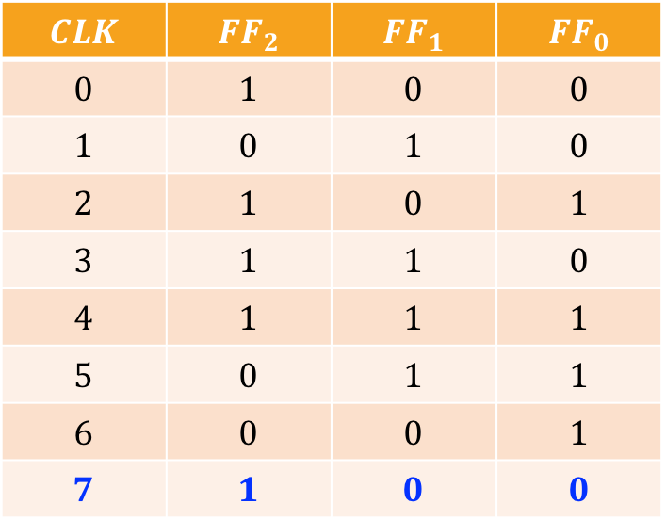
PRNG WITH AN LFSR – cont.
$$CLK$$ | $${FF}_{2}$$ | $${FF}_{1}$$ | $${FF}_{0}$$
$$0$$ | $$1$$ | $$0$$ | $$0$$
$$1$$ | $$0$$ | $$1$$ | $$0$$
$$2$$ | $$1$$ | $$0$$ | $$1$$
$$3$$ | $$1$$ | $$1$$ | $$0$$
$$4$$ | $$1$$ | $$1$$ | $$1$$
$$5$$ | $$0$$ | $$1$$ | $$1$$
$$6$$ | $$0$$ | $$0$$ | $$1$$
$$7$$ | $$1$$ | $$0$$ | $$0$$
After the 7th clock pulse, we run into a cycle.

Slide 8
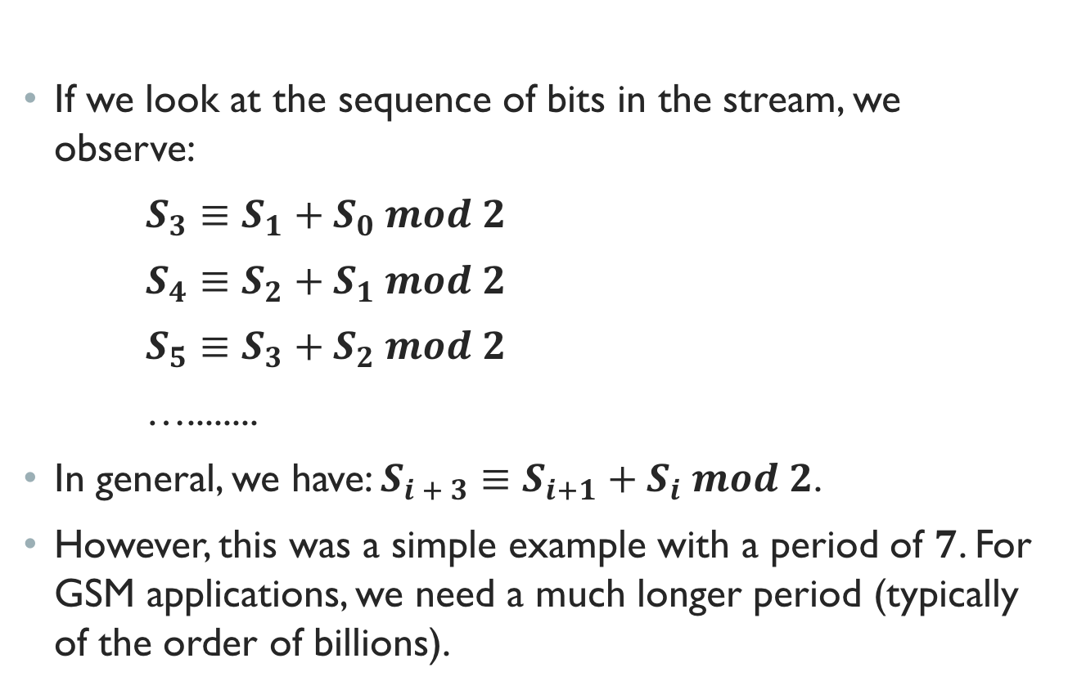
Mathematical formulation
If we look at the sequence of bits in the stream, we observe:
$S_{3}≡S_{1}+S_{0} mod 2$
$S_{4}≡S_{2}+S_{1} mod 2$
$S_{5}≡S_{3}+S_{2} mod 2$
…........
In general, we have: $S_{i + 3}≡S_{i+1}+S_{i} mod 2$.
However, this was a simple example with a period of $7$. For GSM applications, we need a much longer period (typically of the order of billions).

Slide 9
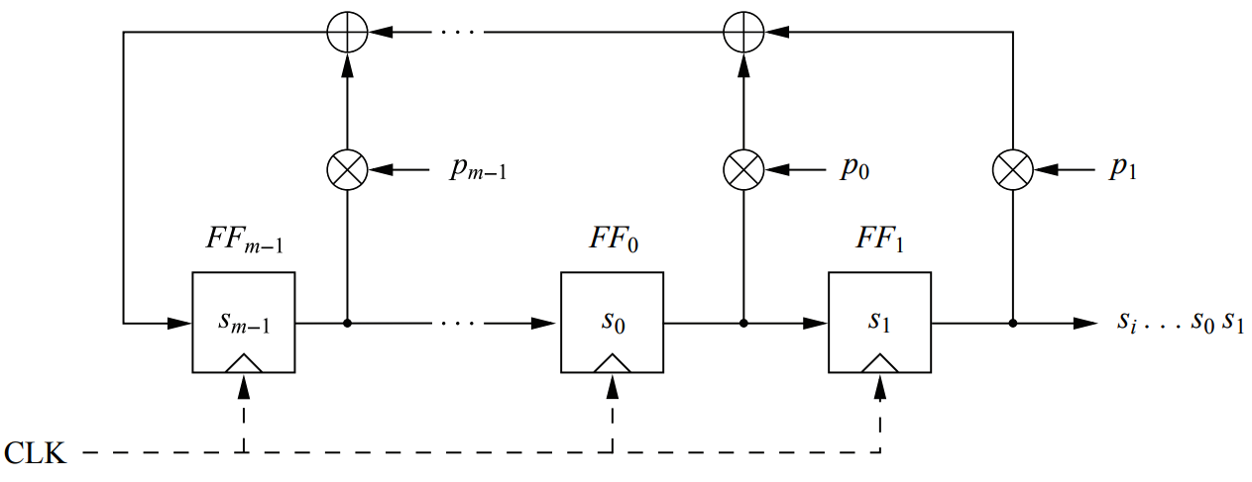
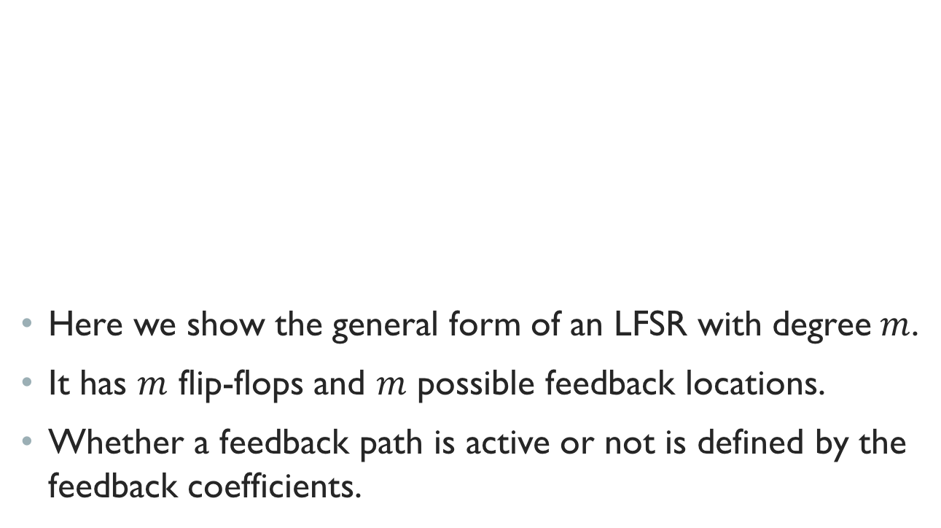
Lfsr: General form
Here we show the general form of an LFSR with degree$m$.
It has $m$ flip-flops and $m$ possible feedback locations.
Whether a feedback path is active or not is defined by the feedback coefficients.

Slide 10
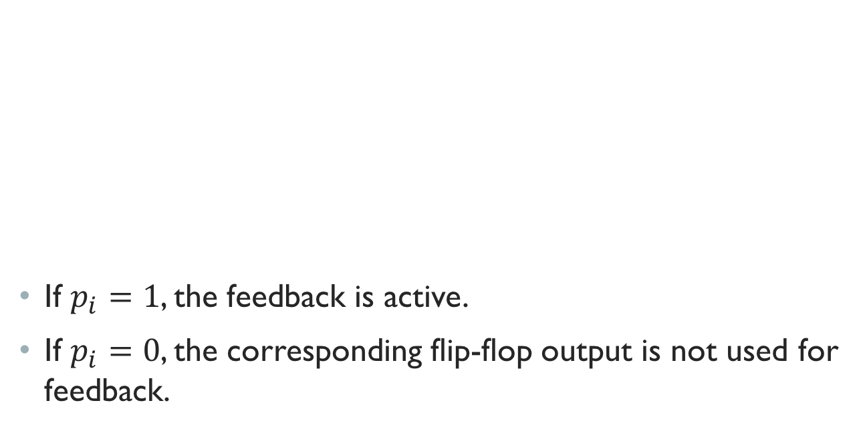
Lfsr: General form – cont.
If $p_{i}=1$, the feedback is active.
If $p_{i}=0$, the corresponding flip-flop output is not used for feedback.

Slide 11
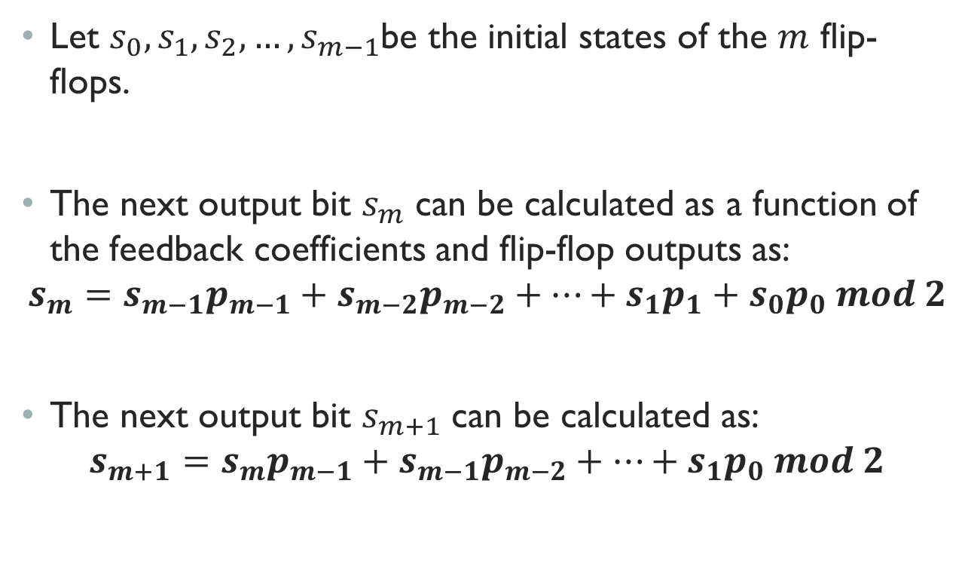
Lfsr: General form – cont.
Let $s_{0},s_{1},s_{2}, …,s_{m−1}$be the initial states of the $m$ flip-flops.
The next output bit $s_{m}$ can be calculated as a function of the feedback coefficients and flip-flop outputs as:
$$s_{m}=s_{m−1}p_{m−1}+s_{m−2}p_{m−2}+…+s_{1}p_{1}+s_{0}p_{0} mod 2$$
The next output bit $s_{m+1}$ can be calculated as:
$$s_{m+1}=s_{m}p_{m−1}+s_{m−1}p_{m−2}+…+s_{1}p_{0} mod 2$$

Slide 12
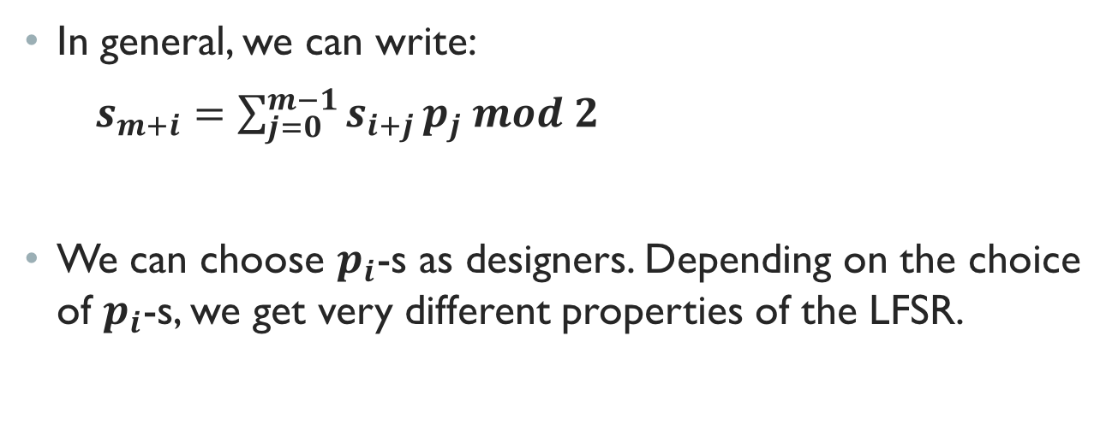
Lfsr: General form – cont.
In general, we can write:
$s_{m+i}=\sum_{j=0}^{m−1}{s_{i+j}}p_{j} mod 2$
We can choose $p_{i}$-s as designers. Depending on the choice of $p_{i}$-s, we get very different properties of the LFSR.

Slide 13
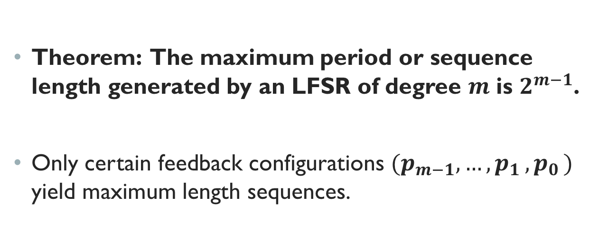
Theorem
Theorem: The maximum period or sequence length generated by an LFSR of degree $m$ is $2^{m−1}$.
Only certain feedback configurations ${(p}_{m−1},{…, p}_{1}{, p}_{0})$ yield maximum length sequences.

Slide 14
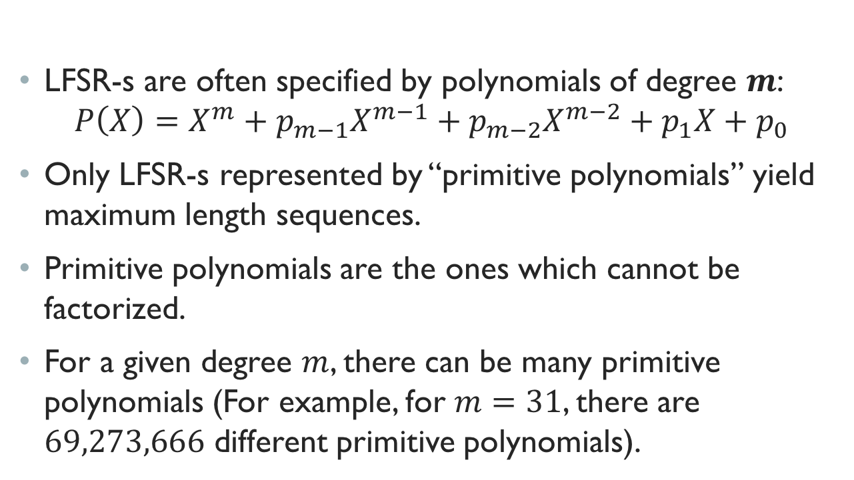
LFSR: polynomial representation
LFSR-s are often specified by polynomials of degree $m$:
$$P\left(X\right)=X^{m}+p_{m−1}X^{m−1}+p_{m−2}X^{m−2}+p_{1}X+p_{0}$$
Only LFSR-s represented by “primitive polynomials” yield maximum length sequences.
Primitive polynomials are the ones which cannot be factorized.
For a given degree $m$, there can be many primitive polynomials (For example, for $m=31$, there are $69,273,666$ different primitive polynomials).

Slide 15
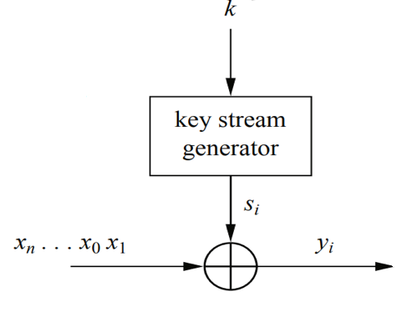
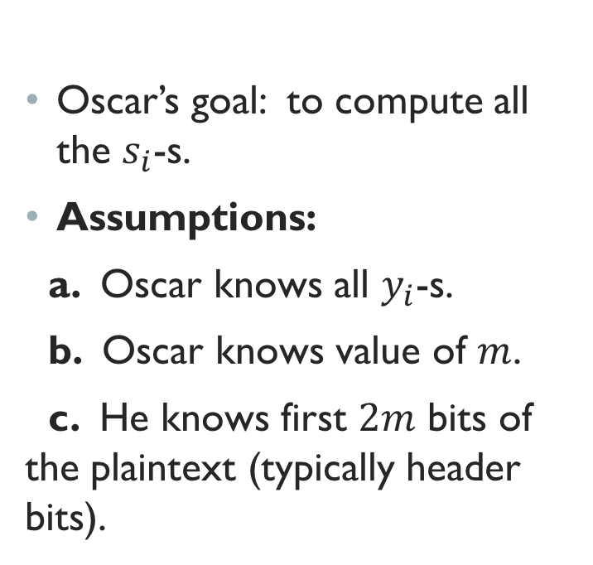
Attack on single lfsr
Oscar’s goal: to compute all the $s_{i}$-s.
Assumptions:
a. Oscar knows all $y_{i}$-s.
b. Oscar knows value of $m$.
c. He knows first $2m$ bits of the plaintext (typically header bits).

Slide 16
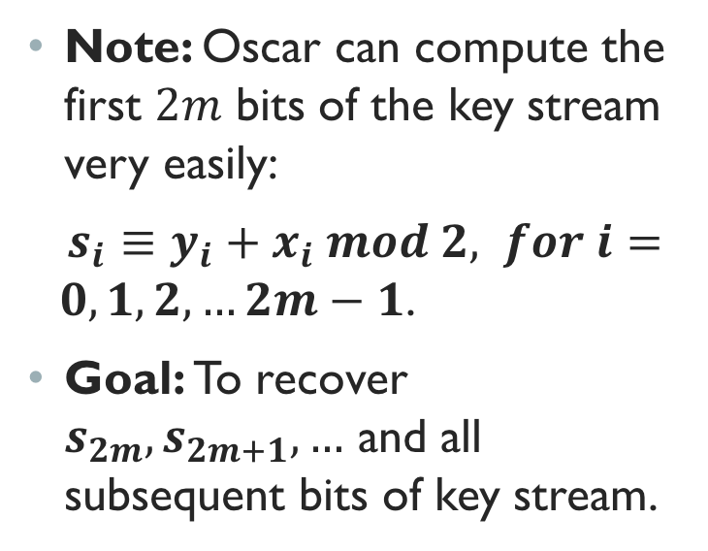
Attack on single lfsr – cont.
Note: Oscar can compute the first $2m$ bits of the key stream very easily:
$s_{i}≡y_{i}+x_{i} mod 2, for i= 0,1,2,…2m−1$.
Goal: To recover $s_{2m},s_{2m+1}, …$ and all subsequent bits of key stream.

Slide 17
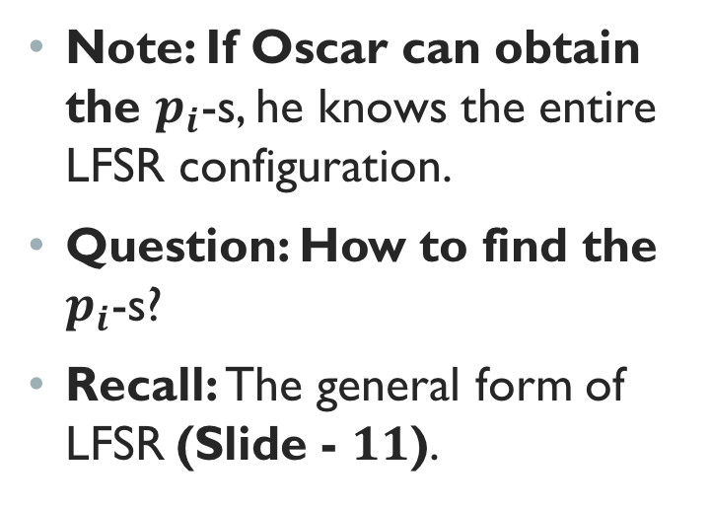
Attack on single lfsr – cont.
Note: If Oscar can obtain the $p_{i}$-s, he knows the entire LFSR configuration.
Question: How to find the $p_{i}$-s?
Recall: The general form of LFSR (Slide - $11$).

Slide 18
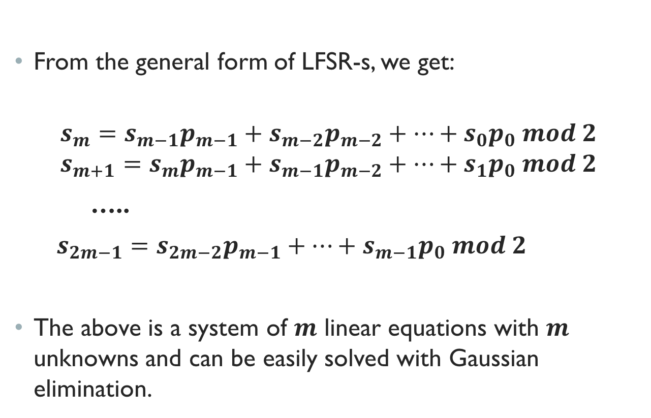
Attack on lfsr – cont.
From the general form of LFSR-s, we get:
$$s_{m}=s_{m−1}p_{m−1}+s_{m−2}p_{m−2}+…+s_{0}p_{0} mod 2$$
$$s_{m+1}=s_{m}p_{m−1}+s_{m−1}p_{m−2}+…+s_{1}p_{0} mod 2$$
…..
$s_{2m−1}=s_{2m−2}p_{m−1}+…+s_{m−1}p_{0} mod 2$
The above is a system of $m$ linear equations with $m$ unknowns and can be easily solved with Gaussian elimination.

Slide 19
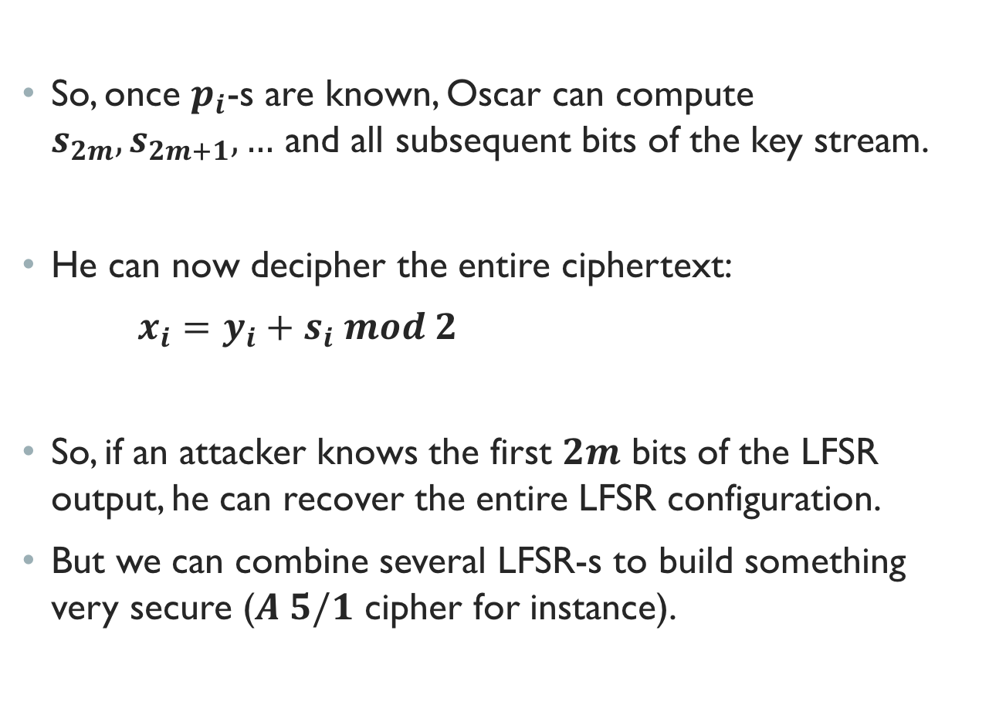
Attack on lfsr – cont.
So, once $p_{i}$-s are known, Oscar can compute $s_{2m},s_{2m+1}, …$ and all subsequent bits of the key stream.
He can now decipher the entire ciphertext:
$x_{i}=y_{i}+s_{i} mod 2$
So, if an attacker knows the first $2m$ bits of the LFSR output, he can recover the entire LFSR configuration.
But we can combine several LFSR-s to build something very secure ($A 5/1$ cipher for instance).

Slide 20
summary
We have discussed:
- Introduction to LFSR
- General LFSR and its properties
- Attack on LFSR

