Slide 1

Course Introduction, An overview of Cryptography
CSCI – 4481 (Fall 2021)
Sujoy Chakraborty
Department of Computer Science Stockton University, NJ, USA

Slide 2
Introduction
CSCI – 4481: CS elective and a Q2 course
Mathematics is the foundation of this course.
You will need to use concepts from:
Discrete Math
Calculus (Calc – II level)
Abstract algebra
Probability
Linear algebra

Slide 3
Syllabus (for details, refer to Blackboard
TOPICS TO BE COVERED:
Course Introduction
Classical Cryptosystems
Number Theory and Modular Arithmetic
Stream Ciphers
Block Ciphers
Public Key Cryptography
Digital Signatures
Hash Functions
Message Authentication Codes (MAC)

Slide 4
Textbooks
Introduction to Cryptography with Coding Theory, Wade Trape and Lawrence Washington
Cryptography and Network Security: Principles and Practice, William Stallings
Cryptography Theory and Practice, Douglas Stinson
The Handbook of Applied Cryptography, Alfred J. Menezes, Paul C. van Oorschot and Scott A. Vanstone
Applied Cryptography: Protocols, Algorithms and Source Code in C, Bruce Schneier
Public-Key Cryptography, Arto Salomaa
A Course in Number Theory and Cryptography, Neal Koblitz
Understanding Cryptography: A Textbook for Students and Practitioners, Christoff Parr and Jan Pelzl.

Slide 5
Assignments
Mathematical assignments: These will be based on mathematical concepts and encryption algorithms that we’ll learn in the class.
Programming assignments: You will need to implement some of the encryption algorithms that we learn in class.
Final Exam/Project: Will be posted on blackboard in the week of finals.

Slide 6
Assignment submissions
All assignments must be submitted through blackboard, as per the instruction.
Assignments must be submitted by 11:59 PM on the day it is due.
Late submissions: You are allowed to have two free late days.
It is up to you how you’d use them, but it is better not to plan using it, for your best interest (to avoid falling behind in the class).
Late days should be used only when there is some unavoidable circumstance which may prevent you from submitting on time.

Slide 7
Grading
Below is how your grade will be computed:
Homework – 40%
Class participation – 10%
Midterm – 25%
Final Exam – 25%
Your final grade will be a letter grade, as per the University Grading System.

Slide 8
Honor code
Please submit your own work for homework assignments. Do not copy someone else’s solution.
This doesn’t mean you cannot have group discussions.
You are encouraged to form study groups. Discuss as much as you want but write your own solutions.
Please refer to the University Academic Honesty policy.

Slide 9
Course tools
Blackboard will be the only tool for all course-related communication.
All the course materials (slides, handouts, assignments etc.) will be posted on blackboard.
You should check blackboard regularly for course updates.

Slide 10
Today
Cryptography and its classification
Overview of Cryptography
Basics / setups
Substitution Cipher
Some attacks on cryptosystems

Slide 11
Some applications of cryptography
Modern applications of Cryptography:
Cell Phone (GSM has voice encryption)
Email communication
Electronic cash
Credit/debit card transactions
Electronic Fund Transfer
VPN-s
Cryptography is an integral component in each of the above applications.

Slide 12
What is Cryptography
When we talk about different branches or parts of Cryptography, we find that the main notion is what we call Cryptology.
Cryptology splits into two sub-branches:
Cryptography
Cryptanalysis
In this course, we mainly focus on Cryptography

Slide 13
Cryptography and its Classification
There are three main parts of the field of Cryptography
Symmetric Cryptography
Asymmetric Cryptography (Public Key Cryptography)
Protocols
We are going to discuss the above three parts in sequence in this course.

Slide 14
How cryptography fits into IT Security
Security is a much broader topic which includes a lot of other things (Secure hardware, software, OS, etc.)
Cryptography is one component/atomic element to build a security application.
It is hard to imagine a security application that doesn’t have Cryptography on-board.
Hence, it is the foundation of modern security applications.

Slide 15
Basic set-up for Symmetric Cryptography
We have two parties who want to communicate over an insecure channel.
The channel is an open medium of transmission (e.g., internet, airwaves etc.).
The two parties Alice and Bob want to exchange messages over the insecure channel.

Slide 16
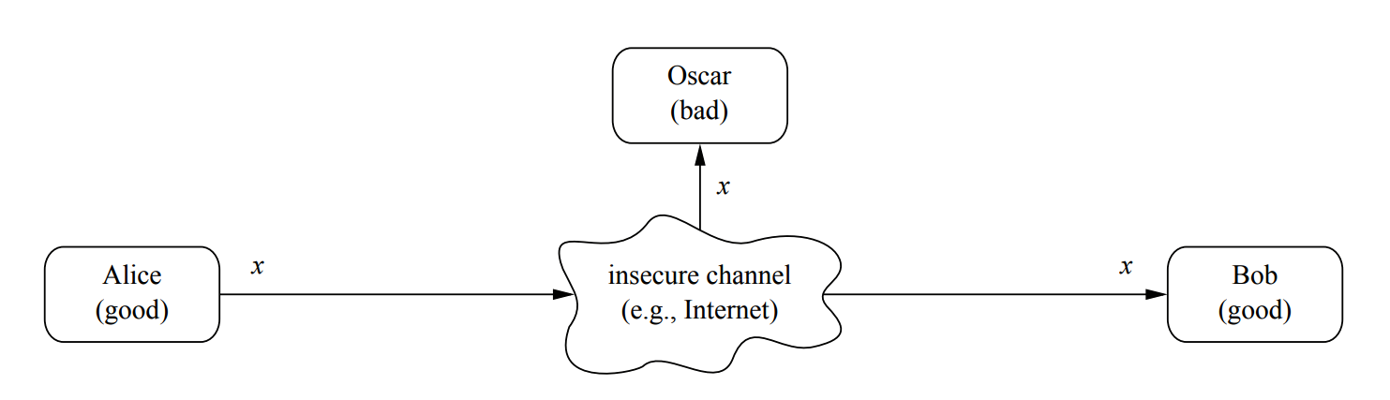
Basic set-up for Symmetric Cryptography
However, there is a bad guy Oscar, who is listening to the channel and wants to wiretap their communication.

Slide 17
Basic set-up for Symmetric Cryptography
Some example of communication could be an email routed through the internet, an electronic transaction etc.
So, the question is, how Alice and Bob will communicate over the channel securely?
Cryptography is the solution to the above problem.

Slide 18
Basic set-up for Symmetric Cryptography
Alice encrypts the message before sending it over the channel.
The encrypted message doesn’t make any sense to Oscar (looks like a noise/random sequence of characters).
Bob upon receiving the message decrypts it back to the original message.

Slide 19
Basic set-up for Symmetric Cryptography
Now the question is, if Bob can decrypt, why Oscar can’t decrypt the message?

Slide 20
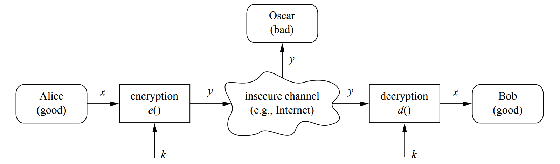
Basic set-up for Symmetric Cryptography
Because Alice and Bob share a secret key which is used in encryption and decryption.
Oscar doesn’t have the secret key.

Slide 21
Basic set-up for Symmetric Cryptography
So, now the question is, how would Alice and Bob exchange the key?
Obviously, they cannot exchange it over the insecure channel.
Solution: They exchange the key over a secure channel. This can be a secure medium (such as a courier or secure mailing service) or can be a person whom they trust, or through some key-exchange protocol based on public key cryptography (Diffie-Hellman key exchange).

Slide 22
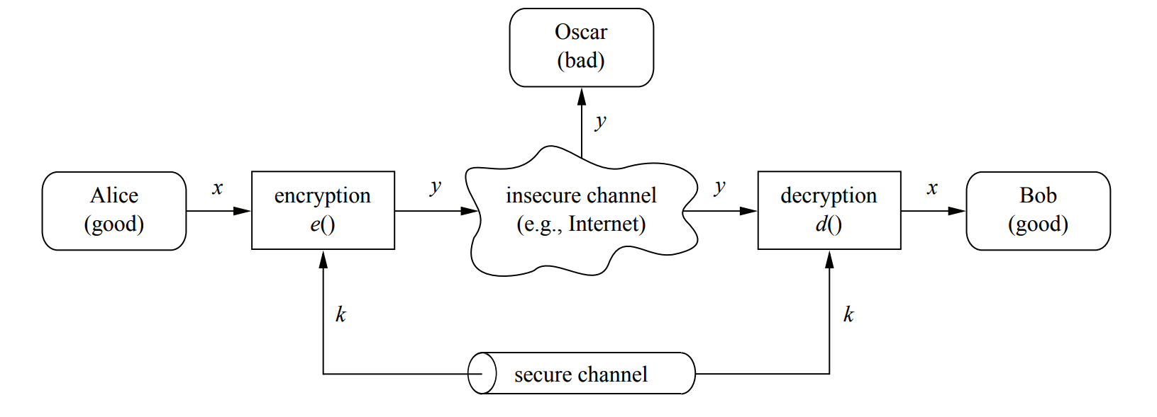
Basic set-up for Symmetric Cryptography
The key exchange is crucial in this setup.
We call this scheme “Symmetric Cryptography” because Alice and Bob share the same key.

Slide 23
Basic set-up for Symmetric Cryptography
Notations:
X: Plaintext / Cleartext
Y: Ciphertext
e: Encryption function
d: Decryption function
k: Key

Slide 24
Basic set-up for Symmetric Cryptography
So, a question is: should we make the functions e( ) and d( ) public or private?
Since ancient Egyptian times until 1970-s, people believed that it is better to keep e( ) and d( ) secret.
It is very tempting to keep the functions e( ) and d( ) private.
But it is not a good idea to do so.

Slide 25
Basic set-up for Symmetric Cryptography
How do you guarantee that your encryption and decryption functions are secure enough that no one can break them?
Most often, there is no mathematical proof that a Crypto algorithm is secure.
It is very easy to believe that your new Crypto algorithm is unbreakable, when actually it is not so.
The only way to ensure the security of a Crypto algorithm is to make them public and allow people to crack it.

Slide 26
Basic set-up for Symmetric Cryptography
So, long story made short, never use an untested Crypto algorithm.
Make sure to use proven and standardized algorithm that suits your application.

Slide 27
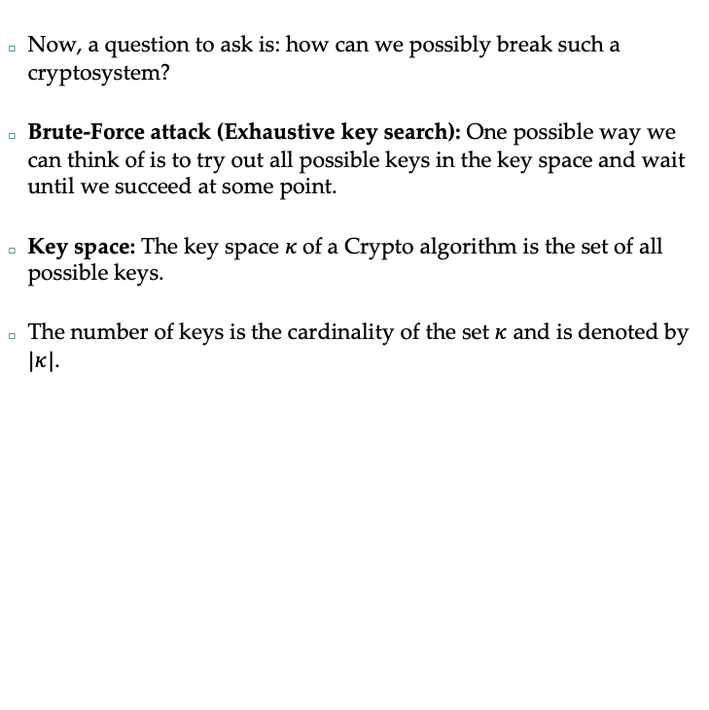
Basic set-up for Symmetric Cryptography
Now, a question to ask is: how can we possibly break such a cryptosystem?
Brute-Force attack (Exhaustive key search): One possible way we can think of is to try out all possible keys in the key space and wait until we succeed at some point.
Key space: The key space $κ$of a Crypto algorithm is the set of all possible keys.
The number of keys is the cardinality of the set $κ$ and is denoted by $|κ|$.

Slide 28
Kerckhoffs’ principle
“A cryptosystem should be secure even if the attacker (Oscar) knows all details about the system, with the exception of the secret key. In particular, the system should be secure when the attacker knows the encryption and decryption algorithms”.
Kerckhoffs’ principle is counterintuitive.

Slide 29
Substitution cipher
Until 1970-s, people built ciphers which operated only on letters (text encryption).
Modern ciphers encrypt bit-wise or byte-wise.
Idea: Replace every plaintext letter by a fixed ciphertext letter.
We build a substitution table for each letter in the alphabet.
Example: A <-> L; B <-> D, C <-> W …, T <-> U, U <-> R, ..., Z <-> P
e(‘CAT’) = ‘WLU’
d(‘WLU’) = ‘CAT’

Slide 30

Substitution cipher
How can we break this?
Key space: For the substitution cipher, $|κ|$=26!
So, the key space is huge ($≈2^{88})$ and hence brute force attack is not feasible.

Slide 31
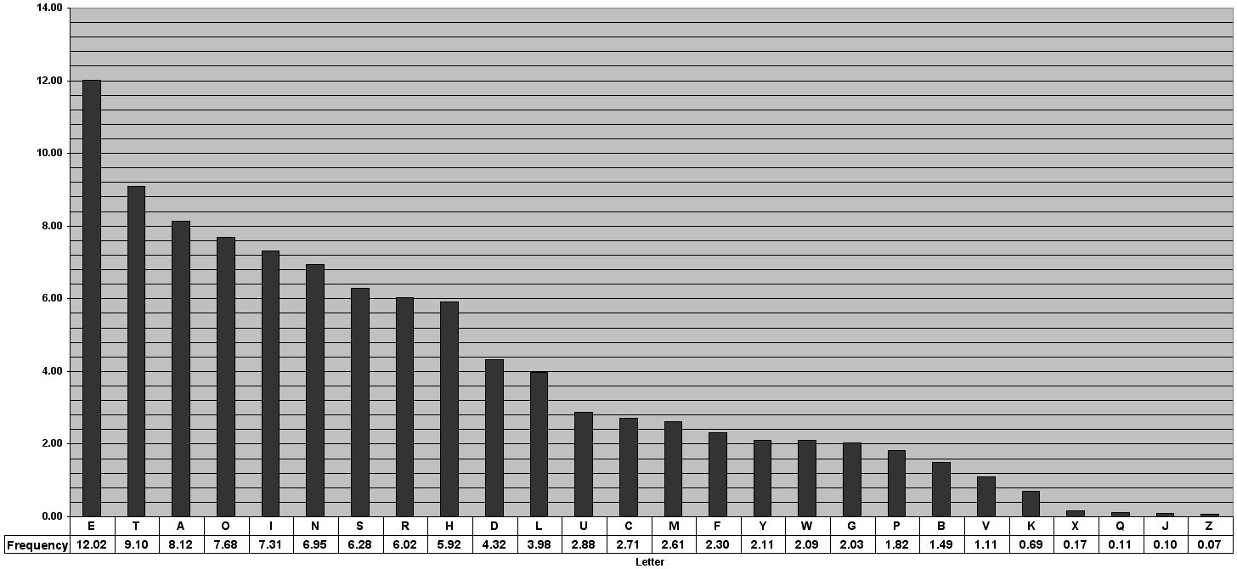
Substitution cipher
Frequency analysis attack: Each letter in English language has certain probability of occurrence.
They are not equally likely to occur.
‘E’ is the most frequent and ‘Z’ is the least frequent letter.

Slide 32
Substitution cipher
For substitution cipher, each letter in the alphabet is mapped to a fixed letter in the ciphertext.
This means that the statistical properties of the plaintext are preserved in the ciphertext.
This can be exploited to break the cipher.
For example, if we find that about 12% of the letters in the text is ‘Q’, then we can guess that it is probably the mapping for the letter ‘E’.

Slide 33
Substitution cipher
Continuing in this way, the mapping for other letters can be found.
Once the mapping for some letters are found, they can be replaced in the ciphertext and we will see parts of the plaintext.
Once the plaintext starts appearing by partial substitutions of the ciphertext letters, the remaining mappings can be easily obtained.

Slide 34
Classification of attacks
There are often three types of attack approaches (“attack vectors”).
Cryptanalysis:
Classical cryptanalysis
a. Brute force
b. Analytical attacks
Social Engineering
Implementation attacks

Slide 35
Classical cryptanalysis
Broadly, two types of attacks fall under classical cryptanalysis:
Brute Force
Analytical attacks
We already discussed brute force or exhaustive key search.
Analytical attacks typically exploit the internal mechanism of the encryption method.
For example, the letter frequency attack on the substitution cipher is an example of analytical attack.

Slide 36
Social Engineering
Sometimes a trickster can call us and persuade us to share our password.
We sometime may trust the person (claiming to be from Bank, or IT security department of your employer, for example) and share our password/security code.
There can be other examples of Social Engineering attack.

Slide 37
Implementation attack
Side channel analysis can be used to find the secret key.
We can measure the power consumption of a processor which operates on the secret key.
For example, we can use a bankcard to purchase something and record the power trace on an oscilloscope.
The wave pattern has a relation with the key, which can be obtained with signal processing techniques.

Slide 38
Summary
Course overview
Cryptography and its classification
Overview of Cryptography
Basics / setups
Substitution Cipher
Some attacks on cryptosystems

Slide 39
THANK YOU!
Questions?

