Slide 1

Data Encryption Standard (DES) - 2
CSCI – 4481 (Fall 2021)
Sujoy Chakraborty
Department of Computer Science Stockton University, NJ, USA

Slide 2
Today
We’ll discuss:
DES key schedule
DES decryption
DES security
DES alternatives

Slide 3
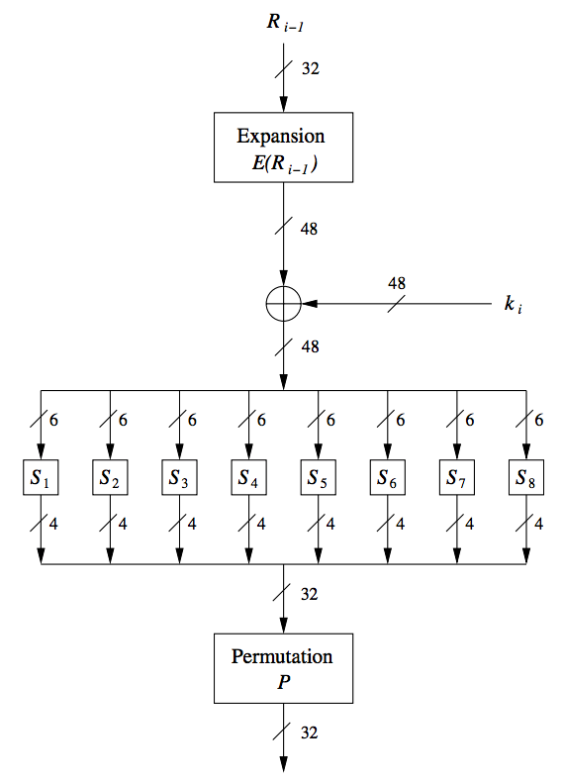
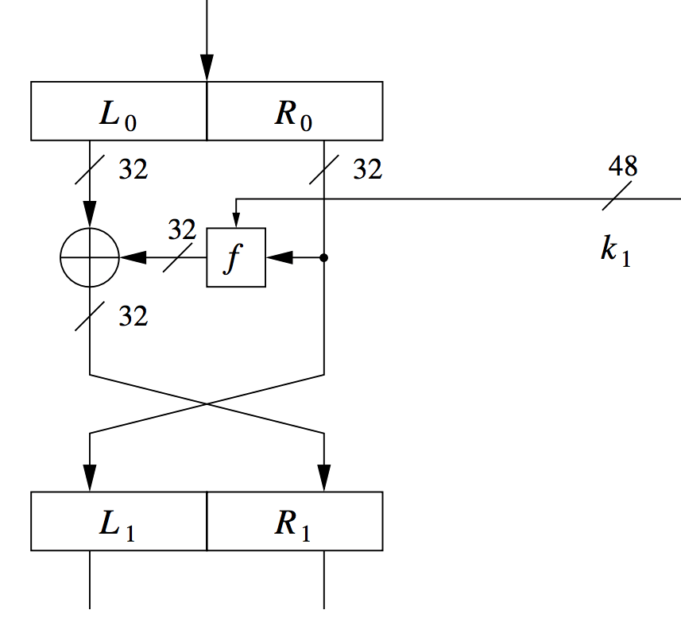
Recall: DES structure and internals
We discussed how each round of encryption takes place.
Today, we will discuss the key schedule.

Slide 4
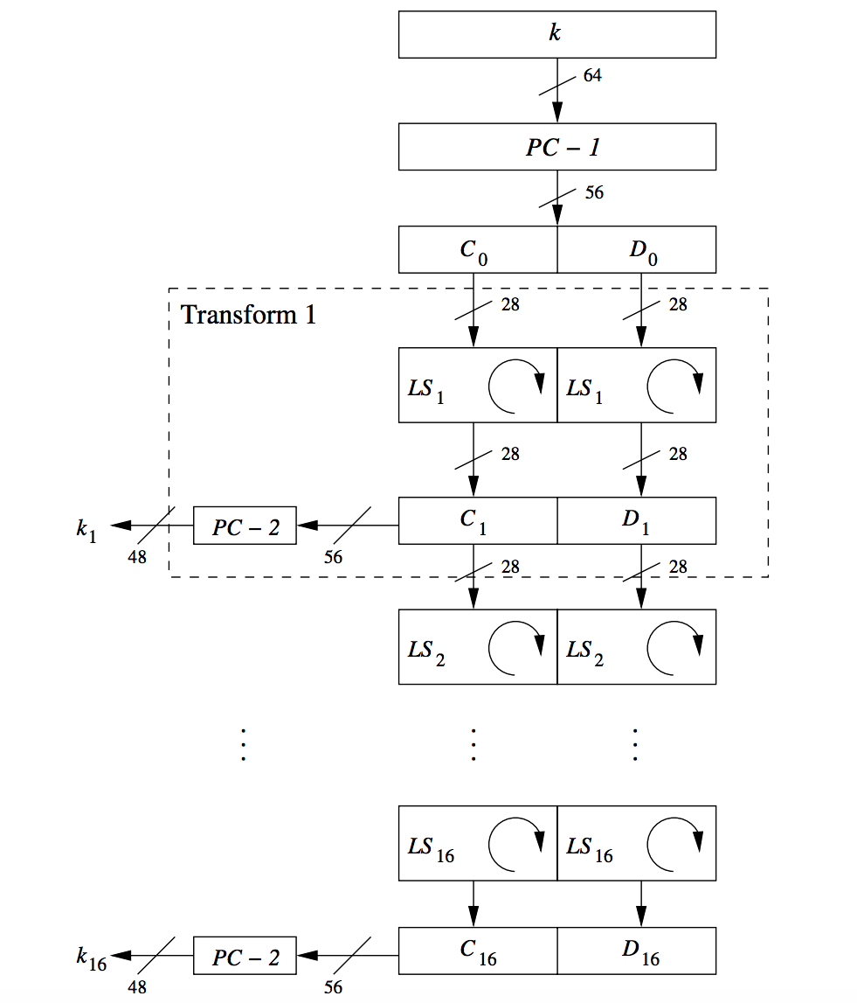
DES key schedule
Question: How to compute the 16 sub-keys for the 16 encryption rounds?
The key schedule for each round is derived from the main 64-bit key.
The process consists of simple operations.

Slide 5
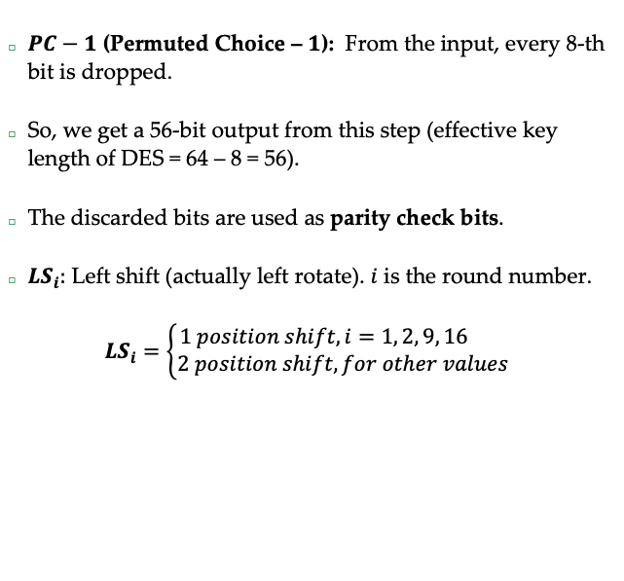
DES key schedule
$PC−1$ (Permuted Choice – $1$): From the input, every 8-th bit is dropped.
So, we get a 56-bit output from this step (effective key length of DES = 64 – 8 = 56).
The discarded bits are used as parity check bits.
${LS}_{i}:$ Left shift (actually left rotate). $i$ is the round number.
$${LS}_{i}=\left\{\begin{aligned}1 position shift, i=1, 2, 9, 16 \\ 2 position shift, for other values\end{aligned}\right.$$

Slide 6
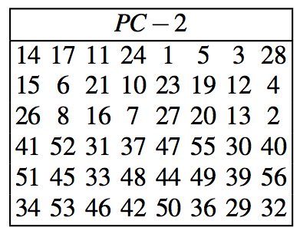
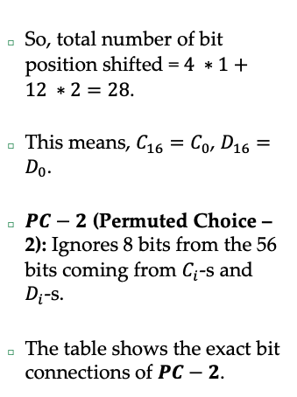
DES key schedule
So, total number of bit position shifted = $4 ∗1+12 ∗2=28$.
This means, $C_{16}=C_{0}$, $D_{16}=D_{0}$.
$PC−2$ (Permuted Choice – 2): Ignores 8 bits from the 56 bits coming from $C_{i}$-s and $D_{i}$-s.
The table shows the exact bit connections of $PC−2$.

Slide 7
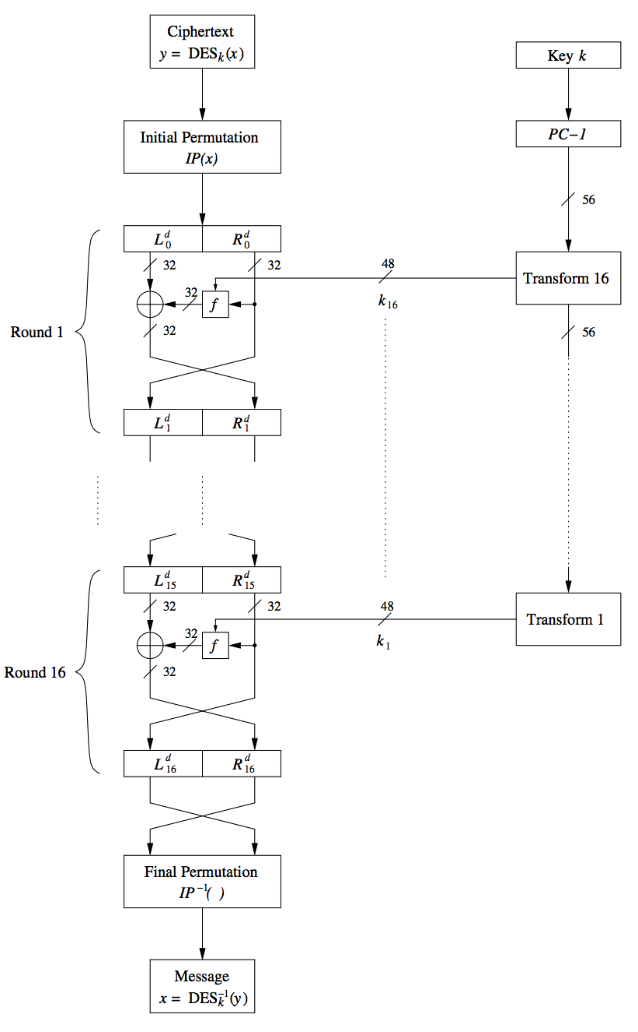
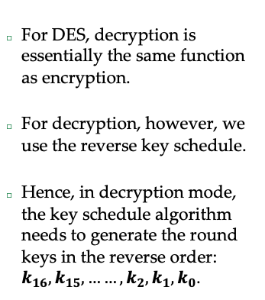
DES decryption
For DES, decryption is essentially the same function as encryption.
For decryption, however, we use the reverse key schedule.
Hence, in decryption mode, the key schedule algorithm needs to generate the round keys in the reverse order: $k_{16},k_{15}, ……,k_{2},k_{1},k_{0}$.

Slide 8
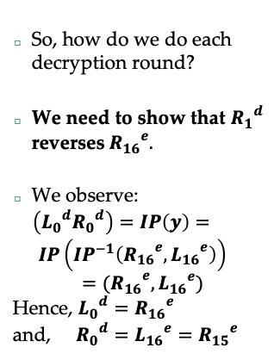
DES decryption
So, how do we do each decryption round?
We need to show that ${R_{1}}^{d}$ reverses${R_{16}}^{e}.$
We observe:
$\left({L_{0}}^{d}{R_{0}}^{d}\right)=IP\left(y\right)= IP\left({IP}^{−1}\left({R_{16}}^{e},{L_{16}}^{e}\right)\right)$
$$={{(R}_{16}}^{e},{L_{16}}^{e})$$
Hence, ${L_{0}}^{d}={R_{16}}^{e}$
and, ${R_{0}}^{d}={L_{16}}^{e}={R_{15}}^{e}$

Slide 9
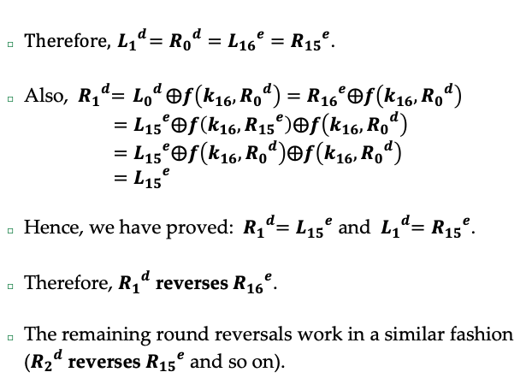
How do we build a Block Cipher
$Therefore, { L_{1}}^{d}={R_{0}}^{d}={L_{16}}^{e}={R_{15}}^{e}$.
Also, ${ R_{1}}^{d}={ L_{0}}^{d}⨁f\left(k_{16},{R_{0}}^{d}\right)={R_{16}}^{e}⨁f\left(k_{16},{R_{0}}^{d}\right)$
$={L_{15}}^{e}⨁f\left(k_{16},{R_{15}}^{e}\right)⨁f\left(k_{16},{R_{0}}^{d}\right)$
$={L_{15}}^{e}⨁f\left(k_{16},{R_{0}}^{d}\right)⨁f\left(k_{16},{R_{0}}^{d}\right)$
$={L_{15}}^{e}$
Hence, we have proved: ${ R_{1}}^{d}={L_{15}}^{e}$ and ${ L_{1}}^{d}={R_{15}}^{e}$.
Therefore, ${R_{1}}^{d}$ reverses${R_{16}}^{e}$.
The remaining round reversals work in a similar fashion (${R_{2}}^{d}$ reverses${R_{15}}^{e}$ and so on).

Slide 10
DES Security
Brute Force attack: In 1998, Deepcrack, a special-purpose DES hardware cracker was built, which could break DES in a few days.
The cost of the hardware was around 250,000 USD.
In 2007, COPACOBANA was built (using FPGA-s etc.) which could break DES in 1.5 days.
The cost of COPACOBANA was around 10,000 USD.
So, DES was broken and needed to be replaced.

Slide 11
DES Alternatives
Cipher | Comment
AES | De facto world standard
3 DES | Still very secure
AES families | There were four other ciphers which were the AES finalists (MARS, RC6, Serpent, Twofish). All of them are very secure.

Slide 12
Summary
We discussed
DES key schedule
Decryption of DES
DES security
DES alternatives

Slide 13
THANK YOU!
Questions?

