Slide 1
CSCI – 4135: Spring 2022
Web Application Engineering
Instructor: Sujoy Chakraborty
Lecture Slides – 1

Slide 2
Outline
What is Web Application Engineering
Web Applications
The case for web engineering
Categories of web applications
Characteristics of web application

Slide 3
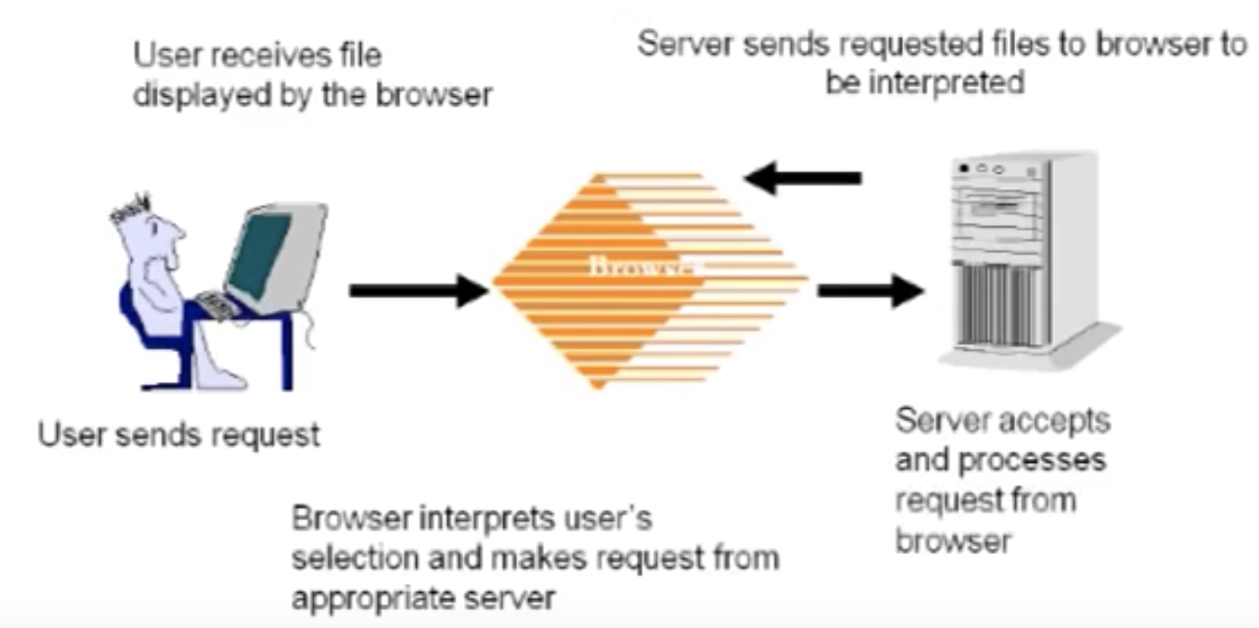
How do we typically use a web application
User needs a browser in his/her system (chrome, mozilla etc.).
The system should be connected to internet.
User sends a request through the browser for some web page residing on a server.
Server receives the request and sends a response back to the user with the requested web page.
Browser displays the response from the web server to the user.

Slide 4
Web Engineering principles
Software Engineering is an engineering discipline that is concerned with all aspects of software production.
The goal of Software Engineering is to build software applications that are:
- on time
- on budget
- with acceptable performance

Slide 5
Web Engineering principles – cont.
Web Engineering is a discipline that is aimed at creating high quality web-based applications.
Software Engineering deals with desktop application, whereas Web Engineering focuses on web applications.
Web Engineering draws on principles and management activities from Software Engineering.
In other words, Web Application Engineering extends Software Engineering to web applications.

Slide 6
Web Application Engineering - definition
“The application of systematic and quantifiable approaches to cost-effective analysis, design, implementation, testing, operation and maintenance of web applications”
Basically, an extension of Software Engineering principles for web applications.

Slide 7
Web Applications – their importance
Web applications have impacted our lives in numerous sectors:
- Economy
- Industry
- Education
- Healthcare
- Entertainment
Reasons of influence:
- Global and permanent
- Comfortable and uniform access

Slide 8
Web Applications – History
WWW started as a medium for information sharing (typically for sharing scientific research outputs)
Gradually evolved into an application medium
Initial applications were static web page based applications.
Complexity of web applications grew over time and now what we have is a full-fledged dynamic environment with databases and client-server architecture.

Slide 9
Web Applications – Distinguishing factors
How they are used:
- User needs to have a Web Browser installed in his system
- The system must be connected to Internet
Technologies and standards for development

Slide 10
Web Applications – Definition
“A system that utilizes W3C standards & technologies to deliver web-specific resources to clients (typically) through a browser”
W3C stands for: World Wide Web Consortium
Major factors involved in a web application: Technology + Interaction

Slide 11
Web Application Engineering – Why to study
Application development on the web was largely adhoc
- Unplanned, one-time events
- Individual experience
- Little or no documentation for code/design
Short-term savings lead to long term problems in operations, maintenance and usability:
- Lack of performance, reliability, user-friendliness and scalability
Because web applications are so interdependent, the problem gets compounded.

Slide 12
Root causes of poor design
Developing an application as an authoring activity.
Developing with a perception that web applications are “easy” to develop.
Techniques that should not be used are misapplied.
Techniques that should be used are omitted (often due to lack of knowledge).

Slide 13
Drawbacks of adhoc approaches – a survey
A survey from Cutter Consortium (2000) revealed:
- Failure to meet business objective (84%)
- Project schedule delay (79%)
- Budget overrun (63%)
- Lack of functionality (53%)
Web Engineering’s solution:
- Clearly defined goals and objectives
- Systematic, phased development
- Careful planning
- Iterative and continuous auditing of the entire process

Slide 14
Categories of web applications
Document-centric
Interactive and transactional
Workflow-based
Collaborative and social
Portal-oriented
Ubiquitous

Slide 15
Document-centric web applications
Originator to web applications (web started as a medium for information sharing)
These web applications were based on static html documents, on which contents were added.
Users could browse the content with a browser.
Updates to the web page were needed to be done manually.
Pros
- Simple, stable, short response times (no processing were needed at the server)
Cons
- High management costs for frequent updates and large collections
- More prone to inconsistent/redundant information
Example: Static home pages

Slide 16
Interactive and transactional web applications
Allows the user to modify content on the web page (With html forms and CGI scripts).
Enabled simple interactivity with the introduction of html forms.
Allows dynamic page creation based on user data:
- Web pages and links to other pages generated dynamically based on user input
Transactional websites improved the interactivity with:
- Database connectivity
- Increased complexity
Example: News sites, booking systems, online banking etc.

Slide 17
Workflow based web applications
Designed to handle business processes across departments, organizations and enterprises.
Automates processes consisting of series of steps.
Business logic defines the structure of the application.
High complexity: autonomous entities
Example: B2B and e-Government.

Slide 18
Collaborative and social web applications
Collaborative:
Users are allowed to collaborate to develop the contents of the web application.
Unstructured, cooperative environments:
Support shared information workspaces to create, edit and manage shared information
Interpersonal communication is paramount
Classic example: Wikipedia
Social:
Unrecognizability traditionally characterized WWW.
Moving towards communities of interest
Example: Blogs, facebook, twitter etc.

Slide 19
Web portals
One specifically designed at a website which brings information together from diverse sources in a uniform way.
Each information source gets its dedicated area.
Example:
- Search engines (google, yahoo search etc.)
- Specialized portals (Business portals, Marketplace portals, Community portals)

Slide 20
Ubiquitous web applications
Customized services delivered anywhere via multiple devices.
Still an emerging field.

Slide 21
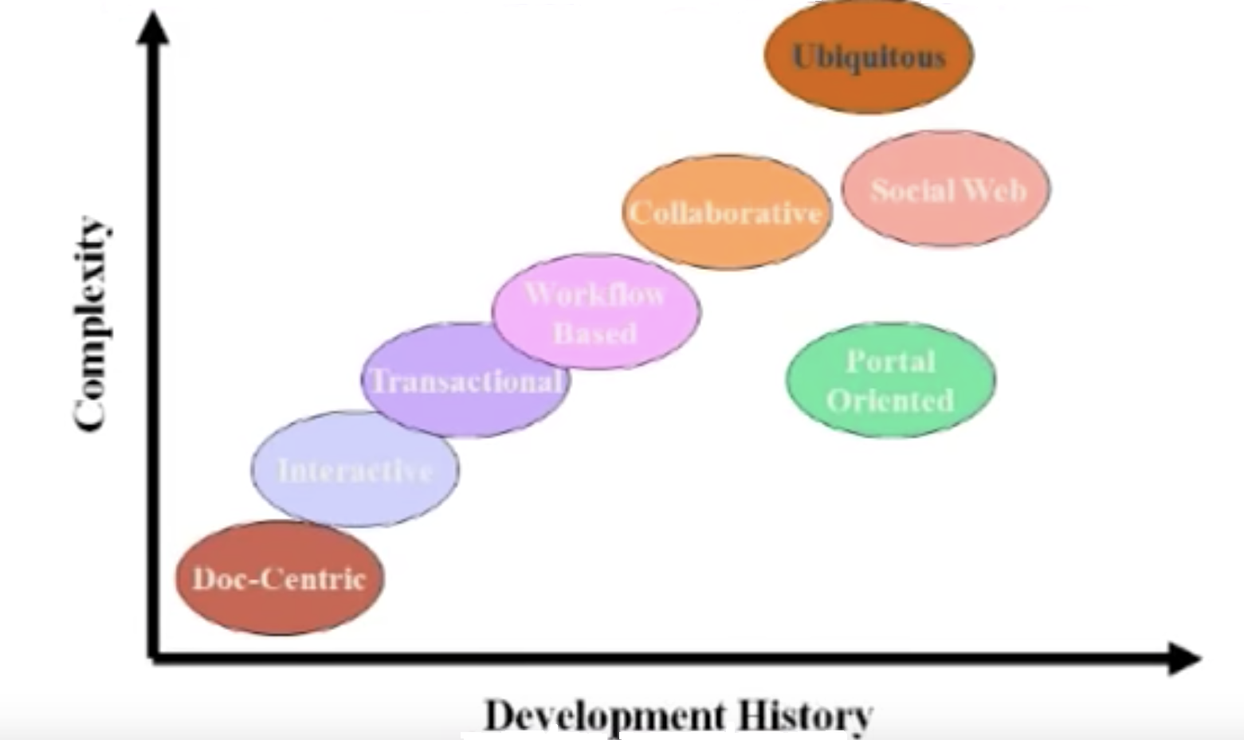
Categories of web applications – Development History vs complexity

Slide 22
Characteristics of web applications
How do web applications differ from conventional desktop applications:
- Product based (Building blocks are different)
- Usage based (Usages are different)
- Development based (Development techniques are different)

Slide 23
Product-based characteristics
Product-related characteristics constitute the “building blocks” of a web application.
Content:
Document character & multimedia (desktop applications focus on functions/services)
Quality demands: current, exact, consistent and reliable
Navigation structure (Hypertext):
Nonlinear structure (links on a web page can be viewed in any order)
Potential problems: Disorientation and cognitive overload
User interface (Presentation):
Appearance (Matters considerable compared to desktop applications)
Should be self-explanatory (For desktop applications, we can refer to help, but not with web applications)

Slide 24
Usage-based characteristics
Much greater diversity compared to traditional non-web applications.
- Users vary in numbers, cultural background, devices, H/W, S/W, location etc.
Social context (users):
- Spontaneous, scalable
- Heterogeneous groups
Technical context (Network & devices)
- Quality of service (Accessed through internet. In contrast, desktop applications are hosted on local machines)
Natural context (Place & Time)
- Globality
- Availability

Slide 25
Development-based characteristics
The Development Team:
- Multidisciplinary – print publishing, s/w development, marketing, computing, art & technology etc.
Technical Infrastructure:
- Lack of control on the client side
Integration:
- Internal: with existing legacy systems
- External: with web services
- Integration issues: correct interaction, guaranteed QoS

Slide 26
Summary
Web Engineering extends software engineering to web applications
Why web engineering
Web applications
Categories and characteristics of web applications

Slide 27
References
Chapter 1, Kappel G, Proll B, Reich S & Retschitzegger W. Web Engineering, John Wiley & Sons.

