Slide 1

HTML – Creating Internal and External links
CSCI – 4135 (Spring 2022)
Sujoy Chakraborty
Department of Computer Science Stockton University, NJ, USA

Slide 2
Outline
How to link between pages of your site (internal links)
How to link to other sites (external links)
How to structure the folders on your web site
Link attributes

Slide 3
HTML links
The crux of HTML is its capability to reference countless pieces of information easily on the internet.
When you link to another page in your own website, the link is known as an internal link.
When you link to a different site, it is known as an external link

Slide 4
HTML links – cont.
Internal links:
The element <a> is used to link another document
Anything between the opening <a> tag and the closing </a> tag becomes part of the link that a user can click in a browser
To link another page, href attribute of the tag <a> tag is used
The value of the href attribute is the name of the file you are linking to
For example:
- <a href = abc.html> Click here </a>
- The tags <a>..</a> and the attribute href are not case sensitive, but the file name is.
- The file should exist in the same folder as the source page.
- To link to other pages in a different folder, specify the complete path.

Slide 5
HTML links – cont.
Here is how you can create an internal link:
<html>
<head>
<title> Internal linking </title>
</head>
<body>
This is the first page. <a href = second.html>Click here</a> to move to the next page.
</body>
</html>

Slide 6
HTML links – cont.
External links:
To link the page of another website, again the href attribute of the tag <a> tag is used.
The value of the href attribute is the full web address for the page you want to link to.
For example:
<a href = http://www.google.com> Click here </a>

Slide 7
HTML links – cont.
Here is an example of an external link:
<html>
<head>
<title> External linking </title>
</head>
<body>
This is the home page. To open Google, <a href = http://www.google.com>Click here</a>.
</body>
</html>

Slide 8
Directory structure
It is not suitable to store all HTML pages in a single directory for a website.
It helps to put related pages in different directories for better organization and management (for example, a folder named images to store all images to be put on the website etc.).
The root directory (or the root folder) is the main directory that holds the whole of your website.
A subdirectory is a directory that is within another directory.
A parent directory is a directory that contains another directory.

Slide 9
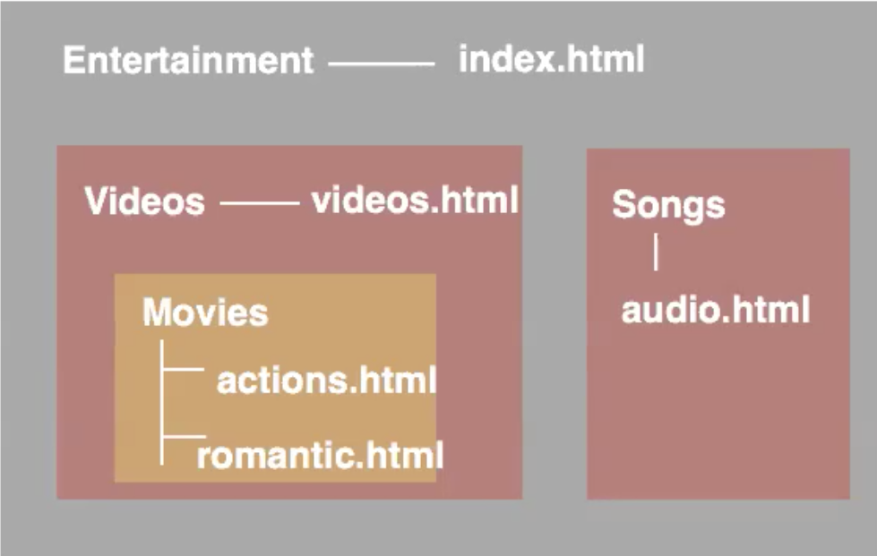
Directory structure – cont.

Slide 10
Referencing a web page
Same Directory:
When you want to link to, or include a resource from the same directory, you can just use the name of that file.
Subdirectory:
subdirectory/../filename
Parent directory:
../filename

Slide 11
Directory structure – cont.
Ex – 1: Linking from romantic.html to actions.html:
<a href = “actions.html”>…</a>
Ex – 2: Linking from romantic.html to actions.html:
<a href = “Videos/Movies/actions.html”>…</a>
Ex – 3: Linking from actions.html to audio.html:
<a href = “../../Songs/audio.html”>…</a>

Slide 12
More attributes for <a>
accesskey: specifies a shortcut key to activate or focus an element.
<a href = “abc.html” accesskey = “a”> … </a>
tabindex: sets the tab ordering of elements in an html page.
<a href = “abc.html” tabindex = “1”> … </a>
target: specifies if the new page is to be opened in the same tab or in a different tab.
<a href = “abc.html” target = “_blank”> … </a> (new tab)
<a href = “abc.html” target = “_self”> … </a> (same tab)
title: shows a brief description of that the link is about, when we hover over the link.
<a href = “abc.html” title = “a link”> … </a>

Slide 13
HTML links – cont.
Here is an example showing the different attributes of the <a> tag in action:
<html>
<head>
<title> Link attributes </title>
</head>
<body bgcolor = “lightblue”>
It is the first link. To open the link, <a href = first.html tabindex = 2 target = “_self” title = “first link” accesskey = “a” >Click here</a>.<br>
It is the second link. To open the link, <a href = first.html tabindex = 1 target = “_blank” title = “second link”>Click here</a>.<br>
</body>
</html>

Slide 14
Summary
We discussed:
How to link between pages of your site (internal links)
How to link to other sites (external links)
How to structure the folders on your web site
Link attributes

Slide 15
THANK YOU!
Questions?

