Slide 1

HTML – Forms
CSCI – 4135 (Spring 2022)
Sujoy Chakraborty
Department of Computer Science Stockton University, NJ, USA

Slide 2
Outline
HTML forms
HTML form elements

Slide 3
HTML forms
Forms provide a means of submitting information from the client to the server.
HTML supports tags for creating forms, however, it doesn’t process the information.
To process the information provided on form, server-side scripts are used.
Server-side script runs on the web server and receives data from a form and uses it to perform a set of tasks.

Slide 4
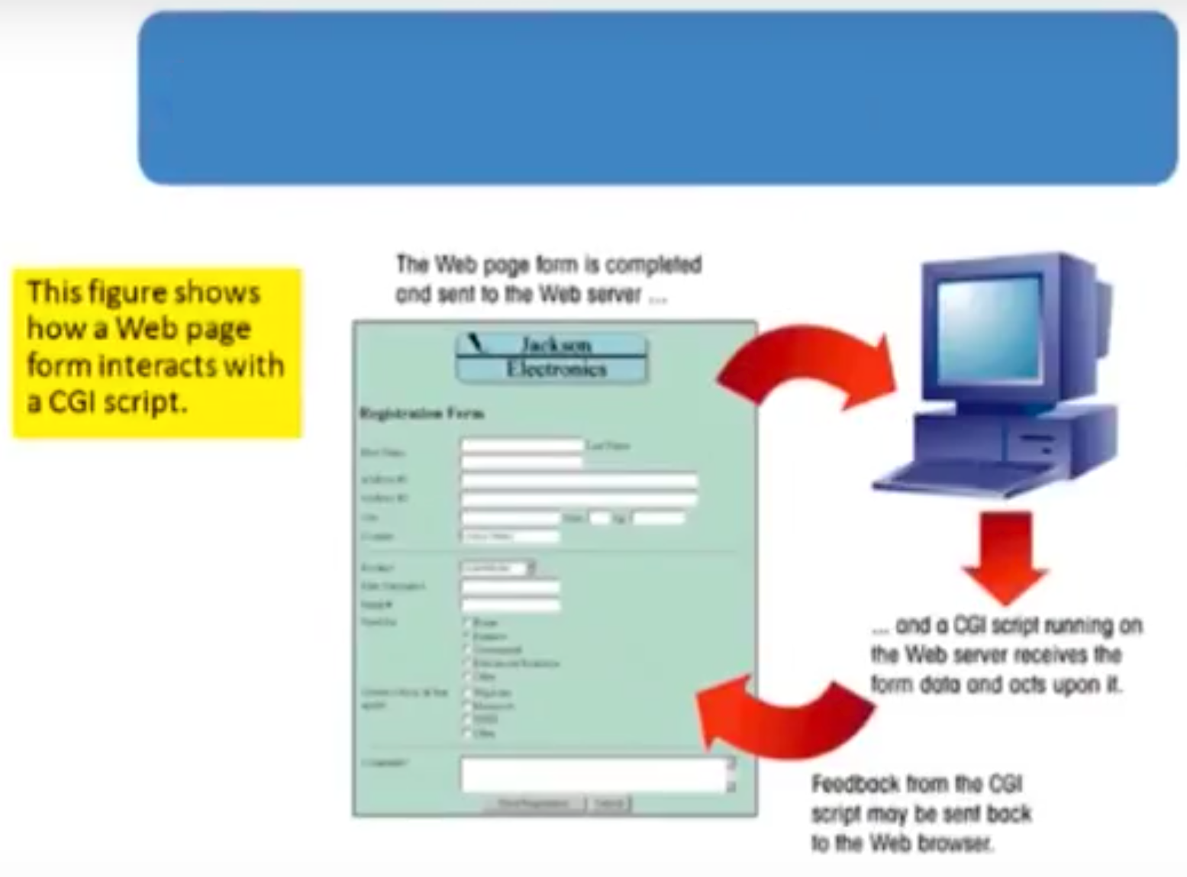
HTML forms

Slide 5
HTML forms – cont.
In HTML, <form> tag is used to start a form while </form> tag indicates the end of the form.
Form elements are placed in between the tags.
We can declare a form as follows:
<form attributes>
form elements and layout tags
</form>
A single page can include several different forms, but you cannot nest one form inside another.

Slide 6
HTML forms – cont.
Form attributes:
action – gives the URL of the application that is to receive and process the data on the forms.
method – sets the HTTP method that the browser uses to send the form’s data to the server for processing: either POST or GET.
name – name of the form

Slide 7
Form Elements
Textbox
Password field
Hidden field
Checkbox
Radio button
Text Area
Select List
Submit button
Reset button

Slide 8
Textbox
Syntax:
<INPUT TYPE = “TEXT”>
- NAME
- SIZE
- VALUE
- MAXLENGTH
e.g., <INPUT TYPE = “TEXT” NAME = NAME SIZE = 30 VALUE = “ALICE” MAXLENGTH = 15>
Example:
<form>
Please Enter your name: <input type = "text" size = 30 value = "Use uppercase letters">
</form>

Slide 9
Password
Syntax:
<INPUT TYPE = “PASSWORD”>
- NAME
- SIZE
- VALUE
- MAXLENGTH
e.g., <INPUT TYPE = “PASSWORD” NAME = NAME SIZE = 30 VALUE = “BOB” MAXLENGTH = 15>

Slide 10
Hidden text field
Syntax:
<INPUT TYPE = “HIDDEN”>
- NAME
- VALUE
e.g., <INPUT TYPE = “HIDDEN” NAME = NAME VALUE = “BOB”>

Slide 11
Checkbox
Syntax:
<INPUT TYPE = “CHECKBOX”>
- CHECKED
- NAME
- VALUE
e.g., <INPUT TYPE = “CHECKBOX” NAME = CHECK VALUE = “CHECKED”>

Slide 12
Radio button
Syntax:
<INPUT TYPE = “RADIO”>
- CHECKED
- NAME
- VALUE
<INPUT TYPE = “RADIO” NAME = RADIO VALUE = “” CHECKED> MALE
<INPUT TYPE = “RADIO” NAME = RADIO VALUE = “”> FEMALE

Slide 13
Select list
Drop down list:
Select
- Name, size
Option
Example:
<SELECT name = “name” size = “size”>
<OPTION value = “NY”>New York</OPTION>
<OPTION value = “PY”>Paris</OPTION>
<OPTION value = “LO”>London</OPTION>
</SELECT>

Slide 14
Text area
Text-area:
Rows
Cols
Name
Example:
<Textarea rows = 5 cols = 5>
Default text
</Textarea>

Slide 15
File-field
File-field
<input type = “file” name = “file-name”>

Slide 16
Submit and reset buttons
Syntax:
<input type = “Submit” Value = “Save”>
<input type = “Reset” Value = “Reset”>

Slide 17
Summary
We discussed:
HTML forms
HTML form elements

Slide 18
THANK YOU!
Questions?

