Slide 1

Cascading Stylesheets (CSS) - 3
CSCI – 4135 (Spring 2022)
Sujoy Chakraborty
Department of Computer Science Stockton University, NJ, USA

Slide 2
Outline
The process to design a page layout
div tag
Coding a page using divs and CSS

Slide 3
Consider a web application to develop
A smaller version of social web.
Users can register themselves.
After registration they can send a text message to anybody who is registered with the website.
Users can view the received message and the messages sent to other users

Slide 4
The process
Controlling text with CSS
Determine the requirements of the site (contents to be put on the web application)
Group the required information
Make a site map (different web pages and their interrelations)
Identify key elements of each page
Decide about the arrangement of information on each page
Translate the design into code

Slide 5
Determining requirements
Understanding the visitors/users
who will visit the site (you can create fictional visitors)?
For example, we decide that men and women of 20 to 50 years of age
Why have they come to your site?
Send messages
- View received messages
What does a visitor need to achieve a goal?
Will they be familiar with your product
How often can you realistically expect them to visit?
In order to make changes

Slide 6
Determining requirements – cont.
Things you want the site to do:
Determining the requirement of the owner of the site which are not already listed
User must register themselves in order to send and receive messages

Slide 7
Grouping and categorization
Group related information/sections
Home page: login form, registration form
User page: user’s information, recent messages
Inbox: received messages
Outbox: sent messages
Send a message: send message form

Slide 8
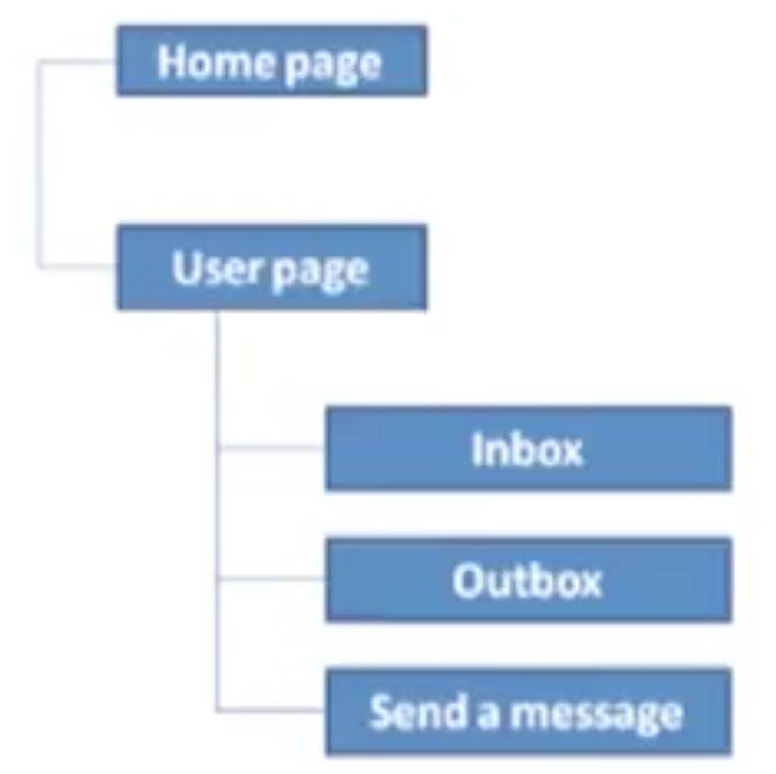
Make a site map
Site map shows how many pages you need and how they relate.
Usually look like either a family tree or a folder list.
Example:

Slide 9
Key element(s) for each page
Common sections:
header, navigation, footer etc.
Page specific sections:
Example:
Common sections (header, footer)
Page specific sections
a. Home page: login and registration forms
b. User page: user’s information, recent messages
c. Inbox page: received messages
d. Outbox page: messages sent by the user
e. Send message page: form to send a message

Slide 10
Summary
We discussed:
The process to design a page layout
div tag
Coding a page using divs and CSS

Slide 11
THANK YOU!
Questions?

