Slide 1
CSIS – 4135: Spring 2022
Web Application Engineering
Instructor: Sujoy Chakraborty
Lecture Slides – 2

Slide 2
Outline
Development process model
- Software development process activities
Requirements for a web application process model
Rational unified process model (RUP)
- Suitability for web application development

Slide 3
Development Process Model
Process Model: A set of related activities that leads to the production of a software product.
- development of software from scratch
- extending and modifying existing systems
Common activities:
- Software specification
- Designing and implementation
- System validation
- System evolution

Slide 4
Process activities
Software specification:
- The functionality of the software and constraints on its operation must be defined
- This is a critical stage and need to be accurate and complete (otherwise can lead to problems in design and implementation)
- Activities:
Feasibility study
Requirement elicitation and analysis (if there are some issues or conflicting requirements)
Requirement specification (Documenting the requirements after analysis)
Requirement validation (validating the requirement with the stakeholders)

Slide 5
Process activities – cont.
Software design and implementation:
- Design is the description of:
i> System structure
ii> Data models
iii> Interface between components
- Implementation entails converting a system specification into an executable system.

Slide 6
Process activities – cont.
System validation:
Intended to show that the system
- Conforms to its specification
- Meets customer’s expectations
Performed in different stages:
- Development testing: Tested by the people who developed the components.
- System testing: Testing after integration of components to find component integration errors.
- Acceptance testing: System is tested by customer’s provided data.

Slide 7
Process activities – cont.
Software evolution:
Software needs to be flexible to meet changing requirements from the customer
Changes can be made to the system during/after development:

Slide 8
Common process models
The Waterfall model:
The process model steps are performed in sequence.
The next step is started based on the output from the previous step in the model.
Changes in the system are costly to implement in this model.
Used more with systems where requirements are unambiguous and chances of changes at a later stage are minimum.
The iterative model:
System is evolved iteratively after validating the functionality with customer at each iteration and incorporating the feedback.
Suitable for small scale projects, or for implementing a big project in small chunks.
Reuse oriented:
Existing components are reused to build added functionality.

Slide 9
Requirements for a web application development process
Recall: Web Applications evolved from informational medium to application medium:
Existing approaches are over-pragmatic.
Such approaches lead to short development time, but often problems are encountered in them due to lack of planning.
Web engineering does not have its own mature development process model.
Software development process models are adopted for development.

Slide 10
Requirements for a web application development process – cont.
Handling short development cycles:
- Development time is short, typically within six months.
- Immediate delivery mechanism (Web application needs to be available on the web quickly, typically to capture share in market)
- Leaves less freedom for systematic development process.
Handling changing requirements:
- Requirements usually change rapidly, often emerge during development (as developers gain better understanding of the business).
- Must facilitate the integration of the changes to the application rapidly, to remain in competition.
- User involvement is more critical, due to emerging and unstable requirements.
Re-use and integration:
- To meet time constraints, developers often try to re-use components (Leads to integration issues)
- Development can’t be isolated from development of other applications within the organization.

Slide 11
Requirements for a web application development process – cont.
Adapting to web application’s complexity level:
- Process depends on the level of complexity
- Process is adapted dynamically
a. For low complexity, it should be like lightweight process (less documentation, focus on output).
b. For high complexity, it should be like heavyweight process (More documentation).

Slide 12
Rational unified process (RUP)
RUP is a heavyweight, phase oriented, incremental and iterative process:
- Documentation is required for every phase
Described in 3 perspectives:
- Dynamic perspective : phases
- Static perspective : activities in phases
- Practice perspective : good engineering practices
RUP Phases:
- Inception:
1. Defines the business case for the project.
2. Goal of inception: To prepare a business case with analysis on feasibility of the application.
3. Identifies and interacts with external entities
4. Assesses the business contribution
5. Artifacts: Business cases

Slide 13
Rational unified process (RUP) – cont.
- Elaboration:
1. Establishes understanding with the problem.
2. Goal of elaboration: To establish scope of the application.
3. Discriminating critical use cases.
4. Estimating cost, schedules and risks.
5. Artifacts: Development plan, use case model, architectural description
- Construction:
1. Involves system design, programming and testing
2. Goals: a) Develop the design, b) implement the design and c) validate the system
3. Artifacts: System, training material
- Transition:
1. Involves installing the system in real environment.
2. Goals: a) Testing in real environment, b) training the users and c) bug fixing and performance enhancements.
- Artifacts: A correctly working documented system.

Slide 14
Rational unified process (RUP) – cont.
RUP activities (workflows)
- Requirements gathering
- analysis
- design
- implementation
- test
RUP good practices:
- Develop software iteratively
- Manage requirements (they may change)
- Use component-based architectures
- Visually model software using UML
- Verify software quality
- Control changes to software

Slide 15
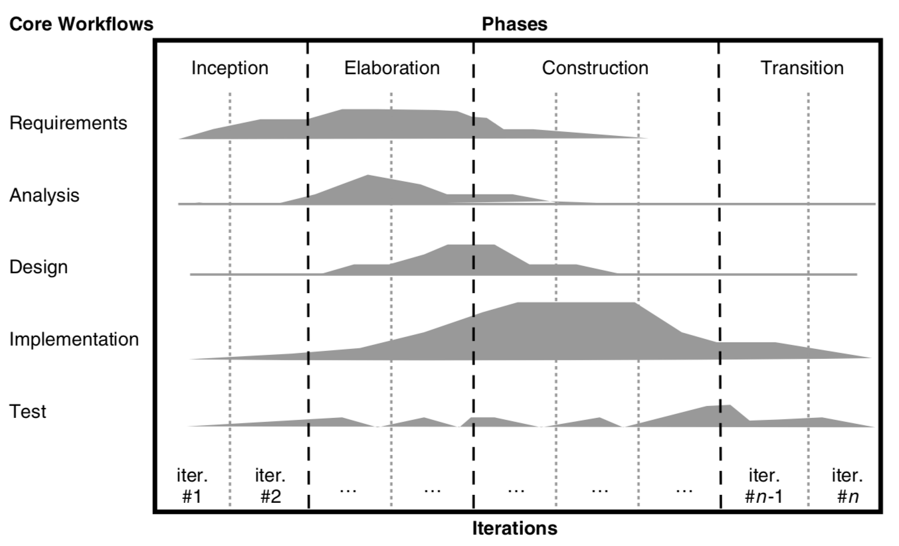
Rational unified process (RUP) – cont.

Slide 16
RUP for web applications
Inception phase:
- Definition is problematic for web application (no concrete view of the system at the beginning)
- has target groups but needs are unknown
Elaboration phase:
- due to short implementation time, first version has priority over clearly defined end product.
Construction phase:
- Involves the web development process
Transition phase:
- Important for a web application

Slide 17
Does RUP satisfy the requirements for a web application development process?
Handling short development cycles:
- Conflicting: short cycle means concession in modeling and documentation while RUP is heavyweight.
- This requirement is not fulfilled for a RUP model.
Handling changing requirements:
- Conflicting with time constraints (requires concrete vision at the end of the inception phase which require more time in web application due to evolving requirements.
Parallel development of different releases:
- Can be met with RUP (only allows parallel development in construction phase)
Re-use and integration:
- Conflicting (requires coordination with development processes of other applications, RUP does not describe this)
Adapting to a web application’s complexity level:
- RUP can be adopted for later stages when complexity of web application is understood.

Slide 18
Summary
Development process models
- Software development process activities
- conventional software development approaches
Requirements for a web development process model
Rational unified process model (RUP)
- suitability for web application development

Slide 19
References
Chapter 10, Kappel G, Proll B, Reich S & Retschitzegger W. Web Engineering, John Wiley & Sons.
Chapter 2, Sommerville, Software Engineering, PEARSON.

