Slide 1

Dialog boxes and HTML DOM
CSCI – 4135 (Spring 2022)
Sujoy Chakraborty
Department of Computer Science Stockton University, NJ, USA

Slide 2
Outline
Dialog boxes in JavaScript
HTML Document Object Model (DOM)

Slide 3
Dialog boxes in JavaScript
JavaScript provides the ability to pickup user input or display small amounts of text to the user by using dialog boxes.
These dialog boxes appear as separate windows and their content depends on the information provided by the user.
JavaScript provides 3 types of dialog boxes:
alert box
prompt box
confirm box

Slide 4
Alert Box
An alert box is simply a small message box that pops up and gives the user some information.
Mostly used to give a warning message to the user.
When an alert box pops up, the user will have to click “OK” to proceed.
Syntax:
alert (“message”)

Slide 5
Alert Box – cont.
<html>
<head>
<script>
function alertme(message)
{
alert(message)
}
alertme("Welcome to my page")
</script>
</head>
<body>
<h1>Hello World. </h1>
</body>
</html>

Slide 6
Prompt box
A prompt box is often used if you want the user to input a value before entering a page.
When a prompt box pops up, the user will have to click either “OK” or “Cancel” to proceed after entering an input value.
If the user clicks OK, the box returns the input value.
If the user clicks Cancel, the box returns null value.

Slide 7
Prompt box – cont.
<html>
<head>
<title>Prompt box</title>
<script>
function promptme()
{
var name = prompt("Please enter your name:", "Name");
document.write("Hello Mr. " + name);
}
promptme()
</script>
</head>
</html>

Slide 8
Confirm box
A confirm box is often used if we want the user to verify or accept something.
When a confirm box pops up, the user will have to click either “OK”, or “Cancel” to proceed.
If the user clicks “OK”, the box returns true.
If the user clicks Cancel, the box returns false.

Slide 9
Document Object Model (DOM)
Once HTML elements are rendered in the browser window, the browser cannot recognize them.
To create interactive web pages, it is vital that the browser continues to recognize HTML elements.
JavaScript enabled browsers do this because they recognize and use DOM.
DOM organizes the HTML elements in a hierarchical form and makes it possible to recognize the HTML elements even after being displayed.

Slide 10
DOM cont.
The HTML DOM defines a standard set of objects for HTML and a standard way to access and manipulate HTML documents.
All HTML elements, along with their containing text and attributes can be accessed through DOM.
HTML DOM is platform and language independent:
It can be used by any programming language like Java, JavaScript, VBScript etc.
HTML DOM can be thought of as a hierarchy moving from the most general object to the most specific.

Slide 11
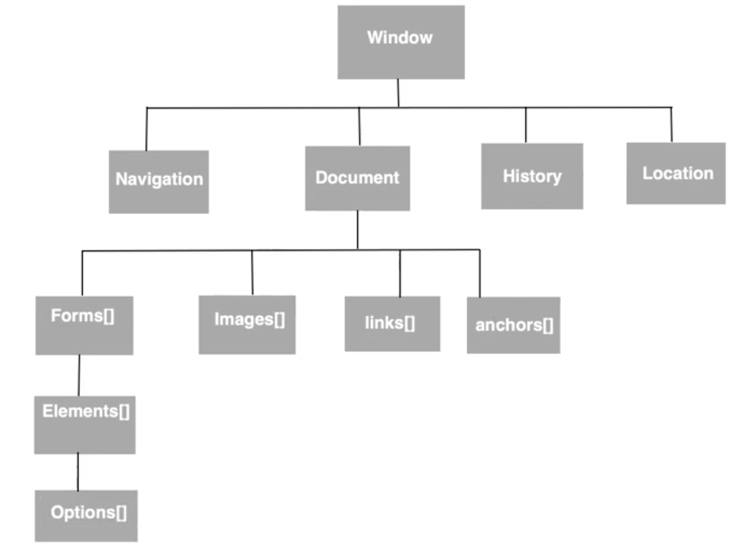
DOM cont.

Slide 12
Dom – cont.
Examples:
document.forms[0].elements[0].value
document.images[0].src
document.links[0].href

Slide 13
Retrieving HTML elements
The getElementById() method is a workhorse method of the DOM, to retrieve HTML elements.
It retrieves a specified element of the HTML document and returns a reference to it.
To retrieve an element, it must have a unique id:
- document.getElementById(“element-id”)
The returned reference can be used to retrieve element attributes:
document.getElementById(“element-id”).attribute
Example: document.getElementById(“pic”).src
document.getElementById(“pic”).height

Slide 14
Retrieving HTML elements – cont.
Example:
<html>
<head>
<title>Retrieving values</title>
<script>
function getValue()
{
var a = document.getElementById("pic")
alert(a.title)
alert(a.height)
}
</script>
</head>
<body>
<img src = "robot.png" id = "pic" height = "100" title = "My Robot" onClick = "getValue()">
</body>
</html>

Slide 15
Retrieving the text of an element
The innerHTML property defines both the HTML code and the text that occurs between that element’s opening and closing.
Example:
document.getElementById(“element-id”).innerHTML

Slide 16
Retrieving the text – cont.
<html>
<head>
<title>Retrieving Text</title>
<script>
function getText()
{
var a = document.getElementById("mypara")
alert(a.innerHTML)
}
</script>
</head>
<body>
<p id = "mypara" onClick = "getText()">
Hello World </p>
</body>
</html>

Slide 17
Getting value of attributes
getAttribute() method is used to retrieve values of attributes:
document.getElementById(“element-id”).getAttribute(“attribute-name”);
For example:
document.getElementById(“pic”).getAttribute(“src”);
Instructions are to be strictly coded in the way they are defined.

Slide 18
Setting values of attributes
So far, we have created references to HTML elements and accessed their attributes through those references.
However, to add dynamic effect on the web page, the next step is to set new values to those attributes.
setAttribute() method is used to set values of attributes:
document.getElementById(“element-id”).setAttribute(“attribute-name”, “Value”)
Example:
document.getElementById(“pic”).setAttribute(“src”, “abc.jpg”)

Slide 19
Summary
We discussed:
Dialog boxes in JavaScript
HTML Document Object Model (DOM)

Slide 20
THANK YOU!
Questions?

