Slide 1

History, Navigator, Screen and Form objects
CSCI – 4135 (Spring 2022)
Sujoy Chakraborty
Department of Computer Science Stockton University, NJ, USA

Slide 2
Outline
History object
Navigator object
Screen object
Form object

Slide 3
The History object
The History object contains the URL-s visited by the user (within a browser window).
The History object is part of the Window object and is accessed through the window.history property.
Used to move forward and backward through the visitor’s browsing history.

Slide 4
The History object – cont.
Properties of the History object:
Length: Returns the number of URL-s in the history list.
Methods of the History object:
back(): Loads the previous URL in the history list.
forward(): Loads the next URL in the history list.
go(): Loads a specific URL from the history list.

Slide 5
The History object – cont.
<html>
<head>
<title>History object</title>
<script>
document.write(history.length)
function goBack()
{
window.history.back()
}
function goForward()
{
window.history.forward()
}
</script>
</head>
<body>
<h1>This is the first page.</h1>
<a href = "JS-2.html">Go to next page</a><br>
<input type = "button" value = "Go Back" onclick = "goBack()">
<input type = "button" value = "Go Forward" onclick = "goForward()">
</body>
</html>

Slide 6
The Navigator object
The Navigator object contains information about the browser.
Provides several properties that assist in the detection of various elements of the visitor’s browser and environment.

Slide 7
The Navigator object – cont.
Properties of the Navigator object:
appCodeName: Returns the code name of the browser
appName: Returns the name of the browser
appVersion: Returns the version information of the browser
Methods of the Navigator object:
javaEnabled(): Specifies whether or not the browser has Java enabled

Slide 8
The Navigator object – cont.
Detecting user’s browser:
Used to write browser specific code
Can also be used to restrict users to use a specific browser

Slide 9
The Navigator object – cont.
<html>
<head>
<title>Browser detection</title>
</head>
<body>
<script>
var browsername = navigator.appName
var browserversion = navigator.appVersion
document.write("You are using " + browsername + "version " + browserversion)
</script>
</body>
</html>

Slide 10
The Screen object
The Screen object contains information about the visitor’s screen.
We might need this information to determine which images to display or how large the page can be.

Slide 11
The Screen object – cont.
Properties of the Screen object:
availHeight: Returns the height of the screen (excluding the windows taskbar)
availWidth: Returns the width of the screen (excluding the windows taskbar)
colorDepth: Returns the bit depth of the color palette for displaying images
height: Returns the total height of the screen
width: Returns the total width of the screen

Slide 12
The Screen object – cont.
<html>
<head>
<title>Screen object</title>
</head>
<body>
<script>
document.write("Available height: " + screen.availHeight)
document.write("<br>Available width: " + screen.availWidth)
document.write("<br><br>Height: " + screen.height)
document.write("<br>Width: " + screen.width)
</script>
</body>
</html>

Slide 13
The Form object
The Form object represents an HTML form.
For each <form> tag in an HTML document, a Form object is created.
The browser creates a “forms[] array” which keeps the number of form objects in the HTML code.
The first form object in the HTML file is held as array index [0], the second as index [1] and so on.
The ”forms[] array” also holds information about each element used within <form> and </form> tags.
Elements[] array keeps information about form elements.

Slide 14
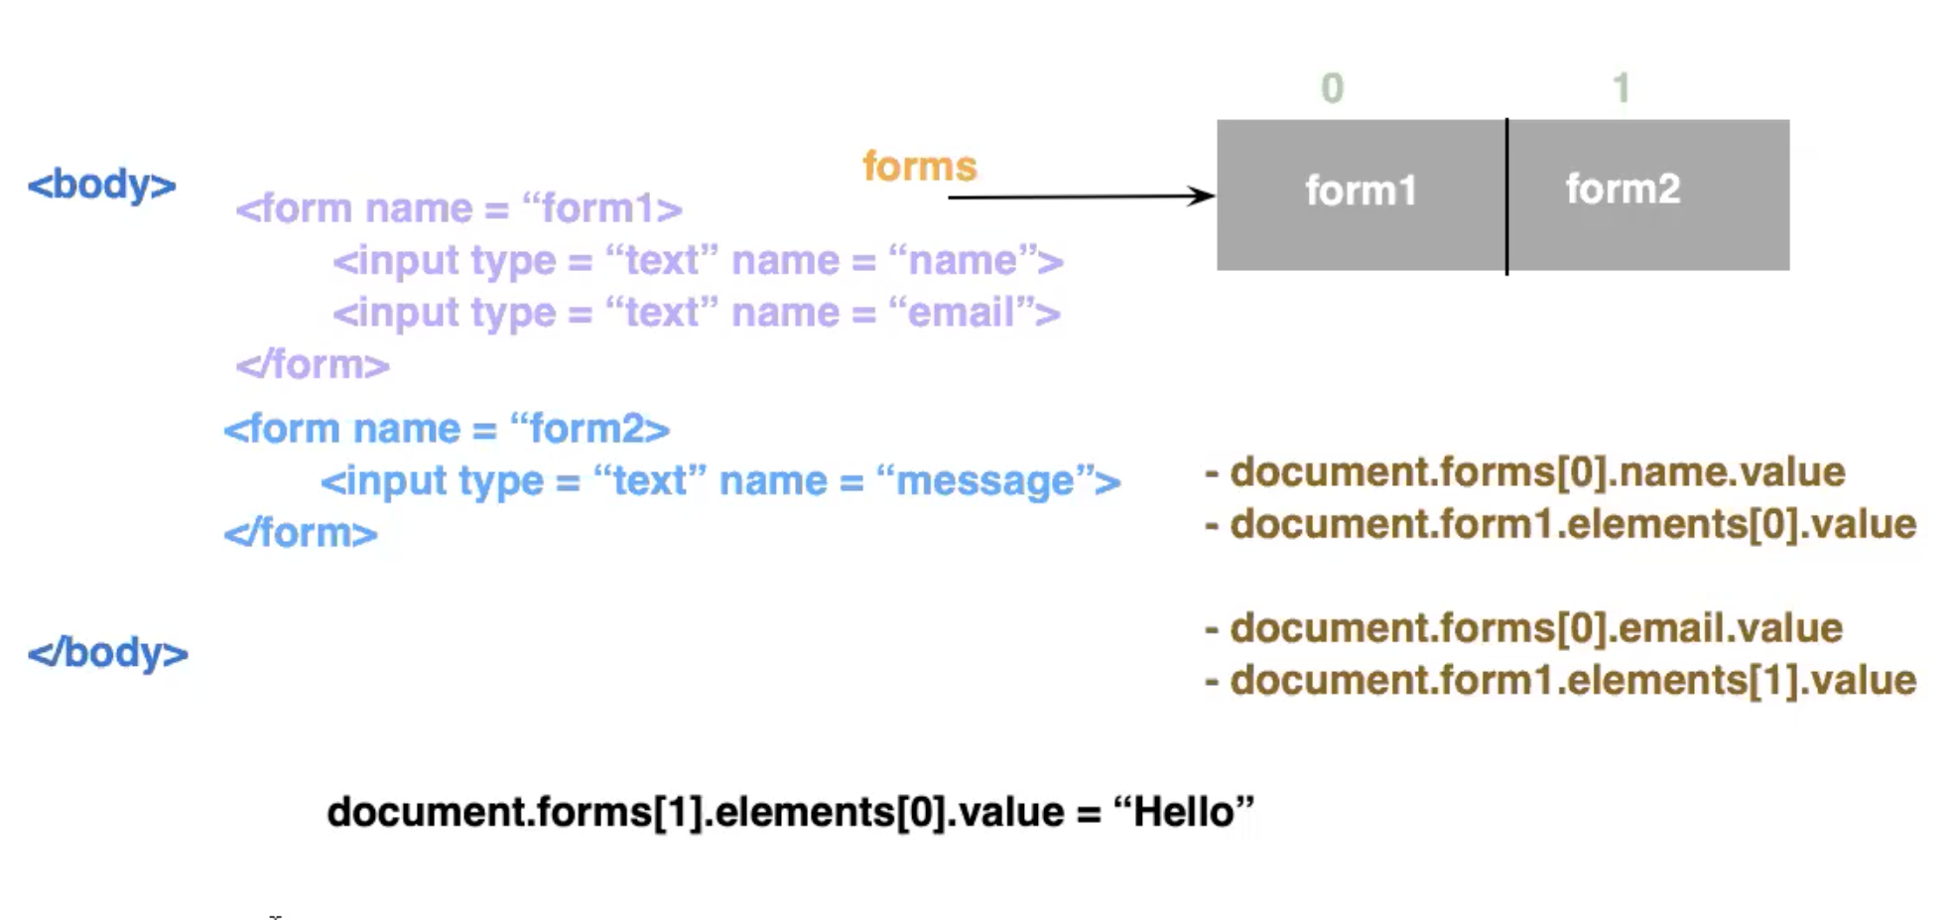
Accessing form elements

Slide 15
Setting form elements
For the previous form example, we can set the form elements as follows:
document.forms[0].name.value = “Alice”
or,
document.form1.elements[0].value = “Alice”
document.forms[0].email.value = Alice1@gmail.com
or,
document.form1.elements[1].value = Alice1@gmail.com
Hence, we can read and write form elements on a web page using JavaScript at run time.

Slide 16
Example:
form1.elements[3].value = form1.elements[2].value * 5
}
}
</script>
</head>
<body>
<form name = "form1">
Previous Reading <input type = "text" size = 30><br>
Current Reading <input type = "text" size = 30 onchange = "ver()"><br>
Usage <input type = "text" size = 30><br>
Billed amount <input type = "text" size = 30><br>
</form>
</body>
</html>
<html>
<head>
<title>History object</title>
<script>
function ver()
{
var cur, pre, ut, bill
cur = form1.elements[1].value
pre = form1.elements[0].value
if(cur<pre)
{
alert("Current reading cannot be less than previous reading")
}
else
{
form1.elements[2].value = cur - pre

Slide 17
Validating form data
We can also validate form data using JavaScript.
For example, we can check if a name field is non-empty, or an email id is valid in a form.

Slide 18
Summary
We discussed:
History object
Navigator object
Screen object
Form object

Slide 19
THANK YOU!
Questions?

