Slide 1

Passing variables between pages
CSCI – 4135 (Spring 2022)
Sujoy Chakraborty
Department of Computer Science Stockton University, NJ, USA

Slide 2
Outline
Super global variables
Passing form data
Passing data with sessions

Slide 3
Passing form data
Forms provide a mean of submitting information from the client to the server.
We can create HTML forms using <form> tag.
Method and action are the most common attributes of the <form> tag.

Slide 4
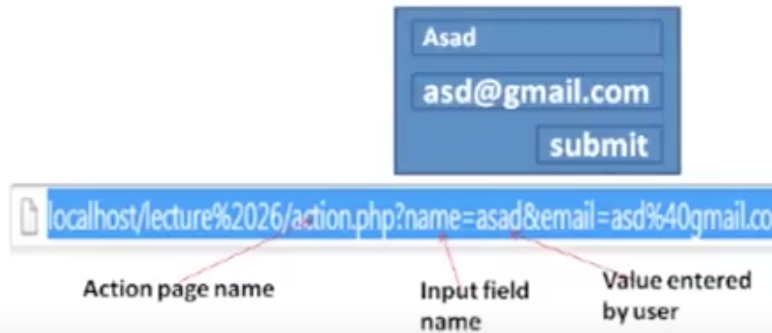
Passing form data – cont.
action: gives the URL of the application that is to receive and process the form’s data.
method: sets the HTTP method that the browser uses to send the form’s data to the server for processing.
- most common methods: GET and POST
GET: all form data is encoded into the URL, appended the action URL as query string parameters.

Slide 5
Passing form data – cont.
Post: form data appears within the message body of the HTTP request.
The data doesn’t appear on the address bar.
Provides better security because the data sent to the server is not visible on the address bar.

Slide 6
Super global variables
We have seen that variables declared in one web page are not accessible from other web pages.
Also, once the form data is submitted, it is no longer available in the web page where the form is defined.
PHP automatically makes few variables available to our program.
These are array variables and can be accessed by name.
These variables are called super-global variables because they can be accessed without regard to scope.

Slide 7
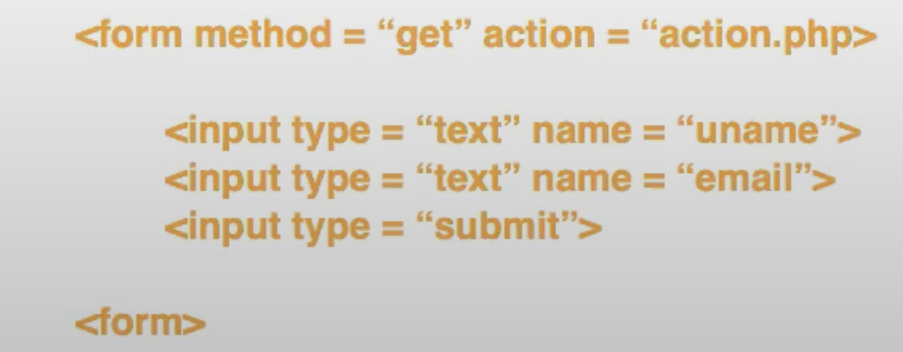
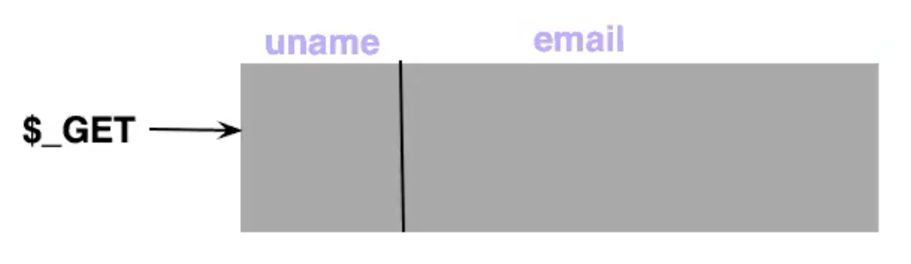
Super global variables – cont.
$_GET: contains all the query string variables that were attached to the URL.
$_POST: contains all the submitted form variables and their data.

Slide 8
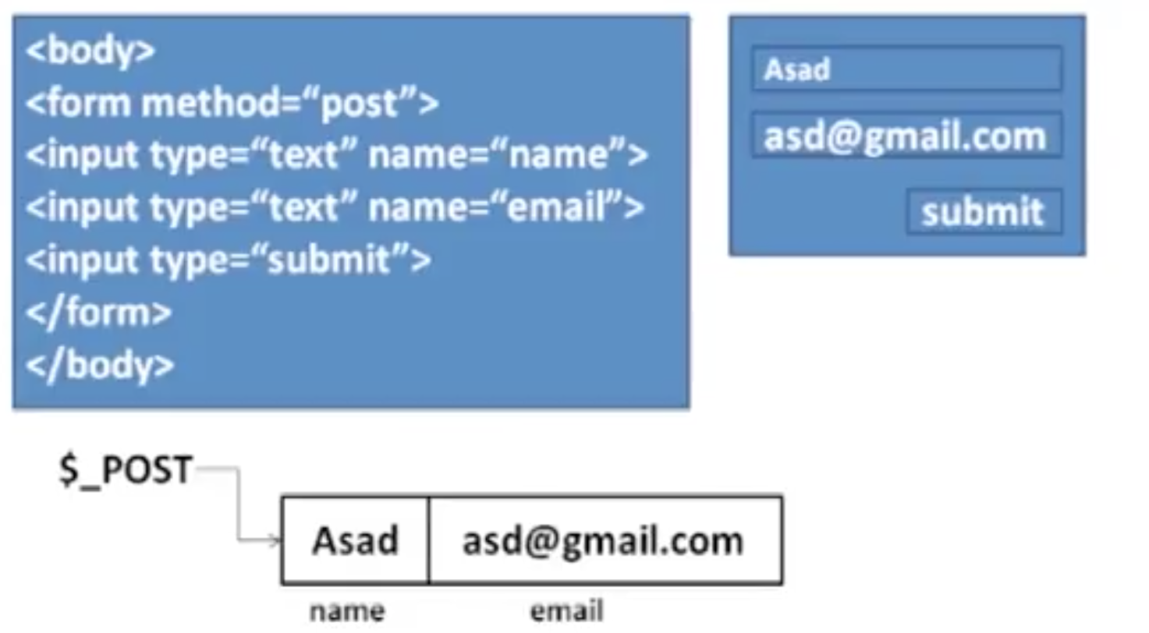
Super global variables – cont.

Slide 9
Accessing form data on action page
Action.php (GET method):
<?php
$name = $_GET[‘name’];
$email = $_GET[‘email’];
?>
Once we have access to the data, we can use it for further processing (for example, validating the data or storing into the database)

Slide 10
Accessing form data on action page
Action.php (POST method):
<?php
$name = $_POST[‘name’];
$email = $_POST[‘email’];
?>

Slide 11
Accessing data on actions page – cont..
<html>
<head>
<title>Transfer data</title>
</head>
<body>
<form id = 'form1' name = "form1" method = "post" action = "action.php">
Enter your name: <input type = "text" name = "name" value = "Your name" /><br>
<input type = "submit" />
</form>
</body>
<html>
<html>
<head>
<title>Actions</title>
</head>
<body>
<?php
$name = $_POST['name'];
echo "Welcome Mr. $name";
?>
</body>
<html>

Slide 12
Accessing data on actions page – cont..
<html>
<head>
<title>Transfer data</title>
</head>
<body>
<form id = 'form1' name = "form1" method = "post" action = "actions_2.php">
Enter your name: <input type = "text" name = "name" value = "Your name" /><br>
<input type = "hidden" name = "hname" value = "Alice" /><br>
<input type = "submit" />
</form>
</body>
<html>
<html>
<head>
<title>Hidden</title>
</head>
<body>
<?php
$name = $_POST['name'];
$hname = $_POST['hname'];
echo "Welcome Mr. $name<br>";
echo "Hidden name is: $hname";
?>
</body>
<html>

Slide 13
Accessing data on actions page – cont..
<html>
<head>
<title>Transfer data</title>
</head>
<body>
<form id = 'form1' name = "form1" method = "post" action = "actions_3.php">
Enter your name: <input type = "text" name = "name" value = "Your name" /><br>
<input type = "hidden" name = "hname" value = "Alice" /><br>
Which of the following languages do you know?<br/>
<input type = "checkbox" name = "C" value = "C++" />C++
<input type = "checkbox" name = "VB" />VB
<input type = "submit" />
</form>
</body>
<html>
<?php
$name = $_POST['name'];
$hname = $_POST['hname'];
echo "Welcome Mr. $name<br>";
echo "Hidden name is: $hname";
echo "<br>";
echo $_POST['C'];
echo "<br>";
echo $_POST['VB'];
echo "<br>";
if($_POST['C'] == 'C++')
echo "You know C++";
else
echo "You don't know C++";
?>

Slide 14
Accessing data on actions page – cont..
<?php
$name = $_POST['name'];
$hname = $_POST['hname'];
echo "Welcome Mr. $name<br>";
echo "Hidden name is: $hname";
echo "<br>";
echo $_POST['C'];
echo "<br>";
echo $_POST['VB'];
echo "<br>";
if($_POST['C'] == 'C++')
echo "You know C++";
else
echo "You don't know C++";
echo "<br>";
echo $_POST['nat'];
?>
<html>
<head>
<title>Transfer data</title>
</head>
<body>
<form id = 'form1' name = "form1" method = "post" action = "actions_4.php">
Enter your name: <input type = "text" name = "name" value = "Your name" /><br>
<input type = "hidden" name = "hname" value = "Alice" /><br>
Which of the following languages do you know?<br/>
<input type = "checkbox" name = "C" value = "C++" />C++
<input type = "checkbox" name = "VB" />VB
Your Nationality: <br />
<input type = "radio" name = "nat" value = "single" />Single
<input type = "radio" name = "nat" />Dual
<br/>
<input type = "submit" />
</form>
</body>
<html>

Slide 15
Accessing data on actions page – cont..
<?php
$name = $_POST['name'];
$hname = $_POST['hname'];
echo "Welcome Mr. $name<br>";
echo "Hidden name is: $hname";
echo "<br>";
echo $_POST['C'];
echo "<br>";
echo $_POST['VB'];
echo "<br>";
if($_POST['C'] == 'C++')
echo "You know C++";
else
echo "You don't know C++";
echo "<br>";
echo $_POST['nat'];
echo "<br>";
echo $_POST['dom'];
?>
<form id = 'form1' name = "form1" method = "post" action = "actions_5.php">
Enter your name: <input type = "text" name = "name" value = "Your name" /><br>
<input type = "hidden" name = "hname" value = "Alice" /><br>
Which of the following languages do you know?<br/>
<input type = "checkbox" name = "C" value = "C++" />C++
<input type = "checkbox" name = "VB" />VB
Your Nationality: <br />
<input type = "radio" name = "nat" value = "single" />Single
<input type = "radio" name = "nat" />Dual
<br>
You are a resident of: <br />
<select name = "dom">
<option value = "New York">New York</option>
<option value = "New Jersey">New Jersey</option>
<option value = "Oregon">Oregon</option>
<option value = "California">California</option>
<br/>
<input type = "submit" />
</form>

Slide 16
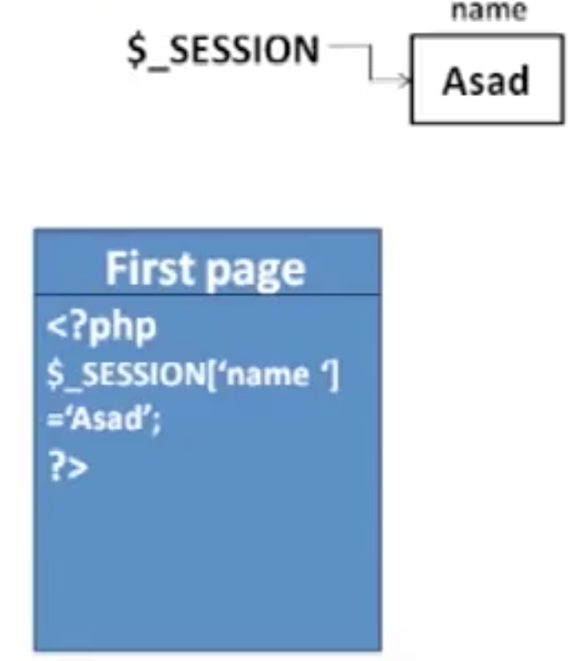
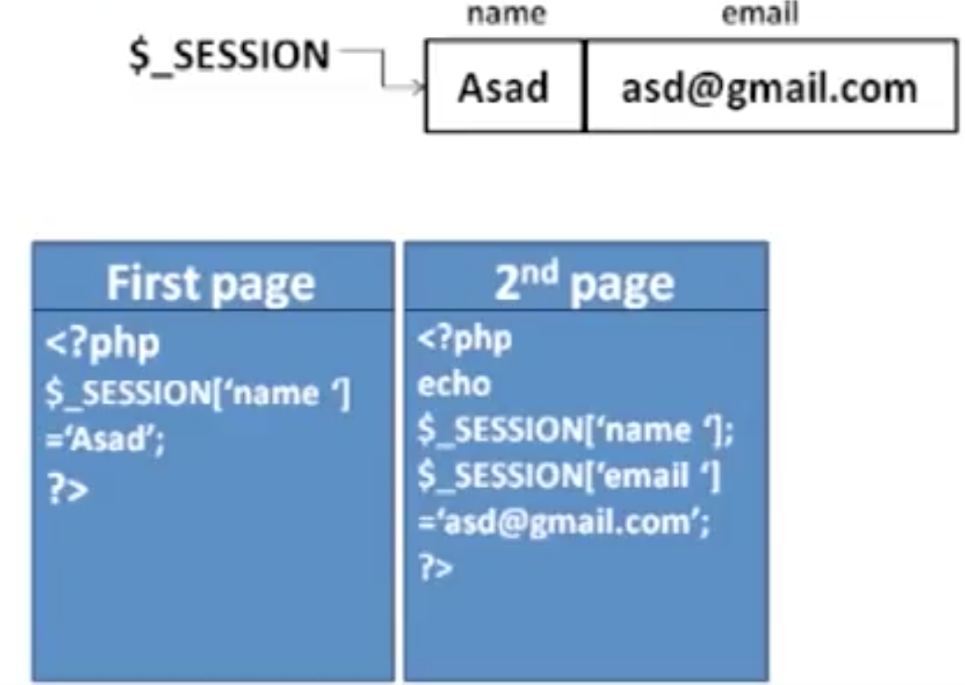
Passing variables using sessions
A session is basically a temporary set of variables that exists only until the browser shuts down.
$_SESSION: represents data available to a PHP script that has previously been stored in a session.
Example:

Slide 17
Passing variables using sessions – cont.
session_start(): used to start a session
$_SESSION[‘variable-name’]: used to store data in session variable
session_destroy(): used to destroy a session (for example, when the user chooses to ‘signout’, all the data related to the user in that session is destroyed.)
unset($_SESSION[‘variable-name’]): used to delete a specific variable (some session variable might be needed until a specific web page in the sequence of processing, after which they may be removed)

Slide 18
Passing variables using sessions – cont.
<html>
<?php
session_start();
?>
<head>
<title>Getting sessions</title>
</head>
<body>
<?php
echo "The value received from session variable is: ". $_SESSION['name'];
?>
<h1>This is the second page</h1>
<a href = "session_3.php">Go to the third page</a>
</body>
<html>
<html>
<?php
session_start();
?>
<head>
<title>Using sessions</title>
</head>
<body>
<?php
$_SESSION['name'] = 'Alice';
?>
<h1>Welcome to the first page</h1>
<a href = "session_2.php">Go to next page</a>
</body>
<html>

Slide 19
Passing variables using sessions – cont.
<html>
<?php
session_start();
unset($_SESSION['name']);
?>
<head>
<title>Destroying session</title>
</head>
<body>
<?php
echo $_SESSION['name'];
?>
</body>
<html>

Slide 20
References
Chapter 2, “Beginning , Apache, MySql web development”, Wrox publication.
Chapter 13, “Beginning PHP and MySQL”, by Gilmore.

Slide 21
Summary
We discussed:
Super global variables
Passing data with forms
Using session variables

Slide 22
THANK YOU!
Questions?

