Slide 1
CSCI – 4135: Spring 2022
Web Application Engineering
Instructor: Sujoy Chakraborty
Lecture Slides – 3

Slide 2
Outline
Web Project management
Tasks and responsibilities involved in project management
Traditional vs. web project management

Slide 3
Web Project management
Project management is the process of planning, organizing, motivating and controlling resources and procedures to develop a software/web project.
It is an essential part of software/web engineering.
Projects need to be managed to:
- ensure budget and time constraints

Slide 4
Project management – responsibilities involved
To ensure:
- project meets budget and time constraints
- high quality product is delivered
To closely monitor the progress of the project to ensure that it is progressing as per the plan, to identify potentials issues and resolve them.
Good management does not guarantee success of the project.
But, bad management usually results in project failure:
- schedule delays
- budget overrun
- not meeting customer’s requirements/low customer’s acceptance

Slide 5
Goals of project management
To deliver the application on time
Meet budget constraints
Fulfill customer’s expectations
Maintain a happy and well-functioning team

Slide 6
Tasks involved in project management
Project planning
Risk management
People management
Reporting
Proposal writing

Slide 7
Tasks involved – cont.
Project planning: The task of project planning entails:
Cost estimation: what resources are needed and what would be the total cost to execute the project.
Project scheduling: analyzing the requirements and preparing a realistic schedule
Resource allocation: what resources are needed for what functions
Monitoring:
- work is carried out according to standards
- progress is according to budget and schedule

Slide 8
Tasks involved – cont.
Project planning at different stages:
At proposal stage:
- are resources available to complete the project
- what price to ask for (effort, s/w, h/w, travelling etc.). Price should be competitive so that the project can be won beating other competitors in the market.
At startup stage:
- who will work (selection is typically based on matching skills required for the project)
- decide about the increments and allocate resources accordingly
- refine estimates as more information is available
During development stage:
- when project plan needs to be changed (due to the change of requirements from the user)
- can make more accurate estimates about time and cost

Slide 9
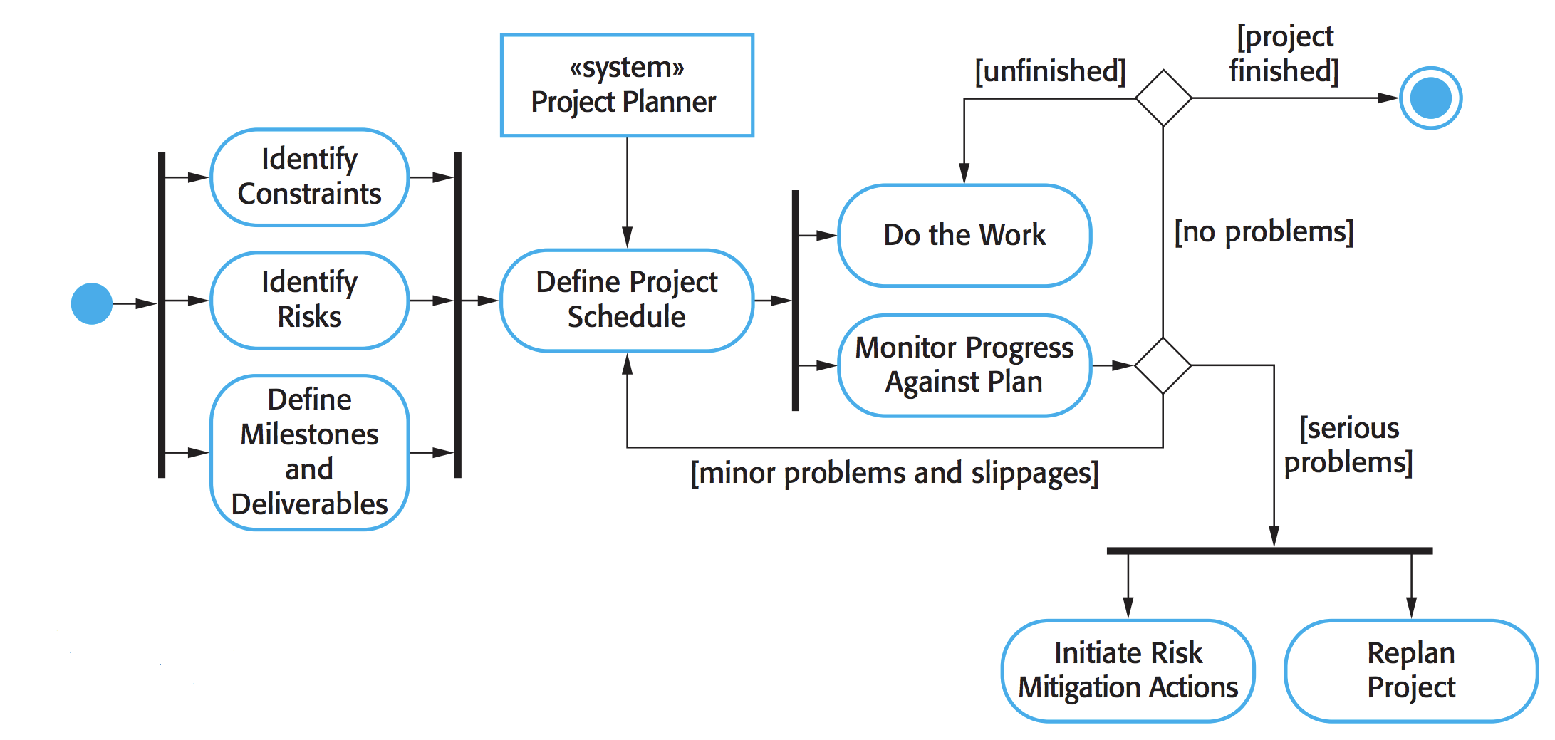
Tasks involved – cont.
Source: “Software Engineering” by Sommerville

Slide 10
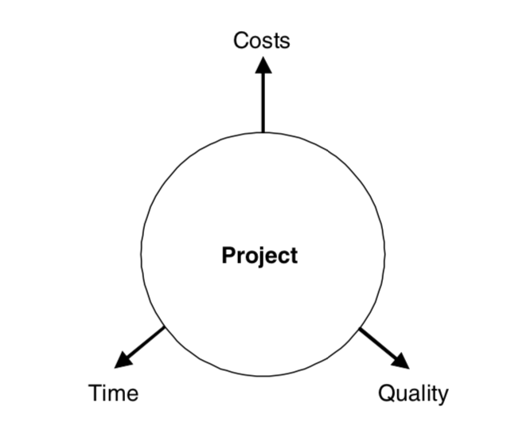
Tasks involved – cont.
Conflicting areas:
- Project requires to have a good balance between budget, time and quality (change in one can influence others)
- Changing one factor is certainly going to influence the other(s).

Slide 11
Tasks involved – cont.
Risk management:
Project managers are responsible for:
- anticipation of risks (potential factors which can affect schedule or quality)
- taking actions to avoid these risks
Risk categories:
- Project risks: affect the project schedule or resources (e.g, an experienced developer leaves the job)
- Product risks: affect the quality and performance of the product (e.g., a purchased component does not work as expected)
- Business risks: affect the organization developing or procuring the product (e.g., a competitor introduced a new product)

Slide 12
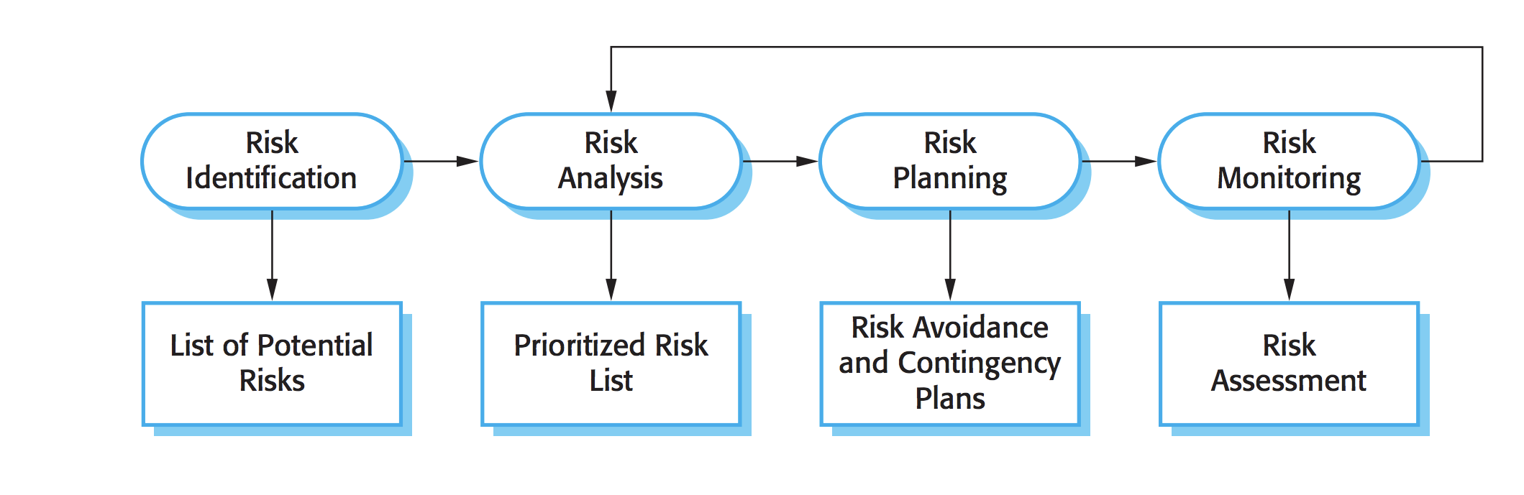
Tasks involved – cont.
An outline of Risk Management process:
Source: “Software Engineering” by Sommerville

Slide 13
Tasks involved – cont.
People management:
Project managers are responsible for
- choosing people
- establishing ways of working (or rules), to ensure that the team can work in its true potential
Characteristics of web development team:
- Multidisciplinary: experts from diverse fields are needed (e.g, content write, web developer, designer etc.)
- Parallelism: parallel work on large task
- Small size: due to budget constraints/short development cycles
Project managers are responsible for resolving conflicts that may arise between team members working as a group:
- must be resolved early to meet time constraints
Due to short development time, even sub-optimal solutions are acceptable sometimes.

Slide 14
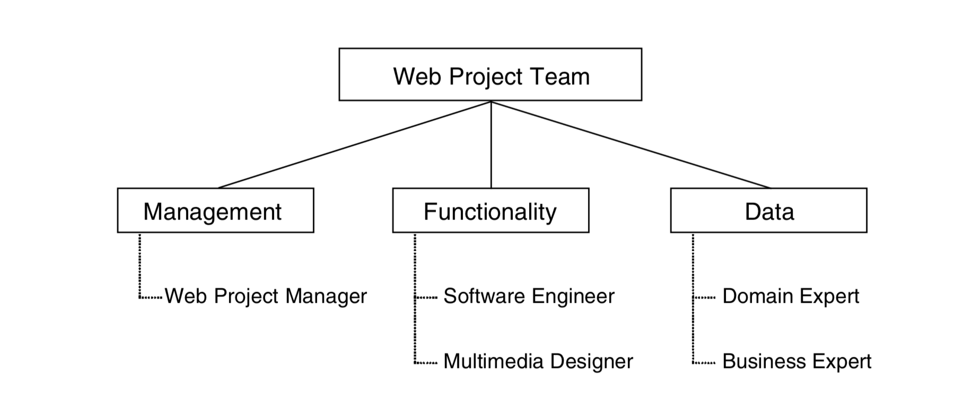
Tasks involved – cont.
Web team composition:
Role
People
Source: “Web Engineering” - Kappel et al.

Slide 15
Tasks involved – cont.
Reporting
Project managers are responsible for reporting
- on progress of a project to customers and managers of the company
Proposal writing:
- Writes a proposal for the organization to win a project
- a very critical task for the manager as well as the organization (there are many competitors in the market)
- Needs to specify the basic objectives of the product, initial estimates of cost and schedule for the project in the proposal.

Slide 16
Golden rules for Web Project Management
Take care of ethics in the team
Stress the importance of different application knowledge for the project:
- Team members are needed to be motivated to learn new technologies for better development of the application.
Solve conflicts quickly (development time is limited for web applications)
- Make sure no team member is a winner or loser all the time
Explain to each team member his or her roles and responsibilities continuously
Identify parallel developments (due to short development times and budget constraints for development of web applications, it is very essential)
Distribute documentation tasks to team members fairly according to their scope.
Promote and coordinate the continuous use of tools from the very beginning of the project.
Translate costs and values into different project areas.
Promote the continuous involvement of customers in the project.
Always keep an eye on the project progress and project objectives.

Slide 17
Traditional vs web project management
Main objective:
- Create a quality product at lowest possible cost (Traditional).
- Create a usable product in shortest possible time (Web).
Project size:
- Medium to large (10 to 100 people or more)
- Usually small (6 +/- 3 people). But conflicts often arise between people coming from different disciplines.
Duration:
- 12 to 18 months
- 3 to 6 months on average (decisions are needed to be taken promptly by a project manager due to meeting time constraints, parallelism needs to be identified, sometimes sub-optimal solutions are adapted)
Cost:
- several million dollars
- several thousand dollars
Development approach:
- based on requirements, structured into phases, incremental, document-driven.
- Agile methods (involves minimum documentation, focus is on quickly developing the product)

Slide 18
Traditional vs web project management – cont.
Technologies:
- OO methods are typically used.
- web technologies are used.
Product:
- Code-based, poor reusability, complex applications
- High reusability, standard components, many standard applications
Staff profile:
- Professional software developers with several years of experience
- Multimedia designers, web programmers, PR/marketing people

Slide 19
Summary
Project Management
Responsibilities/tasks involved in Project Management
- Planning
- Risk Management
- People Management
- Reporting
- Proposal Writing
Traditional vs. Web Engineering

Slide 20
References
Chapter 9, Kappel G, Proll B, Reich S & Retschitzegger W. Web Engineering, John Wiley & Sons.
Chapter 22, Sommerville, Software Engineering, PEARSON.

