Slide 1
CSCI – 4135: Spring 2022
Web Application Engineering
Instructor: Sujoy Chakraborty
Lecture Slides – 4

Slide 2
Outline
Introduction to Requirement Engineering
RE basics
Requirement specifications
RE process
RE specifics in web engineering

Slide 3
Requirement Engineering
The first task in the development of any software or web application is to identify and clearly define its functionalities.
Requirement Engineering: the principles, methods and tools for drawing, describing, validating and managing project goals and needs.
Given the complexity of web applications, RE is a critical initial stage activity, but often poorly executed.
Costs:
- Inadequate software architectures
- “Unforeseen” problems (budget overrun, production delays)
- Low user acceptance

Slide 4
Why Requirement Engineering
Requirements don’t define themselves (Bell & Thayer, 1976).
Removal of mistakes post hoc is up to 200 times more costly (Boehm, 1981).
Iterative collection and refinement is the most important function of a software engineer (Brooks, 1987).
A study based on 340 companies in Austria, more than two-thirds consider the SRS (Software Requirement Specification) as the major problem in development process (1995).
A study on web applications, 16% systems fully meet their requirements while 53% deployed systems do not (Cutter Consortium, 2000).
A study among 8000 projects, 30% of projects fail before completion & almost half do not meet customer requirements (Standish group, 1994):
- Unclear objectives, unrealistic schedules & expectations, poor user participation

Slide 5
Requirement Engineering basics
Identify and involve stakeholders
- those that directly influence the requirements (e.g., client, users, developers etc.)
What are their expectations?
- may be misaligned or in conflict (e.g., client wants to use a tool, which the developers do not want to use in the development, or they are not familiar to the tool.)
- may be too narrowly focused or unrealistic (e.g., client asks for a delivery within a week, where the functionality to be implemented demands more time)

Slide 6
Requirement Engineering basics – cont.
What are requirements?
The description of what the system should do
- services that it provides and the constraints on its operation (e.g., user registration is a functionality/service and the fact that user data should be securely stored in a Database, is a constraint on that functionality)
IEEE 601.12 definition of requirements:
- 1) Solves a user’s problem
- 2) Must be met or possessed by the system to satisfy a formal agreement
- Documented representation of conditions in 1 and 2.

Slide 7
Requirement Engineering basics – cont.
Requirement types:
Functional requirements
- statement of services
- how system reacts to input
- how system behaves in a particular situation
Non-functional requirements:
- constraints on services (timing, quality etc.)
- applies as a whole
Requirements are collected iteratively and change.
Keys to requirement definition:
- Negotiation
- Scenario-based discovery (clients often can not specify requirements clearly)
- clear definition of context and constraints

Slide 8
Requirement specifications
Process of writing down the user and system requirements in a requirements document.
User requirements (for users):
- should be understandable to users
- avoid notations, use simple tables, forms etc.
System requirements (for Software Engineers):
- staring point for the system design
- explains how system provides the services
Writing requirement specifications:
Natural language specification (stories or itemized requirements):
- create a standard format
- distinguish between mandatory and desirable requirements
- don’t use the technical words
- associate rationale with each requirement

Slide 9
Requirement specifications – cont.
Structured specification (is required for engineers to design and develop the system):
- Includes:
a. description
b. inputs/outputs
c. description of the action
d. pre condition
e. post condition

Slide 10
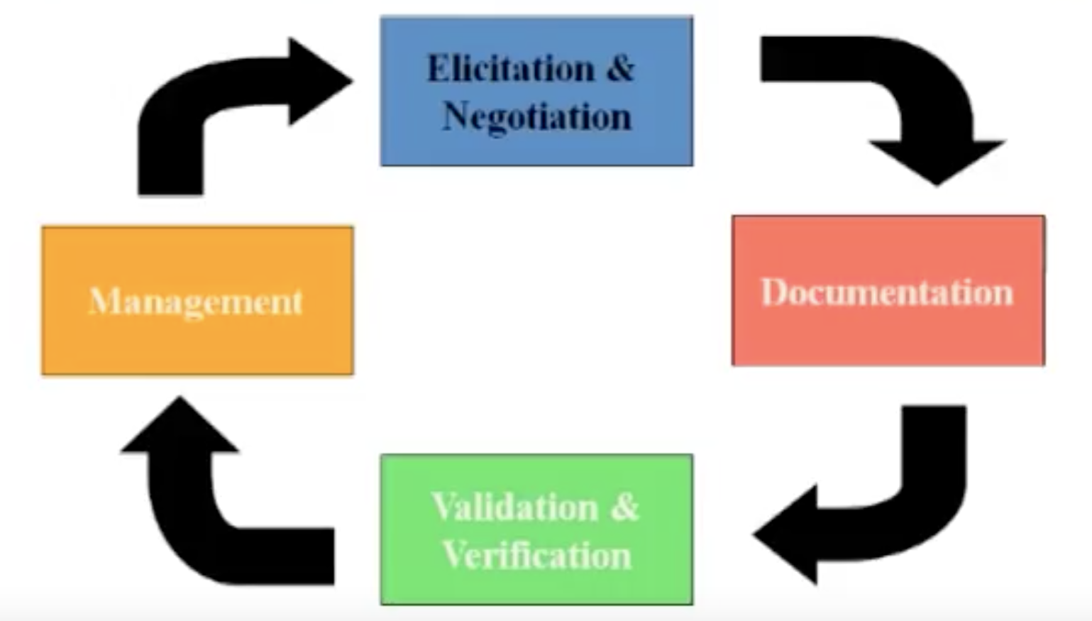
Requirement Engineering process

Slide 11
Requirement Engineering process – cont.
Elicitation and negotiation:
RE engineer involves the stakeholders to define
- application domain
- services
- constraints
Steps:
- Requirement discovery (interviews, scenarios, questionnaires, use cases etc.)
- classification and organization
- prioritization and negotiation

Slide 12
Requirement Engineering process – cont.
Documentation:
Requirements are documented after consensus (through natural language specification or structured specification)
Requirement verification and validation:
Validation: doing right things?
Verification: doing things right?
Requirements management:
Understanding and controlling changes
- problem analysis and change specification
- change analysis and costing
- change implementation

Slide 13
RE specifics in Web Application Engineering
Distinguishing characteristics
Multidisciplinary:
- experts from different disciplines, i.e., media experts, content experts, usability experts (to make the application easy to use) etc.
- challenging to achieve consensus
Unavailability of stakeholders:
- Many stakeholders such as users are unknown during RE process
- Need to find suitable representatives
Rapidly changing requirements and constraints
- Environment is highly dynamic
- Harder to stabilize requirements
Unpredictable operational environment
- Impossible to control the operational environment
- Affects the quality requirements
Legacy systems:
- constrained by existing system
- existing components drive the possibilities

Slide 14
RE specifics in Web Application Engineering – cont.
Quality aspects:
- are decisive, i.e., performance, security, availability
- harder to get exact specification
User interface:
- key component for success of the application (should be simple and user friendly)
- should be aware of IKIWISI (I know it when I see it!). Content on the web application should be self-explanatory.
Quality of content:
- accuracy, objectivity, credibility, relevance, actuality, completeness or clarity

Slide 15
RE principles for web engineering
Understanding the system context:
- Web applications are always a component of a larger entity.
- Why do we need the system?
- how will people use it?
Involving the stakeholders:
- get all groups involved
- balance – one group’s gain should not come at the expense of another
Iteratively define requirements
- requirements need to be consistent with other system aspects (UI, content, test cases)
- start with key requirements at a high level; basis for:
a. feasible architectures
b. key system use cases
c. initial plans for the project

Slide 16
Risk Orientation
Risk management is at the heart of the analysis process
What are the greatest risks for web application development?
- integration issues/legacy systems
- expected vs actual system quality
How to mitigate risks
- prototyping (validate requirements from the user with small prototypes)
- show changes to customer iteratively
- integrate existing systems sooner than later (i.e., at the early stage of the development)

Slide 17
Summary
Introduction to Requirement Engineering
RE basics
Requirement specifications
RE process
RE specifics in web engineering

Slide 18
References
Chapter 2, Kappel G, Proll B, Reich S & Retschitzegger W. Web Engineering, John Wiley & Sons.
Chapter 4, Sommerville, Software Engineering, PEARSON.

