Slide 1
CSCI – 4135: Spring 2022
Web Application Engineering
Instructor: Sujoy Chakraborty
Lecture Slides – 5

Slide 2
Outline
System modeling – why important
UML and UWE
Requirement Modeling
- Use case diagram
- Activity diagram

Slide 3
System modeling
Models are required to simplify the structural complexity of a web application.
It becomes easier for developers to understand the application structure looking at the model, before starting the development.
System modeling: Process of developing abstract models of a system.
Representing systems using graphical notations
- UML (a famous tool for system modeling)
Each model presents a different view or perspective of the system.
- External perspective: System context and environment (define system boundaries and functionalities involving key stakeholders of the system)
- Interaction perspective: How system is supposed to interact with the environment (user interactions with the system)
- Structural perspective: How the system is organized (components of the system and their relationships are identified)
- Behavioral perspective: Dynamic behavior of the system

Slide 4
System modeling – cont.
Models are used during different phases of the development process:
RE phase to derive system requirements
- use-case diagram, activity diagram
Design phase to describe the system to engineers
- class diagrams, sequence diagrams etc.
After implementation
- to document system’s structure and operation

Slide 5
Why system modeling
Provides graphical representations of various perspectives of the system for better understanding of the structure, functionality and the components of the system.
Reduce complexity (complex structure of the system is simplified through modeling for better understanding of the developers)
Document design decisions
Facilitate communication among team members

Slide 6
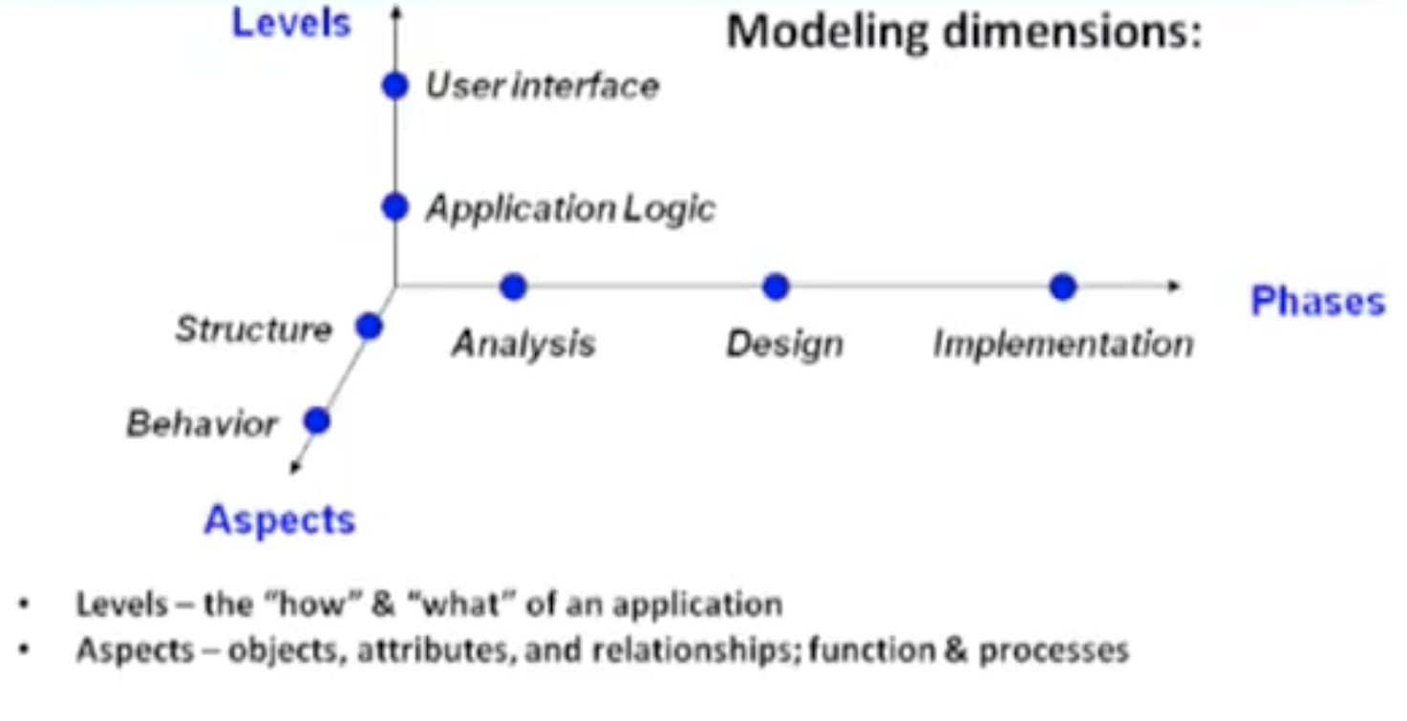
Modeling dimensions (conventional desktop applications)

Slide 7
Unified Modeling Language
The Unified Modeling Language is a visual language for specifying and documenting the artifacts of the systems.
Structural – Class diagrams
Behavioral – Use Case diagrams, State Machine diagrams

Slide 8
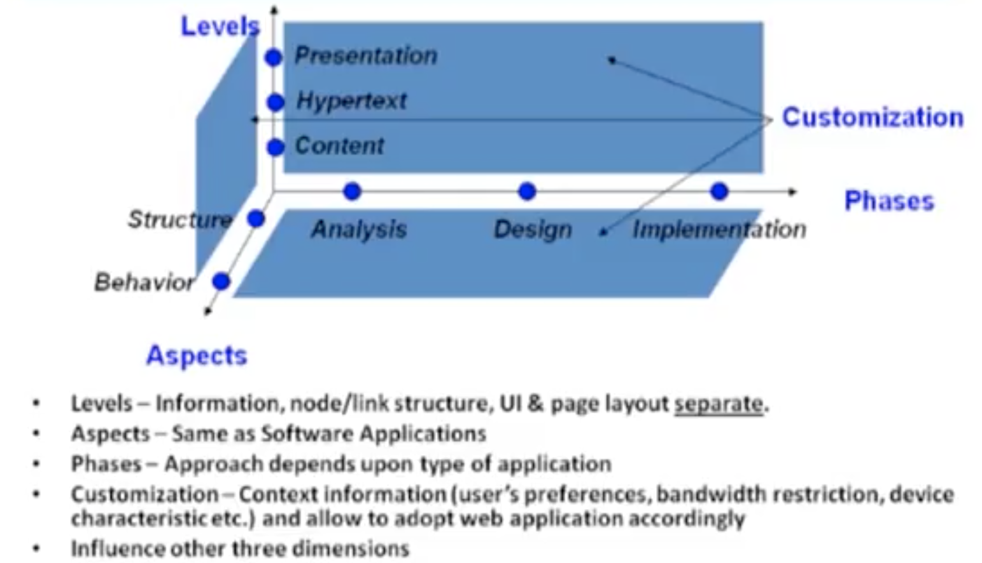
Modeling dimensions (Web applications)

Slide 9
Modeling dimensions for web applications – cont.
Requirement modeling:
Use-case diagram
Activity diagram
Content modeling
Class diagrams
State Machine diagrams
Navigational modeling
To model nodes and navigational structure among them.
Presentation modeling
To model the layout/interface of the web page

Slide 10
UML-based Web Engineering (UWE)
For web-centric modeling, UML is used with some extensions from UWE (UML-based web engineering)

Slide 11
Requirement Modeling
Use-case diagram:
The goal of the diagram is to provide a high-level explanation of the relationship between the system and the outside world (set goals).
Identifies the different users of the application and the functionalities they are expected to perform with the application.
Activity diagram:
A graphical representation of workflows of stepwise activities and actions with support for choice, iteration and concurrency.
To explain in detail (step-by-step) the various activities performed by a user, i.e., the detailed steps involved in a specific activity performed by a user of the application.
Provides a detailed view of a use case.

Slide 12
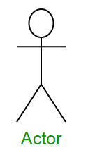
Use-case diagram
Components
The system:
The use case represents a feature/functionality needed in an application:
The actors who trigger the use case to activate:
The communication line to show how the actors communicate with the use case (connects the users with use cases):
System Name
Use-case title
<<actor>> System Name

Slide 13



Use-case diagram – cont.
The include relationship represents the inclusion of the functionality of one use case within another (e.g., the function of the use case login is included in the use-case view email).
<<include>>
The extend relationship represents the extension of the use case to include optional functionality
<<extend>>
A use-case-generalization is a relationship from a child use case to a parent use case, specifying how a child can specialize all behaviors and characteristics described for the parent.
include use-case
base use-case
Base use-case
Extending use-case
Generalized
Specialized
User
Registered user

Slide 14
Use-case diagram – cont.
Web-specific requirements:
Need to distinguish between functional and navigational use-cases
- UWE provides <<browsing>> to represent a navigational use-case and <<processing>> to represent a functional use-case.
Example: An online video sharing system:
- User can search and view the videos
- A user must be a registered user to share videos

Slide 15
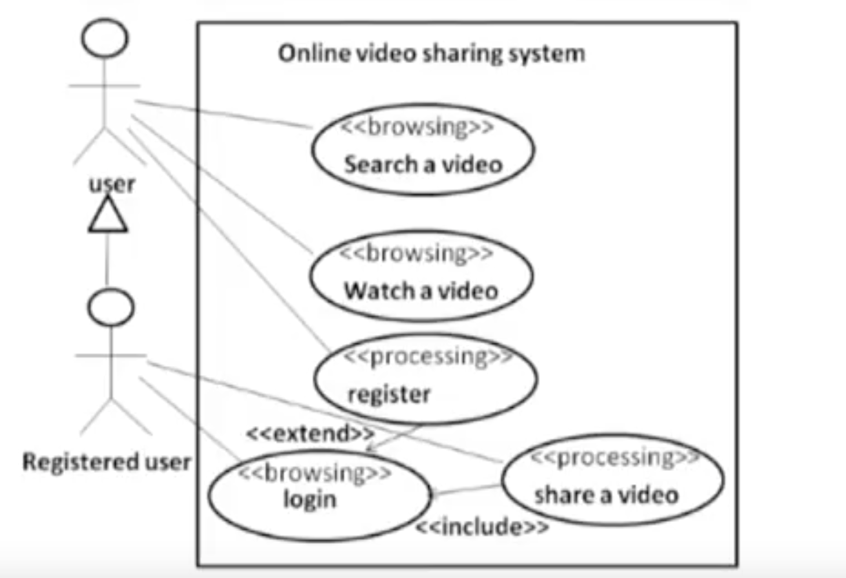
Use-case diagram – cont.

Slide 16
Activity diagram
Elements of an activity diagram:
An activity is a step in a process where some work is getting done
The transition takes place because the activity is completed
activity
Read a page
Turn the page

Slide 17
Activity diagram – cont.
Elements of an activity diagram:
A guard condition can be assigned to a transition to restrict the transition (to make it conditional)
[get driving license]
Decisions:
Learn driving
Drive the car

Slide 18

Activity diagram – cont.
Merge points:
Start and end:

Slide 19
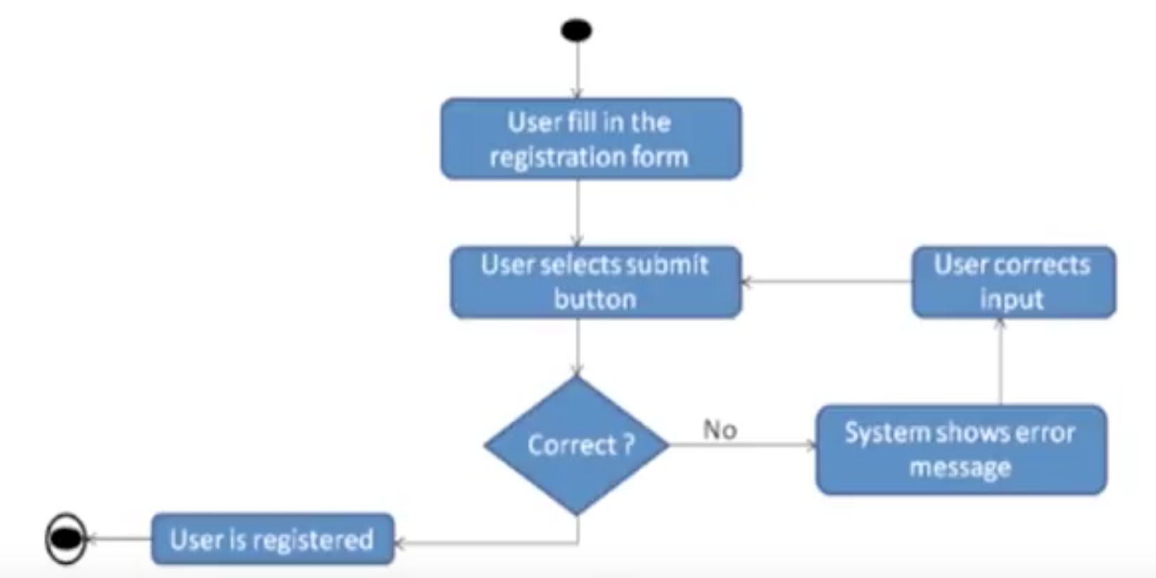
Activity diagram - Example
Let us consider the use case of registration of a user on the online video sharing system:

Slide 20






UWE activity diagram elements
userAction : user’s action or response
systemAction : system’s action
displayAction : display action (web page is displaying some element)
navigationAction : navigation (when user performs some navigation)
displayPin : output
interactionPin : input

Slide 21
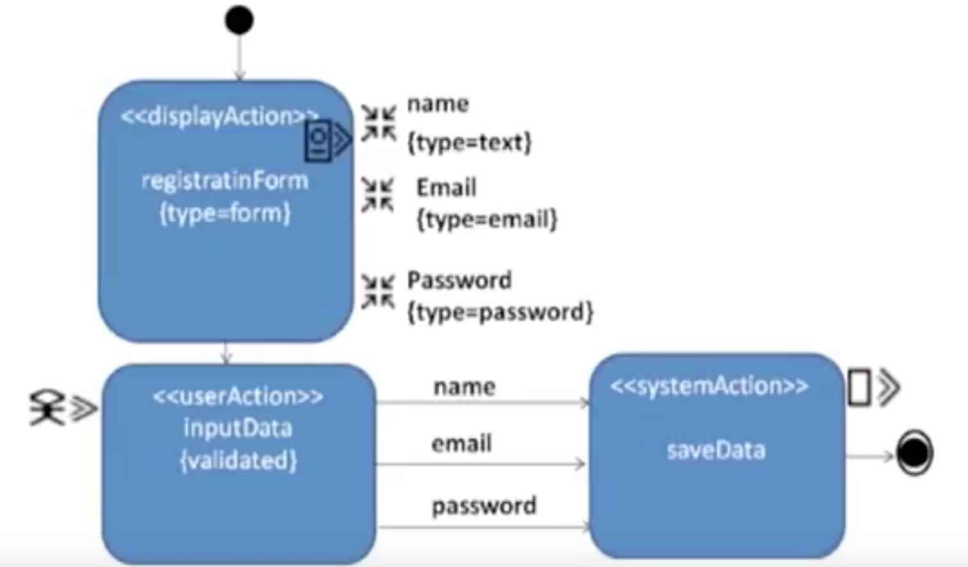
Activity diagram - Example
Drawing the activity diagram of the same use case with UWE notations:

Slide 22
Summary
System modeling
Modeling requirement
- use-case diagram
- activity diagram

Slide 23
References
Chapter 3, Kappel G, Proll B, Reich S & Retschitzegger W. Web Engineering, John Wiley & Sons.
Chapter 5, Sommerville, Software Engineering, PEARSON.

