Slide 1
CSIS – 4135: Spring 2022
Web Application Engineering
Instructor: Sujoy Chakraborty
Lecture Slides – 6

Slide 2
Outline
Content modeling
Navigation modeling
Presentation modeling

Slide 3
Content modeling
The information provided by a web application is one of the most important factors for its success.
Content modeling aims at modeling the information requirements of a web application.
- diagraming the structural and behavioral aspects of the information
- ignores the navigational information
Key models:
- Class diagram: to model structural aspects of information
- State machine diagram: to model behavioral aspects of information

Slide 4
Class diagram
Class diagram describes the structure of a system by:
System’s classes
Class attributes
Operations(methods)
Relationship among objects

Slide 5
Class diagram: cont.
Elements of a class diagram:
Class: Represented by a rectangle with three compartments
- name
- attributes
- methods users
Class name +name: String
Attributes +email: String
Methods +password: String
Adding attributes: methods
an attribute describes a piece of information that an object owns
and specified by:
- name
- kind (data type)
- visibility (+, -, #)
- default value
- syntax: visibility name: type = default value (e.g., +name:string = ‘Alice’ {max 10 chars})

Slide 6
Class diagram – cont.
Adding methods (functions): users
behaviors (things objects can do or can be done with them)
- name attributes
- arguments
- visibility (+, -, #) -register(name:string,
- return value e:string,pwd:string):bool
- Syntax: visibility name (argument_name:type): return_value
e.g., +userLogin(email:string, password:string):null

Slide 7
Class diagram – cont.
Association:
Relationship between classes
- name of relationship
- direction of relationship
owns
Association multiplicity
How many objects participating in the relation
1..1 owns 0..*
Aggregation relation
Class has features of another class plus some own features
0..1 11..11
person
car
person
car
Team
Player

Slide 8
Class diagram – cont.
Composition relation
Child class cannot exist if parent class doesn’t exist
1..1 1..*
Book
Chapter

Slide 9
Class diagram – example (online video sharing system)
-name: string
-email: string
- password: string
- introduction: string
users
1…1
videoSharing
0…*
1…1
- register
- login
0…*
uploads
user
0…*
Registered
user
- vID: int
- vTitle: string
- vDesc: string
video
0…*
+upload
+login

Slide 10
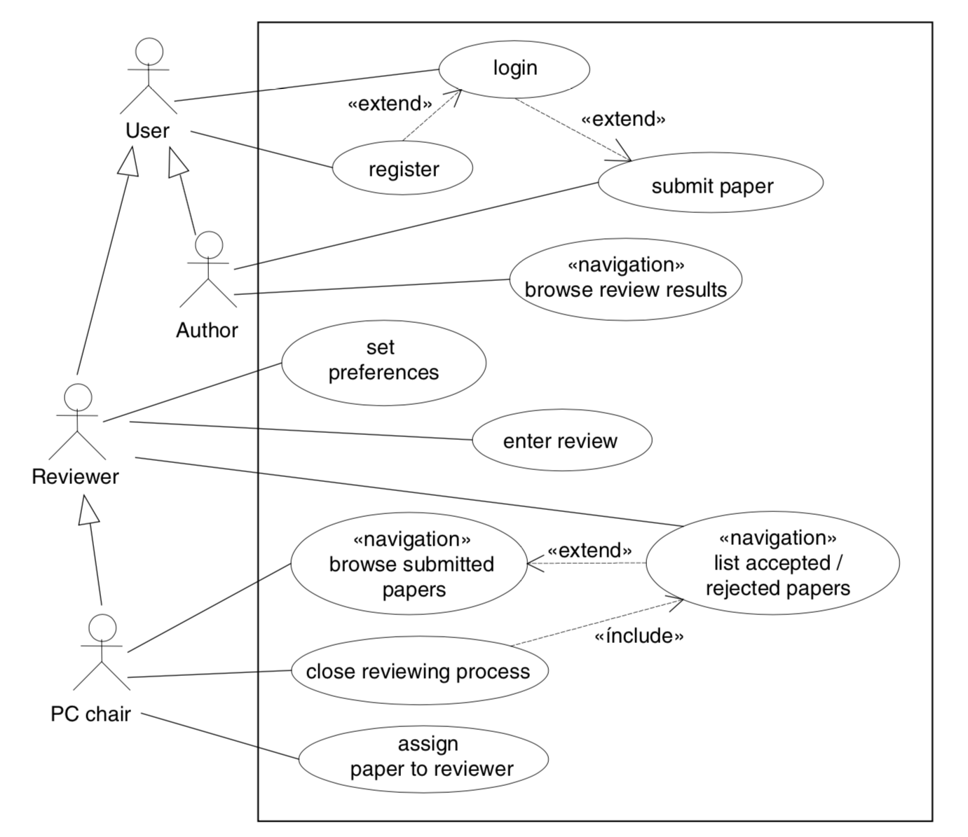
Case Study – (Conference Paper Reviewing System):Use case diagram

Slide 11
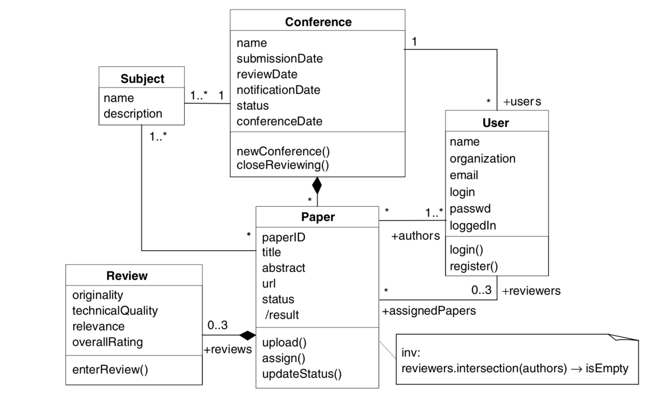
Case Study – (Conference Paper Reviewing System):Class diagram

Slide 12
State machine diagram
For dynamic web applications, they depict important states and events of objects and how objects behave in response to an event (transitions)
Shows the life-cycle of an object
Used only for state-dependent objects
For example, for a Conference paper submission system, a paper can have several states (submitted, under review, accepted, rejected etc.)

Slide 13
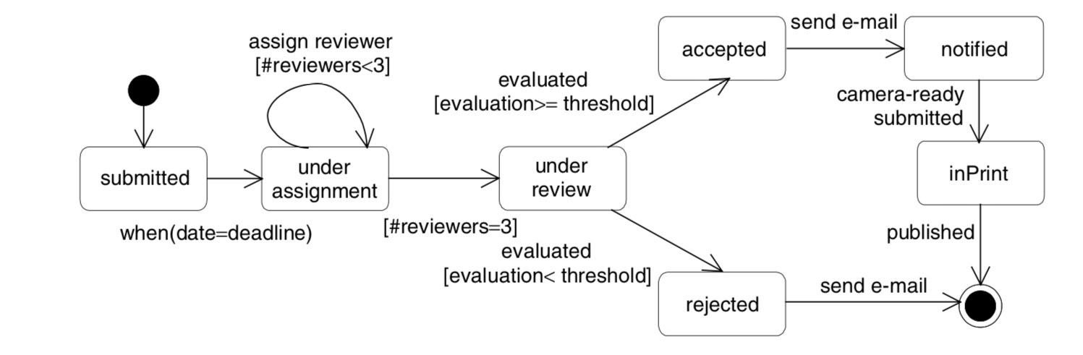
Case Study – (Conference Paper Reviewing System):State Machine diagram

Slide 14
Navigation modeling
Models how web pages are linked together
Defines the structure of the hypertext
- which classes of the content model can be visited by navigation
Content to navigation
UWE navigation modeling
navigationClass
menu
Index
Query
processClass
Processlink
Navigation link
External link

Slide 15
Online video sharing
Home page
Video list
Search video
Upload video
Register
Login
upload

Slide 16
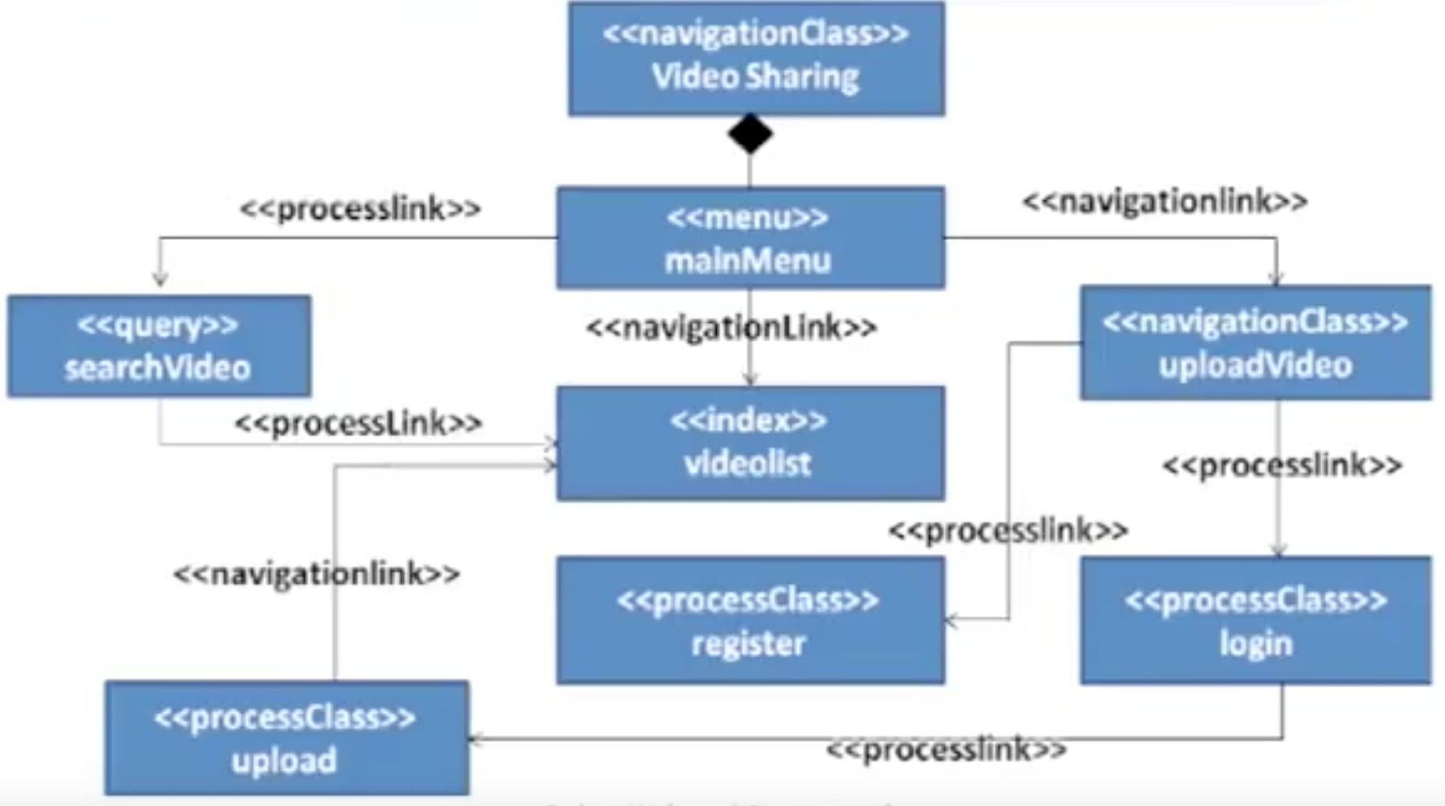
Navigation model – online video sharing

Slide 17
Presentation modeling
Purpose: To model the look & feel of the web application at the page level
The design should aim for simplicity and self-explanation
Describes presentation structure:
Composition and design of each page
Levels:
Presentation page
- Page container
Presentation unit
- A fragment of the page locally defined by grouping related elements
Presentation Element
- A unit’s informational components
- Text, images, buttons, fields.

Slide 18
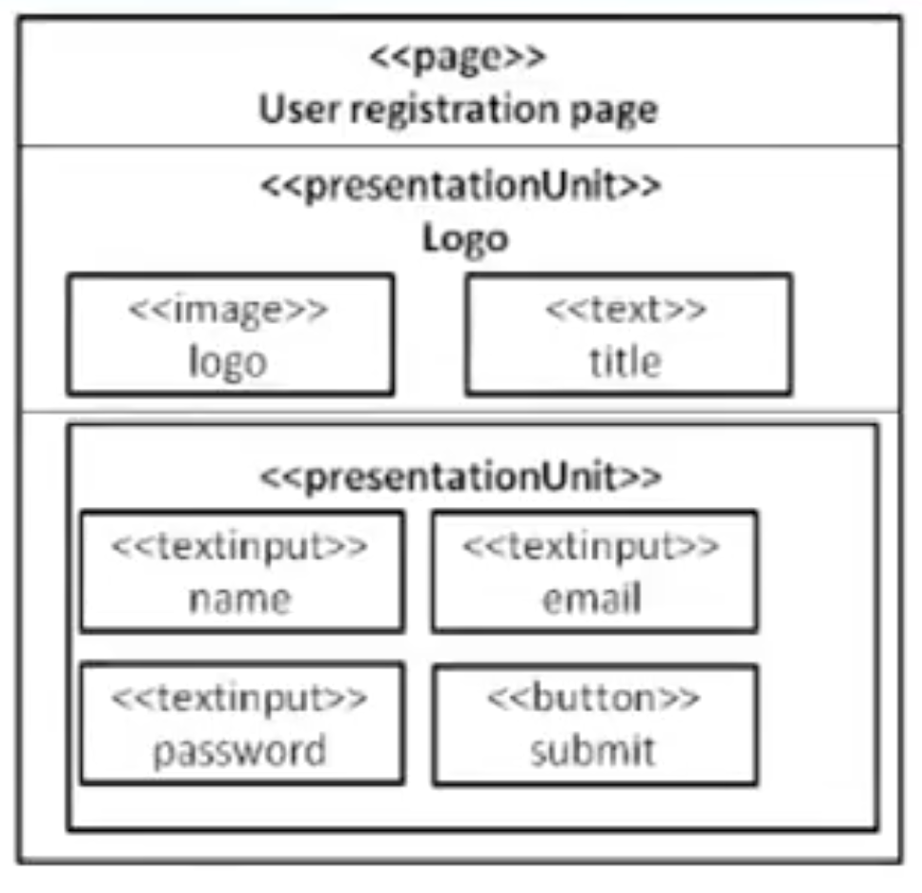
Presentation modeling

Slide 19
Summary
Content modeling
- class diagram
- state machine diagram
Navigation modeling
Presentation modeling

Slide 20
References
Chapter 3, Kappel G, Proll B, Reich S & Retschitzegger W. Web Engineering, John Wiley & Sons.
Chapter 5, Sommerville, Software Engineering, PEARSON.

