Slide 1
CSIS – 4135: Spring 2022
Web Application Engineering
Instructor: Sujoy Chakraborty
Lecture Slides – 7

Slide 2
Outline
Software system architecture
Specifics of web application architecture
Layered web architecture
2-layered
3-layered
N-layered

Slide 3
Software system architecture
The architecture of a computer system is the high-level (most general) design on which the system is based.
Architectural features include:
- Components
- Collaborations (how components interact)
- Connectors (how components communicate)

Slide 4
Key attributes of an architecture
Architecture describes structure
Forms the transition from analysis to implementation
Defines different viewpoints (conceptual, runtime, process and implementation)
Makes a system understandable

Slide 5
Factors influencing system architecture
Functional Requirements
- Clients
- Users
- Other stakeholders
Quality considerations
- Performance
- Scalability
- Reusability
- Other?
Technical aspects
- Operating system
- Middleware
- Legacy systems
- Other?
Experience with
- Existing architecture
- Patterns
- Project Management
- Other?

Slide 6
Specifics in web application architecture
A number of architectures for specific requirements in several application domain has been developed.
For web application architecture, we usually consider:
- layering aspect: to implement the principle of ‘separation of concerns’
- data aspect: to support processing of structured and non-structured data
Specific technical infrastructures are needed for both the development as well as the operation of web applications.
We have to consider:
- web infrastructure architecture (WPA)
- web application architecture (WAA)
Web application architecture depends on the problem domain of the application, therefore we focus on web platform architecture.

Slide 7
Components of a web application architecture
Client:
- generally a browser (user agent) is controlled by a user to operate the web application
- client’s functionality can be expanded by installing plug-ins.
Firewall:
- a piece of software regulating the communication between insecure networks (e.g., the internet) and secure networks (e.g., corporate LAN-s)
- data aspect: to support processing of structured and non-structured data
Proxy:
- A proxy is typically used to store web pages in a cache
Web server:
- A web server is a piece of software that supports various web protocols like HTTP, HTTPS etc. to process client requests.
Database server: This server supplies data in structured form, e.g., in tables.
Legacy application:

Slide 8
Components of a web application architecture – cont.
Media server:
- This component is primarily used for content streaming of unstructured bulk data (e.g., audio or video)
Application server: holds the functionality required by several applications

Slide 9
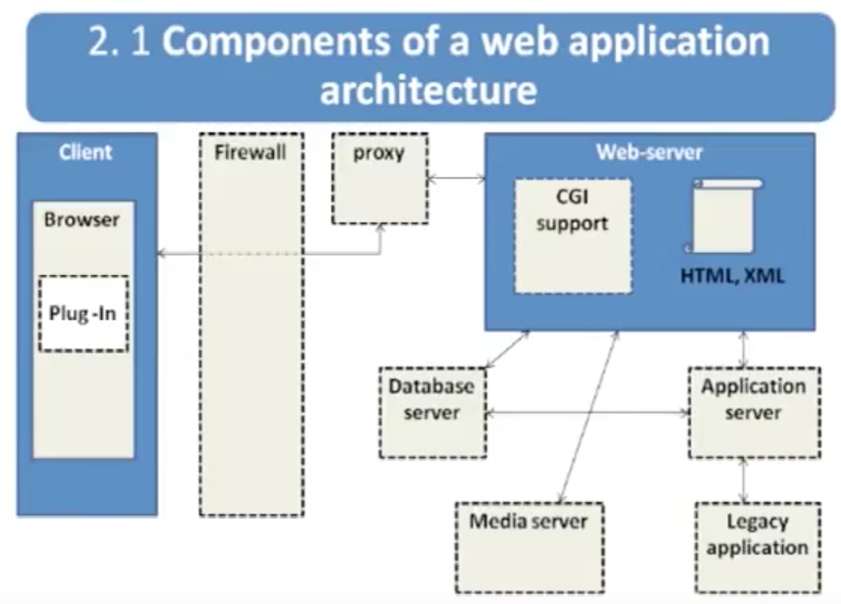
Components of a web application architecture – cont.
Some components are mandatory, some are optional

Slide 10
Layered architecture for web applications
Presentation tier:
Every web application needs to communicate with external entities, human users or other computers
- allows these entities to interact with the system
- implemented as a GUI
How the data should appear to the user
Application tier:
- Web applications do more than information delivery, they perform data processing (Business Logic & calculation)behind the results being delivered.
- Often referred to as:
a. Services
b. Business logic

Slide 11
Layered architecture for web applications – cont.
Data layer:
Web applications need data to work with
Data can reside in databases or other information repositories
Deals with and implements different data sources of information systems

Slide 12
Two-Layer web architecture
Presents architecture in 2 layers:
Layer – 1: Client platform, hosting a web browser
Layer – 2: Server platform, hosting all server software components
Also called client/server architecture
Client directly sends request to the server
Server responds to the request
- Static or dynamic requests

Slide 13
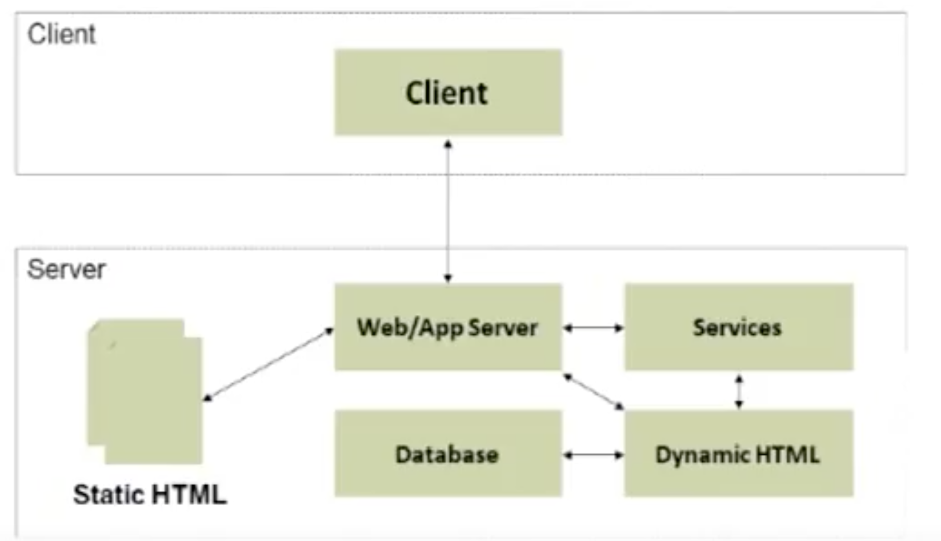
Two-Layer web architecture – cont.

Slide 14
Two-Layer web architecture – cont.
Advantages:
Inexpensive (single platform)
Disadvantage:
Interdependency (coupling) of components
No redundancy
Limited scalability
Typical applications:
10 – 100 users
Small company or organization

Slide 15
Three-Layer web architecture
Usually implemented in 3 layers:
Layer – 1: Data
Layer – 2: Application
Layer – 3: Presentation
Additionally, security mechanism (Firewall) and caching mechanism (Proxies) can be added.

Slide 16
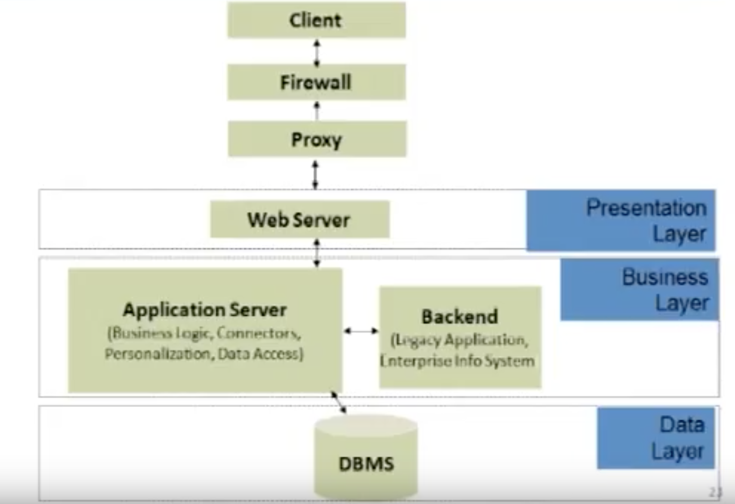
Three-Layer web architecture – cont.

Slide 17
Three-Layered web architecture
Advantages:
- Improved performance
- Decreased coupling of software components
- Improved scalability
Disadvantages:
- No redundancy
Typical applications:
- 100 – 1000 users
- Small business or regional organization, e.g., specialty retailer, small college

Slide 18
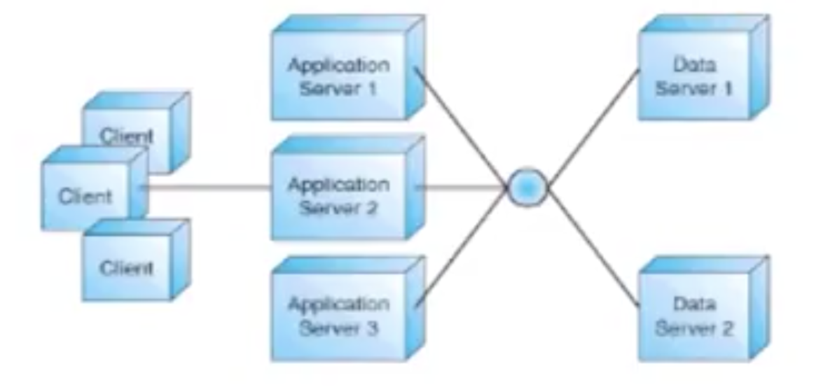
N-Layer web architecture
A multitier (N-layer) architecture is an expansion of the 3-layer architecture, in one of several possible ways:
Replication of the function of a layer
Specialization of function within a layer
Replication:
- Applications and data servers are replicated
- Servers share the total workload

Slide 19
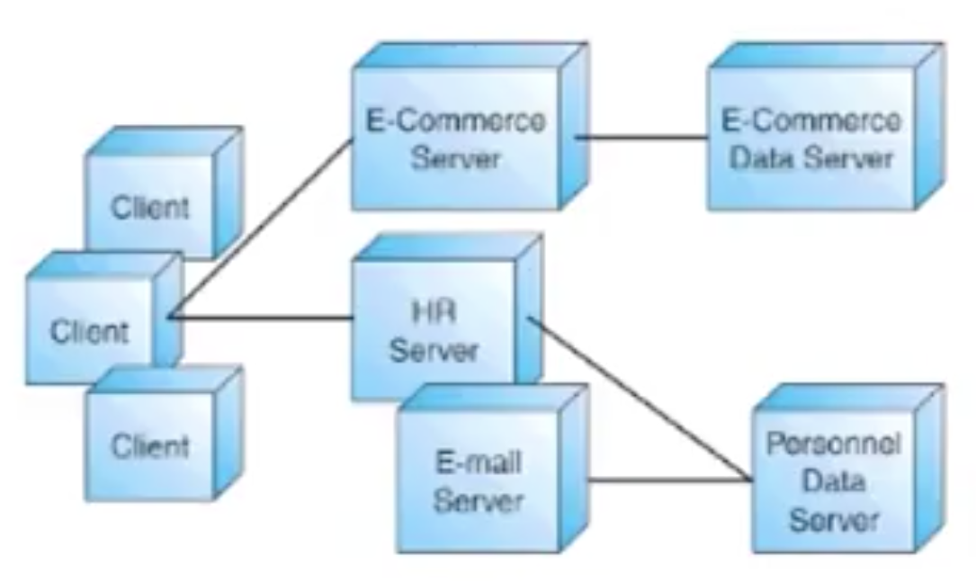
N-Layer web architecture – cont.
Specialization:
- Servers are specialized
- Each server handles a designated part of the workload, by function

Slide 20
N-Layer web architecture – cont.
Advantages:
- Decoupling of software components
- Flexibility to add/remove platforms in response to load
- Scalability
- Reduandancy
Disadvantages:
- Higher cost (maintenance, design, electrical load, cooling)
Typical applications:
- 1000+ users
- Large business or organization

Slide 21
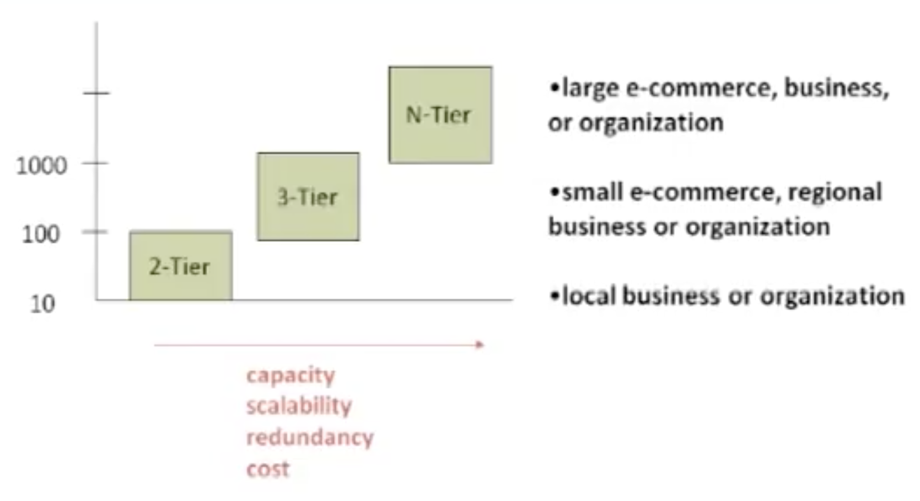
Layered architecture – comparison

Slide 22
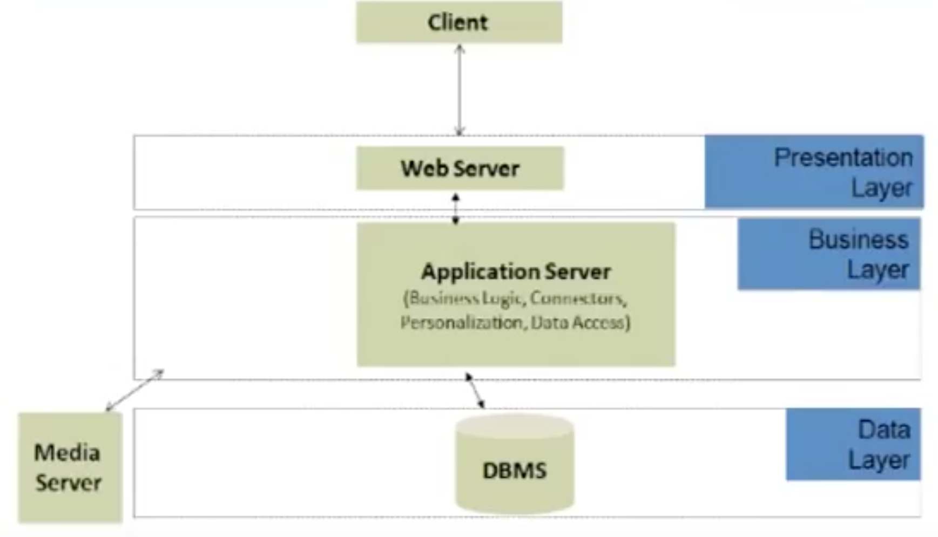
Example:

Slide 23
Summary
Software system architecture
Specifics of web application architecture
Layered web architecture
- 2-layer
- 3-layer
- N-layer

Slide 24
References
Chapter 4, Kappel G, Proll B, Reich S & Retschitzegger W. Web Engineering, John Wiley & Sons.
Web-based application development (Ralph F Grove)

