Slide 1
CSIS – 4135: Spring 2022
Web Application Engineering
Instructor: Sujoy Chakraborty
Lecture Slides - 9

Slide 2
Outline
Web security overview
Secure transmission of data
User’s security issues
Service provider’s issues

Slide 3
Web security
Web client expect web applications to be secure
- preventing access from untrusted or malicious sources to private data
- service providers do not misuse their data (for example, by exchanging data with third party)
Several risks exists for service providers as well
prevent access from attackers
- credit card number can be stolen
- data can be accessed and modified
- availability of service can be reduced
Can influence agreements and cause financial loss

Slide 4
Web security – cont.
We can define web security according to notions of users and service providers as
- securing the end user’s computer and personal data stored on it
- securing information in transit
- securing the server and the data stored on it

Slide 5
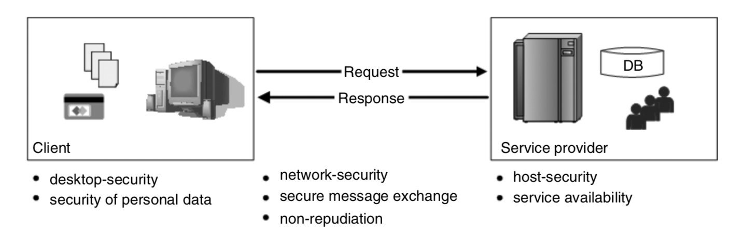
Web security – cont.

Slide 6
Web security – cont.
Security aspects:
Confidentiality:
- communication between a customer and a provider cannot be read by a third party
- data encryption can be used
Integrity:
- nobody is able to modify the exchanged information
Non-repudiation:
- originators of messages should not be able to deny (e.g., customers ordering books at an online store)
Authentication:
- the process of verifying the identity of a person or general subject such as another application invoking a service on behalf of a human user.
- usually implemented by login/password information
Authorization:
- used to infer which privileges authenticated users are granted

Slide 7
Web security – cont.
Availability:
- guaranteeing the availability of web applications (service downtime typically implies financial losses)
Privacy:
- demands the reliable handling of data

Slide 8
Data encryption
Encryption is a basic technology for enabling secure messaging
Encryption:
- translation of data into a format that is intended to be unreadable by anyone except the intended party
- changing the original text to a secret message using some mathematical function. There are broadly two classes of encryption algorithms:
a. Symmetric algorithms
b. Asymmetric algorithms
Decryption:
- changing the secret message back to its original form

Slide 9
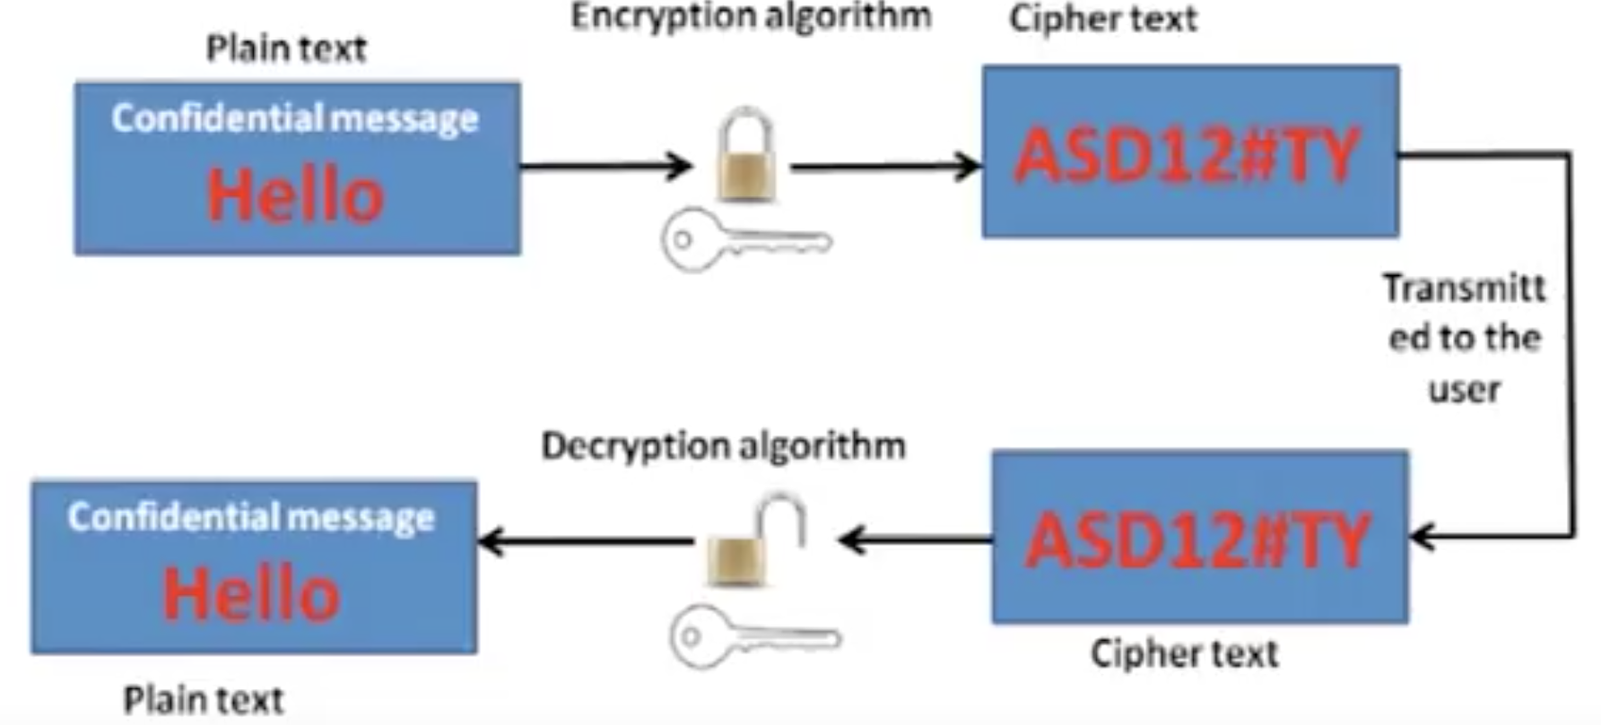
Encryption/Decryption process

Slide 10
Data Encryption
Historical ciphers:
- Caesar shifted each letter of his messages three places down in the alphabet.
- So, BURN THE BRIDGE becomes EXUQ WKH EUKFIG.
Cryptographic algorithms:
- Relies on keys as secret terms for ciphering and deciphering.
- Without key it is computationally impossible to break an algorithm
- An algorithm is considered strong if brute force attack is the only possible attack
Symmetric cryptography:
The same single key is used to encrypt and decrypt a message
DES and AES are examples of symmetric cryptographic algorithms

Slide 11
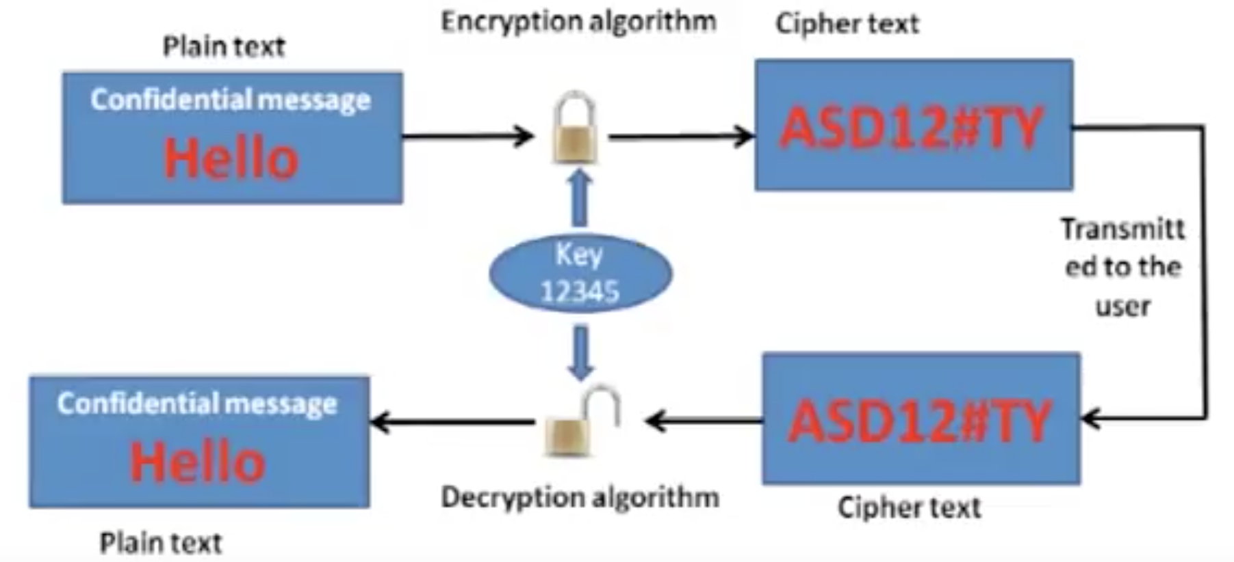
Symmetric cryptography

Slide 12
Asymmetric cryptography
Also known as public key cryptography
Uses two keys instead of one
The public key is known to everyone and can be freely distributed
The private key is known only to the recipient of the message
RSA is an example of asymmetric cryptography.

Slide 13
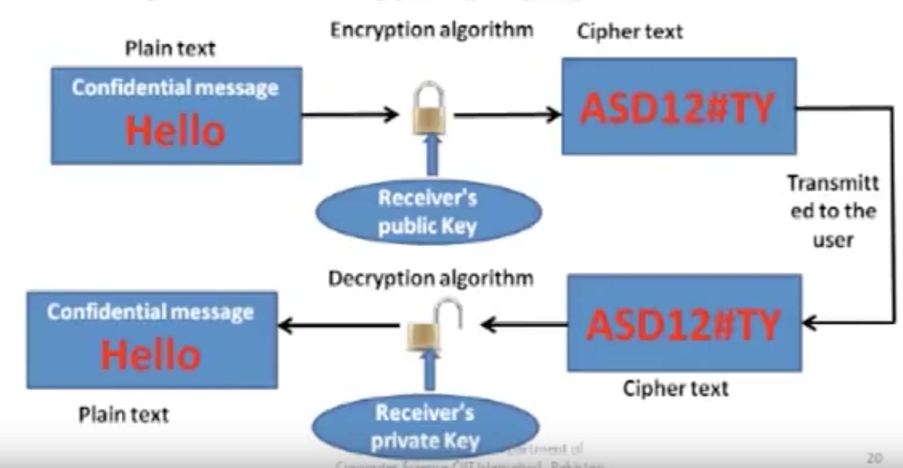
Asymmetric cryptography

Slide 14
Hashing algorithms
Hashing is a one-way process:
- converting a hash back to the original data is difficult or impossible
A hash is a unique “fingerprint” for a set of data:
- this fingerprint, called a message digest, represents the contents

Slide 15
Digital signatures
A digital signature is basically a way to ensure that an electronic document is authentic. Also ensures:
- Integrity
- Non-repudiation
Digital signature creation:
- sender creates a hash of the message
- sender encrypts the message with his/her private key
- attach the digital signature (encrypted output of Step - 2) with the message
Digital signature validation:
- Receiver decrypts the signature with sender’s public key
- Receiver creates the hash of the message
- Created hash is compared with the decrypted message

Slide 16
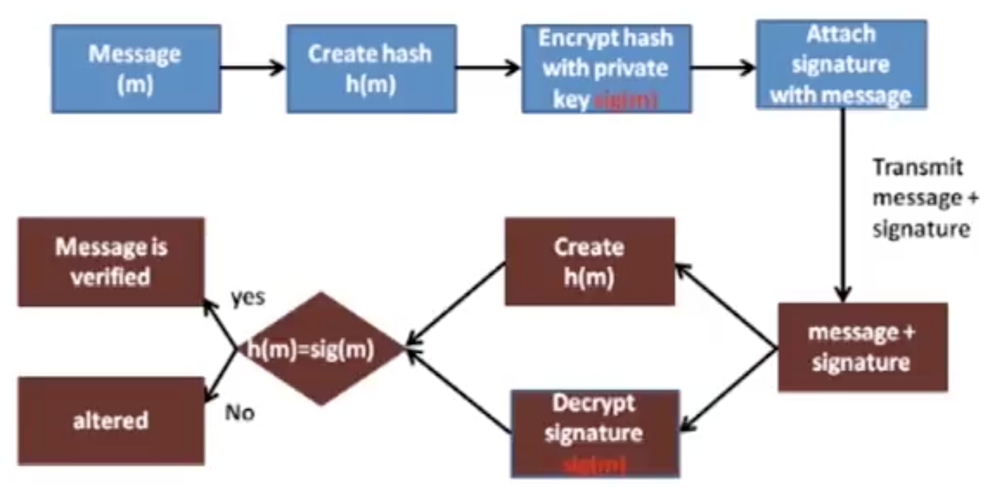
Digital signature verification

Slide 17
Objectives of a secure system
Cryptography ensures
Confidentiality:
Integrity
Availability
Authenticity
Non-repudiation

Slide 18
Securing user’s data
After securely transmitting data user wants:
Privacy:
- providers keep data carefully
- protect data from attackers
Secured desktop
Service providers need to establish trust relationship
- can specify data practices using Platform for Privacy Preferences (P3P) standard
- User can specify its preferences using P3P agents
- P3P-capable browsers inform the user if service provider’s policies conflict with user’s preferences.

Slide 19
Securing user’s data – cont.
Phishing and Web Spoofing:
Phishing is the most common attack to retrieve user’s personal information
Web spoofing denotes mocking the web presence of famous companies
- sends email to users as a representative of some well known company
- encourages the users to enter their personal information

Slide 20
Securing the desktop
User’s security can be at risk through threats like viruses and worms.
Adware and spyware
- adware delivers advertising contents
- spyware monitor user activities and transfers gathered information to remote systems
Remote access/backdoors
- provides remote systems the ability to connect with the user’s machine
- can obtain personal information, damage files and control user’s machine

Slide 21
Securing the desktop
Viruses:
Can damage files or repeat themselves
- distributed through email or by sharing infected files
Worms
Repeat themselves
- increase traffic
- consume processing power
Trojan horses:
Damage files but don’t replicate
Appears as useful programs but performs other functionalities
- aims at data theft and destruction or illegitimate access on computational resources

Slide 22
Service provider issues
Service provider wants to secure the server from attackers.
Common attacks:
Cross-site scripting (XSS)
- attackers inject script in dynamically created pages and try to find user’s information.
SQL-injection:
- attackers inject sql commands as inputs

Slide 23
Summary
Web security overview
Secure transmission of data
User’s security issues
Service provider’s issues

Slide 24
References
Chapter 13, Kappel G, Proll B, Reich S & Retschitzegger W. Web Engineering, John Wiley & Sons.

