Slide 1
Sovereign Default Prediction
Using Machine Learning & Synthetic Controls
1. Juni 2026
Philipp Wetter
github.com/chilipp15/sovereign-default-prediction
τ

Slide 2
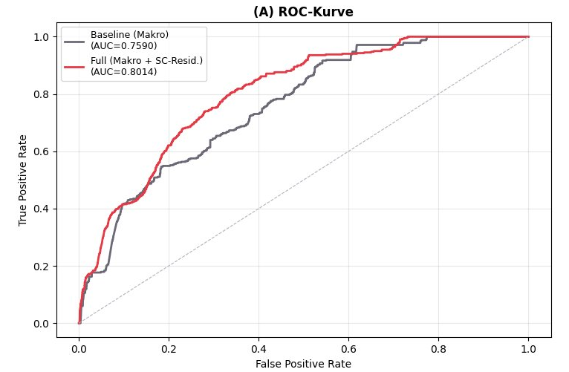
Analytical Framework
① Data & Variables
③ Results · ROC
Panel: 237 countries · 1975–2020 · monthly Default countries: 92 · Non-default donors: 145 Features: Debt/GDP · GS10 (1/3/6/12M changes, log-diff, interaction) · Exports CPI · ER · Lags 1–24M SC Residuals: debt_gdp_change, Exports, er_rate, CPI (rolling 36M)
② Methodology
④ Key Findings
⑤ Outlook
12M
1
Donor Pool ·
In non-defaulted countries
SC residuals improve estimation by +4.2 PP
Not yet super relevant
Run full pipeline: all 237 countries
Forecast horizon
2
Rolling SC ·
Abadie weights on 36M window
3
Residual ·
r = actual − SC prediction (monthly, ex-ante)
4
XGBoost ·
Macro + SC residuals · Goal: predict default in t+12

